Slide 1

BC wildfire predictive model
Tolulope Adegboye
Dien Vo (Jay)
Chi-Yu Lee (Alison)

Slide 2
Table of Contents
Variables
Analysis
Python Model
Two Data Building Procedures
Geospatial
Summary

Slide 3
Variables
Variable | Fire Behavior Role | Why It’s Useful
2m temperature | Fuel ignition | Higher temps → drier, more flammable fuels
2m dewpoint temperature | Moisture content in air | Lower dewpoint = lower fuel moisture
10u & 10v wind | Fire spread direction & speed | Drives how fast and where fires travel
Total precipitation | Fuel moisture replenishment | Rainfall reduces fire risk
Fuel type | Influences ignition and burn intensity | Different fuel types burn at different rates and intensities
Leaf Area Index, High Vegetation | Affects fuel load and canopy density | Higher LAI = more available biomass, which increases burn potential and fire spread

Slide 4
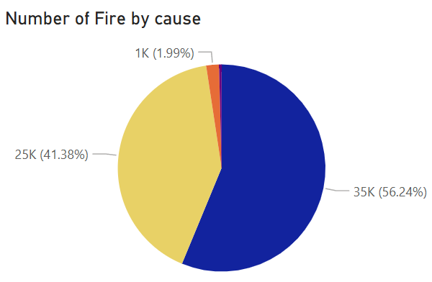

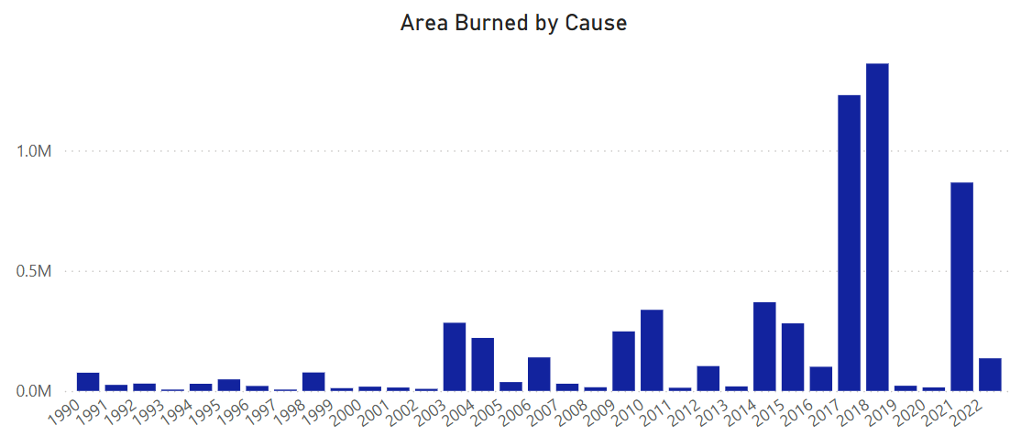
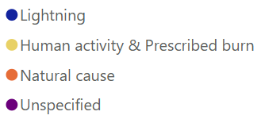

Analysis-General Trends
Top 5 Month
Month | Area burned (K ha)
April | 119
May | 320
June | 877
July | 3,485
August | 1,291
In 2017,
77% from wildfires larger than 100,000 ha

Slide 5


Two Data Building Procedures
Python Analytics
PyGIS

Slide 6
Python Analytics
Models | AUC | RSME | Accuracy | Precision | Recall
Random Forest | 0.9989 | 0.0853 | 0.9914 | 0.9916 | 0.9780
XGBoost | 0.9585 | 0.1613 | 0.9659 | 0.9396 | 0.9413
Logistic | 0.9437 | 0.2923 | 0.8763 | 0.7860 | 0.7793

Slide 7
Analysis: Confusion Matrix
 | Predicted Non-Fire Points | Predicted Fire Points
Actual Non-Fire Points | 203155 | 220
Actual Fire Points | 1167 | 33131

Slide 8
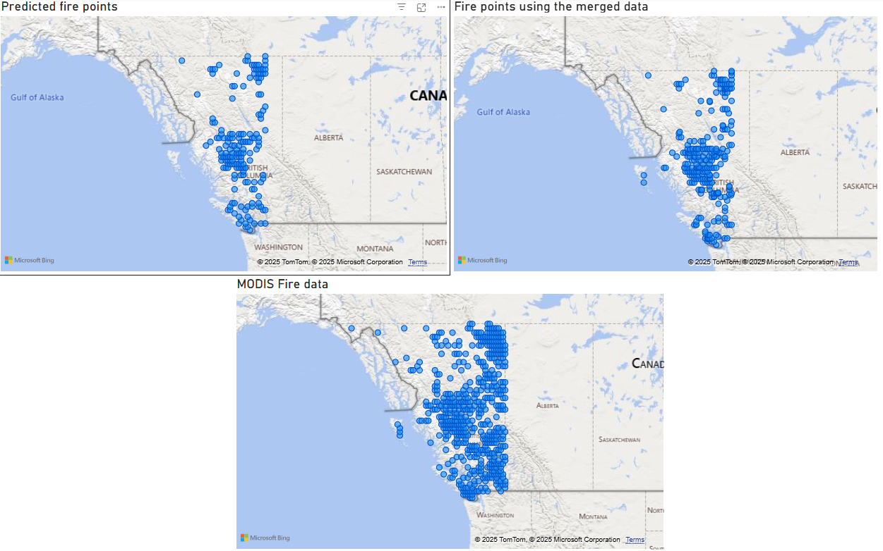
Analysis: Predicted Map Comparison

Slide 9
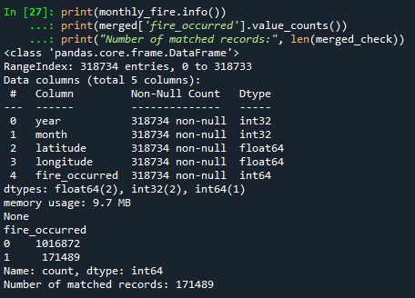


Why we think GIS is a better approach
The original data
The Modis Fire data

Slide 10
PyGIS: Model Accuracy
Model | AUC | Root Mean Squared Error (RMSE) | Accuracy | Precision | Sensitivity (recall)
Logistic regression | 0.8679 | 0.3479 | 0.8789 | 0.9012 | 0.9596
XGBoost | 0.9679 | 0.2633 | 0.93066 | 0.9425 | 0.9762
Random forest | 0.9883 | 0.1281 | 0.9840 | 0.9890 | 0.9913
Notes:
In all models, the sensitivity was higher than precision, which is indicative of its increased ability to detect fires. This could also be dependent on the sample as 83.1% of the test data consisted of fire points.
Random forest most accurate model and logistic regression least accurate

Slide 11
Analysis: Confusion Matrix
 | Predicted Non-Fire Points | Predicted Fire Points
Actual Non-Fire Points | 122655 | 7025
Actual Fire Points | 5589 | 633838
Notes:
Out of the 639 thousand total tested fire points, it managed to predict 633 thousand of them accurately.
Out of the 130 thousand non-fire points, it managed to predict only 122 thousand of them accurately.
The number of fire points predicted inaccurately was less than 1500 more than the inaccurately predicted non-fire points even though there were almost 5 times as many fire points than non-fire points.
This reinforces the observation that the model is better at detecting areas with fires than areas without fires.

Slide 12
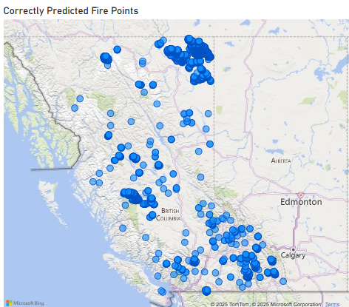
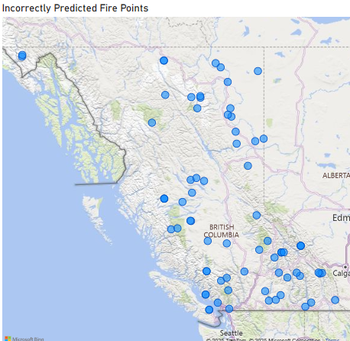
Analysis: Predicted Map Comparison
Notes:
This outlines the comparison between the predicted fire points and the actual fire points in August 2024 using the random forest model. The map on the left highlights the actual fire points that were predicted correctly, and the map on the right highlights the fire points that were predicted incorrectly.
Out of the 74,819 actual fire points, it failed to predict not 1000, not 500, but 73 of them. This highlights the heightened ability of the model to detect fires.

Slide 13
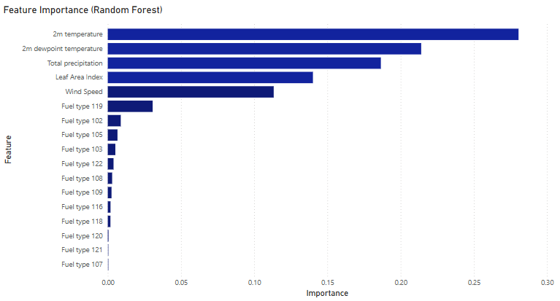
Feature Importance
Notes:
Most important features 2m-temperature, 2m-dewpoint temperature and total precipitation.
Leaf Area Index and Windspeed not as important
Most important fuel type is 119 which funny enough is "non-fuel"
This is used for alpine areas with patchy vegetation that would not normally support fire

Slide 14
Analysis: Feature Impact on risk
Used partial independence plots to portray average predicted probabilities for each training point based a certain value of the feature
Used to isolate the effects of certain variables by standardizing the conditions
Notes:
To deduce the estimated impact of certain features, partial independence plots were produced which display the average predicted probabilities for each training point with a certain value of the feature. This can be used to isolate the effects of certain variables on a more specific level by standardising the conditions through the average values.

Slide 15
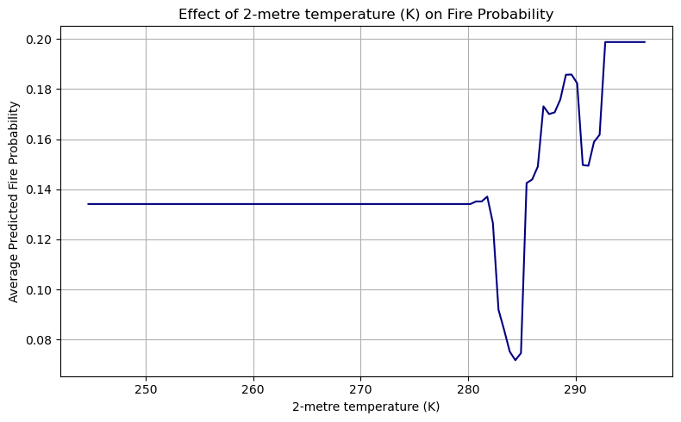
Analysis: Feature Impact on Risk
2-meter temperature
Notes:
Increasing the temperature has no influence on the average probability from 245 to 282K with it remaining at 13 percent.
From 282 to 284 K, it decreases from 13% to 7%
From 284 to 285 K, it increases by 7% and continues to generally rise from there.
Understandable as high temperatures cause vegetation to dry out, making it more flammable thereby increasing fire risk.

Slide 16
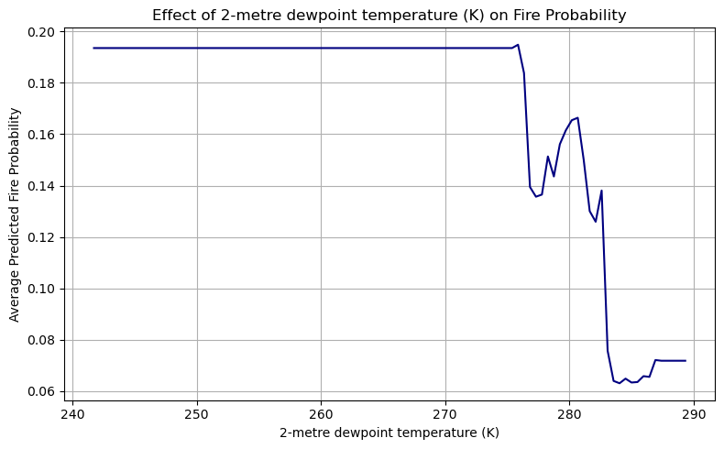
Analysis: Feature Impact on Risk
2-meter dewpoint temperature
Notes:
2m dew point temperature has an opposite effect on the average probabilities.
From 241 K to 276 K, increasing it has no effect with it remaining at a consistent level of 19%.
At 277 K, it decreases to 14% and generally exhibits the same trend.
Higher dewpoint temperatures indicate more humid air, which decreases the potential for ignition for vegetation.

Slide 17
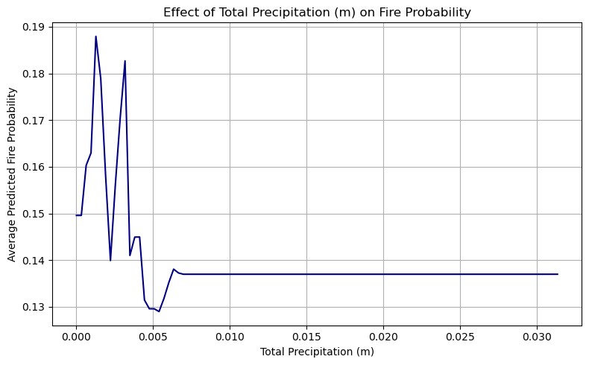
Analysis: Feature Impact on Risk
Total precipitation
Notes:
The average probabilities generally decrease with an increase in total precipitation.
At values higher than 0.005 m, an increase in precipitation has no effect.
The lower total precipitation values indicate a lack of rain which leads to dry conditions and fuel buildup, increasing fire potential

Slide 18
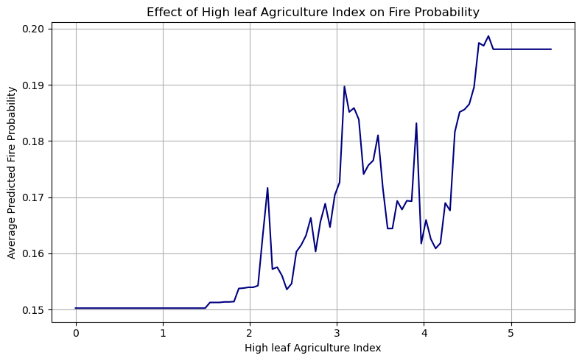
Analysis: Feature Impact on Risk
Leaf Area Index
Notes:
At the earlier values, the LAI value has a negligible effect on the average predicted probability
At a certain point, it then starts to increase until it reaches a peak of 20 percent before flattening out
This pattern is understandable with a high LAI indicating more available fuel and more intense fires.

Slide 19

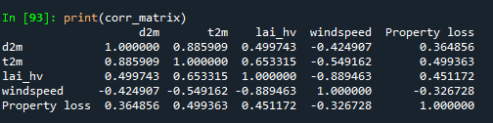
Impact on Property Damage
The Clients data
Our built data

Slide 20
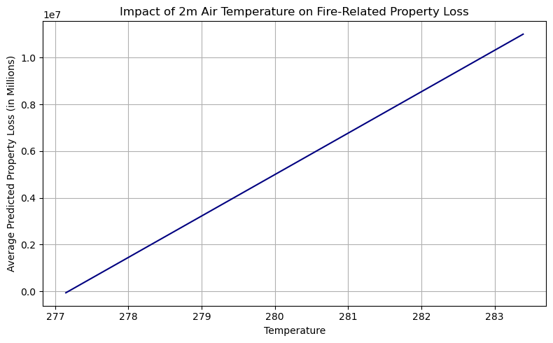
Impact on Property Damage

Slide 21
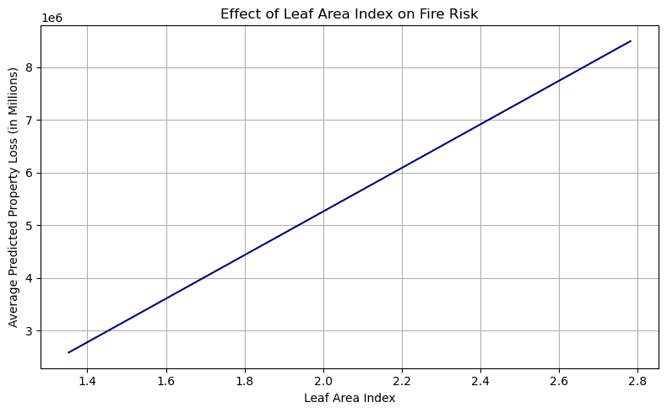
Impact on Property Damage
Notes:
Interpretation:
Low dewpoint = drier air, which typically promotes fire ignition and spread.
As humidity increases (higher dewpoint), conditions are less favorable for fire, and thus, predicted property loss drops.
Your model sees dewpoint temperature as a protective factor: the lower it is, the more likely fires could become destructive.
Conclusion:
This aligns with fire science — drier air (low dewpoint) increases wildfire risk.
Dewpoint temperature is likely a key predictor in your model and should be monitored for early warning systems.

Slide 22
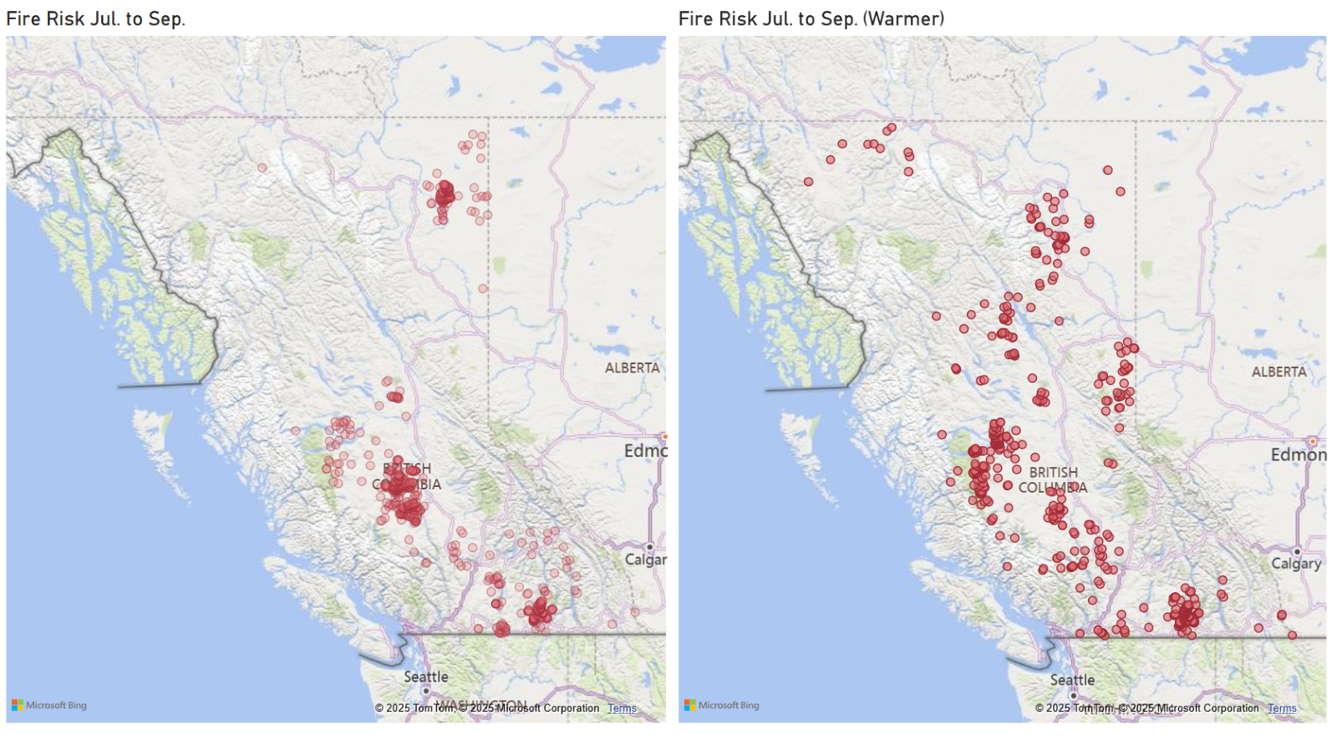
Seasonal risk prediction

Slide 23
Summary
Key Findings
Recommendations
Implementation Plan
Conclusion

Slide 24
Key Findings
Geospatial Model
Most important features:
2m temperature, 2m dewpoint temperature, and total precipitation
Impact on fire risk
Higher 2m temperature increases fire probability
Greater total precipitation decreases fire probability
Impact on property damage
2m temperature & dewpoint temperature show positive correlation
High vegetation leaf area index also positively correlated with property damage
Seasonal risk prediction shows that higher temperatures lead to more fire occurrences

Slide 25
Recommendations
Monitor 2m Temperature: Focus on areas approaching 280 K, where the highest increase in fire probability is observed (Random Forest model).
Track 2m Dewpoint Temperature: Areas with dewpoint up to 280 K show elevated fire risk.
Watch for Low Precipitation Zones: Regions with low rainfall consistently show a higher chance of fires.
Identify Dense Vegetation Areas: Areas with high Leaf Area Index (LAI) are positively linked to greater property damage (correlation analysis).
Actionable Response: With these indicators, BC SMART can proactively target high-risk zones for early intervention.

Slide 26
Implementation Plan
How BCIT SMART Can Apply the Models
Fire Probability Mapping: Use Random Forest models and existing climate data to create 5-year forecasts and generate predicted fire probability maps across BC.
Targeted Drone Monitoring: One year in advance, deploy drones to survey utility infrastructure in areas with ≥50% predicted fire risk, collecting detailed temperature and precipitation data.
Proactive Operational Planning: Based on forecasted risk levels, wildfire services and local utilities can:
Issue crew safety bulletins
Plan public safety power shutoffs
Adjust operations in high-risk zones

Slide 27
Conclusion
Due to this model:
Can accurately predict the occurrence of fires.
Can perform on the relevant explanatory variables to detect areas with a high risk of fires one season ahead.
It's costly to implement but will ultimately save lives and reduce the impact wildfires have on the environment and property.

Slide 28
Q & A

Slide 29
Thank You!

Slide 30
References
McNorton, J. R., et al. A Global Probability-Of-Fire (PoF) Forecast. 14 June 2024
ChatGPT: For reference in analytical methodology and sentence refinement.
Van Wagner, C. E. (1974). Structure of the Canadian Forest Fire Weather Index. Vol. 1333. Ottawa, ON: Environment Canada, Forestry Service.
Mohajane, M., et al. (2021). Application of Remote Sensing and Machine Learning Algorithms for Forest Fire Mapping in a Mediterranean Area. Ecological Indicators, 129.
Canada’s National Forestry Database. Forest Fires Data. Retrieved from: http://nfdp.ccfm.org/en/data/fires.php
NASA FIRMS. (2024). MODIS Active Fire Data. NASA Earth Science Data and Information System (ESDIS), Fire Information for Resource Management System (FIRMS). Available at: https://firms.modaps.eosdis.nasa.gov/download/create.php
Hersbach, H., Bell, B., Berrisford, P., et al. (2023). ERA5 Monthly Averaged Data on Single Levels from 1979 to Present. Copernicus Climate Change Service (C3S), Climate Data Store (CDS). Available at: https://cds.climate.copernicus.eu/datasets/reanalysis-era5-single-levels-monthly-means?tab=download
Environment and Climate Change Canada. (2024). Monthly Climate Data – Station ID 1309 (Vancouver, BC). Government of Canada. Available at: https://climate.weather.gc.ca/climate_data/monthly_data_e.html

