Slide 1
Manage Equipments
Instructor Author
Mr.Tuan Le Mr. Vo Le Hau
Notes:
Hi everyone, nice to meet all in my presentation. My name is Vo Le Hau and badge id is 220555. Today i will presentation about my application. Its name is manage equipments.
Now, let's start.

Slide 2
Contents
Introduction
System architecture
Features
Database
Demo
Overview
Notes:
This presentation include 6 contents.
They are Introduction, System architecture, Features, Database, Demo and Overview.
We will go into the details of each content.

Slide 3
1. Introduction
Use Laravel framework.
Manage all equipments of company.
Each equipment may be assigned to one or no employee.
It can add, edit, remove, view and list out all equipment which is assigned to an employee.
Notes:
Firstly, about the introduction. My application use laravel framework.
It manages all equipments of company
Each equipment may be assigned to one or no employees.
It can add, edit, remove, view and list out all equipment which is assigned to an employee.
I said my app uses laravel framework. So what is laravel? Let's go to the next slide.

Slide 4
What is laravel?
Laravel is an open-source PHP framework. It use MVC design pattern.
Advantages of Laravel.
+ The web application becomes more scalable.
+ Considerable time is saved.
Notes:
Laravel is an open-source PHP framework, it is robust and easy to understand. It use MVC design pattern.
The Advantages of Laravel.
The web application become more scalable and save time.

Slide 5
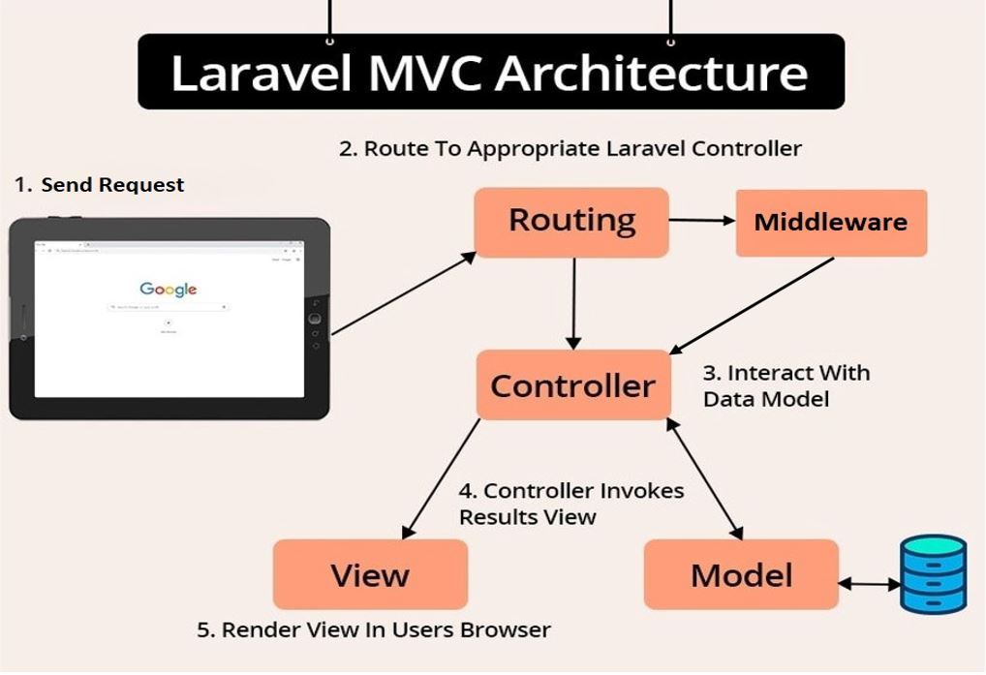
2. System architecture
Notes:
Next, about System Architecture.
This is the laravel MVC architecture that I used in the application. I will explain its working flow.
Firstly, user send a request.
Next, the route will go to the middleware to authenticate or find the appropriate controller
Then, controlle interact with data model.
After that, controller invokes results to the view
Lastly, the view render data to Users Browser.
Next, we will go into the details of each component.

Slide 6
Routing
Help mapped all request.
Find appropriate controller.
Routing in Laravel includes :
+ Route parameters
+ Named Routes
+ ...
Notes:
Firstly, about routing.
All requests are mapped with the help of routes.
The task of routing is to find the appropriate controller.
Routing in Laravel includes :
+ Route parameters (Route Parameters is a route used to "catch" the parameters on the URL and send it to the controller for it to display the corresponding content.)
+ Named Routes (It is used to refer to routes when generating URLs to make it easier to redirect to specific routes.)

Slide 7
Middleware
Filter HTTP requests.
Layer of protection.
User authentication.
Notes:
Secondly, about middleware.
Middleware provides a convenient mechanism for filtering HTTP requests.
It's a layer of protection.
It is used for user authentication, preventing users from accessing when they are not logged in.

Slide 8
Controller
In MVC pattern, the C stands for Controller.
Bridge between View and Model.
Process and get the result.
Return to the view.
Notes:
Thirdly, about Controller.
In MVC pattern, the 'C' stands for Controller.
It's a bridge between View and Model.
It will interact with the model to process and get the result, then return to the view.

Slide 9
Model
In MVC pattern, the M stands for Model.
Is a table in the database.
Stores all the data of the application
Notes:
Fourth, about Model.
In MVC pattern, the M stands for Model.
Each model corresponds to a table in the database.
It is the part that stores all the data of the application

Slide 10
View
In MVC pattern, the V stands for View.
User can see and interact.
Notes:
Fifth, about View.
In MVC pattern, the V stands for View.
It is an interface that the user sees and interacts.

Slide 11
Eloquent ORM
Object-relational mapper.
Each database table has a corresponding model.
Allow you to insert, update, and delete records from the table.
Notes:
Sixth, about Eloquent ORM.
Eloquent ORM is an object-relational mapper.
Each database table has a corresponding "Model" that is used to interact with that table.
It is allows to insert, update, and delete records from the table as well.

Slide 12
Migration
It is a Laravel tool.
Allows creating tables and columns.
Working with many databases such as:
+ MySQL
+ SQL Server
+ PostgreSQL
+ ...
Notes:
Seventh, about Migration.
Migration is a tool very of Laravel. It's like a management system for your database.
It allows to create tables, column using PHP command line.
The good point of Migration is that it works with many databases such as: MySQL, SQL Server, PostgresSQL, ...

Slide 13
Seeder
Create sample data for the database.
Support us to create test data, change and update data.
Notes:
Eight, about Seeder.
Seeder is actually a class to create sample data for the database during application building.
This class will support us to create test data, change and update data when necessary.

Slide 14
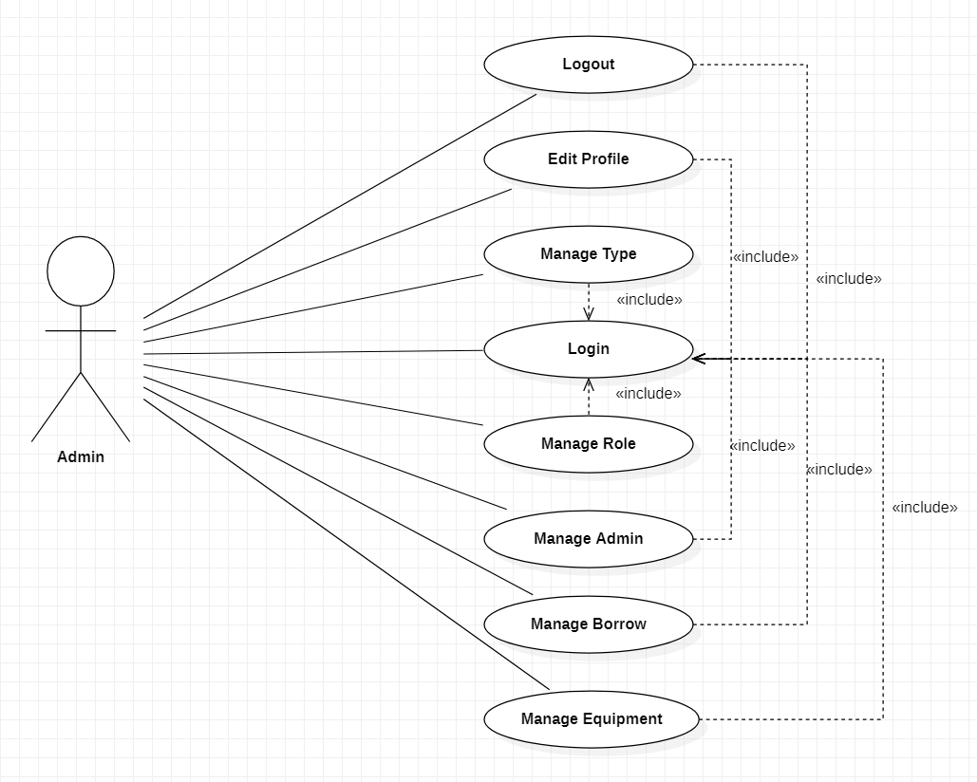
3. Features
Use case for Admin site :
Notes:
Thirdly, about the Features.
I split my application into 2 sites : admin site and client site.
Admin site will have features such as : Login, Logout, Manage Type, Manage Equipment, Manage Borrow, Manage Role, Manage Admin and Edit Profile.

Slide 15
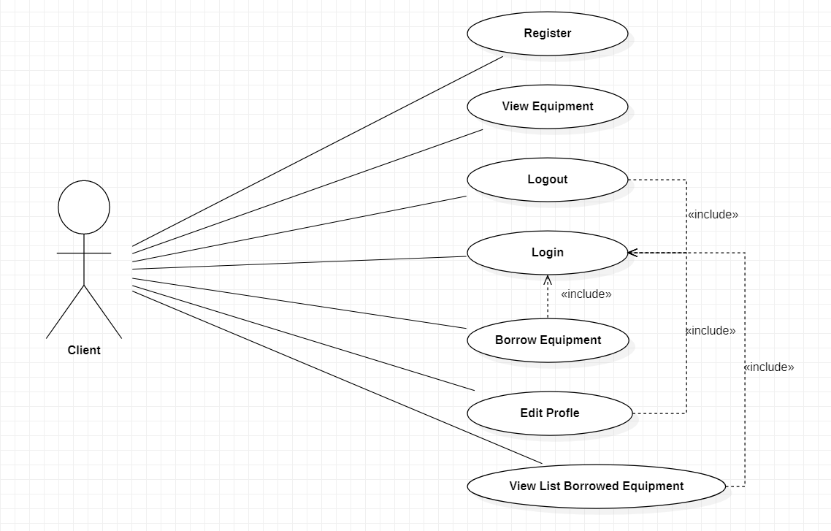
3. Features
Use case for Client site :
Notes:
Client site will have features such as : Login, Logout, Register, View Equipment, Borrow Equipment, View List Borrowed Equipment and Edit Profile.

Slide 16
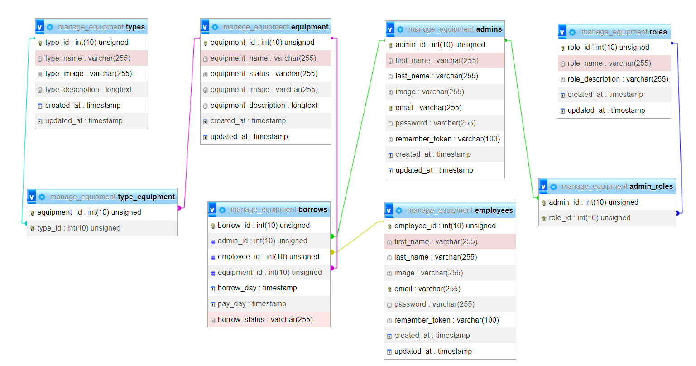
4. Database
Class diagram
Notes:
Fourth, about Database.
My application have 8 tables. You can see on the screen.
They are type, equipment, typeEquipment, Admin, Role, adminRole, Employee, Borrow.

Slide 17
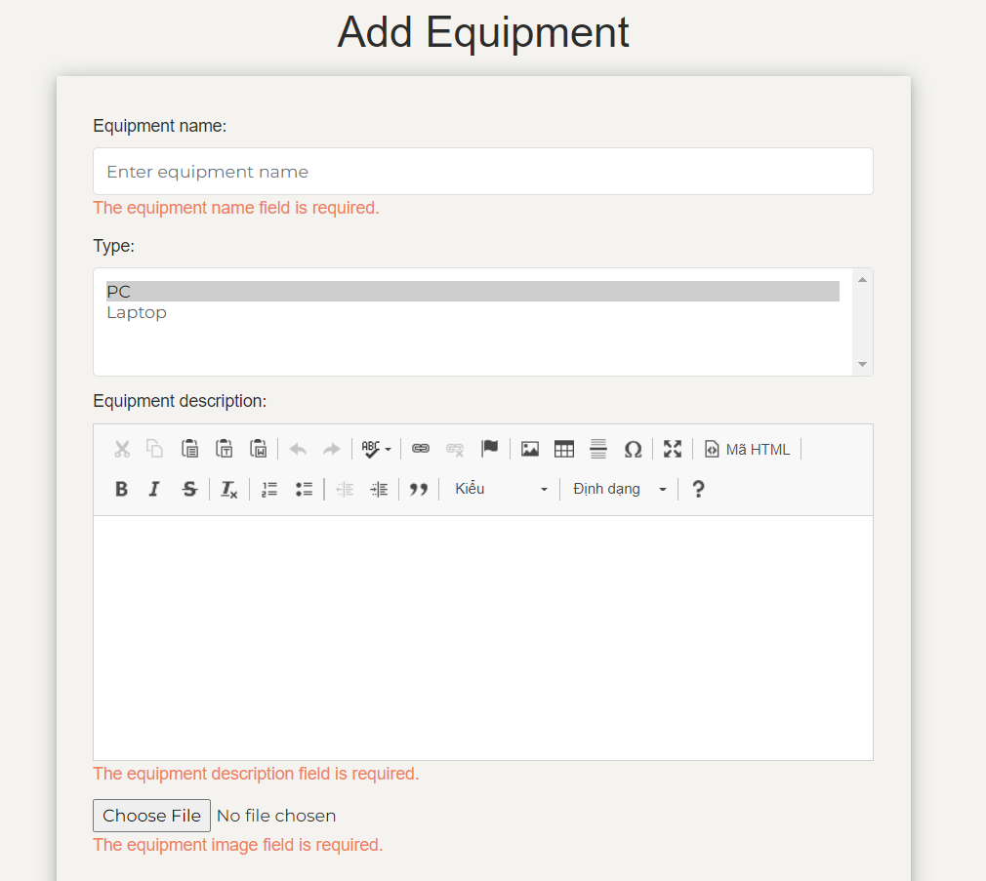
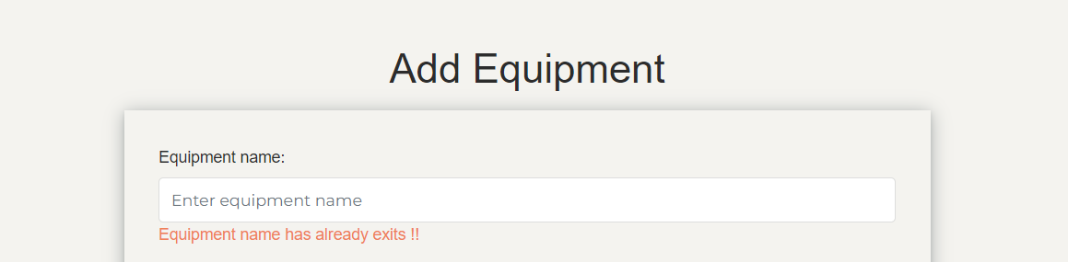
5. Demo
Add new Equipment
Picture 2
Picture 1
Notes:
First, the feature add new equipment.
If I leave the fields blank and press add, it will alert like picture 1 and if I enter a equipment name that already exists in the database, it alert like picture 2. If two error above don't occurs. The equipment will be added.

Slide 18
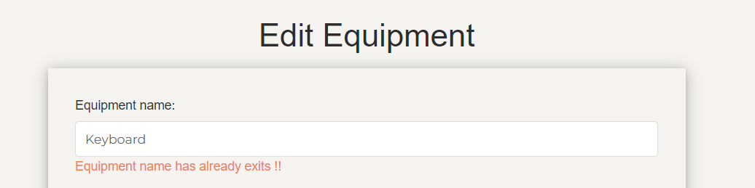
5. Demo
Edit Equipment
Picture 3
Notes:
Next, the feature edit equipment. If I enter a equipment name that already exists in the database, it alert like picture 3. If error above don't occurs. The equipment will be edited.

Slide 19
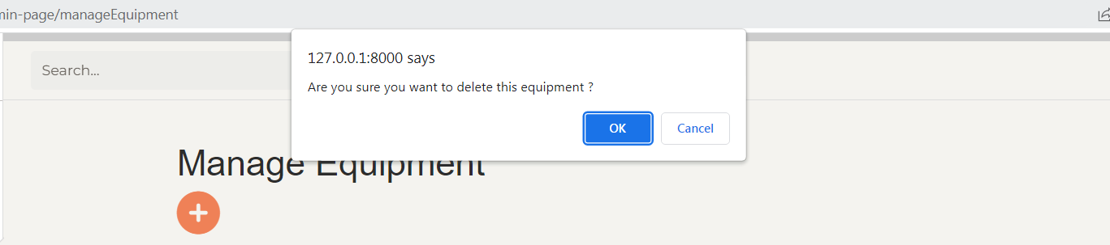
5. Demo
Delete Equipment
Picture 4
Notes:
Next, the feature delete equipment. When I click on delete icon. The system will ask me like picture 4. If I choose yes then equipment will be deleted or If choose cancel then nothing happened.

Slide 20
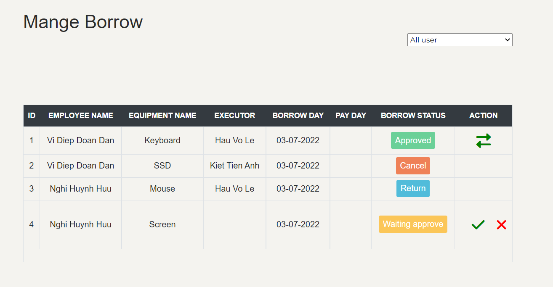
5. Demo
Manage Borrow
Picture 5
Notes:
Next, about the feature manage borrow. You can see picture 5. Here, after employee borrow equipment, the admin can click on tick icon to approve or click on x icon to cancel. When employee return the equipment then admin can click on return icon to update equipment status is enable.

Slide 21
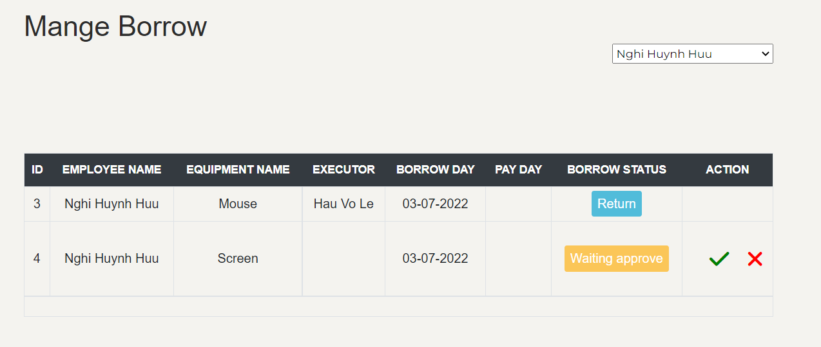
5. Demo
List out all equipment which is assigned to an employee
Picture 6
Notes:
In addition, admin can list out all equipment which is assignted to an employee like picture 6.

Slide 22
6. Overview
Advantages
+ Reusable and easier to maintain.
+ User authentication.
Notes:
Lastly, about the Overview.
First, about Advantage :
My application can reusable and easier to maintain and I use User authentication when accessing the application.

Slide 23
6. Overview
Disadvantages
+ My application hasn’t implemented the service and the repository design pattern.
+ Use Auth instead of JWT.
+ Can’t change password.
+ Can’t use feature “Remember me” when login.
Notes:
Next, about Disadvantage :
The system has not implemented the service and the repository design pattern.
Use Auth instead of JWT.
Can not change password.
Can not use feature “Remember me” when login.

Slide 24
6. Overview
Improvements
+ Code more easier to maintain.
+ Use both Auth and JWT.
+ Use the service and the repository design pattern.
+ Can change password.
+ Can use feature “Remember me” when login.
Notes:
Finally, about Improvement :
Code more easier to maintain.
Use both Auth and JWT.
Use the service and the repository design pattern.
Can change password.
Can use feature “Remember me” when login.

Slide 25
Thank you
Notes:
That all my presentation. Thank all for listening.

