Slide 1
Equipment Management
Advisor
Le Tuan
Author
Diep Doan Dan Vi
Notes:
1 : Hello everyone,my name is Diep Doan Dan Vi , welcome to my presentation about the application Manage Equipment with Framework Laravel

Slide 2

Table of Contents
2022 July 4
TMA SOLUTIONS
I
Introduce
II
Technical Used
III
Architecture
IV
Database
V
Feature
Presentation
VI
Overview
2
Notes:
My presentation include 6 contents
Introduace
Technical Used
Architecture
Database
Features
Overview

Slide 3
Manage all equipment of company.
2022 July 4
I INTRODUCE
Equipment may be assigned to one or no employee.
List out all equipment which is assigned to an employee.
Should have ability to add, edit, remove and view equipment.
2
3
Notes:
First Introduce and Requirements
The application is used to manage all equipment of company. Equipment may have type (PC/Laptop), name, ID, status and description.
Equipment may be assigned to one or no employee.
It can list out all equipment which is assigned to an employee.
The application should have ability to add, edit, remove and view equipment.

Slide 4







Front end
II TECHNICAL USED
2022 July 4
Back end
2
4
Notes:
About frontend , I use HTMl,Css,Bootstrap for User Interface, and use Jquery to interact with users
About backend, I use Laravel framework to design and I use mysql as a database. So what is Laravel ?

Slide 5
Free PHP Framework
2022 July 4
What is Laravel ?
Follows a model-view-controller design pattern
Helps web applications to be designed more structured and executed.
It saves a lot of time if you are planning to develop a website
2
5
Notes:
Laravel is an open-source PHP framework, which is robust and easy to understand.
It follows a model-view-controller design pattern. Laravel reuses the existing components of different frameworks which helps in creating a web application.
So Helps web applications to be designed more structured and executed.
If you are familiar with advanced php language. Laravel will make your task easier and It saves a lot of time if you are planning to develop a website

Slide 6

III ARCHITECTURE
2022 July 4
Database
Response
VIEW
Data
SQL query
User
Request
Data
Data
Data
Data
ROUTE
CONTROLLER
SERVICE
REPOSITORY
MODEL
Request
Request
Request
2
6
MIDDLEWARE
Notes:
This is architecture of my Application. User send request. The request will be sent to the database through Route, Controller, Service,Repository,Model to get data back to view and then
View response to the user.
I will explain the components in this architecture

Slide 7
Filtering HTTP requests in application
2022 July 4
Middleware
Decentralize access between administrators and employees
Prevent unauthorized access from outside
2
7
Notes:
Middleware Filtering HTTP requests in application before putting into logic processing
Decentralize access between administrators and employees
Prevent unauthorized access from outside

Slide 8
Takes requests from users
2022 July 4
Routing
Can have methods, parameters, and names
2 types of routing in laravel
Web Route
Api Route
Navigates to the appropriate controller
2
8
Notes:
Routing takes requests from users
Routes can have methods, parameters, and names. we can also group with route group, route prefix
There are 2 types of routing in laravel Web route define routes for web
Api route define routes for Api
Then navigates to the appropriate controller

Slide 9
Get data from users
2022 July 4
Controller
Handle if logic is simple
Return results to view
Call to layer service
2
9
Notes:
Controller get data from users
If the logic is simple, the Controller can handle it directly.
Then result will return to view
But If you write too much to the controller it will overload the controller, you can call to service layer instead

Slide 10
Located between the UI and the data backend
2022 July 4
Service
Transform and interpret data between two layers
Where you write your application logic
Call to repository
2
10
Notes:
Service Layer" is located between the UI and the data backend
transform and interpret data between two layers
where you write your application logic
Call to repository when get data from database

Slide 11
Where you write database queries
2022 July 4
Repository
Place to change data access, data processing
Easier to read, reduce error and repeats code
Through the model to get the data
2
11
Notes:
Repository " is where you write database queries
A single place to change data access as well as data processing
When you have The repository layer The code is easier to read, reduces errors when querying and repeats the code.
Through the model to get the data

Slide 12
Connections to entities in the database
2022 July 4
Model
Interact with the data in the table
Use Eloquent ORM
2
12
Notes:
Connections to entities in the database
Model interact with the data in the table
Use Eloquent ORM to interact simply and conveniently

Slide 13
Interacting with users
2022 July 4
View
Get data and return it according to user's request
2
13
Notes:
Interacting with users
Get data and return it according to user's request

Slide 14
Define tables, struture of the tables
2022 July 4
Migration
Update changes to those tables in PHP
Synchronize Database
Work with many databases
2
14
Notes:
Besides, Laravel have a feature called migration
Migration allows you to define tables in the database, define the Structure of the tables
update changes to those tables entirely in PHP
Migration helps to synchronize Database
Can work with many databases such as: MySQL, SQL Server

Slide 15
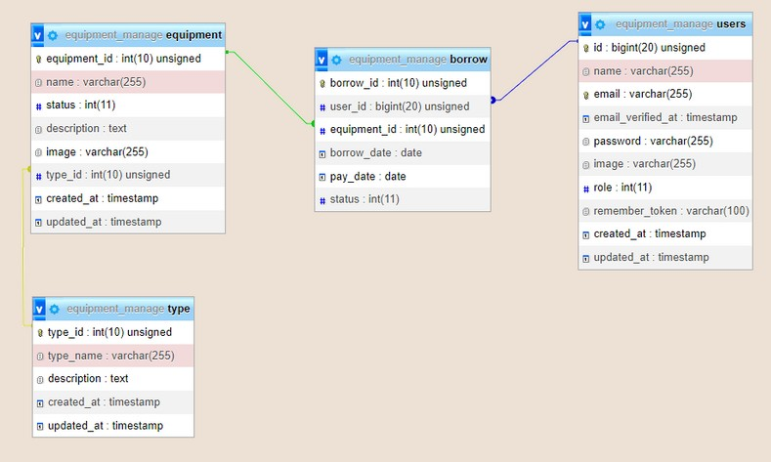
IV DATABASE
2022 July 4
2
15

Slide 16
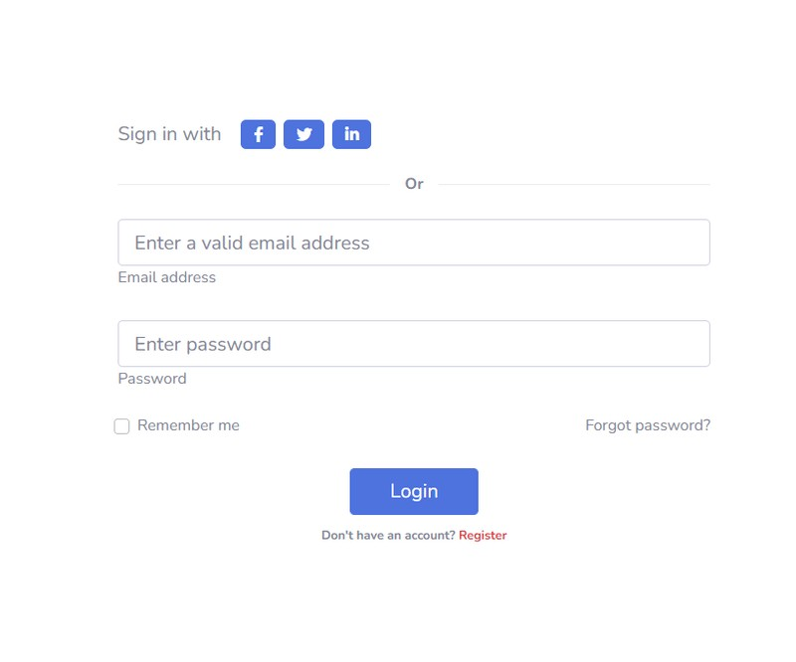
LOGIN
2022 July 4
V FEATURE
2
16
Notes:
I will demo some feature of the application
BOTH MANAGERS AND EMPLOYEES MUST LOG IN TO USE THE FEATURES OF THEIR WEBSITE.
You must enter your registered email and password first

Slide 17




2022 July 4
Manage Types
Manage Equipments
Manage equipment borrow and return
Admin
Add employee account
2
17
Notes:
If you login as an admin you can

Slide 18
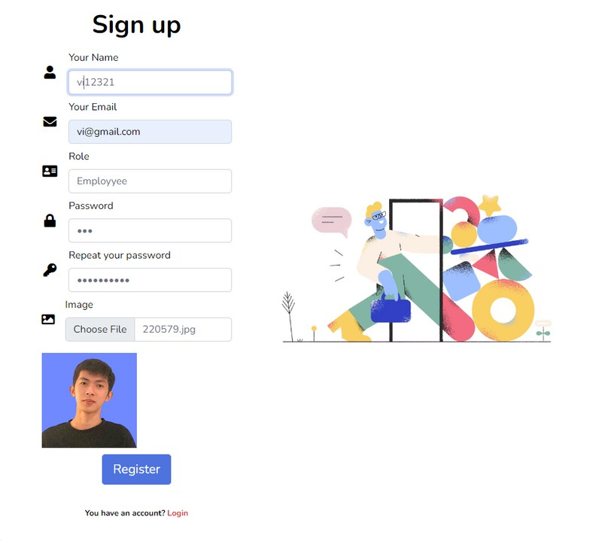
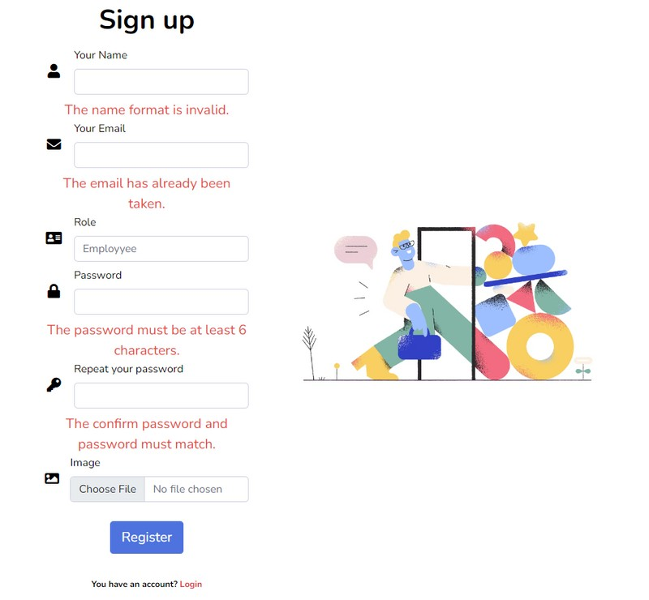
Register Account
2022 July 4
2
18
Notes:
With feature Register account You must fill in the valid information
I use validation in laravel to check the validity of input data.
If you do not enter the correct requirements, the system will not allow you to register

Slide 19
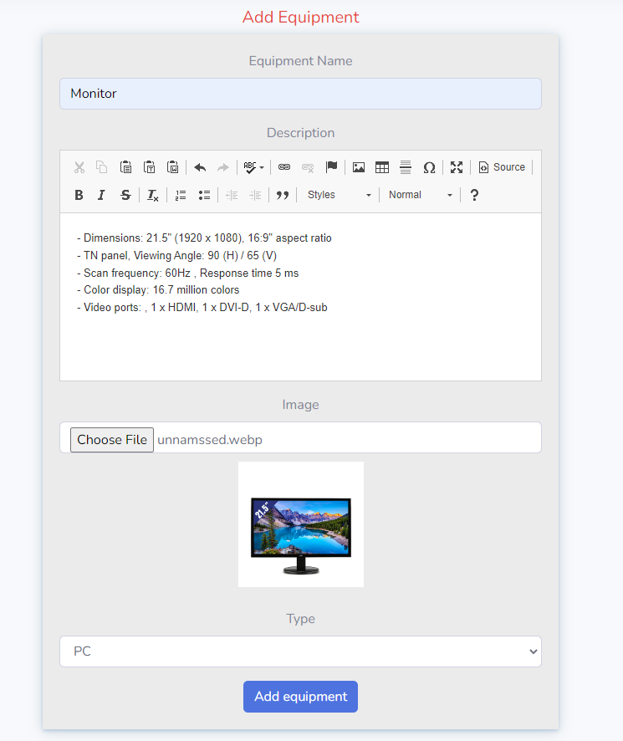
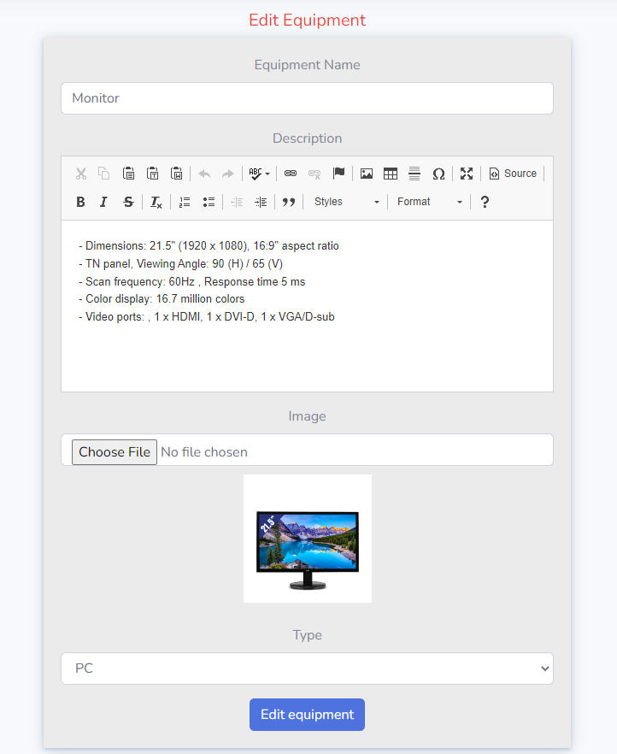
Manage Equipment
2022 July 4
Add Equipment
Edit Equipment
2
19

Slide 20
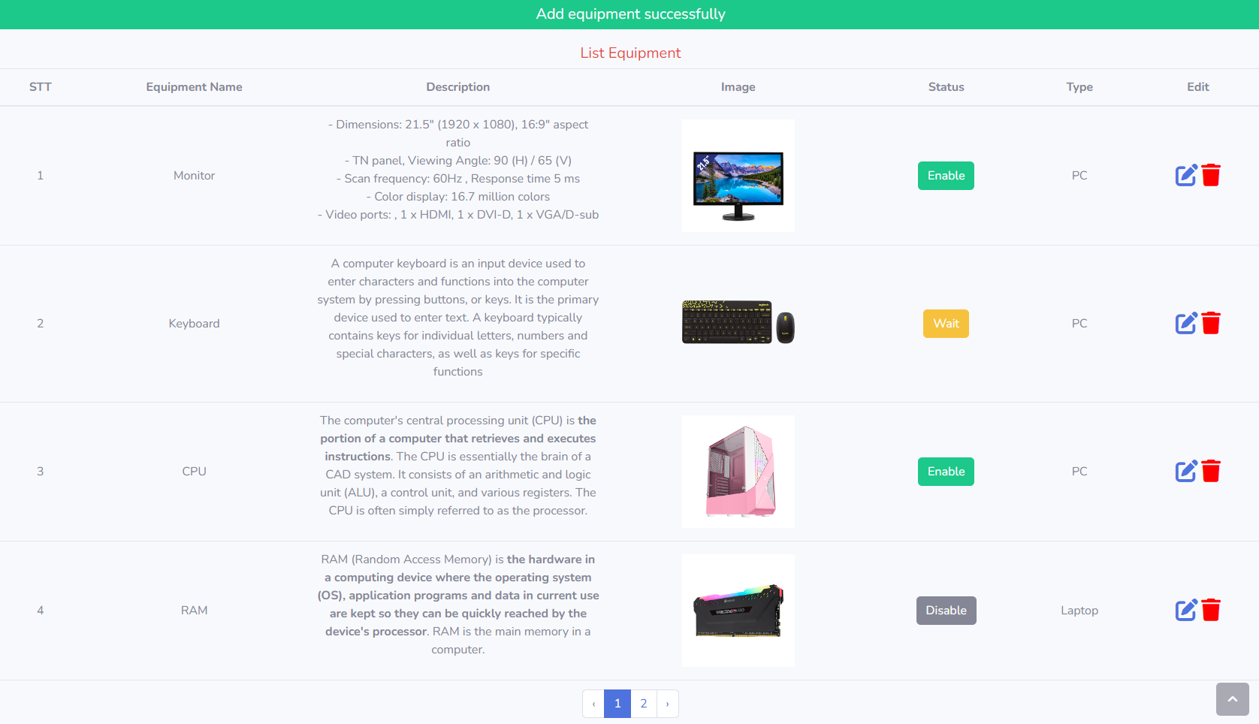
List Equipments
2022 July 4
2
20
Notes:
With this site you can see which equipments have been added with name, description, image, type and their status.
You can edit and delete them

Slide 21
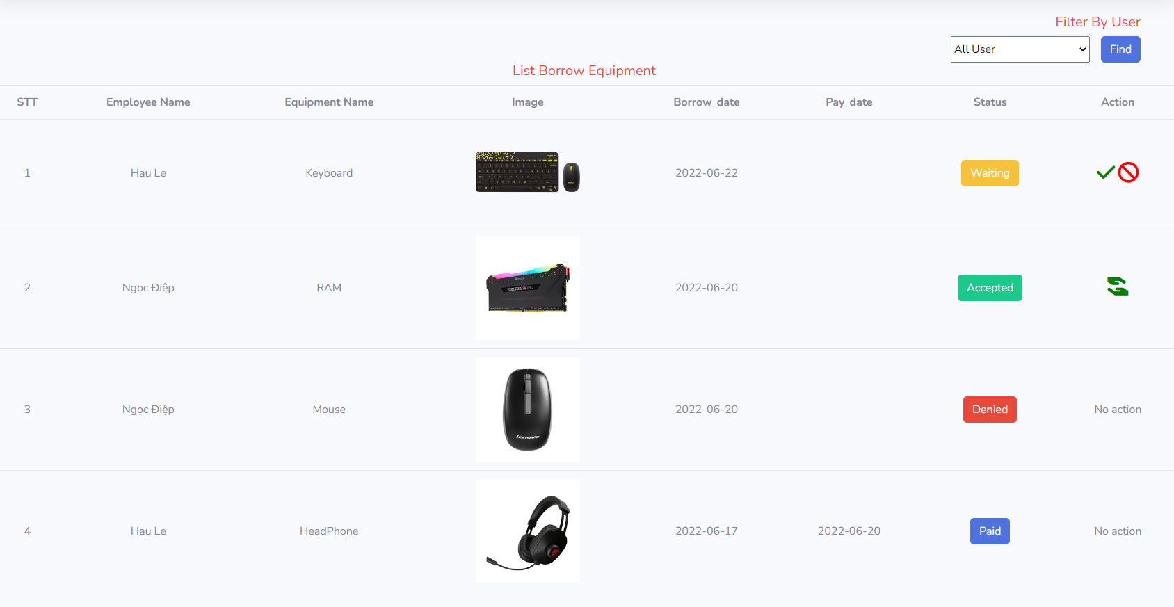
Manage Borrow
2022 July 4
2
21
Notes:
With this site you can see which equipment is borrowed by whom, borrowed date, return date and the status of this borrow.
You can accept or deny and confirm returned

Slide 22
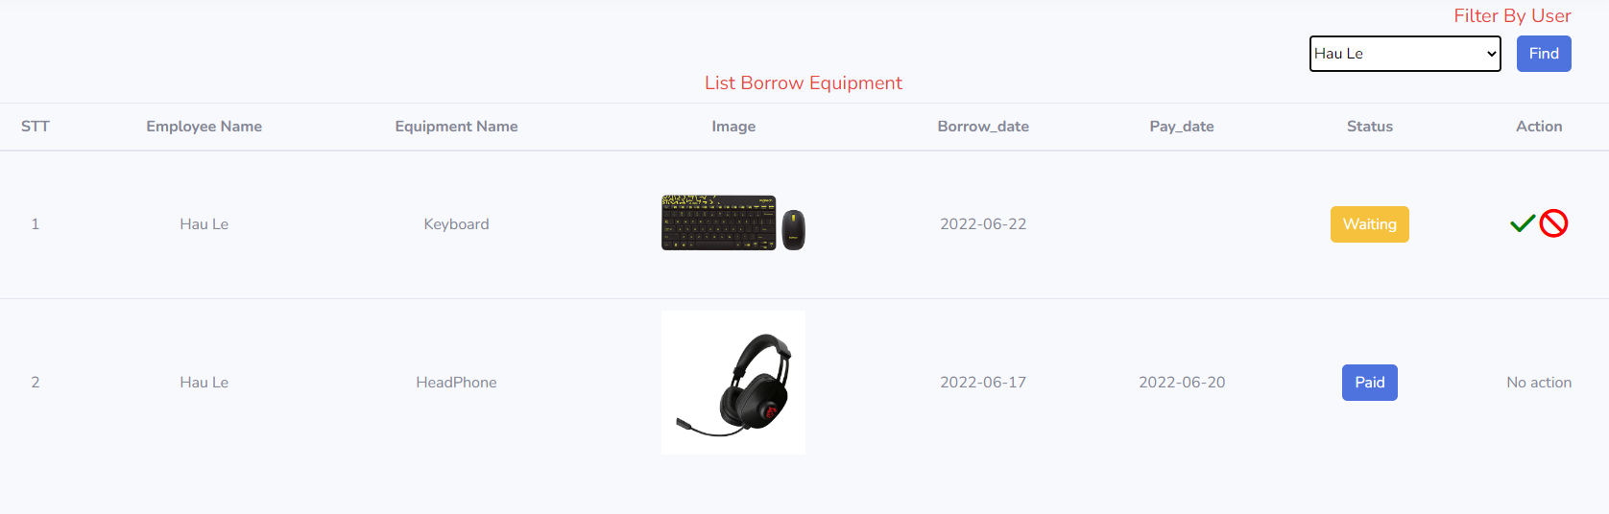
Search equipment borrow list by employee name
2022 July 4
2
22
Notes:
You can also list out all equipment which is assigned to an employee.

Slide 23


2022 July 4
View Equipments
Borrow Equipments
Employee
2
23
Notes:
If you login as an employee you can

Slide 24
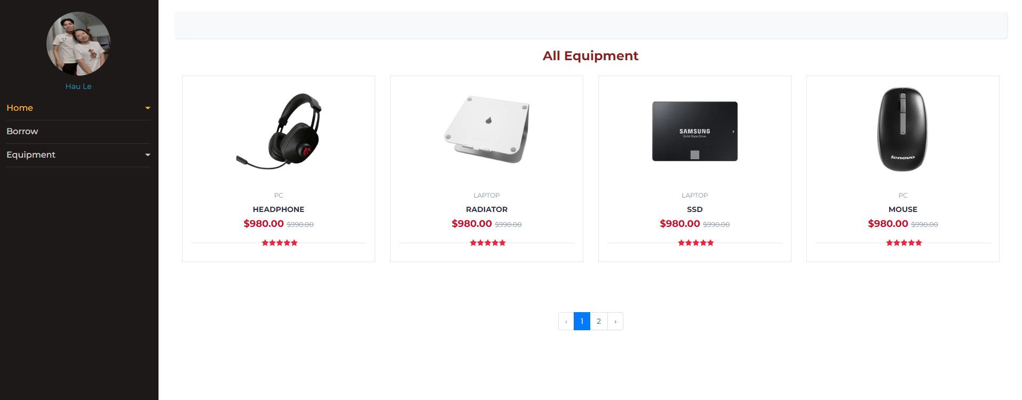
2022 July 4
View Equipment
2
24
Notes:
You can view all equipments that you can borrow

Slide 25
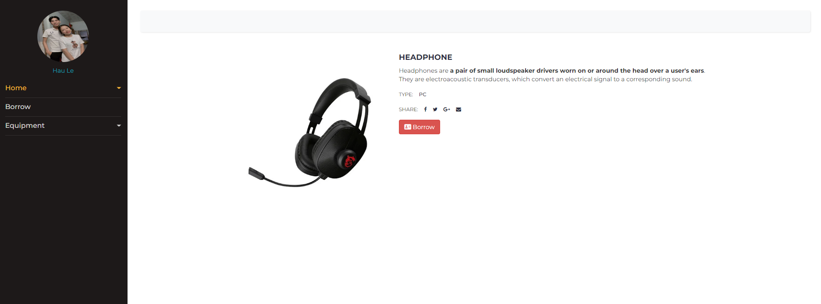
Detail Equipment
2022 July 4
2
25
Notes:
You can see detail equipment such as name, description and type You can also borrow it.

Slide 26
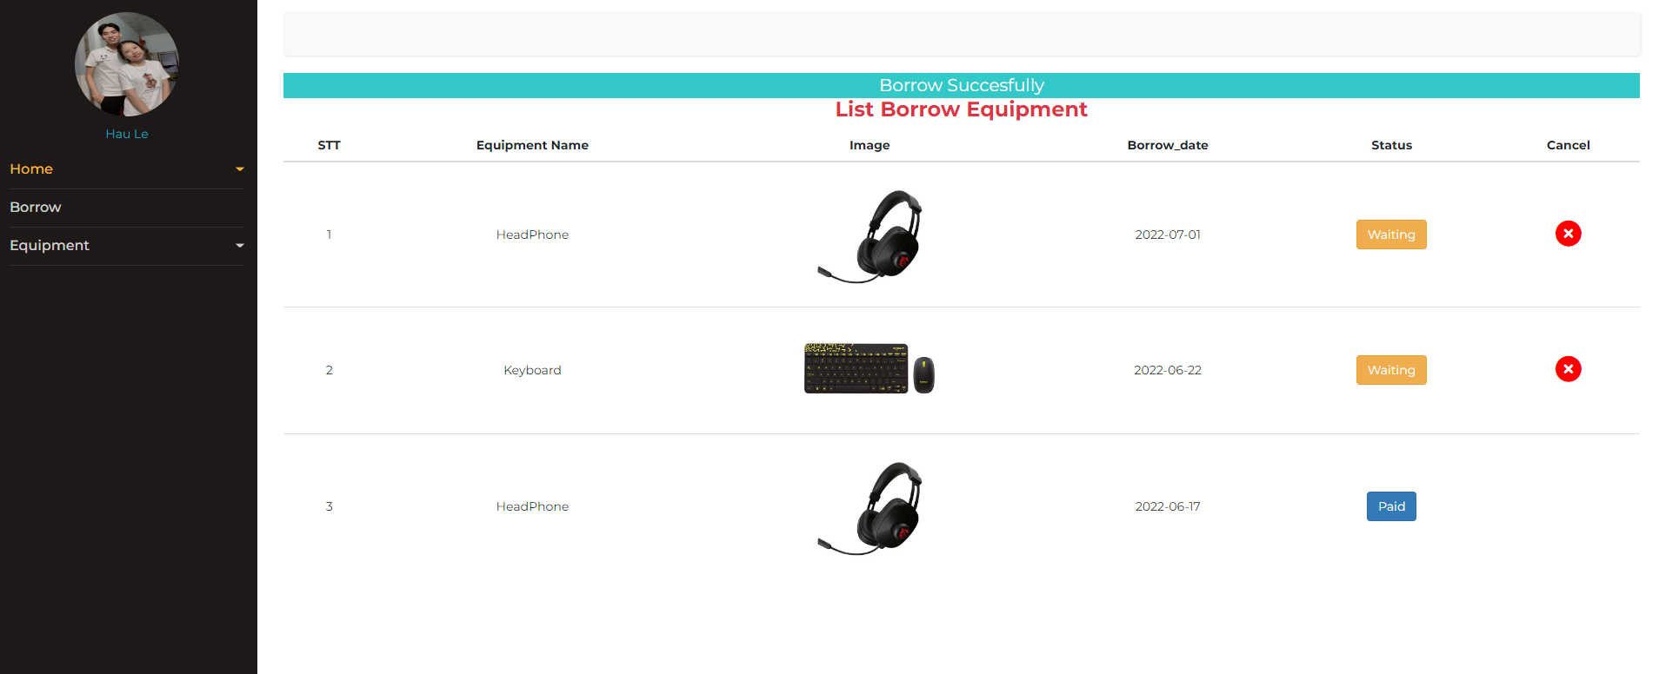
View List Borrow
2022 July 4
2
26
Notes:
With this site you can see the equipments you have borrowed, You paid sand you are waiting to borrow.
You can cancel the request to borrow the equipment when the manager has not approved it

Slide 27
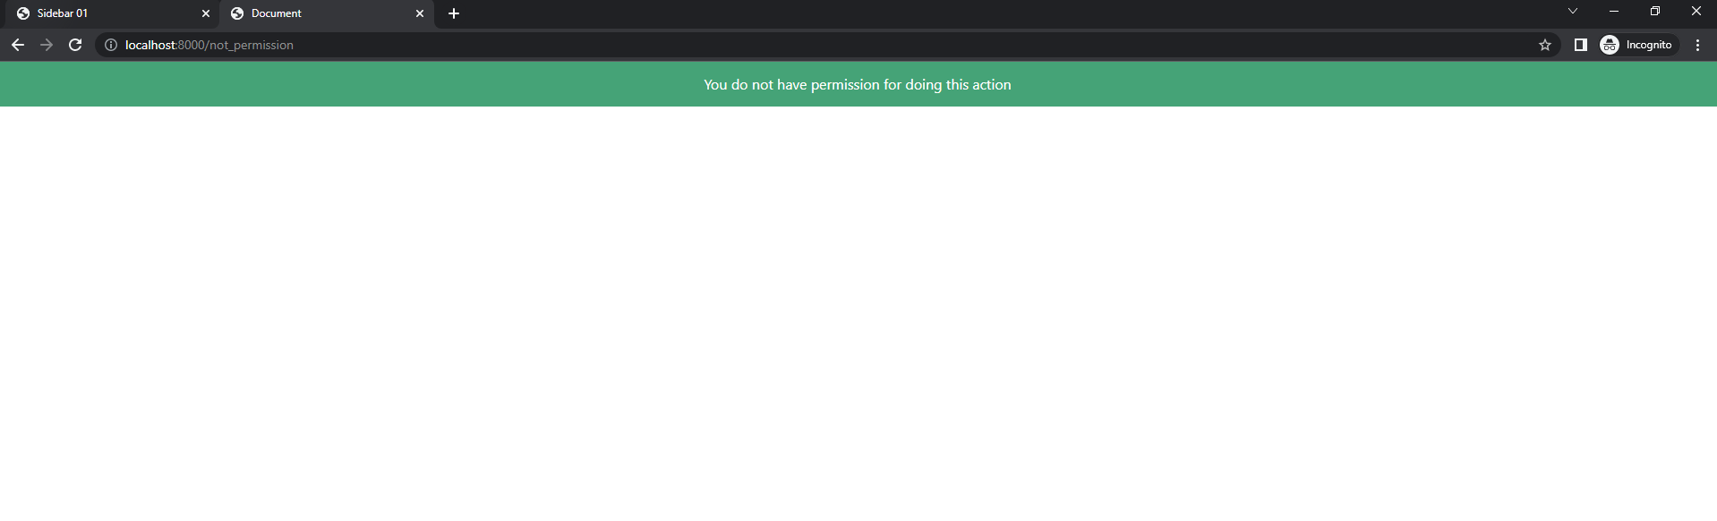
Permission
2022 July 4
2
27
Notes:
If you are logged in as an employee. You cannot access the administrator's page.
I create a middleware to assign access rights for users.
20

Slide 28
VI OVERVIEW
2022 July 4
LIMITATIONS
Not authorize for admin
The list feature is simple
Website security is not high
Unhandled exceptions
2
28

Slide 29
2022 July 4
DEVELOPMENT DIRECTIONS
Assign specific permissions to admins
Add some features
Use JWT
Catching exceptions
2
29
Notes:
DEVELOPMENT DIRECTIONS
Add some features such as: of equipments by status, manage when and where is the equipment used,change password
Use jwt to specify user permissions
Catching exceptions and show a message to the user when there is an exception

Slide 30
2022 July 4
TMA SOLUTIONS
Thank you for listening!
Advisor
Le Tuan
Author
Diep Doan Dan Vi
Presentation

