Slide 1
A little bit of Xception
Jayson Cunanan

Slide 2
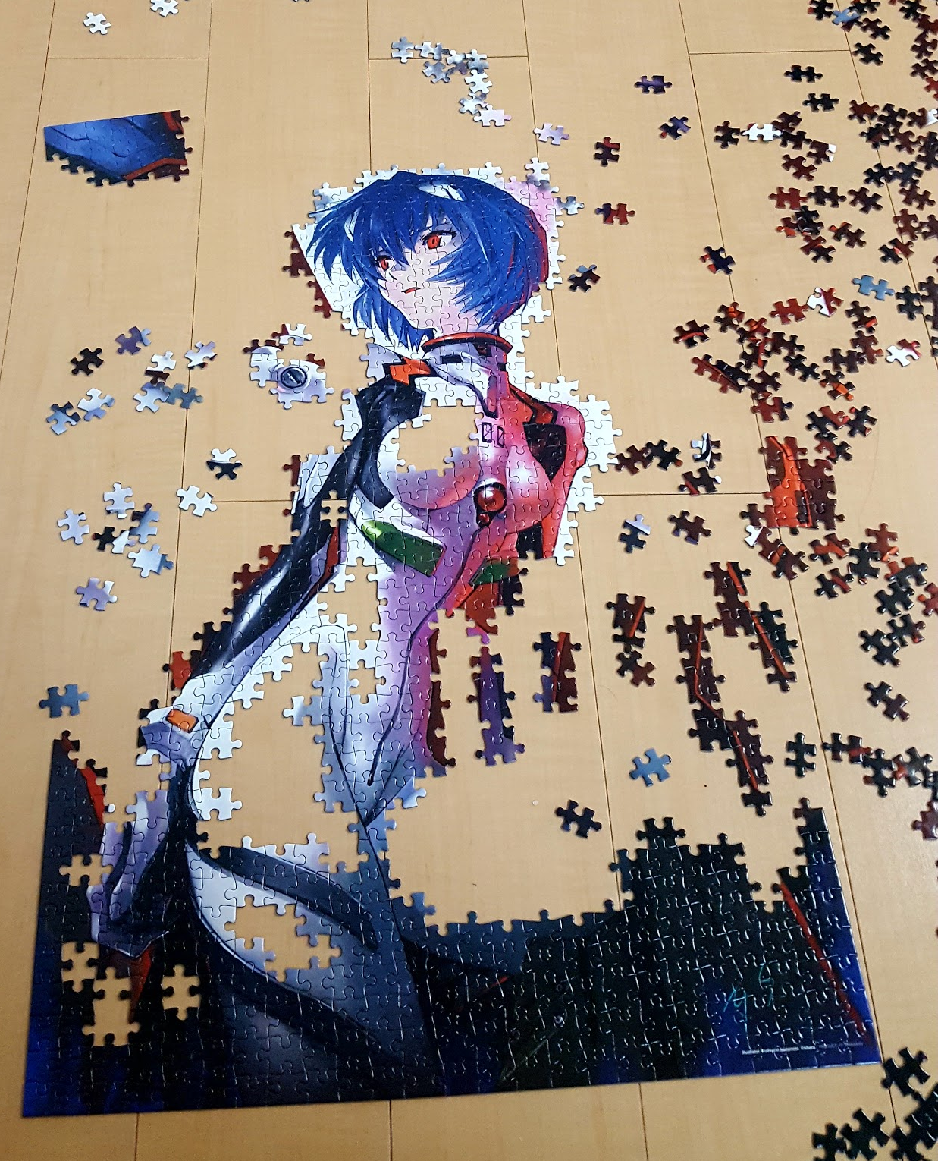
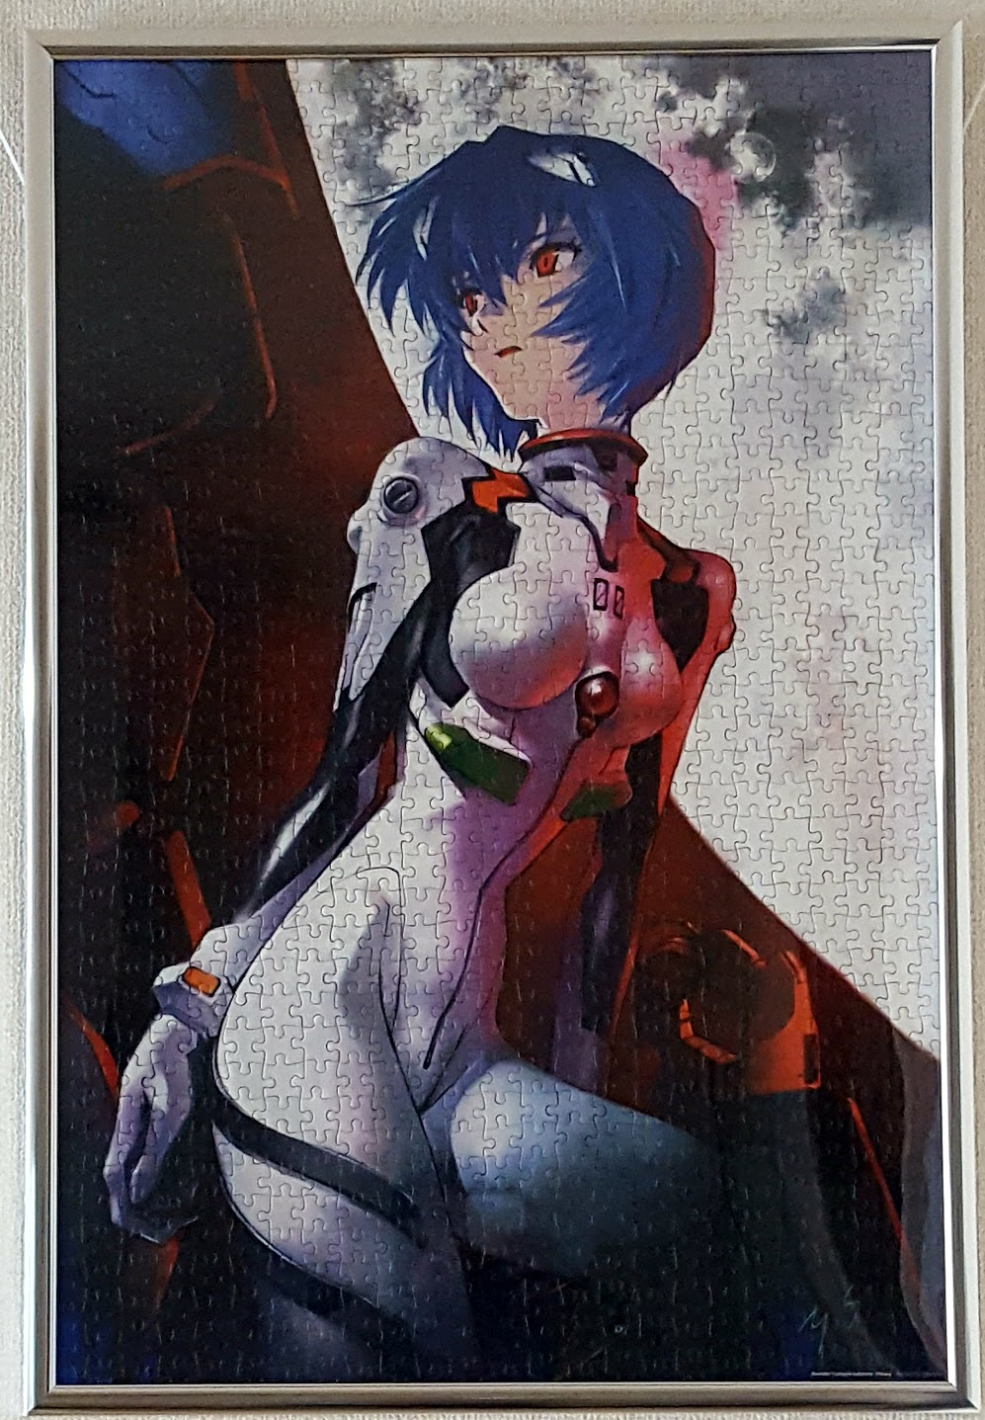
PATTERN MATCHING

Slide 3
1-channel output
ConvOP_1
ConvOP_2
ConvOP_3
3-channel input
Conv2D
“A single convolution kernel is tasked with simultaneously mapping cross-channel correlations and spatial correlations”
Single Channel 2D Convolution (ConvOP)

Slide 4
1x1 Cov2D layers are only mapping cross-channel correlations

Slide 5
concat
The Inception Hypothesis
“cross-channel correlations
and spatial correlations are sufficiently decoupled that it is preferable not to map them jointly”
3x3 Conv2D
3x3 Conv2D
3x3 Conv2D
1x1 Conv2D
1x1 Conv2D
1x1 Conv2D
input
simplified Inception module
Notes:
This idea behind the Inception module is to make this
process easier and more efficient by explicitly factoring it
into a series of operations that would independently look at
cross-channel correlations and at spatial correlations

Slide 6
concat
3x3 Conv2D
3x3 Conv2D
3x3 Conv2D
Q1. What is the effect of the number of segments in the partition (and their size)?
Q2. Would it be reasonable to make a much stronger hypothesis than the Inception hypothesis, and assume that cross-channel correlations and spatial correlations can be mapped completely separately?
1x1 Conv2D
input
Equivalent formulation of simplified Inception module

Slide 7
concat
Spatial correlations
3x3 Conv2D
3x3 Conv2D
3x3 Conv2D
3x3 Conv2D
3x3 Conv2D
3x3 Conv2D
Cross-channel correlations
1x1 Conv2D (6 output channels)
input
“extreme” Inception module

Slide 8
1x1 Conv2D
concat
DepthwiseConv2D
with depth multiplier=1
3x3 Conv2D
3x3 Conv2D
3x3 Conv2D
3x3 Conv2D
3x3 Conv2D
3x3 Conv2D
Two minor differences between and “extreme” version of an Inception module and a separable convolution would be:
The order of the operations
The presence or absence of a non-linearity after the first operation
Input (6 channel)
SeparableConv2D

Slide 9
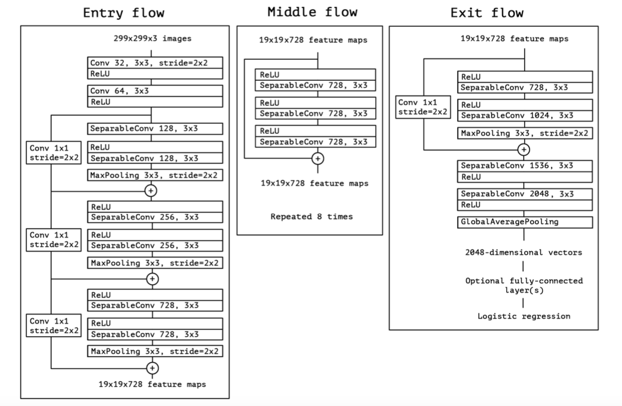

Slide 10
Thanks for joining! Don’t forget to quickly fill up our feedback form!

