Slide 1


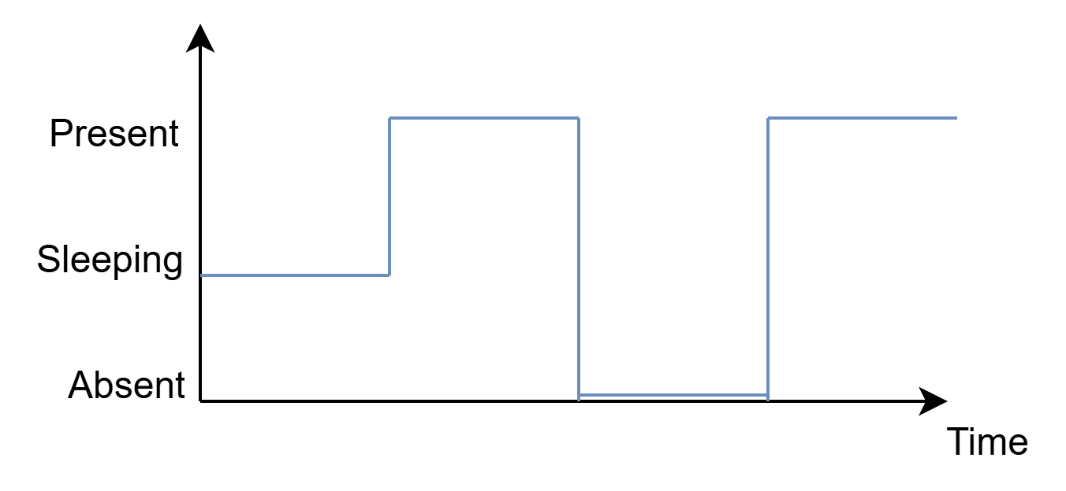
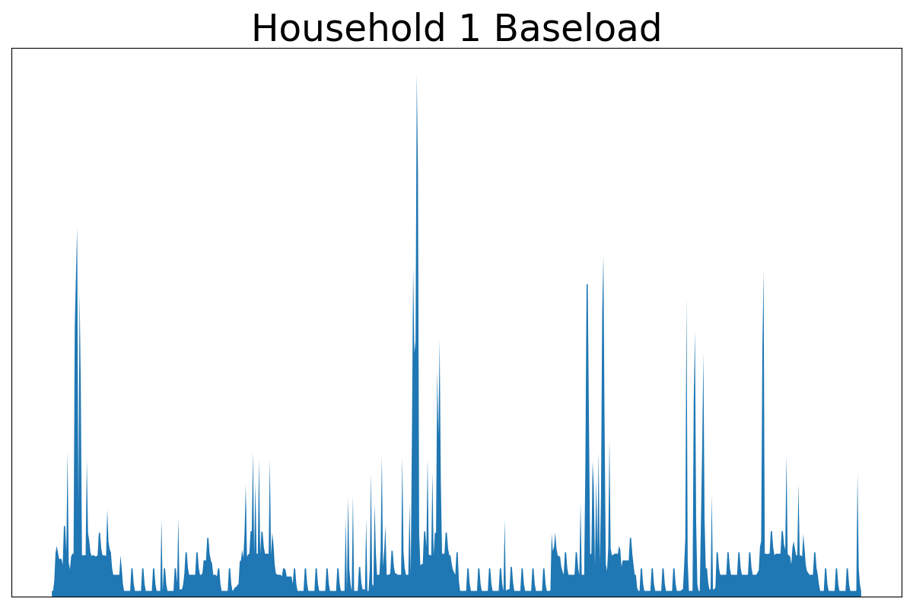
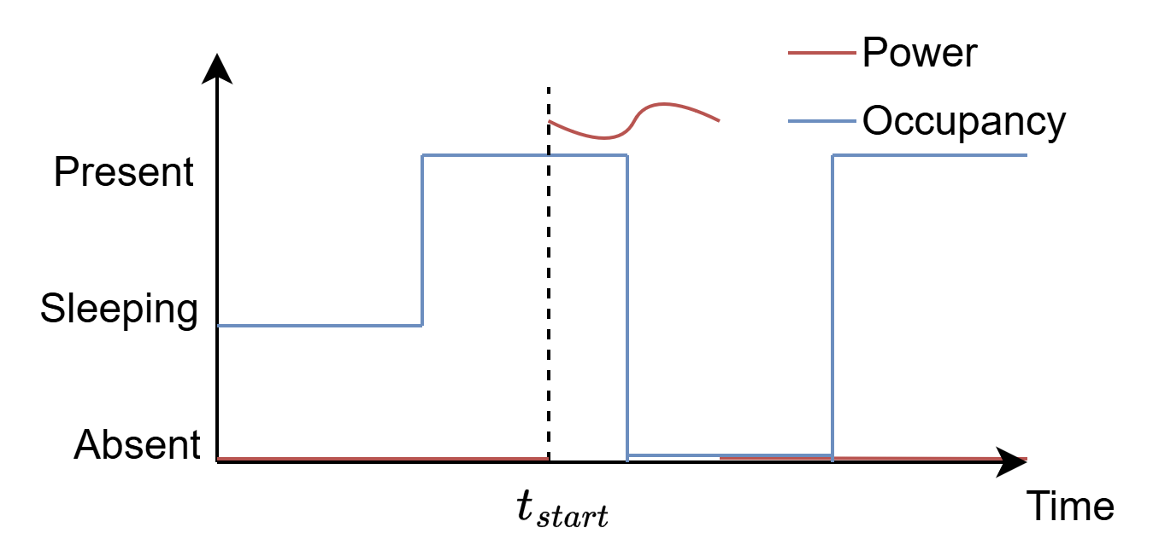
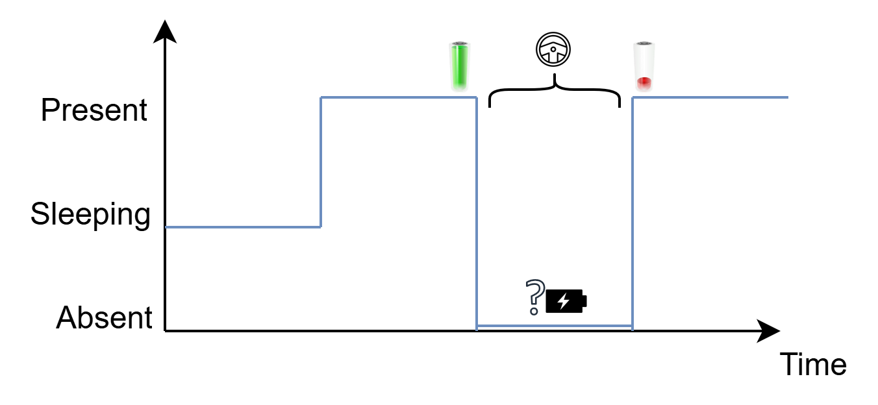
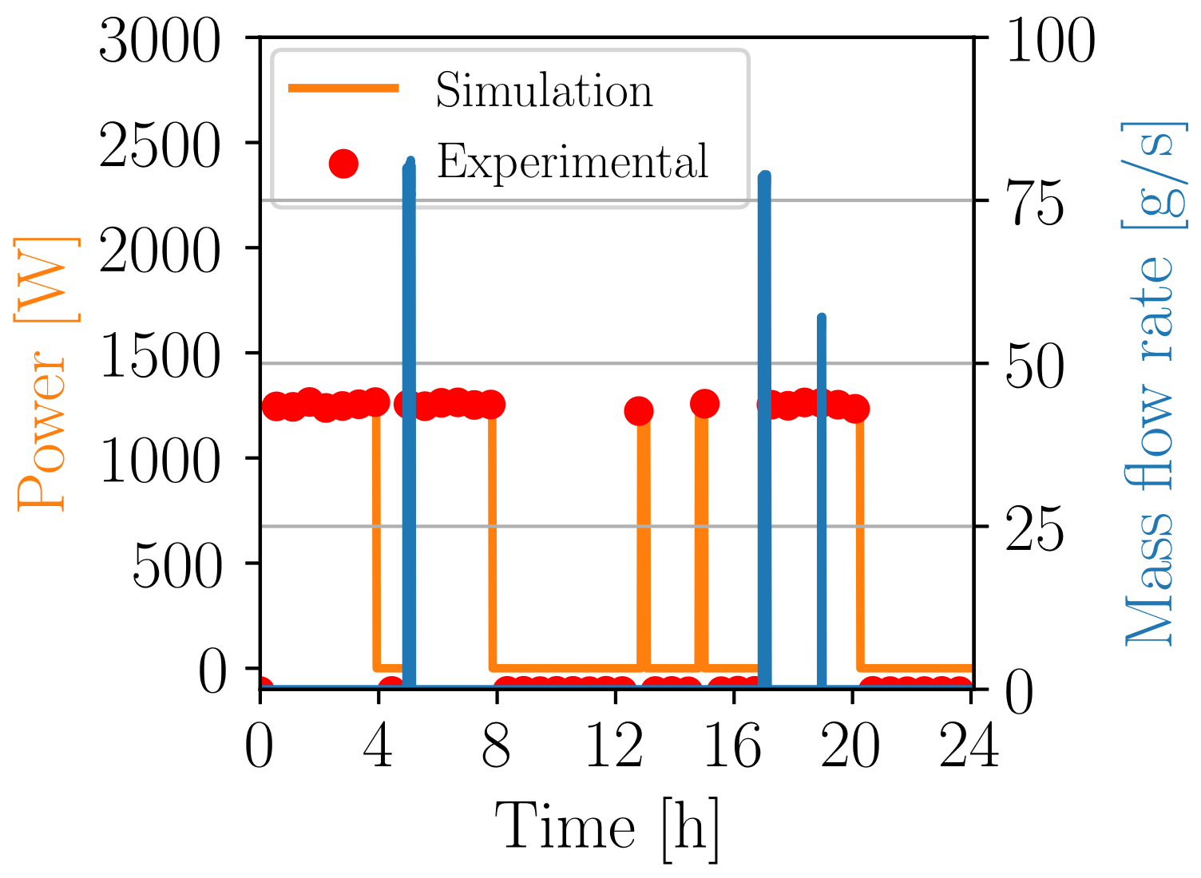
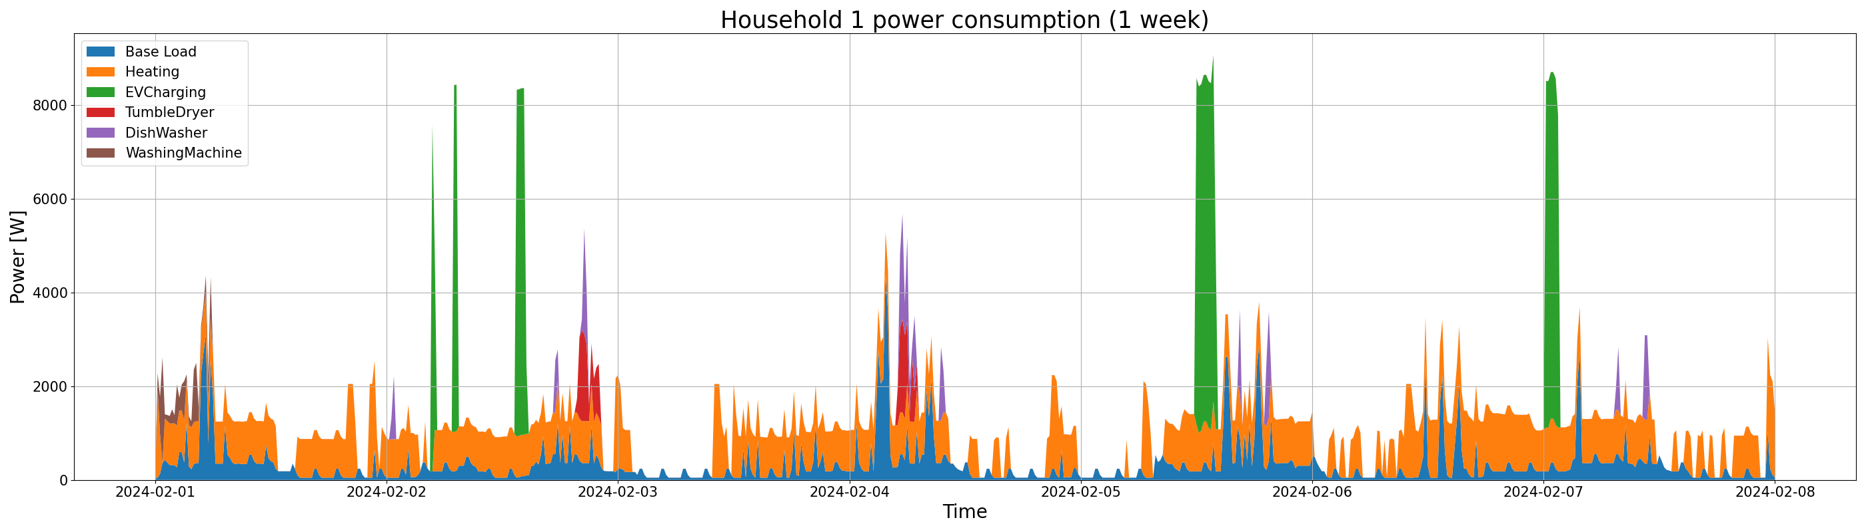

Stochastic generator for flexible residential load profiles
Thomas Stegen*¹, Joakim Castiaux¹, Noé Diffels¹, Maxime Duchesne¹, Bertrand Cornélusse¹
Context
This work proposes a tool to generate synthetic electrical load profiles using a stochastic occupancy generator[1].
The profiles are designed to include flexibility on the demand side for residential users.
Profile construction
Each load profile is constructed cumulatively depending on the appliance inside the home.
Base profile
Wet appliances
Electric vehicle
Water boiler
Space heater
All the non-controllable appliances are probabilistically activated.
Shiftable controllable loads (washing machine, drier and dishwasher).
When the car owner leaves home, a “driving event” can start.
The hot water needs are converted to electrical consumption.
There are 3 temperature setpoints, wall types and home sizes are modelled.
Result
Aggregating
Flexibility
A flexibility component is added to the profiles for each flexible appliance stating when the appliance can or has to be activated.
Different flexibility types can be defined:
Maximum time shift or number of cycles for wet appliances.
Maximum temperature gradient for boilers and HP.
Maximum charging delay for the EVs.
Define population
Generate
profiles
Update population
Types and proportions for:
Houses
Families
Cars (+ usage)
Heating systems
For the whole population, compute yearly profiles to match the predefined probability of the case study
To model longer term scenarios, the population characteristics can be updated to account for new usages
Conclusion
This tool provides an efficient solution to assess the flexibility of the electrical demand of residential users.
It could be useful to measure efficiency of new tariffication schemes or to quantify potential impact of residential flexibility in the evolution of the load in distribution networks
Reference
[1] Baetens, R., Saelens, D.: ‘Modelling uncertainty in district energy simulations by stochastic residential occupant behaviour’, Journal of Building Performance Simulation, 2016, 9, (4), pp. 431–447
Github of the tool https://github.com/Diffels/ResFlexLoad
¹ University of Liège, Montefiore Institute, Liège, Belgium *Corresponding Author: tstegen@uliege.be

