Slide 1
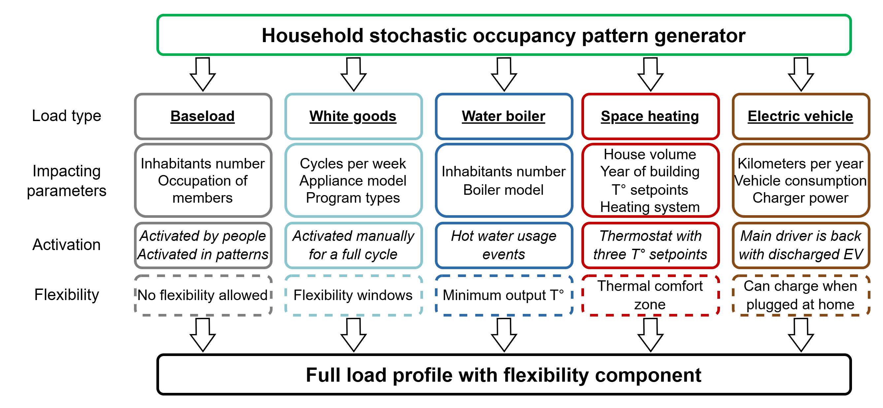

1092 – ResFlex: A residential load profile generator to model individual demand response in distribution grids
Thomas Stegen, Joakim Castiaux, Noé Diffels, Maxime Duchesne, Bertrand Cornélusse Montefiore Institute, University of Liège, Belgium
Introduction
Modelling evolving residential load is key to achieve efficient energy transition and distribution system planning
Profile generator
The lack of existing public data pushed us to develop synthetic profiles. Our aim is to model known populations from realistic individuals.
Occupancy Profile
Using StROBe [1], a family is modelled for the house and their behavior is defined for the full year (Active-Sleeping-Away).
Base Load
Stochastic use of plugged-in appliances is defined depending on presence in house, with data coming from [1].
White Goods
Dishwashers, washing machines and driers with given programs and profiles are launched at specific times.
Water Boiler
A model of water consumption and heating, with thermostatic control is included.
Space Heating
The house is modelled as a block with thermal losses and coefficient. Wall are modelled as a thermal buffer/capacitance.
Electric Vehicle
Driving events with realistic energy use are inferred from the home occupancy profile. Home or outside charge are possible.
Generating a population
This tool aims to model complete distribution grids. Adapted function and inputs can be used to match known parameters for the population from feeder level.
Scenario modelling
For long term planning, evolving populations can be created with increasing penetration parameters representing evolution of the electrification.
Conclusions
This tool provides load profiles with a flexibility component that are realistic regarding users’ behavior, assets’ models and populations’ metrics. Results have been validated on Belgian data.
Reference
[1] Baetens, R., Saelens, D.: ‘Modelling uncertainty in district energy simulations by stochastic residential occupant behaviour’, Journal of Building Performance Simulation, 2016
Download the tool https://github.com/Diffels/ResFlex
CIRED 2025 – Paper No: 1092

Slide 2
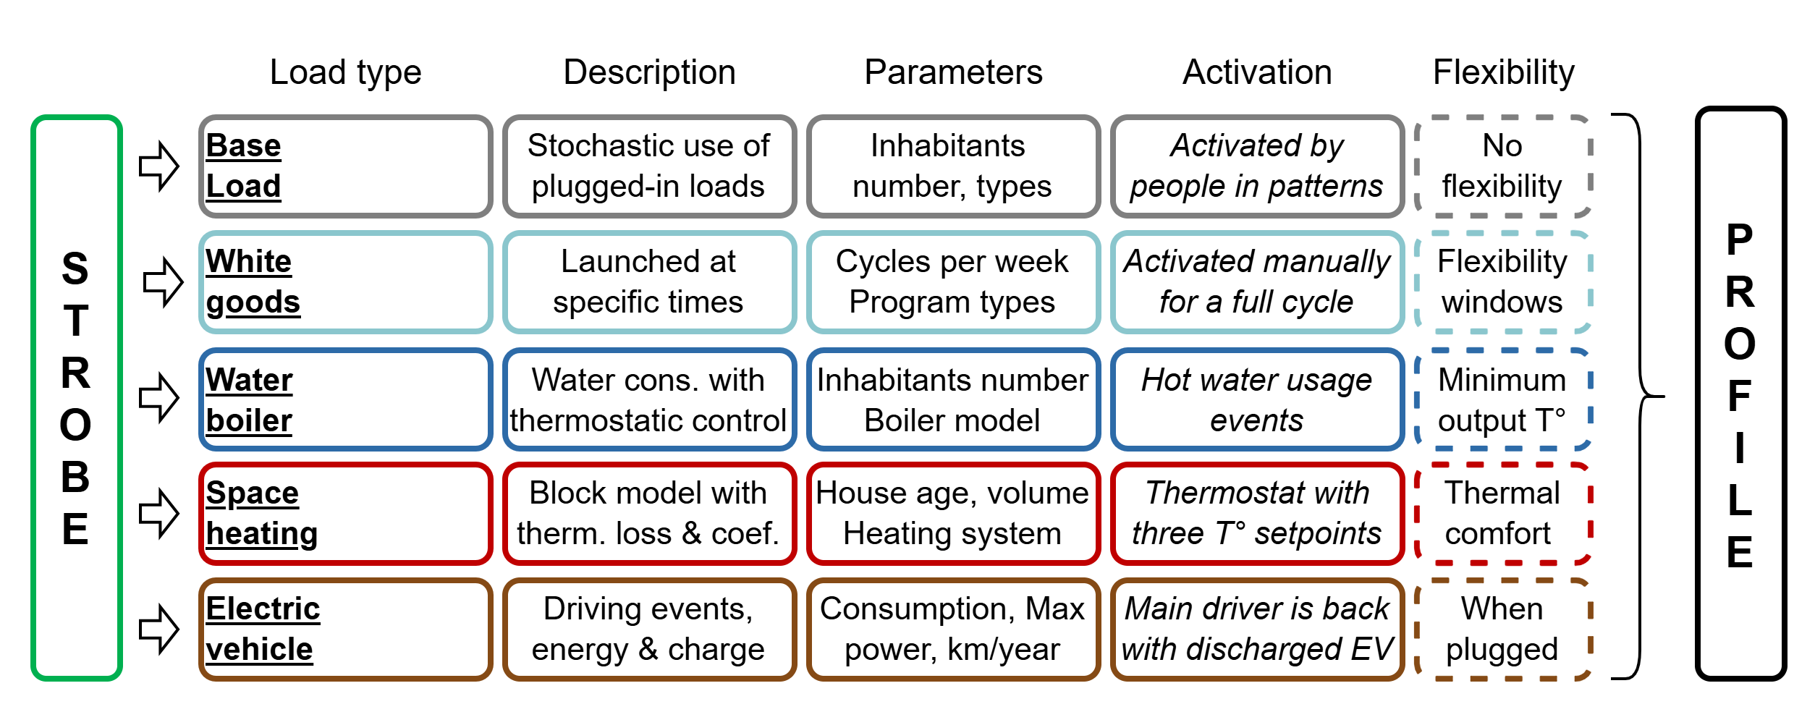
1092 – ResFlex: A residential load profile generator to model individual demand response in distribution grids
Thomas Stegen, Joakim Castiaux, Noé Diffels, Maxime Duchesne, Bertrand Cornélusse Montefiore Institute, University of Liège, Belgium
Introduction
Modelling evolving residential load is key to achieve efficient energy transition and distribution system planning
Profile generator
The lack of existing public data pushed us to develop synthetic profiles. Our aim is to model known populations from realistic individuals.
Generating a population
This tool aims to model complete distribution grids. Adapted function and inputs can be used to match known parameters for the population from feeder level.
Scenario modelling
For long term planning, evolving populations can be created with increasing penetration parameters representing evolution of the electrification.
Conclusions
This tool provides load profiles with a flexibility component that are realistic regarding users’ behavior, assets’ models and populations’ metrics. Results have been validated on Belgian data.
Reference
[1] Baetens, R., Saelens, D.: ‘Modelling uncertainty in district energy simulations by stochastic residential occupant behaviour’, Journal of Building Performance Simulation, 2016
Download the tool https://github.com/Diffels/ResFlex
CIRED 2025 – Paper No: 1092

Slide 3





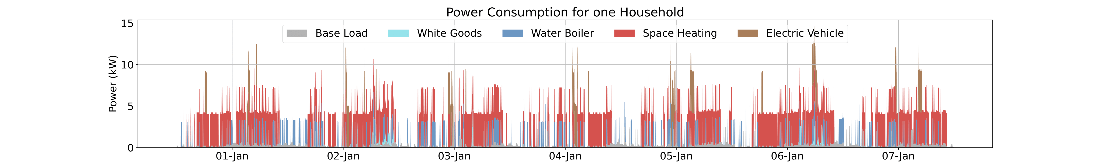
1092 – ResFlex: A residential load profile generator to model individual demand response in distribution grids
Thomas Stegen, Joakim Castiaux, Noé Diffels, Maxime Duchesne, Bertrand Cornélusse Montefiore Institute, University of Liège, Belgium
Introduction
Modelling evolving residential load is key to achieve efficient energy transition and distribution system planning
Profile generator
The lack of existing public data pushed us to develop synthetic profiles. Our aim is to model known populations from realistic individuals.
Household Occupancy Profile Generated using StROBe [1]
A family is modelled in the house and individual behavior is defined for the full year (Active-Sleeping-Away).
Base Load
White Goods
Water Boiler
Space Heating
Electric Vehicle
Stochastic use of plugged-in loads
Launched at specific times
Water cons. with thermostat. control
Block model with therm. loss & coef.
Driving events, energy & charge
Inhabitants number, types
Cycles per week Program types
Inhabitants number Boiler model
House year, volume Heating system
Consumption, Max power, km/year
Activated by people in patterns
Activated for a full cycle
Hot water usage events
Thermostat with three T° setpoints
Main driver is back with discharged EV
No flexibility
Flexibility windows
Minimum output T°
Thermal comfort
When plugged
Complete profile with flexibility component
This tool aims to model complete distribution grids. Adapted function and inputs can be used to match known parameters for the population at feeder level.
Generating a population
This tool aims to model complete distribution grids. Adapted function and inputs can be used to match known parameters for the population at feeder level.
Scenario modelling
For long term planning, evolving populations can be created with increasing penetration parameters representing evolution of the electrification.
Conclusions
This tool provides load profiles with a flexibility component that are realistic regarding users’ behavior, assets’ models and populations’ metrics. Results have been validated on Belgian data.
Reference
[1] Baetens, R., Saelens, D.: ‘Modelling uncertainty in district energy simulations by stochastic residential occupant behaviour’, Journal of Building Performance Simulation, 2016
Download the tool https://github.com/Diffels/ResFlex
CIRED 2025 – Paper No: 1092

Slide 4

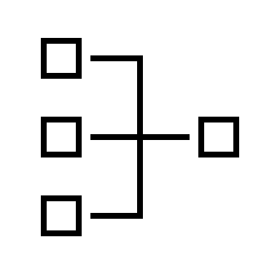
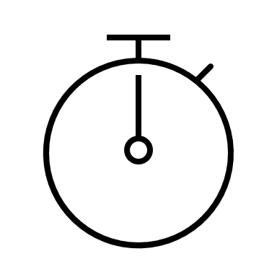
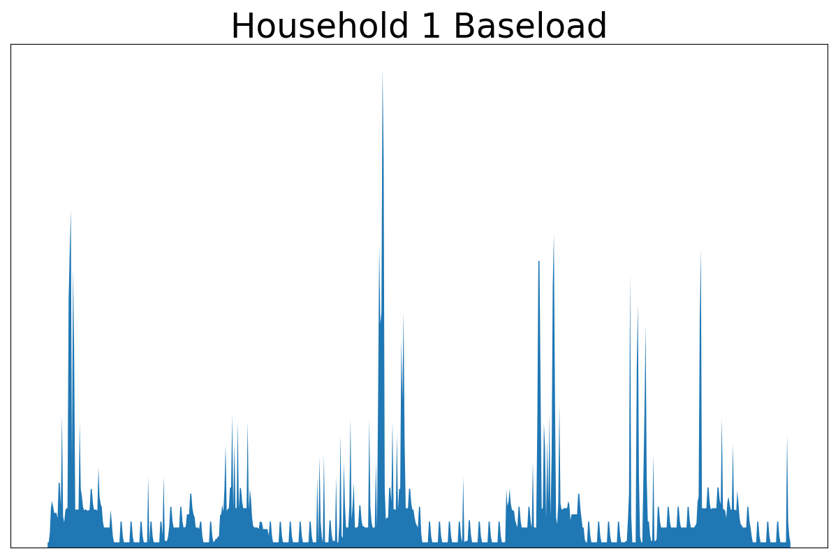
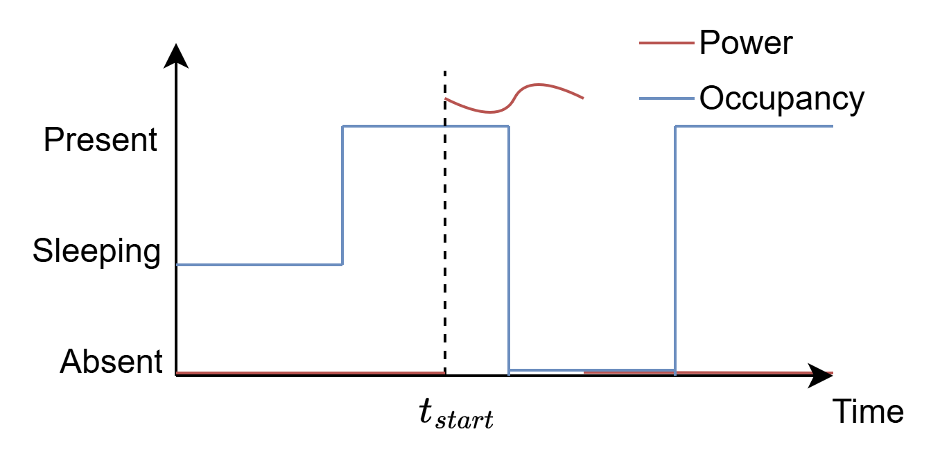
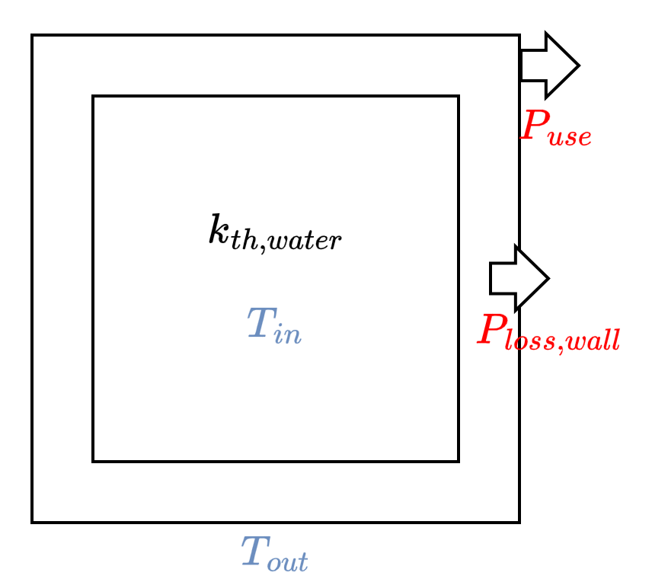
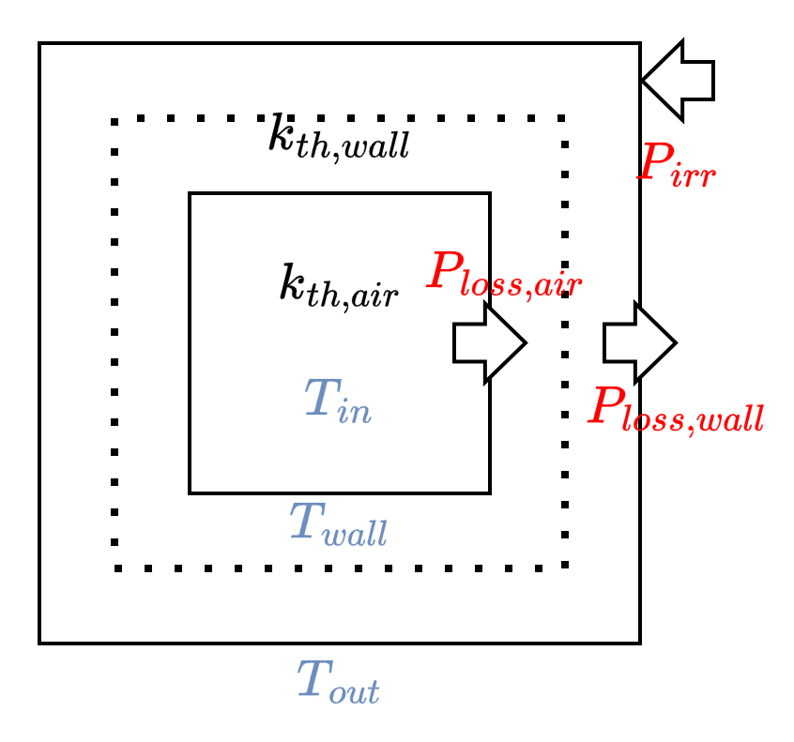
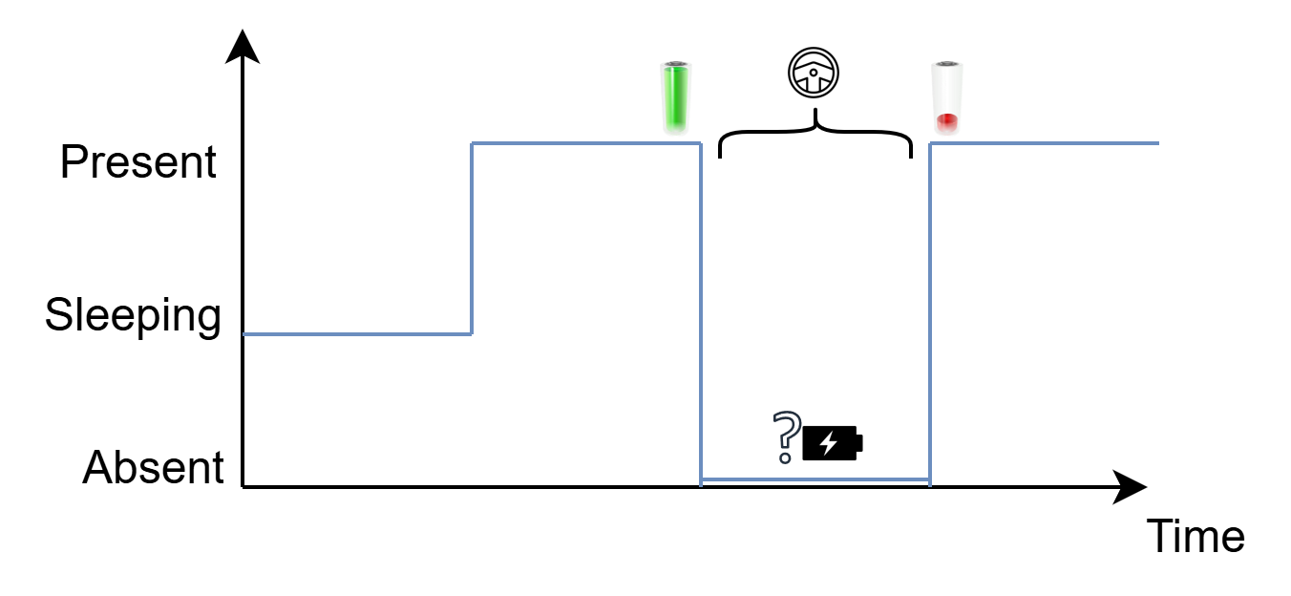

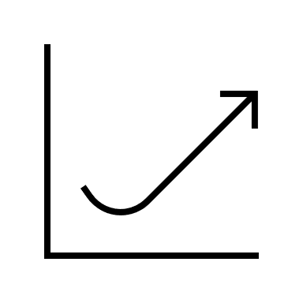


1092 – ResFlex: A residential load profile generator to model individual demand response in distribution grids
Thomas Stegen, Joakim Castiaux, Noé Diffels, Maxime Duchesne, Bertrand Cornélusse Montefiore Institute, University of Liège, Belgium
Introduction
Modelling evolving residential load to achieve efficient energy transition and distribution system planning.
Profile generator
Due to lack of data, our aim is to get synthetic profiles for known populations from realistic individuals.
Household Occupancy
A family is modelled in the house and individual behavior is defined for the full year using StROBE [1].
Base Load
White Goods
Water Boiler
Space Heating
Electric Vehicle
Stochastic use of plugged-in loads
Launched at specific times
Water cons. with thermostat. control
Block model with therm. loss & coef.
Driving events, energy & charge
Inhabitants number and occupations
Cycles per week Program types
Inhabitants number Boiler model
House year, volume Heating system
Consumption, Max power, km/year
Activated by people in patterns
Activated for a full cycle
Hot water usage events
Thermostat with three T° setpoints
Main driver is back with discharged EV
No flexibility
Flexibility windows
Minimum output T°
Thermal comfort
When plugged
Population
This tool aims to model complete distribution grids. Adapted function and inputs can be used to match known parameters for the population at feeder level.
Scenarios
For long term planning, evolving populations can be created with increasing penetration parameters representing evolution of the electrification.
Conclusions
This tool provides load profiles with a flexibility component that are realistic regarding users’ behavior, assets’ models and populations’ metrics. Results have been validated on Belgian data.
Reference
[1] Baetens, R., Saelens, D.: ‘Modelling uncertainty in district energy simulations by stochastic residential occupant behaviour’, Journal of Building Performance Simulation, 2016
Download the tool https://github.com/Diffels/ResFlex
The project source of the results presented in this paper has received funding from the Belgian Energy Transition Fund (UNLEASH Project)
CIRED 2025 – Paper No: 1092

Slide 5
1092 – ResFlex: A residential load profile generator to model individual demand response in distribution grids
Thomas Stegen, Joakim Castiaux, Noé Diffels, Maxime Duchesne, Bertrand Cornélusse Montefiore Institute, University of Liège, Belgium
Goal
Modelling evolving residential load to achieve efficient energy transition and distribution system planning.
Generator
Due to lack of data, our aim is to get synthetic profiles for known populations from realistic individuals.
Household Occupancy
A family is modelled in the house and individual behavior is defined for the full year using StROBE [1].
Base Load
White Goods
Water Boiler
Space Heating
Electric Vehicle
Stochastic use of plugged-in loads
Launched at specific times
Water cons. with thermostat. control
Block model with therm. loss & coef.
Driving events, energy & charge
Inhabitants number and occupations
Cycles per week Program types
Inhabitants number Boiler model
House year, volume Heating system
Consumption, Max power, km/year
Activated by people in patterns
Activated for a full cycle
Hot water usage events
Thermostat with three T° setpoints
Main driver is back with discharged EV
No flexibility
Flexibility windows
Minimum output T°
Thermal comfort
When plugged
Population
This tool aims to model complete distribution grids. Adapted function and inputs can be used to match known parameters for the population at feeder level.
Scenarios
For long term planning, evolving populations can be created with increasing penetration parameters representing mass electrification.
Conclusions
This tool provides load profiles with a flexibility component that are realistic regarding users’ behavior, assets’ models and populations’ metrics. Results have been validated on Belgian data.
Reference
[1] Baetens, R., Saelens, D.: ‘Modelling uncertainty in district energy simulations by stochastic residential occupant behaviour’, Journal of Building Performance Simulation, 2016
Download the tool https://github.com/Diffels/ResFlex
The project source of the results presented in this paper has received funding from the Belgian Energy Transition Fund (UNLEASH Project)
CIRED 2025 – Paper No: 1092

Slide 6
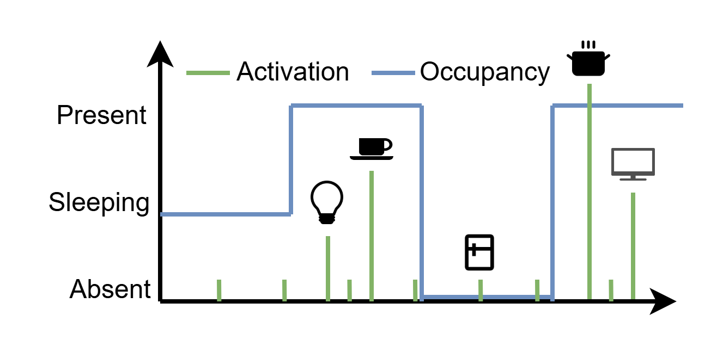
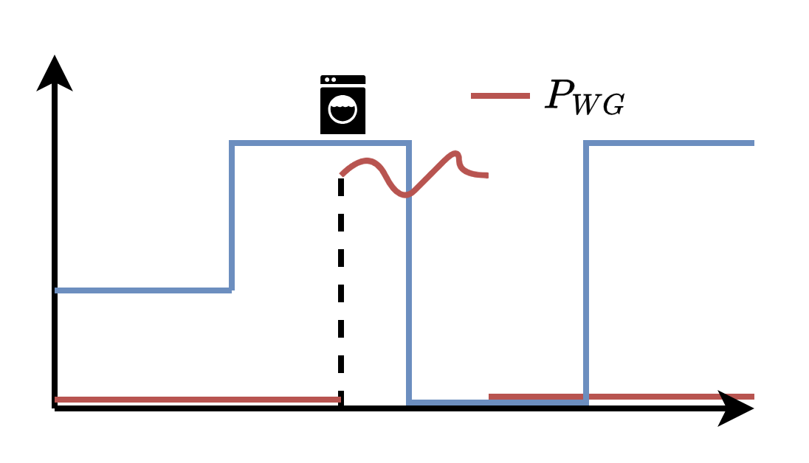
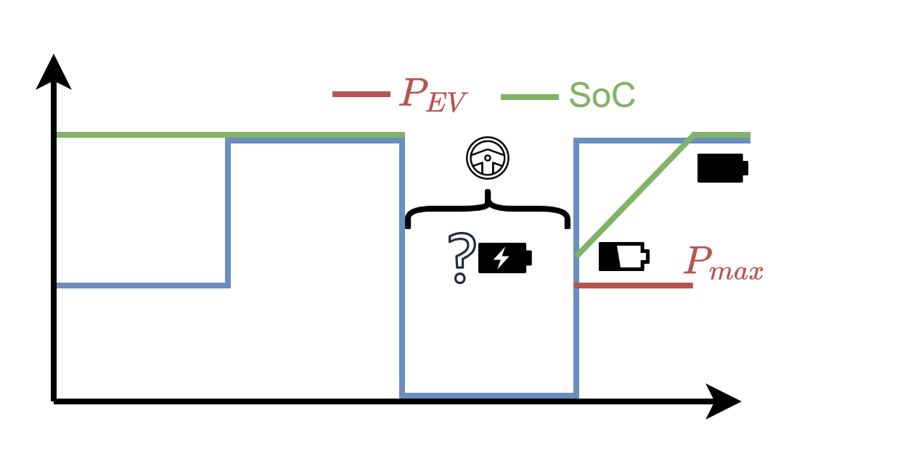
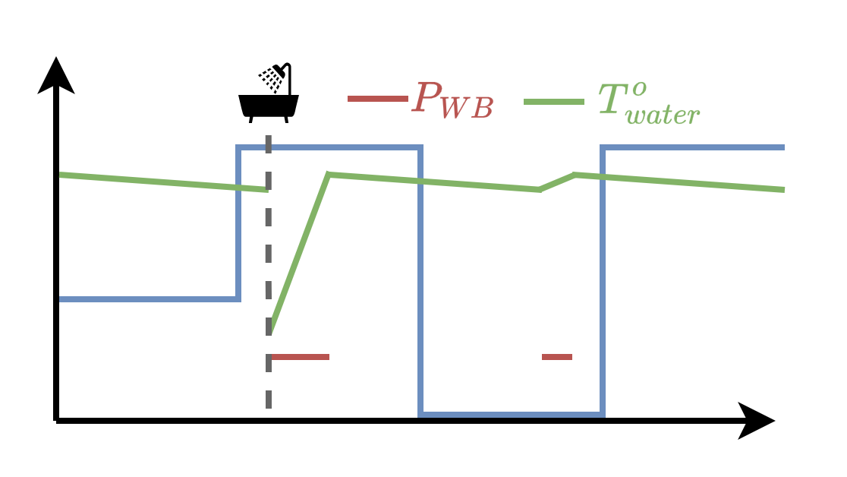
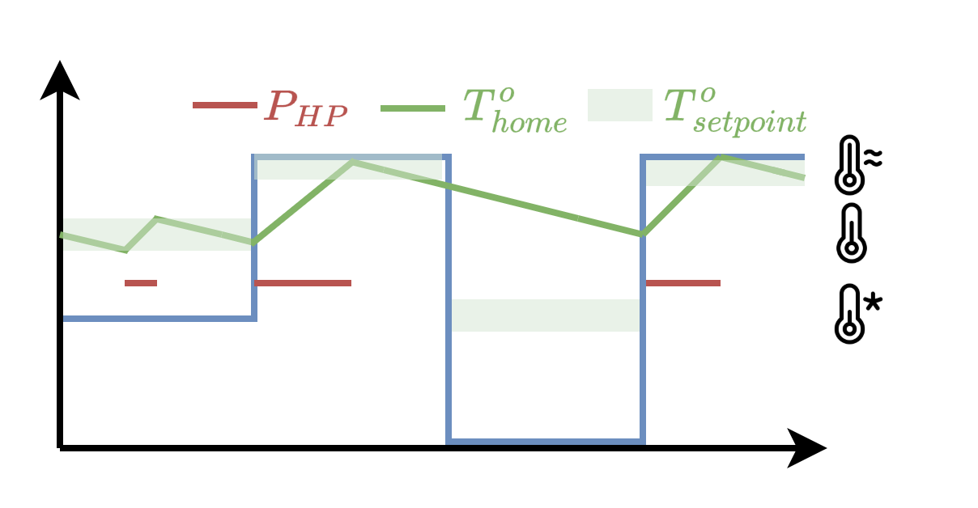
1092 – ResFlex: A residential load profile generator to model individual demand response in distribution grids
Thomas Stegen, Joakim Castiaux, Noé Diffels, Maxime Duchesne, Bertrand Cornélusse Montefiore Institute, University of Liège, Belgium
Goal
Modelling evolving residential load to achieve efficient energy transition and distribution system planning.
Synthetic generator
Due to lack of data, our aim is to get synthetic profiles for known populations from realistic individuals.
Household Occupancy
A family is modelled in the house and individual behavior is defined for the full year using StROBe [1].
Base Load
White Goods
Electric Vehicle
Water Boiler
Space Heating
Stochastic use of plugged-in loads
Launched at specific times
Driving events, energy & charge
Water cons. with thermostat. control
Block model with therm. loss & coef.
Inhabitants number and occupations
Cycles per week Program types
Consumption, Max power, km/year
Inhabitants number Boiler model
House year, volume Heating system
Activated by people in patterns
Activated for a full cycle
Main driver is back with discharged EV
Thermostat with water usage events
Thermostat with three T° setpoints
No flexibility
Flexibility windows
When plugged
Minimum output T°
Thermal comfort
Population modelling
This tool aims to model complete distribution grids. Adapted function and inputs can be used to match known parameters for the population at feeder level.
Evolving scenarios
For long term planning, evolving populations can be created with increasing penetration parameters representing mass electrification.
Conclusions
This tool provides load profiles with a flexibility component that are realistic regarding users’ behavior, assets’ models and populations’ metrics. Results have been validated on Belgian data.
Reference
[1] Baetens, R., Saelens, D.: ‘Modelling uncertainty in district energy simulations by stochastic residential occupant behaviour’, Journal of Building Performance Simulation, 2016
Download the tool https://github.com/Diffels/ResFlex
The project source of the results presented in this paper has received funding from the Belgian Energy Transition Fund (UNLEASH Project)
CIRED 2025 – Paper No: 1092

Slide 7
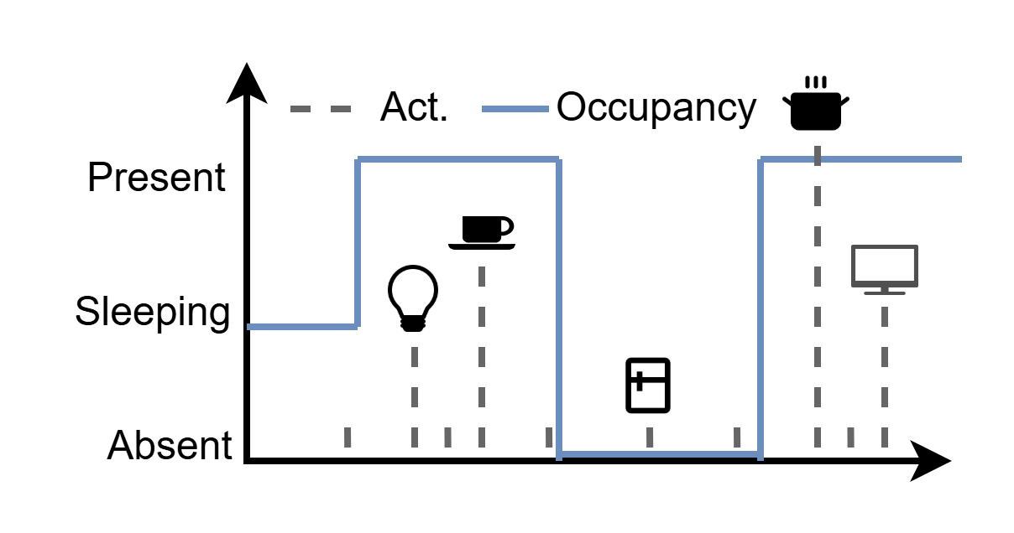
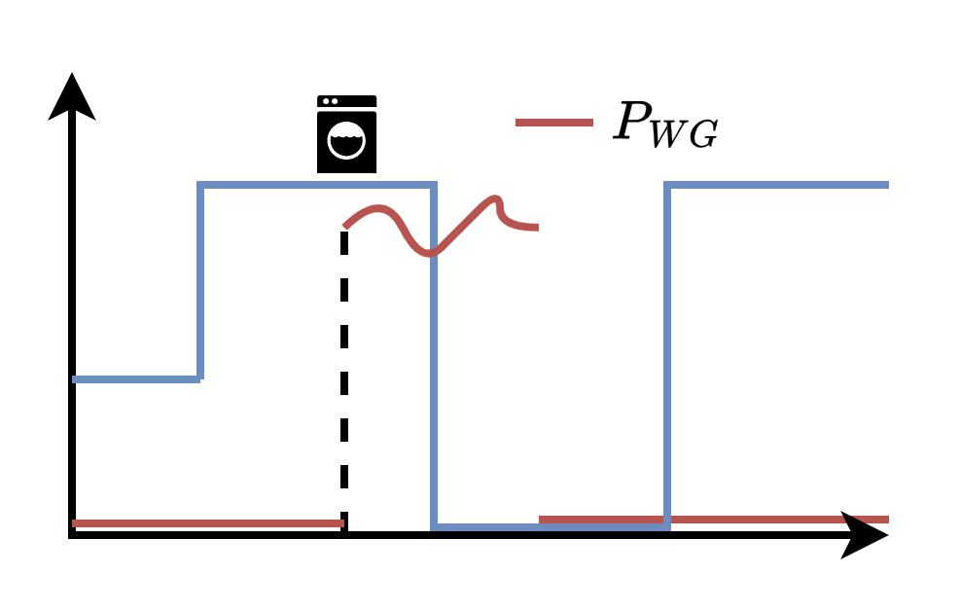
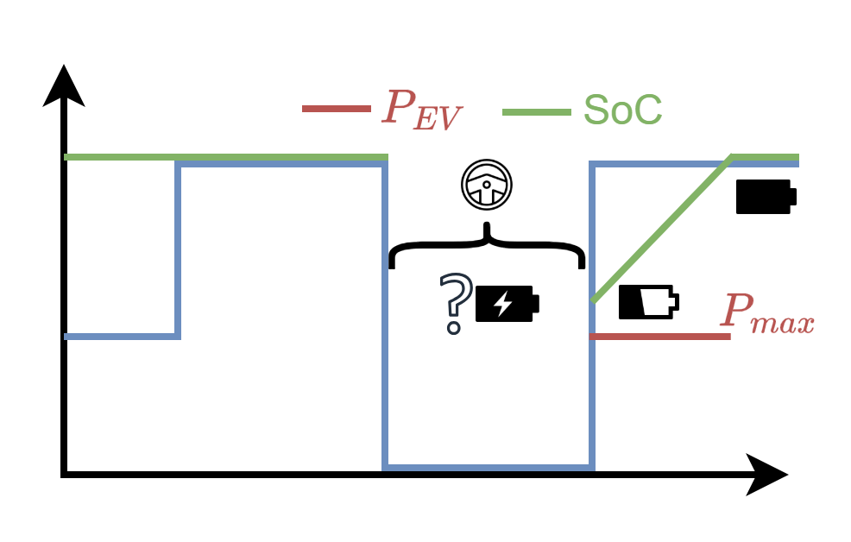
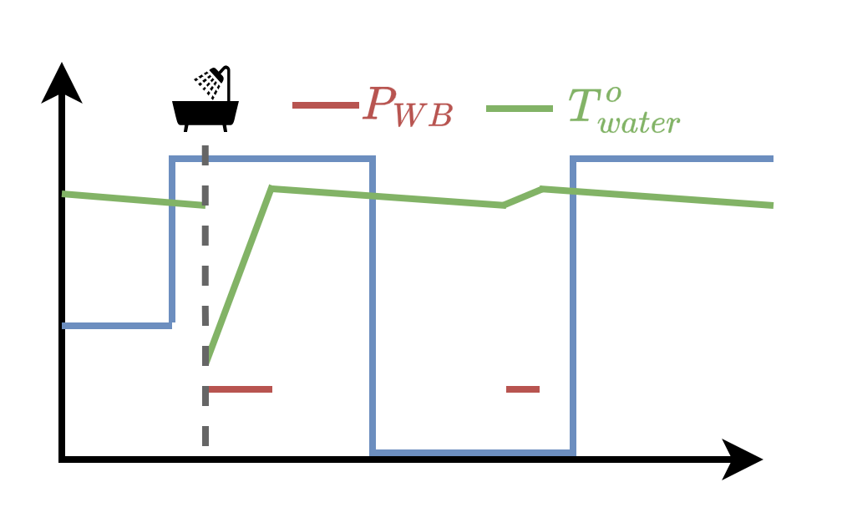
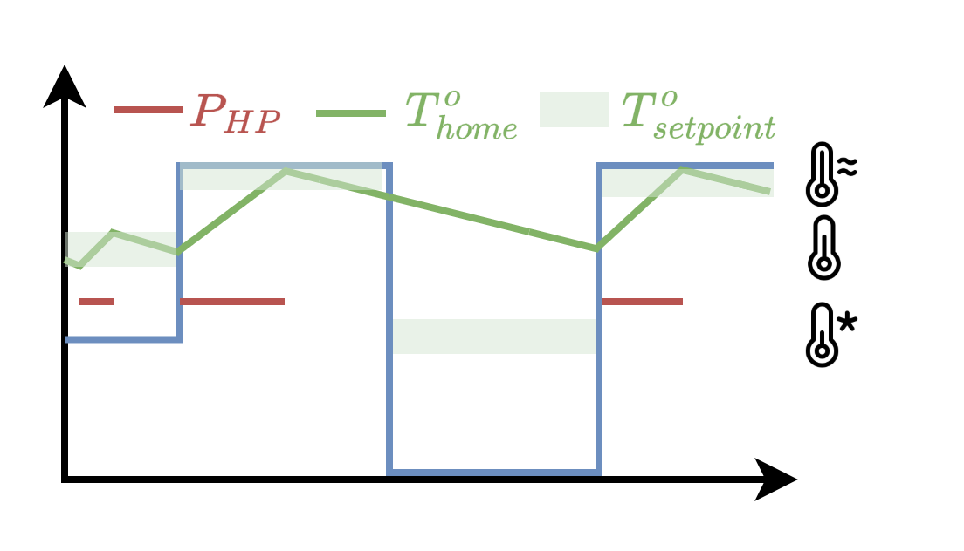
1092 – ResFlex: A residential load profile generator to model individual demand response in distribution grids
Thomas Stegen, Joakim Castiaux, Noé Diffels, Maxime Duchesne, Bertrand Cornélusse Montefiore Institute, University of Liège, Belgium
Goal
Modelling evolving residential load to achieve efficient energy transition and distribution system planning.
Synthetic generator
Due to lack of data, our aim is to get synthetic profiles for known populations from realistic individuals.
Household Occupancy
A family is modelled in the house and individual behavior is defined for the full year using StROBe [1].
Base Load
White Goods
Electric Vehicle
Water Boiler
Space Heating
Stochastic use of plugged-in loads
Launched at specific times
Driving events, energy & charge
Water cons. with thermostat. control
Block model with therm. loss & coef.
Inhabitants number and occupations
Cycles per week Program types
Consumption, Max power, km/year
Inhabitants number Boiler model
House year, volume Heating system
Activated by people in patterns
Activated for a full cycle
Main driver is back with discharged EV
Thermostat with water usage events
Thermostat with three T° setpoints
No flexibility
Flexibility windows
When plugged
Minimum output T°
Thermal comfort
Population modelling
This tool aims to model complete distribution grids. Adapted function and inputs can be used to match known parameters for the population at feeder level.
Evolving scenarios
For long term planning, evolving populations can be created with increasing penetration parameters representing mass electrification.
Conclusions
This tool provides load profiles with a flexibility component that are realistic regarding users’ behavior, assets’ models and populations’ metrics. Results have been validated on Belgian data.
Reference
[1] Baetens, R., Saelens, D.: ‘Modelling uncertainty in district energy simulations by stochastic residential occupant behaviour’, Journal of Building Performance Simulation, 2016
Download the tool https://github.com/Diffels/ResFlex
The project source of the results presented in this paper has received funding from the Belgian Energy Transition Fund (UNLEASH Project)
CIRED 2025 – Paper No: 1092

Slide 8
1092 – ResFlex: A residential load profile generator to model individual demand response in distribution grids
Thomas Stegen, Joakim Castiaux, Noé Diffels, Maxime Duchesne, Bertrand Cornélusse Montefiore Institute, University of Liège, Belgium
Goal
Modelling evolving residential load to achieve efficient energy transition and distribution system planning.
Synthetic generator
Due to lack of data, our aim is to get synthetic profiles for known populations from realistic individuals.
Household Occupancy
A family is modelled in the house and individual behavior is defined for the full year using StROBe [1].
Base Load
White Goods
Electric Vehicle
Water Boiler
Space Heating
Stochastic use of plugged-in loads
Launched at specific times
Driving events, energy & charge
Water cons. with thermostat. control
Block model with therm. loss & coef.
Inhabitants number and occupations
Cycles per week Program types
Consumption, Max power, km/year
Inhabitants number Boiler model
House year, volume Heating system
Activated by people in patterns
Activated for a full cycle
Main driver is back with discharged EV
Thermostat with water usage events
Thermostat with three T° setpoints
No flexibility
Flexibility windows
When plugged
Minimum output T°
Thermal comfort
Population modelling
This tool aims to model complete distribution grids. Adapted function and inputs can be used to match known parameters for the population at feeder level.
Evolving scenarios
For long term planning, evolving populations can be created with increasing penetration parameters representing mass electrification.
Conclusions
This tool provides load profiles with a flexibility component that are realistic regarding users’ behavior, assets’ models and populations’ metrics. Results have been validated on Belgian data.
Reference
[1] Baetens, R., Saelens, D.: ‘Modelling uncertainty in district energy simulations by stochastic residential occupant behaviour’, Journal of Building Performance Simulation, 2016
Download the tool https://github.com/Diffels/ResFlex
The project source of the results presented in this paper has received funding from the Belgian Energy Transition Fund (UNLEASH Project)
CIRED 2025 – Paper No: 1092

Slide 9
1092 – ResFlex: A residential load profile generator to model individual demand response in distribution grids
Thomas Stegen, Joakim Castiaux, Noé Diffels, Maxime Duchesne, Bertrand Cornélusse Montefiore Institute, University of Liège, Belgium
Introduction
Modelling evolving residential load is key to achieve efficient energy transition and distribution system planning
Profile generator
The lack of existing public data pushed us to develop synthetic profiles. Our aim is to model known populations from realistic individuals.
Household Occupancy Profile Generated using StROBe [1]
A family is modelled in the house and individual behavior is defined for the full year (Active-Sleeping-Away).
Description
Parameters
Activation
Flexibility
Base Load
Stochastic use of plugged-in loads
Inhabitants number, types
Activated by people in patterns
No flexibility
White Goods
Launched at specific times
Cycles per week Program types
Activated for a full cycle
Flexibility windows
Water Boiler
Water cons. with thermostat. control
Inhabitants number Boiler model
Hot water usage events
Minimum output T°
Space Heating
Block model with therm. loss & coef.
House year, volume Heating system
Thermostat with three T° setpoints
Thermal comfort
Electric Vehicle
Driving events, energy & charge
Consumption, Max power, km/year
Main driver is back with discharged EV
When the car is plugged
Complete load profile
A).
Generating a population
This tool aims to model complete distribution grids. Adapted function and inputs can be used to match known parameters for the population at feeder level.
Scenario modelling
For long-term planning, evolving populations can be created with increasing penetration parameters representing evolution of the electrification.
Conclusions
This tool provides load profiles with a flexibility component that are realistic regarding users’ behavior, assets’ models and populations’ metrics. Results have been validated on Belgian data.
Reference
[1] Baetens, R., Saelens, D.: ‘Modelling uncertainty in district energy simulations by stochastic residential occupant behaviour’, Journal of Building Performance Simulation, 2016
Download the tool https://github.com/Diffels/ResFlex
CIRED 2025 – Paper No: 1092

