Slide 1
ResFlex: a residential load profile generator to model individual demand response in distribution grids
Smart-Microgrid team meeting
Thomas Stegen

Slide 2
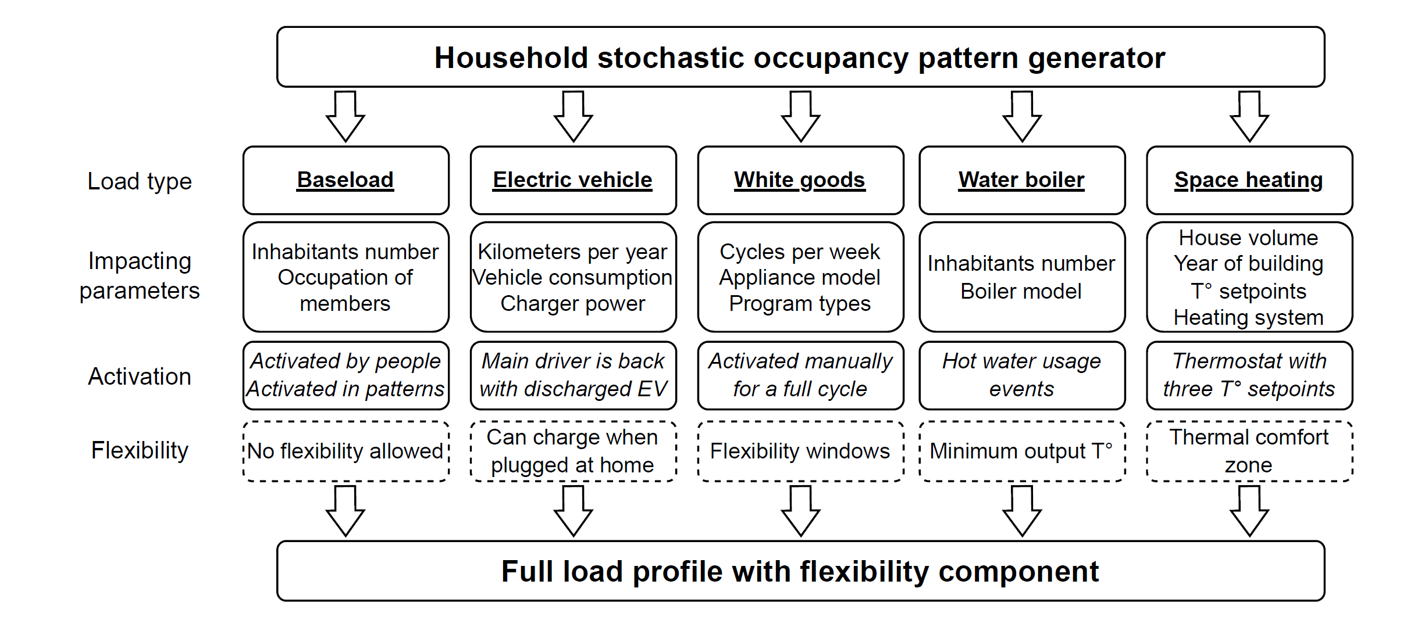
ResFlex architecture

Slide 3
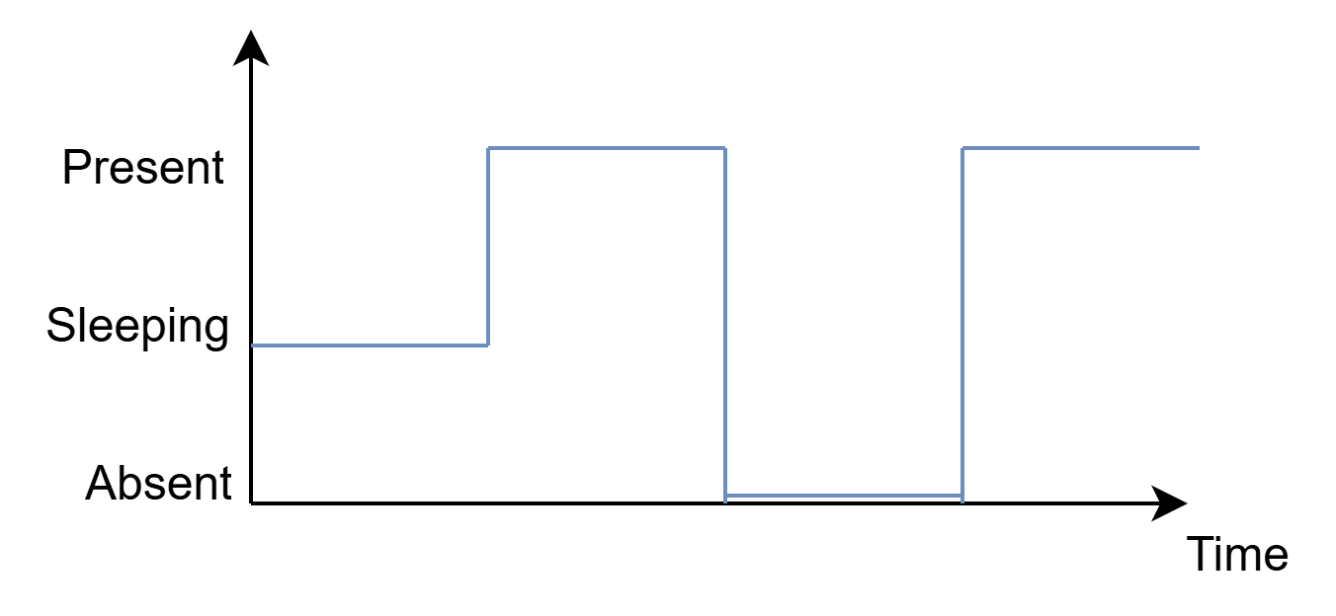
Model of the BaseLoad
Entirely based on the StROBe library [1], modelling households’ member behaviors: occupancy and plugged-in appliance activation
A family composition is converted to an occupancy profile
Stochastic events of appliance utilization are generated and added to the power profile
[1] Baetens, R., Saelens, D.: ‘Modelling uncertainty in district energy simulations by stochastic residential occupant behaviour’, Journal of Building Performance Simulation, 2016, 9, (4), pp. 431–447

Slide 4
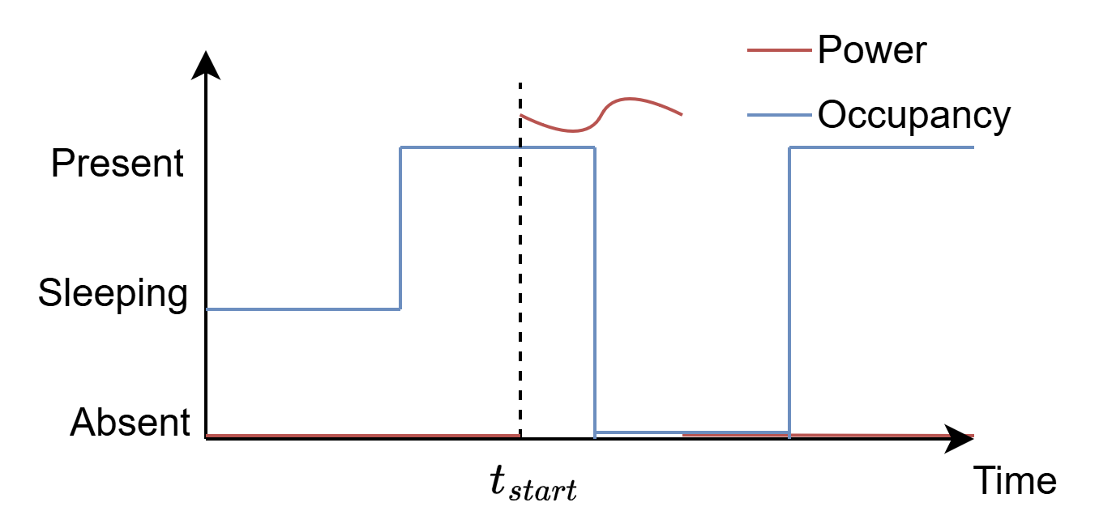
Model of the White Goods
Activation
Output
Program profile
A given number of cycles per week is assigned for each appliance
The appliance can be launched when someone is home
A random program is then assigned to this timestep
Specific column for each appliance
The flexibility component can be:
Max time shift dependent
The number of cycles per week
Defined by occupancy

Slide 5
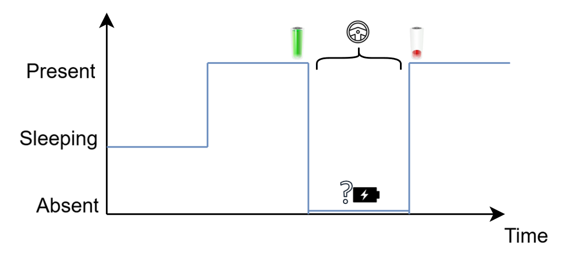
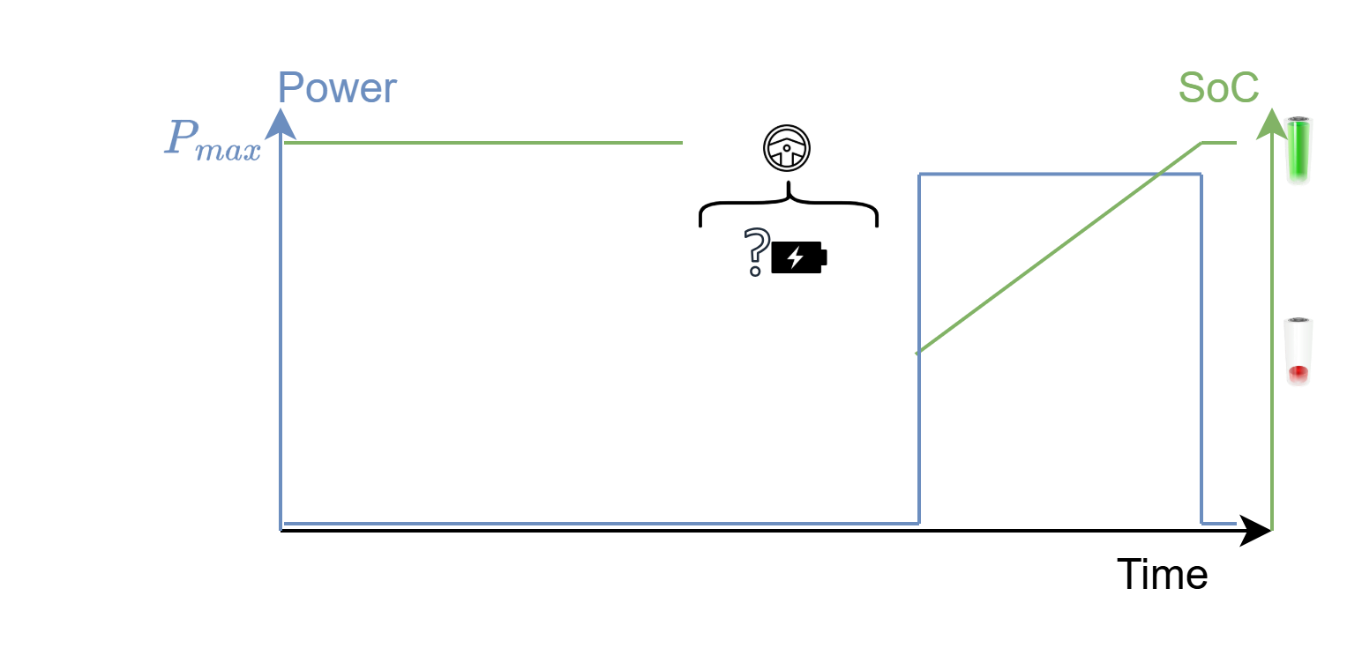
Model of the Electric Vehicle
One member is the driver
Driver leaving the house → EV event
Consumption from the absence duration and input params
Driver comes back with discharged EV that gets recharged

Slide 6
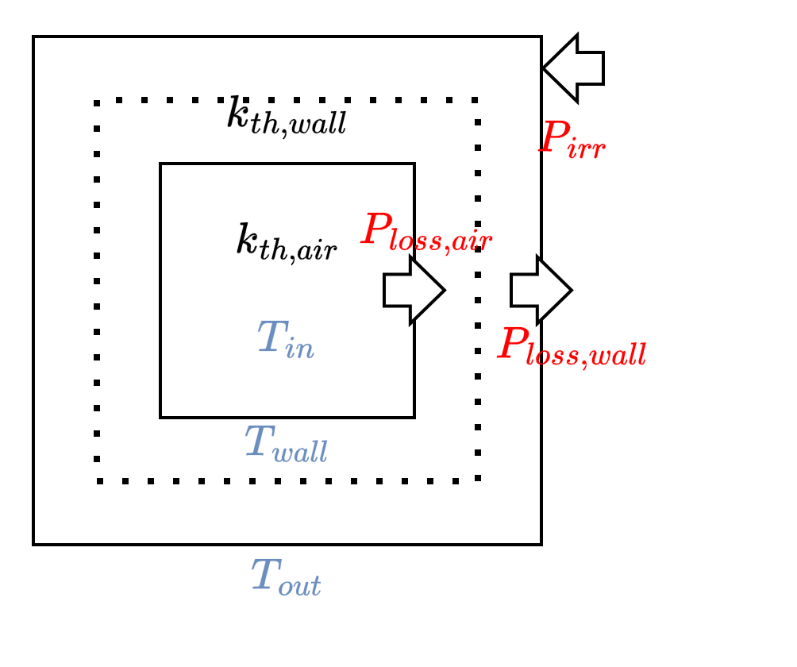
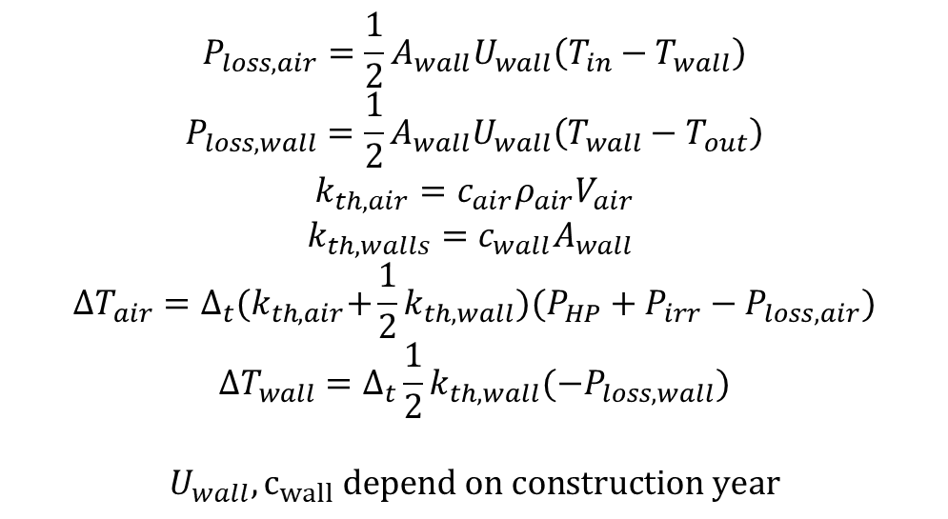
Model of the Heat Pump
$$P_{loss,air}=\frac{1}{2}A_{wall}U_{wall}\left(T_{in}−T_{wall}\right)$$
$$P_{loss,wall}=\frac{1}{2}A_{wall}U_{wall}\left(T_{wall}−T_{out}\right)$$
$$k_{th,air}={c_{air}ρ}_{air}V_{air}$$
$$k_{th,walls}=c_{wall}A_{wall}$$
$$ΔT_{air}=Δ_{t}{(k}_{th,air}+\frac{1}{2}k_{th,wall})(P_{HP}+P_{irr}−P_{loss,air})$$
$$ΔT_{wall}=Δ_{t}\frac{1}{2}k_{th,wall}(−P_{loss,wall})$$
$$U_{wall},c_{wall} depend on construction year$$
The temperature profile is converted to a power profile using a thermostatic controller

Slide 7
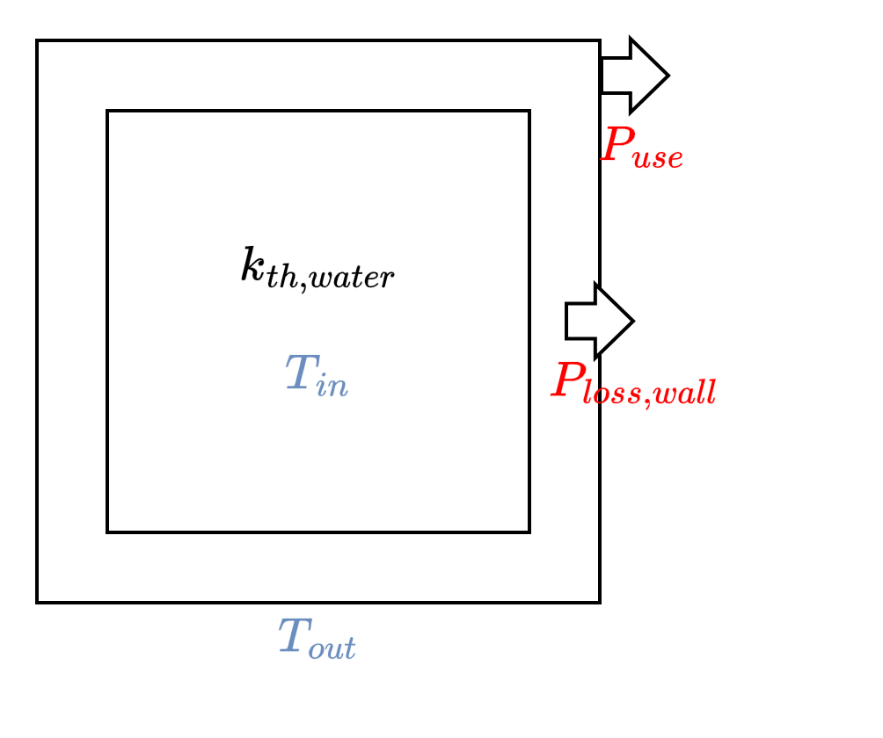
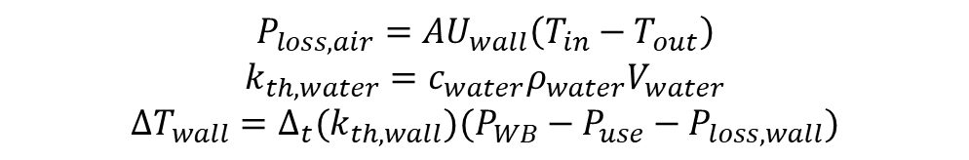
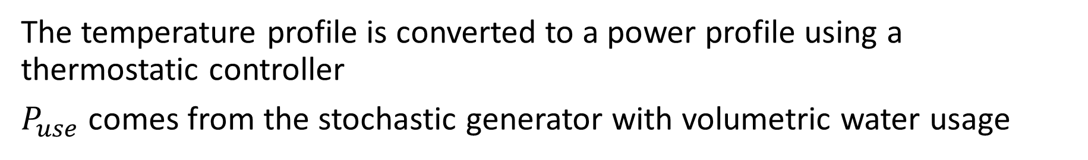
Model of the Water Boiler
$$P_{loss,air}=AU_{wall}\left(T_{in}−T_{out}\right)$$
$$k_{th,water}={c_{water}ρ}_{water}V_{water}$$
$$ΔT_{wall}=Δ_{t}{(k}_{th,wall})(P_{WB}−P_{use}−P_{loss,wall})$$
The temperature profile is converted to a power profile using a thermostatic controller
$P_{use}$ comes from the stochastic generator with volumetric water usage

Slide 8
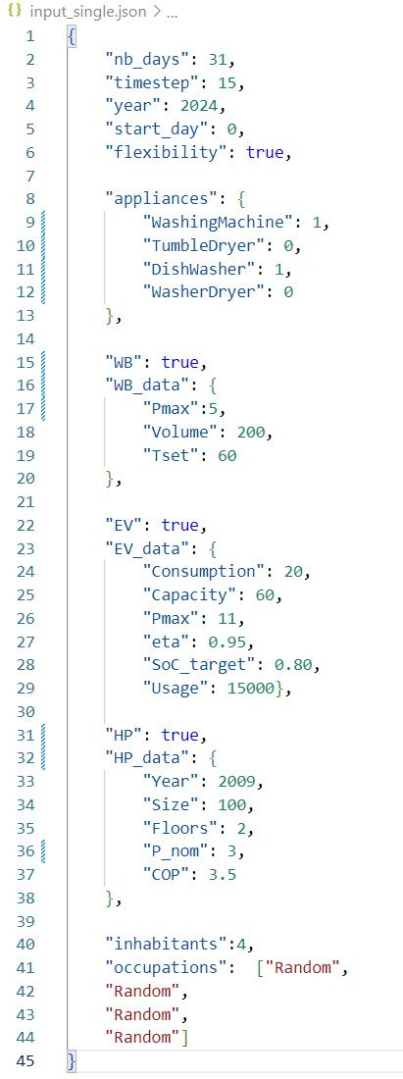
Inputs

Slide 9
Reference power profile | Outputs (1)
One power reference for each appliance and each timestep.
The number of columns depends on the appliances in the house
The number of rows depends on simulation length and timestep
 | BaseLoad | DishWasher | WashMachine | P_EV | P_WB | P_HP
1jan24 00:00 | x | x | x | x | x | x
1jan24 00:01 | x | x | x | x | x | x
1jan24 00:02 | x | x | x | x | x | x

Slide 10
Flexibility profile | Outputs (2)
One power reference for each appliance and each timestep.
The number of columns depends on the appliances in the house
The number of rows depends on simulation length and timestep
 | Occupancy | EV | T_in | T_wall | T_out | P_lossair
1jan24 00:00 | x | x | x | x | x | x
1jan24 00:01 | x | x | x | x | x | x
1jan24 00:02 | x | x | x | x | x | x

Slide 11
Household parameters | Outputs (3)
The third file is a JSON with all the constant parameters of the house:
All the input parameters are copied in this file
Other parameters generated and used during simulation are added
Additional fields can be added for other uses (BSS, PV,…)
Sufficient information to “regenerate” and “modify” the initial profile.

Slide 12
Generating a population
Inputs
Outputs
The JSON config file has the same structure, except:
Boolean values changed to probabilities (penetrations)
Quantitative parameters replaced by lists
Lists of corresponding probabilities provided
Additional “nb_houses” parameter
Each profile is labeled “House{i} ”
The tables are saved in Excel with one sheet per house.
The probabilistic input parameters are converted to individual parameters and saved as a dictionary in JSON.

Slide 13
Recap on last publication
Quantify the flexibility potential for residential load profiles
Define an discomfort metric linked to flexible load displacement
Propose an energy community framework to harness flexibility
Assess stress reduction on the grid and financial savings for members
Model and quantify demand flexibility
for residential loads
Optimize load profile in the community framework
Propose two profit sharing mechanisms
Notes:
Here, we want to model flexibility and
To reach the objective we proposed a three step approach

Slide 14
Previous simulation scenarios
Community Framework
Individual Framework
With Flexibility
Without Flexibility
With Flexibility
Without Flexibility
Problem (1)
Problem (2)
Problem (3)
Problem (4)
(2) - (1) = Additional profits generated by the flexibility,
→ will be shared in settlement
(4) - (2) = Profits generated
by the community framework
→ not part of this work
(4) - (3) = Additional profits generated by the flexibility,
without the community
Those benefits can be compared to quantify how much the REC improves them

Slide 15
Previous conclusions and next steps
Implicit flexibility can provide benefits for all members and the grid
The community framework can increase said benefits
Flexibility activation and remuneration should be well designed
We will develop a more realistic model for prosumers’ reactions:
→ “Explicit Local Flexibility Reward Mechanisms for Renewable Energy Communities” (maybe change title)

Slide 16
Proposed approach
Base case: no community, no flexibility
Individual flexibility: every prosumer uses flexibility for own production
Community fixed: a community framework is added with fix profiles from (2)
Community flex: full bilevel problem
This sequential approach should be more realistic
The final results will be compared to [1]

Slide 17
Optimum for the community (Upper-Level)
Maximize flexibility savings of the full community
Subject to:
Community costs and exchanges
Flexibility activation rules
Remuneration mechanism for flexibility
Optimal members reaction (Lower-Level)

Slide 18
Optimal members reaction (Lower-Level)
Maximize individual savings considering discomfort
Subject to:
Individual costs
Flexible capacity model
Flexible appliances constraints
Discomfort equations

Slide 19
Interactions between the two levels
Upper-Level
Lower-Level
Ensures global optimality
Decides how much flexible capacity is valued
Decides the activation of individual flexibility
Defines individual bills
Ensures individual optimality
Models the reaction of each members to the price signal
Determines flexible capacity depending on discomfort
Final activation should be possible
Prices for capacity
Capacity of users
Activation of users

Slide 20
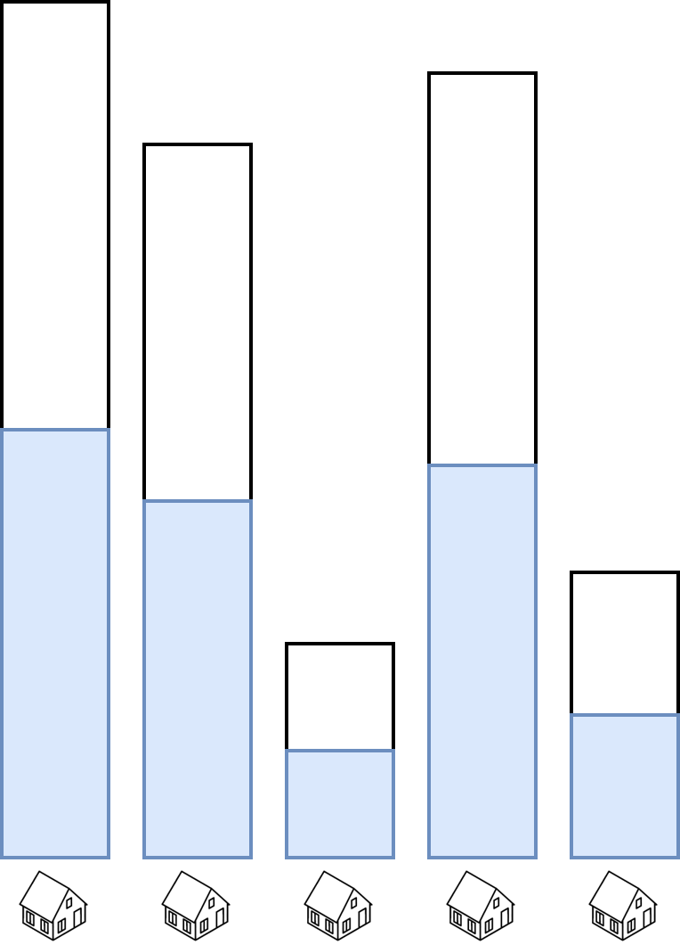
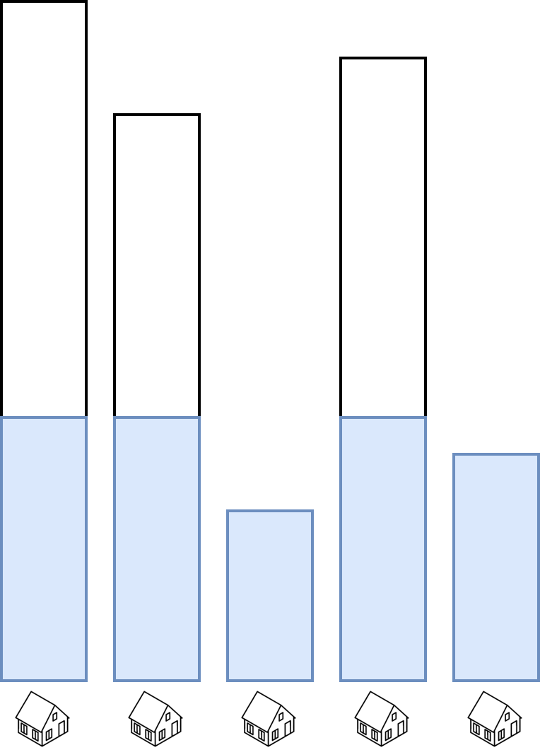

Rules for activation
Equal
Proportional
Cascade
Every activation is identical
This can lead to suboptimalities
Identical ratio of offered capacity
Favors “big” members
Equal sharing multiple times
Favors “small” members
Flexibility offered
Flexibility activation

Slide 21
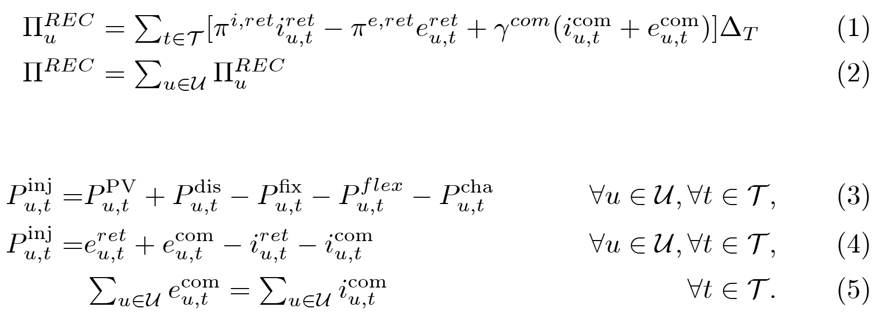
Math 1 | Upper-Level cost & exchanges

Slide 22
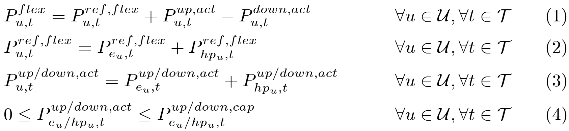
Math 2 | Activation
Activation magnitudes depend on instantaneous need and presented rules

