Slide 1
ResFlex: a residential load profile generator to model individual demand response in distribution grids
Smart-Microgrid team meeting
Thomas Stegen

Slide 2
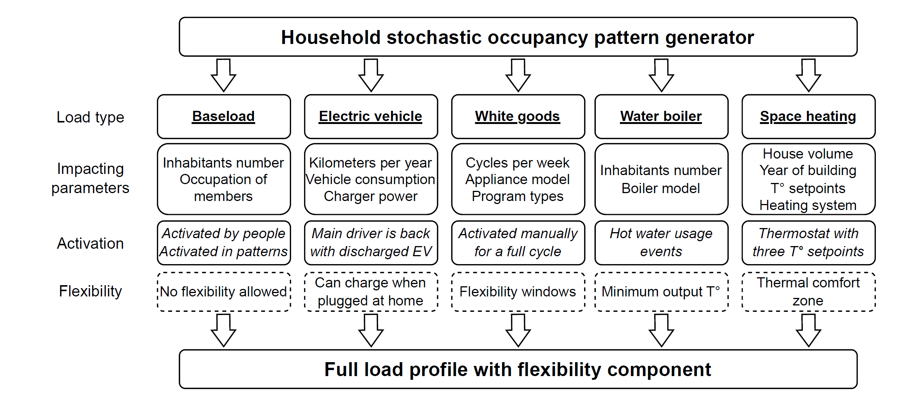
ResFlex architecture

Slide 3
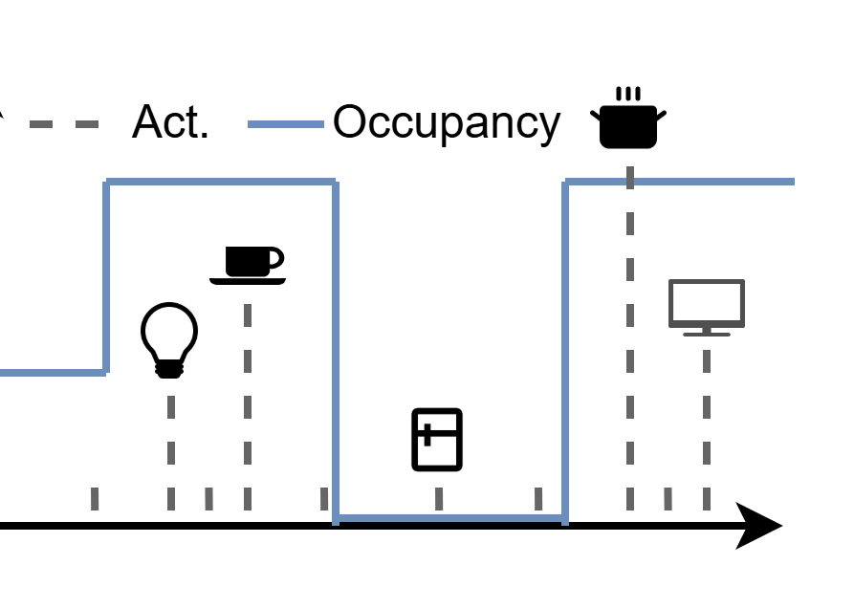
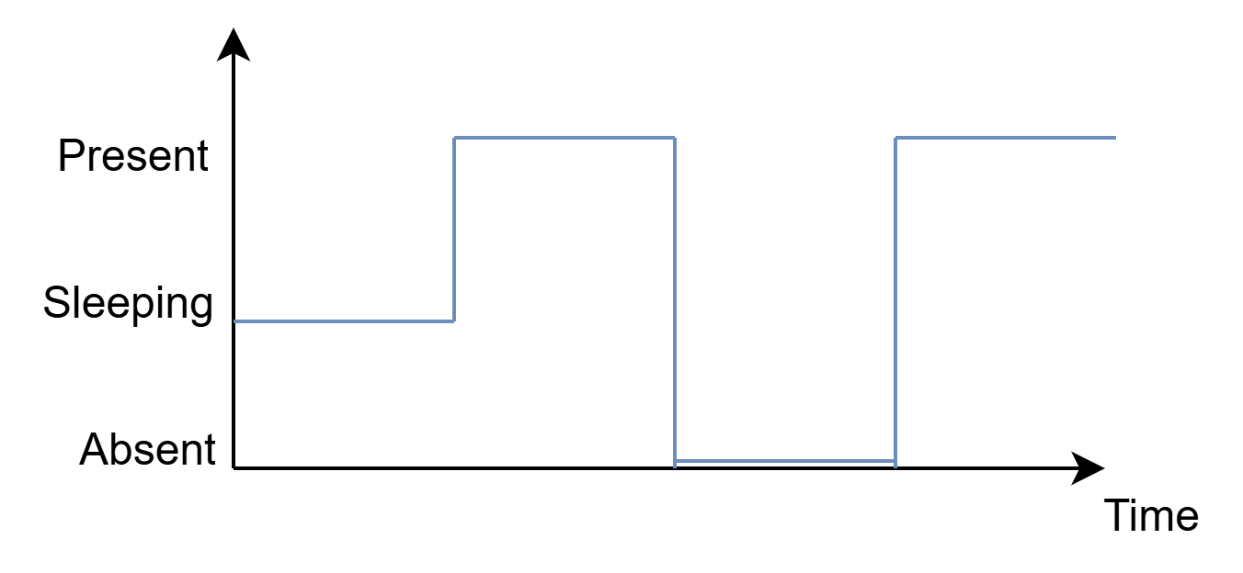
Model of the BaseLoad
Entirely based on the StROBe library [1], modelling households’ member behaviors: occupancy and plugged-in appliance activation
A family composition is converted to an occupancy profile
Stochastic events of appliance utilization are generated and added to the power profile
[1] Baetens, R., Saelens, D.: ‘Modelling uncertainty in district energy simulations by stochastic residential occupant behaviour’, Journal of Building Performance Simulation, 2016, 9, (4), pp. 431–447

Slide 4
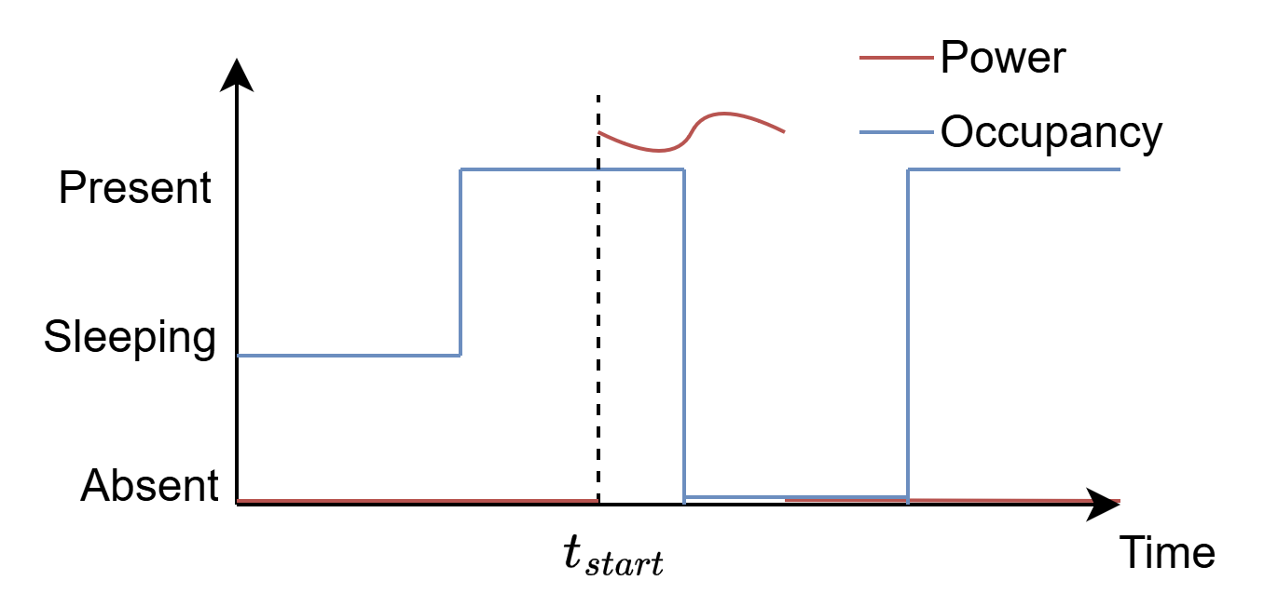
Model of the White Goods
Activation
Output
Program profile
A given number of cycles per week is assigned for each appliance
The appliance can be launched when someone is home
A random program is then assigned to this timestep
Specific column for each appliance
The flexibility component can be:
Max time shift dependent
The number of cycles per week
Defined by occupancy

Slide 5
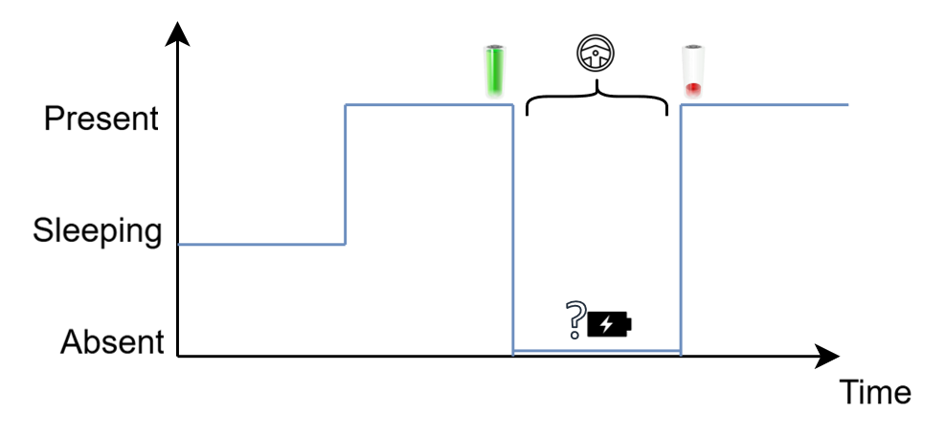
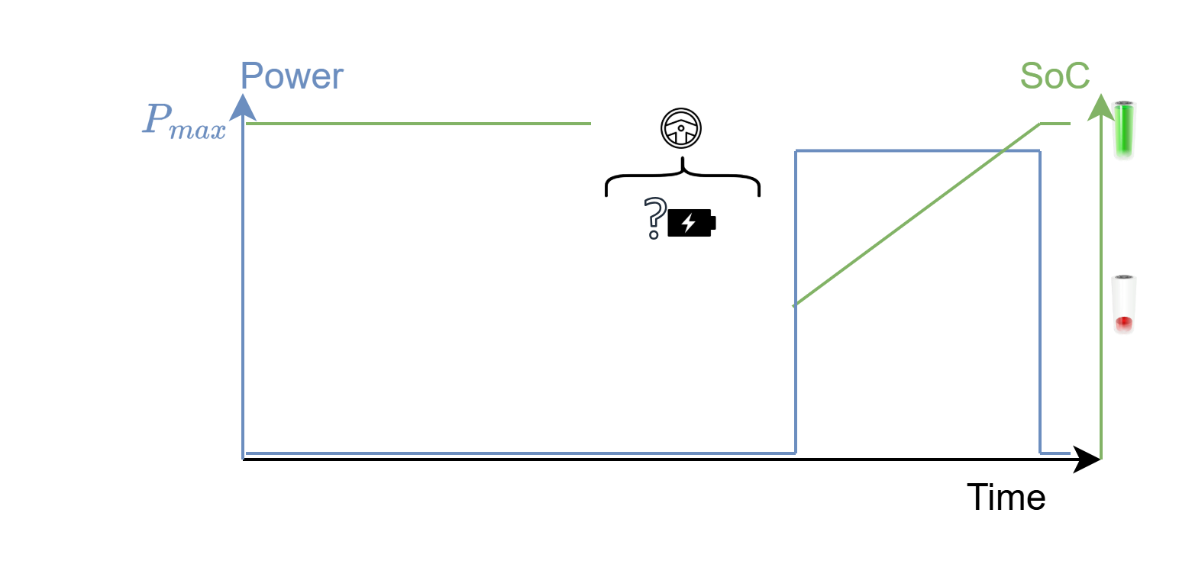
Model of the Electric Vehicle
One member is the driver
Driver leaving the house → EV event
Consumption from the absence duration and input params
Driver comes back with discharged EV that gets recharged

Slide 6
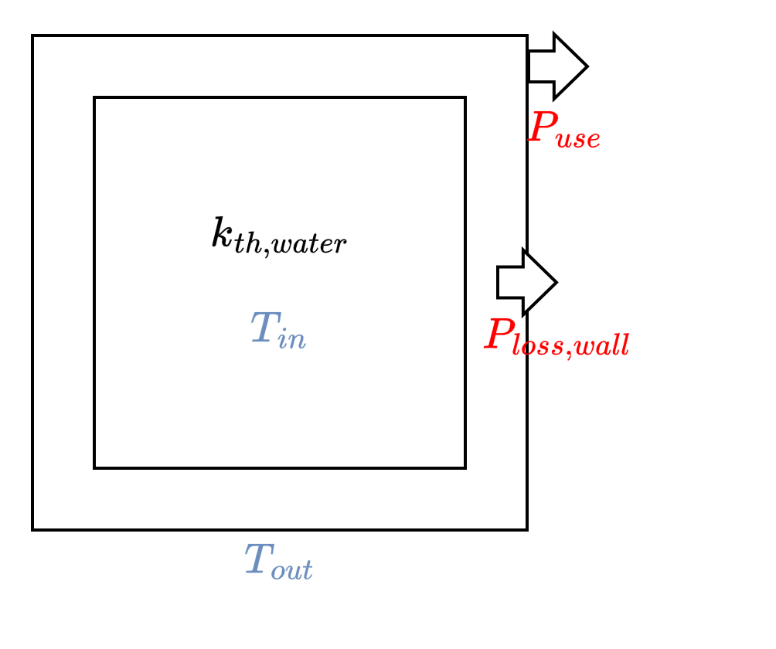
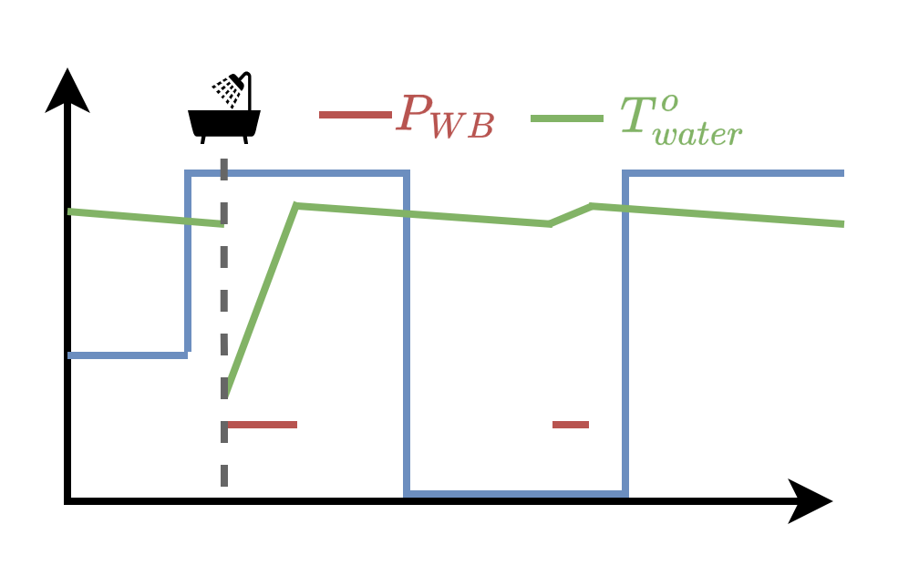
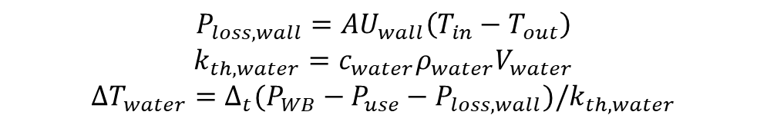
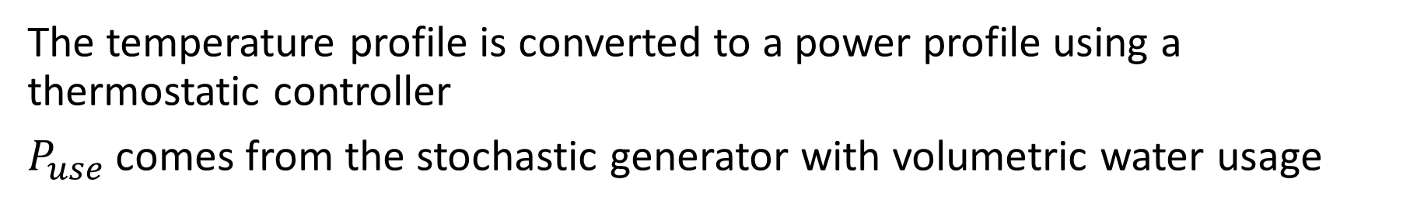
Model of the Water Boiler
$$P_{loss,wall}=AU_{wall}\left(T_{in}−T_{out}\right)$$
$$k_{th,water}={c_{water}ρ}_{water}V_{water}$$
$$ΔT_{water}=Δ_{t}(P_{WB}−P_{use}−P_{loss,wall})/k_{th,water}$$
The temperature profile is converted to a power profile using a thermostatic controller
$P_{use}$ comes from the stochastic generator with volumetric water usage

Slide 7
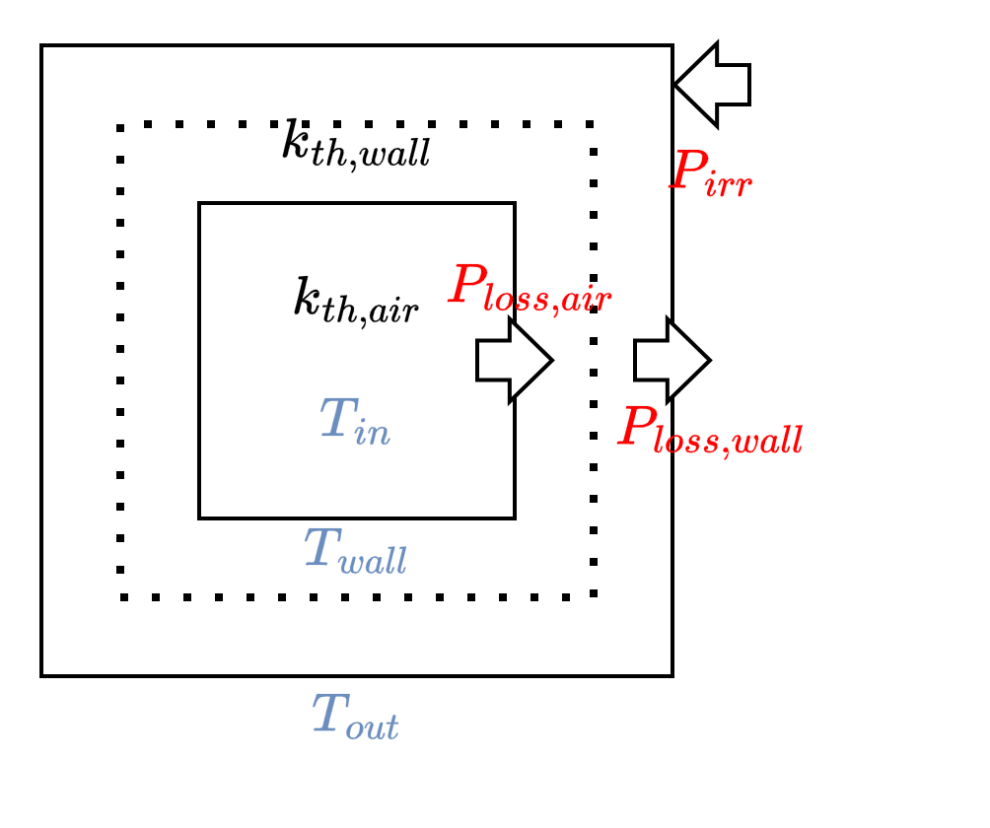
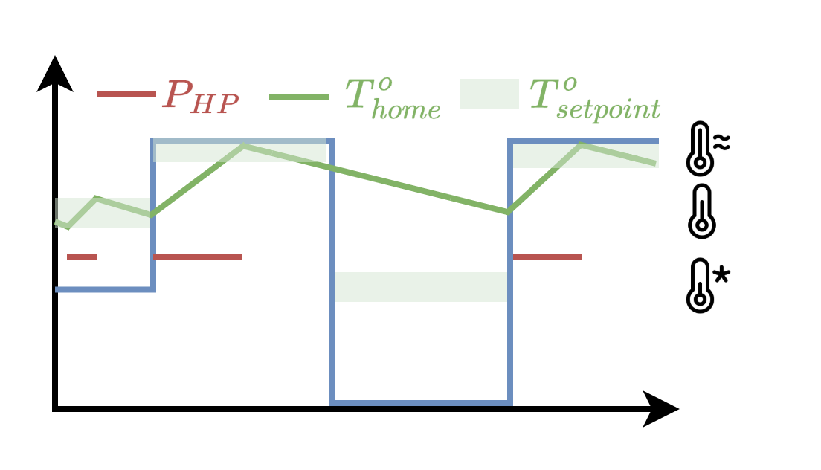

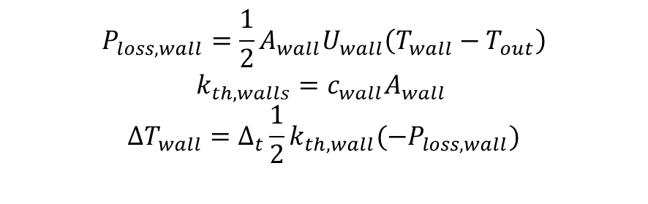
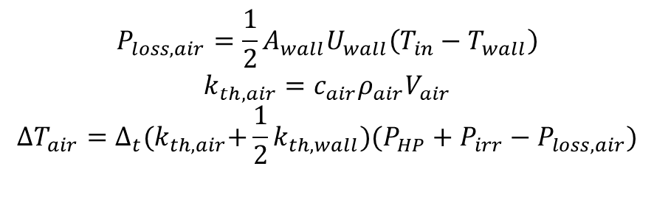
Model of the Heat Pump
$$P_{loss,air}=\frac{1}{2}A_{wall}U_{wall}\left(T_{in}−T_{wall}\right)$$
$$k_{th,air}={c_{air}ρ}_{air}V_{air}$$
$$ΔT_{air}=Δ_{t}{(k}_{th,air}+\frac{1}{2}k_{th,wall})(P_{HP}+P_{irr}−P_{loss,air})$$
$$P_{loss,wall}=\frac{1}{2}A_{wall}U_{wall}\left(T_{wall}−T_{out}\right)$$
$$k_{th,walls}=c_{wall}A_{wall}$$
$$ΔT_{wall}=Δ_{t}\frac{1}{2}k_{th,wall}(−P_{loss,wall})$$
The temperature profile is converted to a power profile using a thermostatic controller, $U_{wall},c_{wall} depend on construction year$

Slide 8
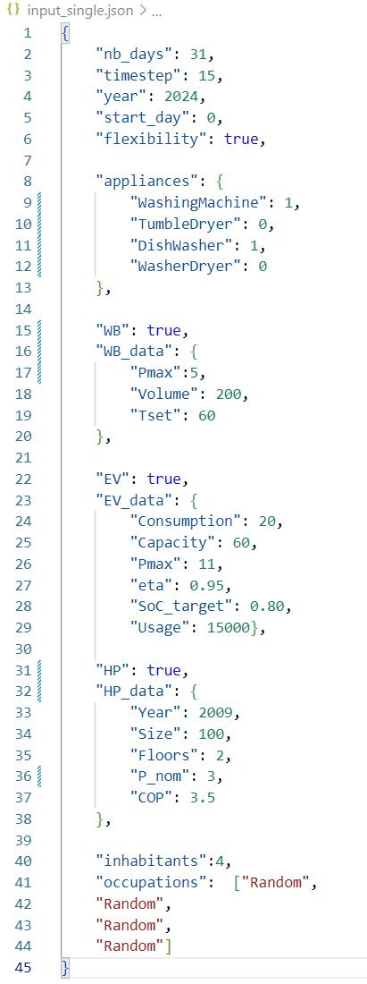
Inputs

Slide 9
Reference power profile | Outputs (1)
One power reference for each appliance and each timestep.
The number of columns depends on the appliances in the house
The number of rows depends on simulation length and timestep
 | BaseLoad | DishWasher | WashMachine | P_EV | P_WB | P_HP
1jan24 00:00 | x | x | x | x | x | x
1jan24 00:01 | x | x | x | x | x | x
1jan24 00:02 | x | x | x | x | x | x

Slide 10
Flexibility profile | Outputs (2)
One power reference for each appliance and each timestep.
The number of columns depends on the appliances in the house
The number of rows depends on simulation length and timestep
 | Occupancy | EV | T_in | T_wall | T_out | P_lossair
1jan24 00:00 | x | x | x | x | x | x
1jan24 00:01 | x | x | x | x | x | x
1jan24 00:02 | x | x | x | x | x | x

Slide 11
Household parameters | Outputs (3)
The third file is a JSON with all the constant parameters of the house:
All the input parameters are copied in this file
Other parameters generated and used during simulation are added
Additional fields can be added for other uses (BSS, PV,…)
Sufficient information to “regenerate” and “modify” the initial profile.

Slide 12
Generating a population
Inputs
Outputs
The JSON config file has the same structure, except:
Boolean values changed to probabilities (penetrations)
Quantitative parameters replaced by lists
Lists of corresponding probabilities provided
Additional “nb_houses” parameter
Each profile is labeled “House{i} ”
The tables are saved in Excel with one sheet per house.
The probabilistic input parameters are converted to individual parameters and saved as a dictionary in JSON.

