Slide 1
HACKOUT 2026
DIGITAL TRANSFORMATION IN LENDING
DhanSathi
A banking assistant that can refuse to sell you something.
AI-powered, hyper-personalised banking for Bharat
160
34
Mumbai
18.03%
automated assertions,
zero API keys needed to run
architecture decisions,
each with its alternatives
live Postgres, region read
off the running connection
the APR hidden behind
a 14.5% headline rate
Notes:
Open with the line, not the stack.
"Every team here built something that decides what to sell a customer. We built something that can decide not to sell. That distinction turns out to change the whole architecture."
Then name the team. Keep this slide under 20 seconds.

Slide 2
01 · THE PROBLEM
Banks already have the data to personalise. The risk is who it gets aimed at.
For customers
For banks
The trap nobody names
Banking apps feel generic and confusing, especially in Tier 2, 3 and 4 towns. First-time digital users drop off mid-journey, and pop-up offers have nothing to do with their actual finances.
Rising customer acquisition costs, high drop-offs in loan and product journeys, and cross-sell that reaches the wrong customer at the wrong moment.
The same transaction data that finds the right moment also finds the most financially fragile customer. Optimise that for conversion and you have built predatory lending at scale.
Most solutions ask: what should we sell this customer?
We ask: should we be selling to them at all, right now?
DhanSathi · Explainable banking for Bharat
02 / 15
Notes:
The first two columns are the brief's own words. The third is our reading of it.
The brief warns against over-recommending loans to financially stressed customers. That warning is the design brief for this product: personalisation is only a benefit if it can decide against selling.
Land the reframing line and move on. About 30 seconds.

Slide 3
02 · OUR APPROACH
The model proposes. The rules dispose.
A trained model may pull a customer into protection. It can never release one the rules have flagged. A wrong model costs the bank a sale; it cannot cost a customer their safeguard.
01
02
03
The LLM narrates. It never decides.
A hard-coded gate can cancel any sale.
Every decision is explainable, contestable, sealed.
Every recommendation, score and gate decision is deterministic TypeScript. The language model only phrases the result, and its output is figure-checked against the facts before anyone sees it.
When signals show financial stress, the wellness gate withholds credit, investment and insurance alike, and substitutes support. No prompt can talk it out of that.
Plain-language reason traces, exact counterfactuals, and a hash-chained audit record for every step a decision takes.
DhanSathi · Explainable banking for Bharat
03 / 15
Notes:
This is the whole thesis on one slide. Everything after it is evidence.
"The model proposes, the rules dispose" answers the question judges always ask about AI in lending: what happens when the model is wrong? Here, a wrong model can only make us more cautious.
Principle one is also our explainability and compliance answer: the thing that decides is code a regulator can read.

Slide 4
03 · ARCHITECTURE (DELIVERABLE)
From data sources to action, with the language model kept out of the decision path.
01
02
03
04
05
06
Data sources
Consent check
Signals engine
Recommender + timing
Distress model
Wellness gate
Transaction ledger and consent ledger in Postgres, Mumbai
Per scope, before any data is read
Salary regularity, savings, EMI misses, volatility, life stage
Rules pick the product, timing picks the moment
Machine learning. May escalate, never clear
Cancels any sale when signals show stress
Personalised output, on any channel
Narration layer
LLM (Gemini) phrases the decision from the reason trace only. Output guardrails check every figure. Grounded templates if the LLM is unavailable.
App dashboard
Chat · Hindi and English
SMS · 160 characters
IVR script
Key Facts Statement
Hash-chained audit ledger every step above is sealed with the SHA-256 of the record before it, persisted in Postgres
DhanSathi · Explainable banking for Bharat
04 / 15
Notes:
This is the architecture deliverable: data sources, AI engine, personalised output.
Walk it left to right in one breath, then point at two things.
First, the white box. The wellness gate sits after the model and before any output. Nothing downstream can override it.
Second, the dashed box. The LLM is not in the decision path at all. It receives a finished decision and only phrases it, and a guardrail checks every number it writes against the facts. If Gemini is down or out of quota, templates take over and the UI says which one spoke.
The bottom band: every step is a sealed, tamper-evident record.

Slide 5
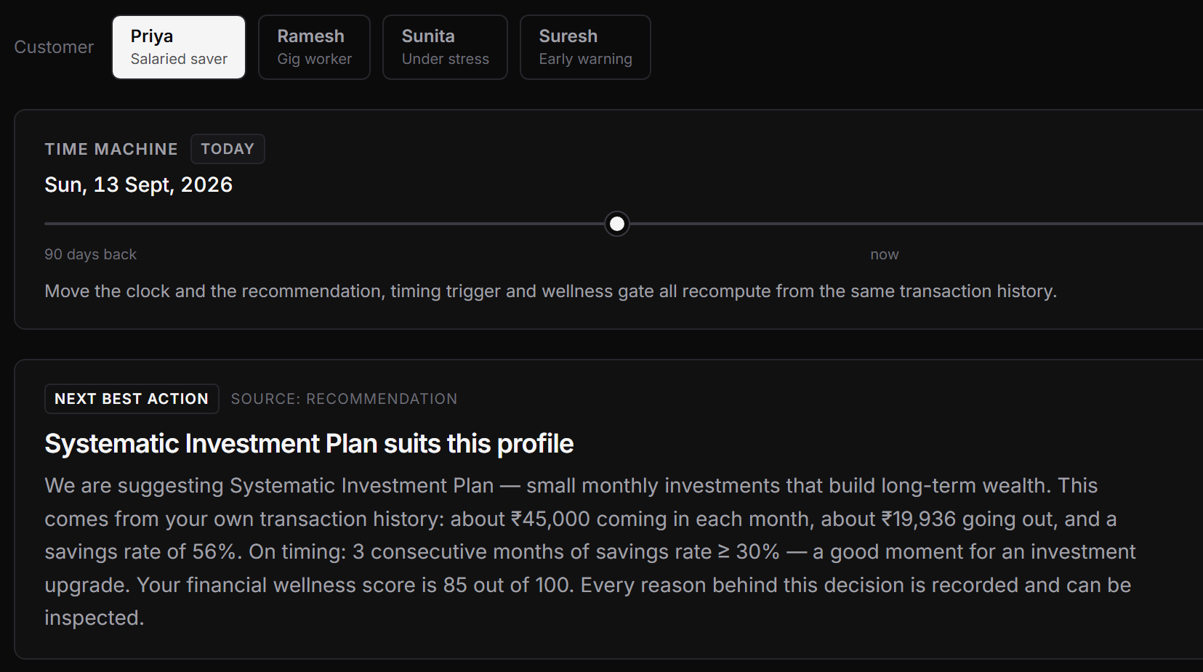
04 · CHALLENGE 1 — THE RIGHT PRODUCT AT THE RIGHT MOMENT
Recommendations built from a customer's own money, timed to their life.
Signals from real transactions
Salary regularity, savings rate, missed EMIs, spend volatility and life-stage tags, all traceable.
A timing engine, not a pop-up
Salary just credited, EMI due soon, festival window, savings momentum, spend shift.
A Time Machine you can drag
Move the clock and every rolling window, due date and gate decision recomputes. The claim is testable in the room.
One next best action
Priority is fixed: protection, then early warning, then timing, then the offer.
Behavioural segments
k-means cohorts: “saves more than 75% of comparable customers”.
Live prototype Priya, salaried saver in a Tier 3 town. Systematic Investment Plan, timed to three months of 30%+ savings.
DhanSathi · Explainable banking for Bharat
05 / 15
Notes:
Challenge 1 asks for the most relevant product at the right moment, not a generic pop-up.
The recommendation comes from the customer's own ledger. The timing engine decides when it is worth saying anything.
The Time Machine is the part to demo: every timing rule takes an injectable clock, so dragging the slider moves the whole pipeline. Everyone will claim contextual timing; this is the version a judge can falsify while you stand there.

Slide 6
05 · CHALLENGE 3 — EARLY WARNING, EMPATHETIC INTERVENTION
Suresh has missed nothing yet. The model flagged him anyway.
Support, not a default flag
Sunita
Suresh
Self-employed · Tier 3 town
Gig worker · Tier 4 town
The intervention is a check-in and EMI relief. Never a penalty, never a quiet credit offer, and never an immediate default flag.
RULES AND MODEL AGREE
MODEL CATCHES WHAT RULES MISS
Missed EMIs, 90 days
2
Missed EMIs, 90 days
0
DhanSathi: इस माह खर्च ज़्यादा दिखा. कोई नया ऑफ़र नहीं. EMI राहत के लिए 1 दबाएँ. मदद: 1800-XXX.
Rules wellness score
50 / 100
Rules wellness score
85 / 100
Model distress risk
63.6%
Model distress risk
15.6%
Natural offer
Withheld
Intervention threshold
10%
Sunita's SMS, 95 of 160 characters, no smartphone needed.
Outcome EMI restructuring, no penalty.
Outcome Vehicle loan held back before anything goes wrong.
Found in the data, not planted. Suresh is one of fifteen seed customers; the escalation fell out of the model.
DhanSathi · Explainable banking for Bharat
06 / 15
Notes:
Challenge 3 asks for early warning of stress and empathetic, non-punitive intervention.
Sunita is the easy case: two missed EMIs, the rules and the model agree, and her natural offer is withheld in favour of EMI restructuring.
Suresh is the case that justifies the machine learning. Zero missed EMIs. The rules score him 85, healthy. The model puts him at 15.6%, above the 10% intervention threshold, because his income regularity and expense ratio look like customers who ran into trouble within 90 days. So we hold the offer back before anything has gone wrong.
If asked whether he was planted: no, he is one of fifteen seed customers.

Slide 7
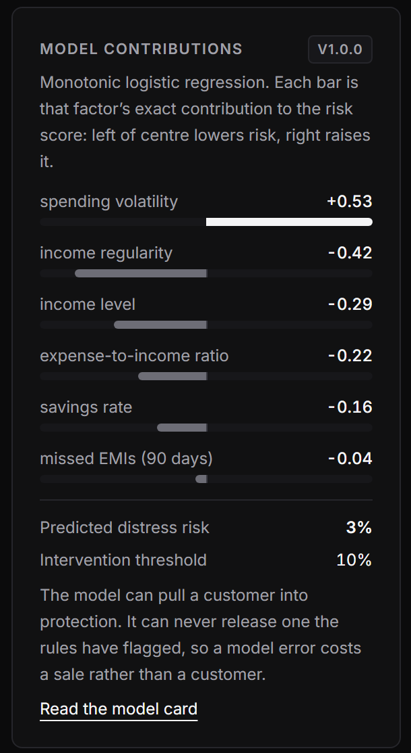
06 · AI / ML APPROACH (DELIVERABLE)
Machine learning where it helps. Arithmetic where it has to be exact.
Distress prediction
Threshold chosen by cost
L2-regularised logistic regression with monotonic sign constraints: more missed EMIs can never lower risk, by construction. Test AUC 0.72 at a 7.1% base rate — honest, not leaked.
A missed warning costs 10× a false alarm. We minimise total cost with at most 20% of customers flagged, which gives a 10% threshold and 39% recall.
Behavioural segmentation
Vernacular NLP
k-means, k = 4, over savings, EMI misses, volatility and income regularity: steady earner 25%, under pressure 19%, disciplined saver 26%, variable income 30%.
LLM narration grounded only in the reason trace and figure-checked by output guardrails. A deterministic topic and injection guard for Hindi, Hinglish and Devanagari.
Exact per-feature contributions. Additive, so it is arithmetic, not SHAP.
Trained offline, shipped as JSON, inferred in TypeScript. No Python or ML runtime in production, so it runs on Vercel's free tier with no cold-start download.
DhanSathi · Explainable banking for Bharat
07 / 15
Notes:
This is the AI/ML deliverable. Four techniques, each with a reason.
Distress prediction: we chose logistic regression over gradient boosting on purpose. Additive models give exact per-feature reasons, and monotonic constraints mean the model cannot learn something indefensible from noise.
AUC 0.72 will get a question. At a 7% base rate that is honest. A model claiming 0.95 on this task is leaking its label. And the threshold is not chosen for accuracy: predicting nobody is at risk is 93% accurate and useless. We priced the errors instead.
The full model card, with calibration and per-cohort performance, is at /model-card.

Slide 8
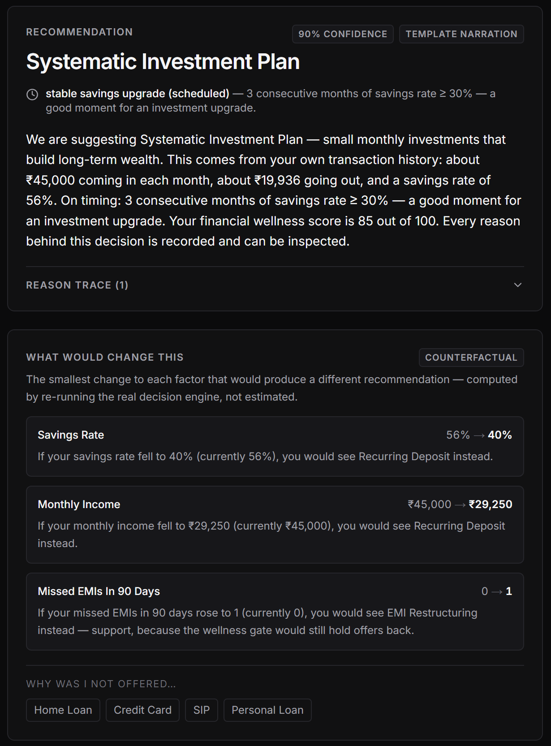
07 · EXPLAINABILITY
Every decision tells the customer what would change it.
Reason traces, shown to the customer
Every threshold that fired, in plain language, on the card — not kept in an internal log.
Exact counterfactuals
Because every decision function is pure, we search the real engine for the smallest change that flips the outcome. True by construction, not estimated.
“If your missed EMIs in 90 days fell to 0 (currently 2), you would see a Systematic Investment Plan instead.”
What Sunita is told
“Why was I not offered…?”
A decision receipt to keep
Ask about any product and get the one change that unlocks it, or an honest “no single change gets you there”.
One download with every fact used, the reasons, what would change it and the audit hashes. Ready for an ombudsman.
DhanSathi · Explainable banking for Bharat
08 / 15
Notes:
Explainability is usually "why this product". The question a declined customer actually asks is "what would I have to do differently".
Counterfactuals are what lending regulators mean by a route to recourse. Because our decision functions are pure, we do not approximate: we re-run the real engine and report the exact minimum change.
Point at Sunita's line: clearing both missed EMIs reopens the offer. One alone is not enough, because the model still sees pressure.

Slide 9
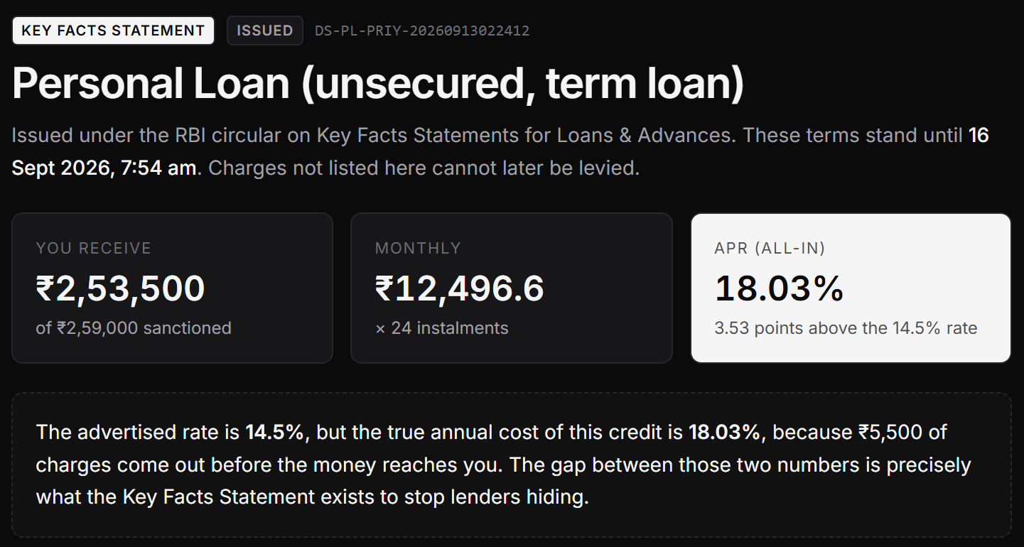
08 · RBI COMPLIANCE READINESS
We built the Key Facts Statement that RBI mandated in 2024.
Advertised rate
Actual annual cost (APR)
14.5%
18.03%
per annum, fixed
3.53 points hidden
₹5,500 of charges come out before the money arrives. She receives ₹2,53,500 of ₹2,59,000 sanctioned. We compute APR by internal rate of return over what she actually receives, and publish both annualisation conventions.
The full statement
Cooling-off exit
Sized to repay
Gate before paperwork
RBI/2024-25/18: Part 1 rows 1–10, Part 2 disclosures, Annex B APR sheet, amortisation schedule.
3 days. Exiting on day one costs ₹127.94 of proportionate APR. Zero penalty, fees refunded.
Instalment capped at half the observed surplus and 40% of income: ₹12,532 maximum.
A customer under stress cannot reach a loan document. Enforced on the server, not by hiding a button.
DhanSathi · Explainable banking for Bharat
09 / 15
Notes:
RBI's circular on Key Facts Statements for Loans and Advances made this mandatory for retail and MSME term loans from 1 October 2024. Almost no one implements it.
The headline comparison is the point of the regulation: a 14.5% rate is really an 18.03% annual cost once ₹5,500 of upfront charges are taken out of what she receives.
Two decisions are ours rather than the regulator's. The loan is sized by affordability, not product ceiling. And we deliberately do not price on the distress model: charging the most fragile customer the highest rate is legal, common, and exactly what this product exists to resist.
Cooling-off follows the Digital Lending Guidelines: principal plus proportionate APR, no penalty.

Slide 10
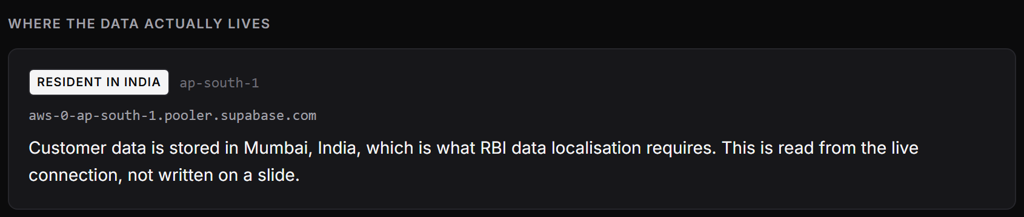
09 · ETHICAL SAFEGUARDS — PRIVACY AND CONSENT (DELIVERABLE)
Withholding data costs protection. We tell customers that in plain words.
The trade-off nobody else shows
DPDP-style consent
Append-only consent ledger
Three separate scopes, each stating its purpose and what is lost without it. Withdrawing is one tap.
Every grant and withdrawal is a timestamped row with its purpose, so “what had they consented to when we decided?” has an answer.
Switch off spend categories for Sunita and her two missed EMIs become invisible — we cannot tell an EMI from a grocery bill. The wellness gate cannot fire, confidence drops, and the card says why. The same data that lets a bank sell to you is what lets it notice you are in trouble.
Tamper-evident audit
Localisation, verified live
Each record carries the SHA-256 of the one before. Our tests alter a stored row and verification fails.
Postgres in Mumbai, ap-south-1. The compliance page reads the region off the running connection.
No raw transactions reach the LLM. It only ever sees derived reasons.
PII screened on the way out. Aadhaar, PAN and phone patterns are blocked before a reply is shown.
DhanSathi · Explainable banking for Bharat
10 / 15
Notes:
This slide covers the DPDP and data localisation half of the ethical safeguards deliverable.
The trade-off is the strongest thirty seconds in the live demo. Consent is per scope and every scope removes real capability. Switching off spend categories makes Sunita's missed EMIs invisible, so the gate cannot protect her. We do not hide that; the card explains it.
Localisation is not a claim on a slide. The compliance page reads the database region off the live connection. If the project were in Singapore it would say so.

Slide 11
10 · ETHICAL SAFEGUARDS — BIAS AND PREDATORY NUDGING (DELIVERABLE)
We ran the fairness audit, and published the result that fails.
Four-fifths rule, 6,000 customers through the full pipeline: signals, recommendation, model and wellness gate.
1,052
ATTRIBUTE
IMPACT RATIO
RESULT
Gender
0.98
offers deliberately withheld from under-pressure customers — 17.5% of the modelled base
PASS
City tier
0.92
PASS
Income type
0.65
Protected attributes are never model features; they exist only to measure outcomes.
FLAGGED
Monotonic constraints hold for every subgroup: more missed EMIs raises risk for everyone.
Why income type fails, and why we show it. The gate withholds offers from gig workers far more often: 37% versus 2.5% for salaried customers. The gap is in offers withheld, not support denied, and it falls on the people most harmed by badly timed credit. We would rather defend that number than hide it.
No risk-based pricing on the distress model.
Every outcome is contestable through its counterfactual.
DhanSathi · Explainable banking for Bharat
11 / 15
Notes:
The brief names algorithmic bias and predatory nudging. Most answers are a bullet point.
We put six thousand modelled customers through the real pipeline and applied the four-fifths rule used in fair-lending enforcement. Gender passes at 0.98. City tier passes at 0.92. Income type fails at 0.65.
Pause there. Then explain: the gate holds offers back from gig workers far more often, because their cash flow is more volatile. That is the gate doing its job, and it is still a disparity a bank must be able to see and defend. A product that hid this number would be less trustworthy.
1,052 is the predatory-nudging answer: the number of offers we chose not to make.

Slide 12
11 · USABILITY FOR VERNACULAR-FIRST USERS
Built for a feature phone as much as a smartphone.
Chat and voice
SMS
IVR, on a missed call
Hindi, Hinglish and Devanagari are first-class. Speak instead of typing. Answers use the customer's own numbers in everyday words.
Every persona's decision fits one 160-character message in both languages. Asserted in the test suite, not hoped for.
No smartphone and no data connection. The bank calls back and reads the same decision aloud.
who won the cricket match
DhanSathi: बचत दर 56%. आपके लिए SIP सही रहेगा. जानकारी हेतु 1 दबाएँ. रोकने हेतु STOP.
1
Namaste, this is a call from DhanSathi.
2
Based on your account, Systematic Investment Plan suits you.
I can only help with banking and your personal finances, so I can't answer questions about sports. Try asking me: “why was this product recommended?”
3
Your savings rate is 56 percent.
Priya's decision, as an SMS
4
Press 1 to hear the reasons. Press 2 to speak to a representative.
Also high-contrast neutral interface in light and dark · consent written as a purpose, not legalese · refusals explain themselves and suggest what to ask instead
DhanSathi · Explainable banking for Bharat
12 / 15
Notes:
Usability for non-tech-savvy, vernacular-first users.
The decision layer does not care what channel it lands on. The same deterministic decision renders as a chat answer, a 160-character Hindi SMS, and an IVR script for a feature phone on 2G.
The chat guard runs before any model call. Off-topic questions are refused, the refusal names the topic, and it suggests three banking questions instead. Ask about the weather and you get a different answer, not the previous one recycled.
Be honest if asked about onboarding and KYC: the guided form journey is on the roadmap slide.

Slide 13
12 · TECHNICAL FEASIBILITY AND SCALABILITY
Built to survive a live demo, and a real bank's infrastructure.
160
34
0
12
automated assertions across 7 suites, including 26 against the live database
architecture decisions recorded, each with alternatives and consequences
API keys or databases required to run the full product
API routes behind one async boundary; every decision is a pure function
Scales with the bank
Fails safely
One async boundary. Data loads once; every decision after that is a pure, stateless function that scales horizontally.
LLM down or out of quota. Grounded templates take over, and the UI labels which one spoke.
Dataset-agnostic. Swap one loader to train on a real ledger. Nothing downstream changes.
Database unreachable. Bundled seed after a hard timeout. Never a hung screen or a 500.
Channel-agnostic. App, chat, SMS, IVR and Key Facts Statement from a single decision.
Retries cannot fork the ledger. Audit writes are idempotent on the record hash.
No ML runtime. Weights are JSON; inference is a dot product in TypeScript.
Stack. Next.js 16, TypeScript, PostgreSQL on Supabase in Mumbai, Gemini, Vercel.
DhanSathi · Explainable banking for Bharat
13 / 15
Notes:
Innovation and technical feasibility, and scalability across existing infrastructure.
Feasibility: 160 automated assertions, including 26 integration checks against the live Mumbai database. The product runs end to end with no API key and no database at all, which is also why the demo cannot die on quota.
Scalability: the one-async-boundary design is the key idea. Data loads once, and every decision after it is a pure function. That is what lets the counterfactual engine re-run the decision hundreds of times per request, and what makes the service stateless.
Every architectural choice is written up in ADR.md with the alternatives we rejected.

Slide 14
13 · LIVE DEMO
Four customers, four different decisions, one pipeline.
Priya
Ramesh
Sunita
Suresh
Salaried saver · Tier 3
Gig worker · Tier 2
Two missed EMIs · Tier 3
Zero missed EMIs · Tier 4
Systematic Investment Plan
Vehicle Loan
Offer withheld → EMI restructuring
Offer withheld → support
WATCH FOR
WATCH FOR
WATCH FOR
WATCH FOR
Timing and counterfactuals, then her Key Facts Statement and a one-tap cooling-off exit.
Irregular income sized to his earnings, not penalised for being irregular.
The wellness gate, and what switching off one consent scope costs her.
The model catching what the rules cleared, before anything goes wrong.
ALSO IN THE WALKTHROUGH
Time Machine
Off-topic chat refusal
Hash-chained audit ledger
Decision receipt
/fairness
/model-card
/compliance
DhanSathi · Explainable banking for Bharat
14 / 15
Notes:
Switch to the live app here. DEMO.md has the timed script.
Before presenting: run npm run db:reset so the audit ledger starts at 1, have /fairness open in a second tab, and match the theme to the room.
Order that works: Priya with the Time Machine, Sunita and the gate, Suresh and the model, Priya's Key Facts Statement, Sunita with spend categories switched off, one off-topic chat question, then close on /fairness.

Slide 15
14 · WHAT COMES NEXT
What we would build next
A product that can say no is a product you can trust with a yes.
01
Fraud and anomaly detection
Unusual-pattern rules plus an outlier score. The intervention is a one-tap “was this you?”, never an account freeze.
02
Guided onboarding, loan and KYC journey
Step persistence, stall detection, resume on another channel, and drop-off analytics for the bank.
03
Model governance
Drift monitoring and scheduled revalidation, trained on a real labelled ledger.
DhanSathi
Explainable, consent-first banking for Bharat. Every number in this deck comes from the running product.
04
Production hardening
Authentication, real account linkage, and write-once storage for the audit chain.
DhanSathi · Explainable banking for Bharat
15 / 15
Notes:
Name what is not built before a judge does. It reads as judgement, not weakness.
Fraud is named in Challenge 3 and is our first priority. The guided onboarding and KYC journey is the fuller answer to Challenge 2.
Then close on the line, and stop talking.
"A product that can say no is a product you can trust with a yes."

