Slide 1

Automating Interface Control in Extractor/Stripper in Solvent Extraction
Government of India
Waste Management Division (WMD)
Waste Immobilization Plant (WIP)
Trombay, Mumbai - 400085
Project By:
Yash Manohar Agarwal – BITS Pilani
Diganta Das – NIT Agartala
Guided By:
Smt. Jyoti Diwan
Shri. Satheesh Kumar Pillai

Slide 2



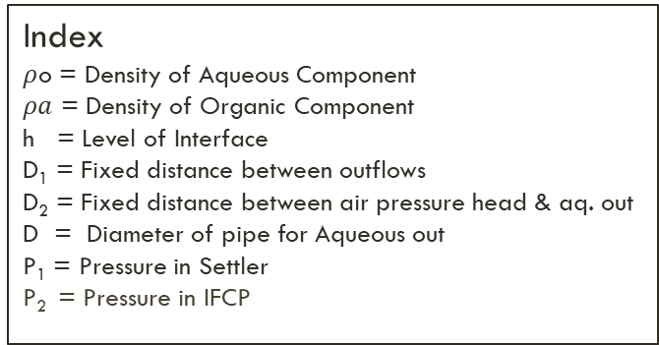

System Description
Index
$ρ$o = Density of Aqueous Component
$ρa$ = Density of Organic Component
h = Level of Interface
D₁ = Fixed distance between outflows
D₂ = Fixed distance between air pressure head & aq. out
D = Diameter of pipe for Aqueous out
P₁ = Pressure in Settler
P₂ = Pressure in IFCP
Fine PRV
Aqueous In
Organic In
p₁
Organic Out
Organic ($ρ$o)
D₁
Interface
p₂
h
Aqeouas ($ρa$)
D₂
D
Aqueous Out
HOT CELL
IFCP
SETTLER

Slide 3



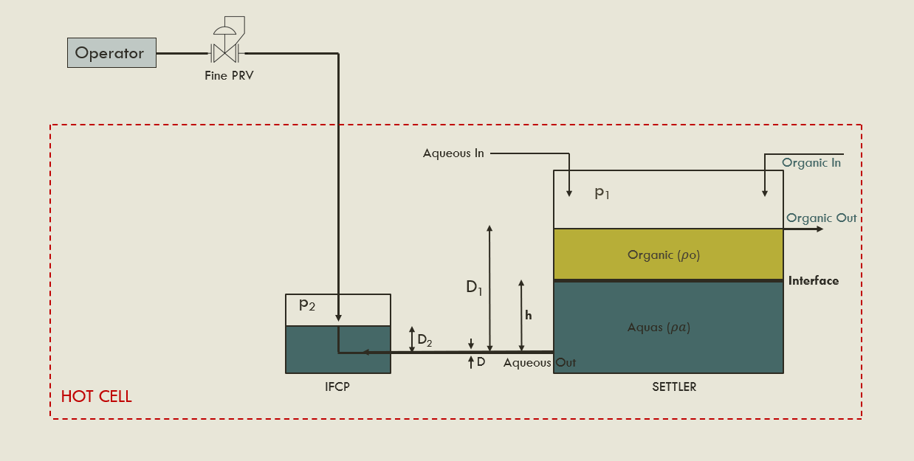


Currently Used Method
Manual change
P₁ , P₂ , $ρ$o , $ρa$ , h
Control Room
(Monitors the parameters and communicates the changes to be made)

Slide 4
We felt the need for a control system, which would work without an on-site operator.
We used an electronic air pressure controller. Next, we show the entire designing.

Slide 5
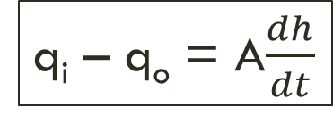
Proposed Method - Mathematical Approach
Underlying principles:
We manipulate ‘h’ through ‘q_{o}’ by manipulating ‘P₂’
Poiseuille’s
Bernoulli’s
Governing Equation:
1. Poiseuille’s Equation
2. Bernoulli’s Equation
q_{i} – q_{o} = A$\frac{dh}{dt}$
Advantages
Disadvantages
Advantages
Disadvantages
Linearized Bernoulli’s Equation using Taylor’s Series Expansion!!

Slide 6
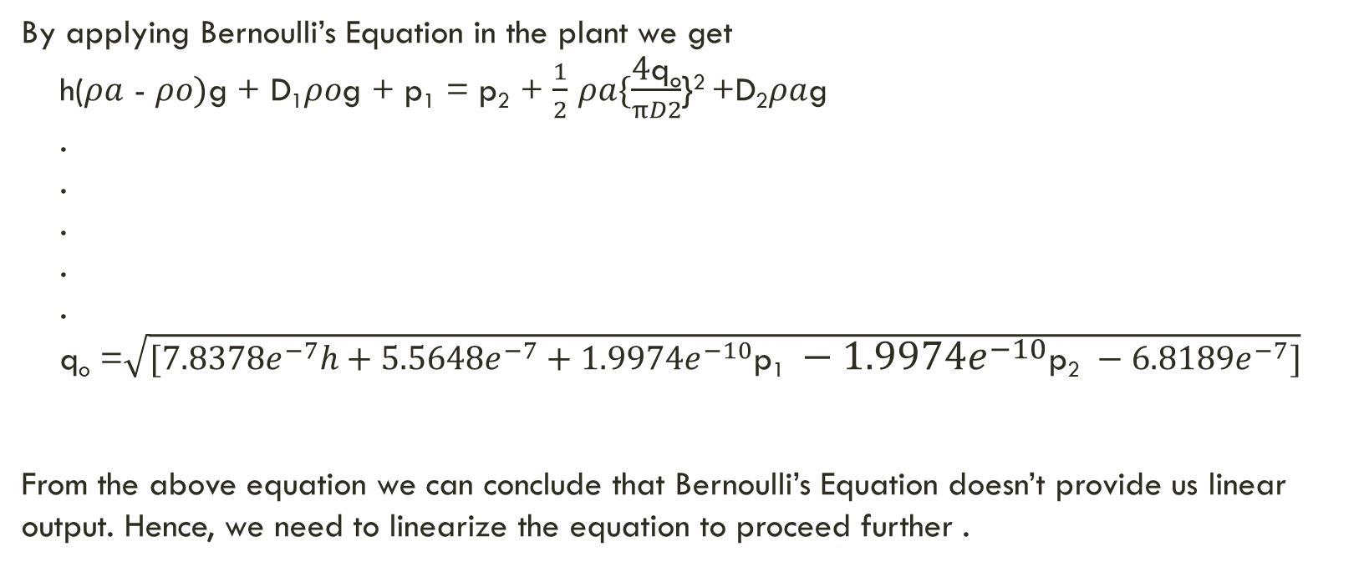
Derivation from Bernoulli’s Equation
By applying Bernoulli’s Equation in the plant we get
h($ρa$ - $ρo)$g + D₁$ρo$g + p₁ = p₂ + $\frac{1}{2}$ $ρa\{\frac{\text{4}\text{q}\text{o}}{πD2}$}² +D₂$ρa$g
.
.
.
.
.
q_{o} =$\sqrt{{[7.8378e}^{−7}h+5.5648e^{−7}+1.9974e^{−10}\text{p}\text{1} −1.9974e^{−10}\text{p}\text{2} −6.818{9e}^{−7}]}$
From the above equation we can conclude that Bernoulli’s Equation doesn’t provide us linear output. Hence, we need to linearize the equation to proceed further .

Slide 7





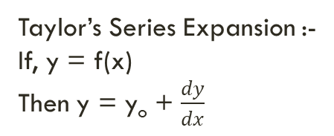






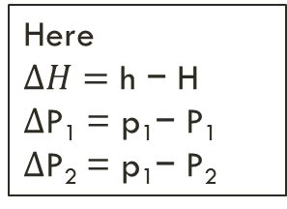
Linearizing The Bernoulli’s Equation
Taylor’s Series Expansion :-
If, y = f(x)
Then y = y_{o} + $\frac{dy}{dx}$
Here,
The Operating points are (x₀ , y₀)
$$\frac{\text{(}\text{x}\text{−}\text{x}\text{0}\text{) }}{1!}$$
$$\frac{dx^{2}}{d^{2}y}$$
$$\frac{\text{(}\text{x}\text{−}\text{x}\text{0}\text{) }}{2!}$$
$$\frac{dx^{3}}{d^{3}y}$$
$$\frac{\text{(}\text{x}\text{−}\text{x}\text{0}\text{) }}{3!}$$
+
+
+ ………….
x=x₀
x=x₀
x=x₀
Relation b/w Q_{o} and other parameters in the operating region of interface.
q_{o} = f(p₁, p₂ , h)
Here
$$∆H=\text{h} \text{−} \text{H}$$
$∆\text{P}\text{1}$ = $\text{p}\text{1}\text{−} \text{P}\text{1}$
$∆\text{P}\text{2}$ = $\text{p}\text{1}\text{−} \text{P}\text{2}$
Operating Range :-
H = 180 mm
P₁ = -120 mmWc
P₂ = -113.0212 mmWc
So Using the above Expansion we can derive :-
q₀ = Q₀
+
$$\frac{∂q_{0}}{∂h}$$
$$∆H$$
+
$$\frac{∂q_{0}}{∂\text{p}\text{1}}$$
$$∆\text{P}\text{1}$$
+
$$\frac{∂q_{0}}{∂\text{p}\text{2}}$$
$$∆\text{P}\text{2}$$
N.B. :- As we have ruled out the other higher order terms which have very negligible effect.
h = H
p₁= P₁
p₂= P₂
h = H
p₁= P₁
p₂= P₂
h = H
p₁= P₁
p₂= P₂

Slide 8
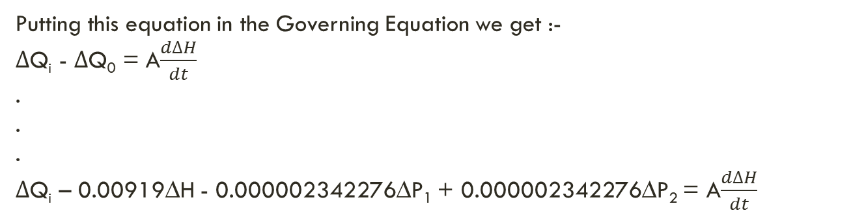
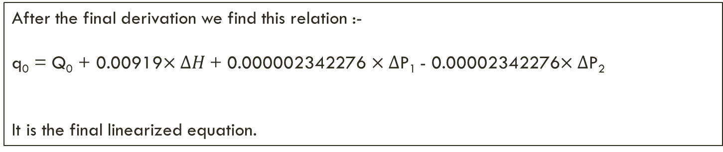
Linearizing The Bernoulli’s Equation
After the final derivation we find this relation :-
q₀ = Q₀ + 0.00919$×∆H$ + 0.000002342276 $×∆\text{P}\text{1}$ - 0.00002342276$×∆\text{P}\text{2}$
It is the final linearized equation.
Putting this equation in the Governing Equation we get :-
$∆$Q_{i} - $∆$Q₀ = A$\frac{d∆H}{dt}$
.
.
.
$∆$Q_{i} – 0.00919∆H - 0.000002342276∆P₁ + 0.000002342276∆P₂ = A$\frac{d∆H}{dt}$
$∆$Q_{i} – 0.00919∆H - 0.000002342276∆P₁ + 0.000002342276∆P₂ = 1.78 × $\frac{d∆H}{dt}$

