Slide 1


CSE326: INFORMATION
SYSTEM DESIGN SESSIONAL
Project Presentation on Use Case Diagram & Class Diagram

Slide 2
B1 Group-2:
2105068 - Anika Morshed
2105071 – Tanzim Tousif
2105081 - Diganta Saha Tirtha
2105082 – Jahedul Islam Nayeem
2105084 – Dibya Jyoti Sarkar
2105063 – Ramisa Tasnia

Slide 3
Trip.com
4 core features of Hotel Booking Module:
Searching and availability checking
Reviews and ratings
Favourites and booking history
Booking confirmation and cancellation
Trip.com
Trip.com is a online travel booking platform, dedicated to providing a seamless travel booking experience for all users.

Slide 4
Actors:
Web User
Guest User
Registered User
Hotel Admin
Payment Gateway
Guest and Registered Users specialize Web User
Use Case Diagram

Slide 5
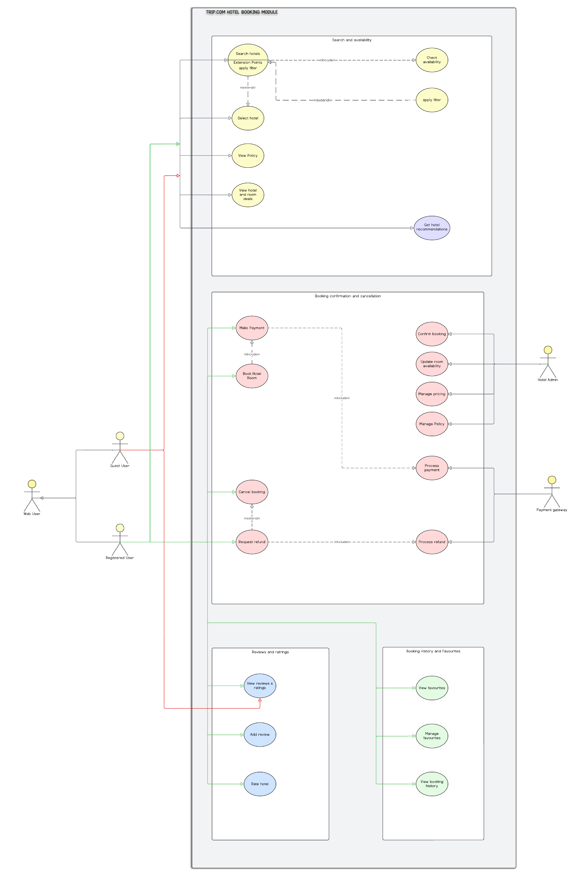
Use Case Diagram
Actors:
Web User
Guest User
Registered User
Hotel Admin
Payment Gateway
Guest and Registered Users specialize Web User
Trip.com

Slide 6
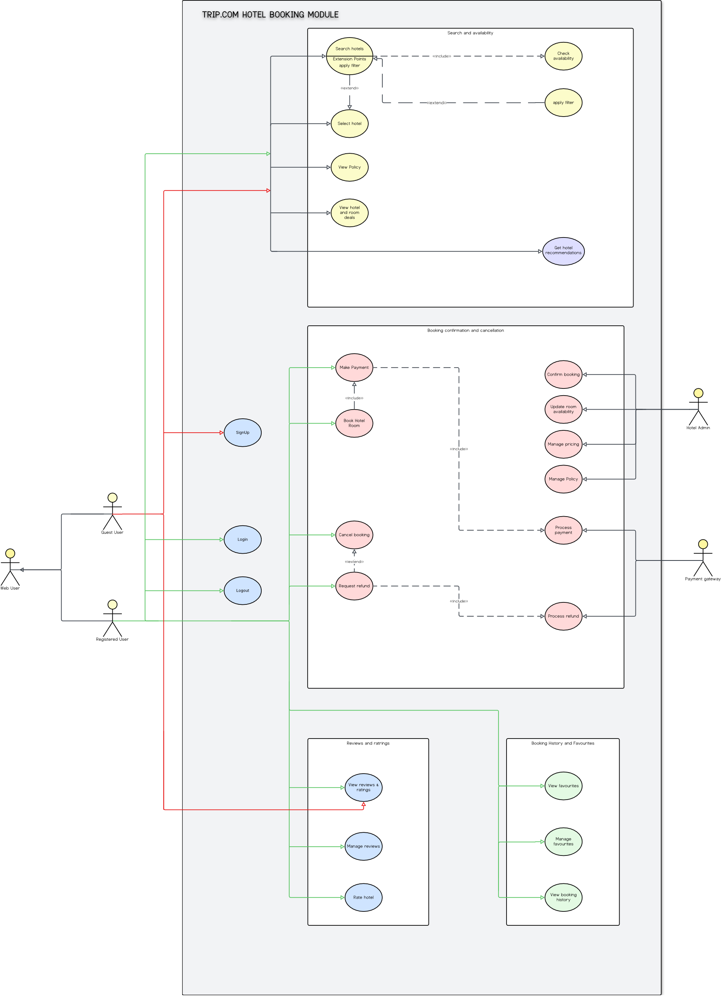


Use Case
Diagram(whole)
GREEN
RED

Slide 7
Use Case
Diagram(whole)
GREEN
RED

Slide 8
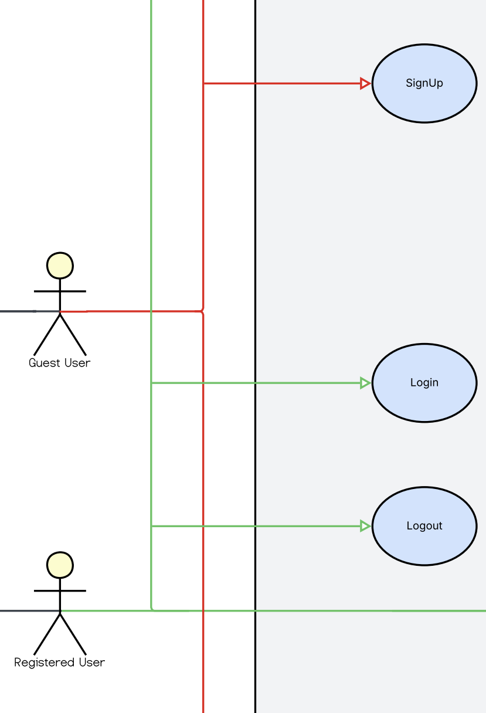
Use Case Diagram(Authentication)

Slide 9
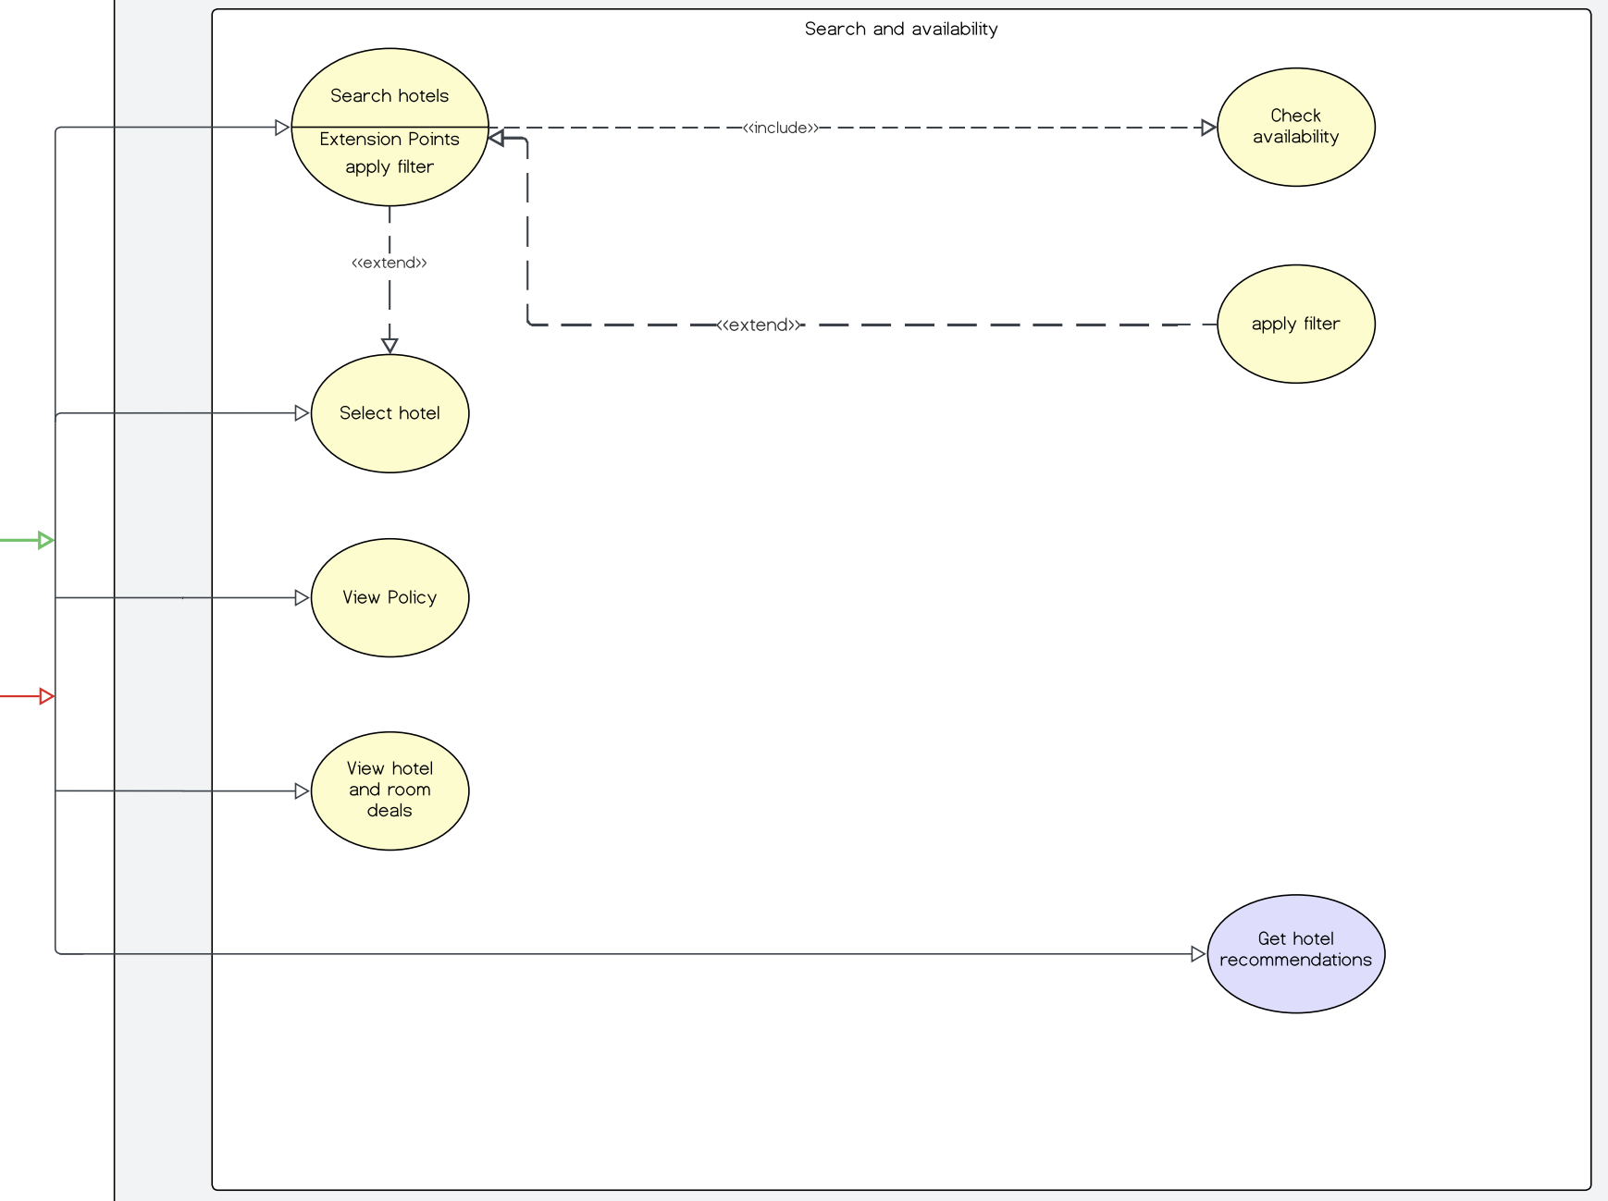
Use Case Diagram(Searching & Availability Checking)

Slide 10
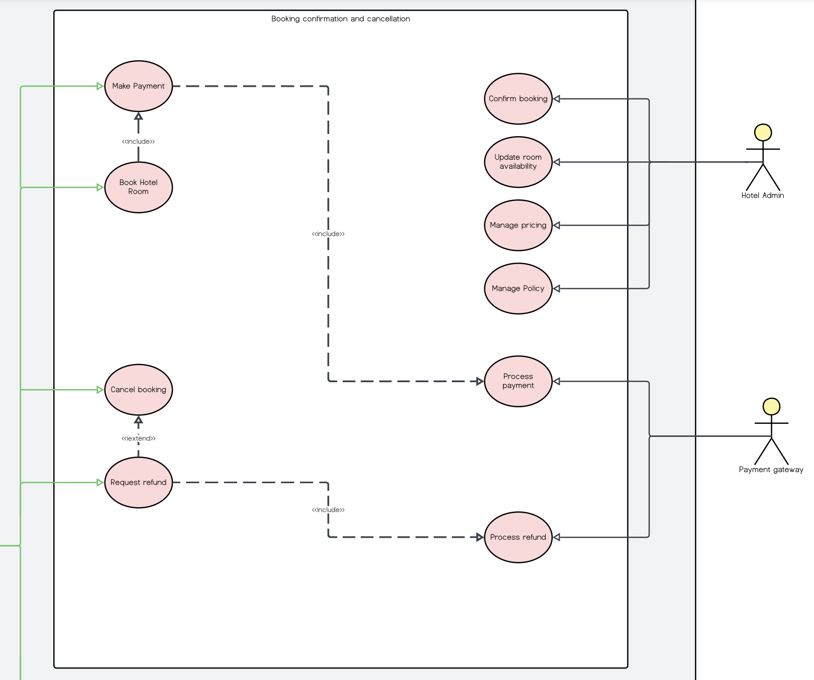
Use Case Diagram (Booking Confirmation & Cancellation)

Slide 11
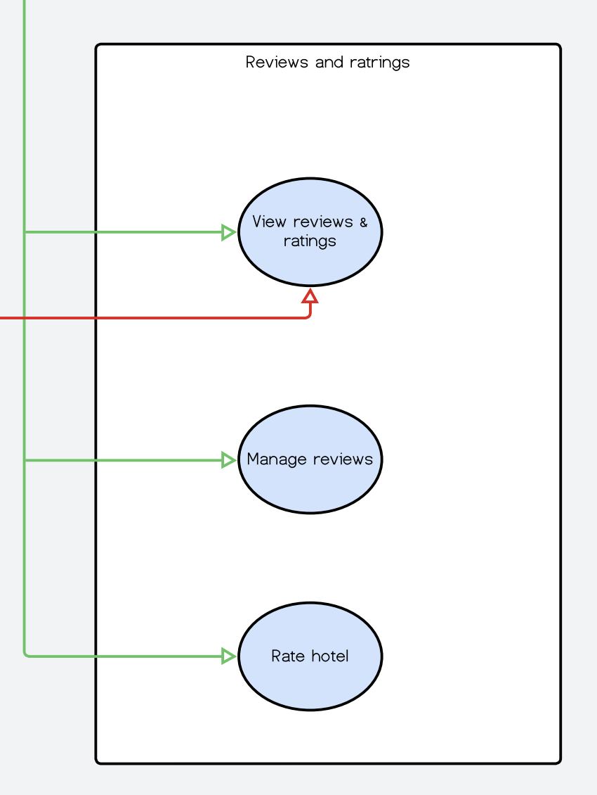
Use Case Diagram(Review & Rating)

Slide 12
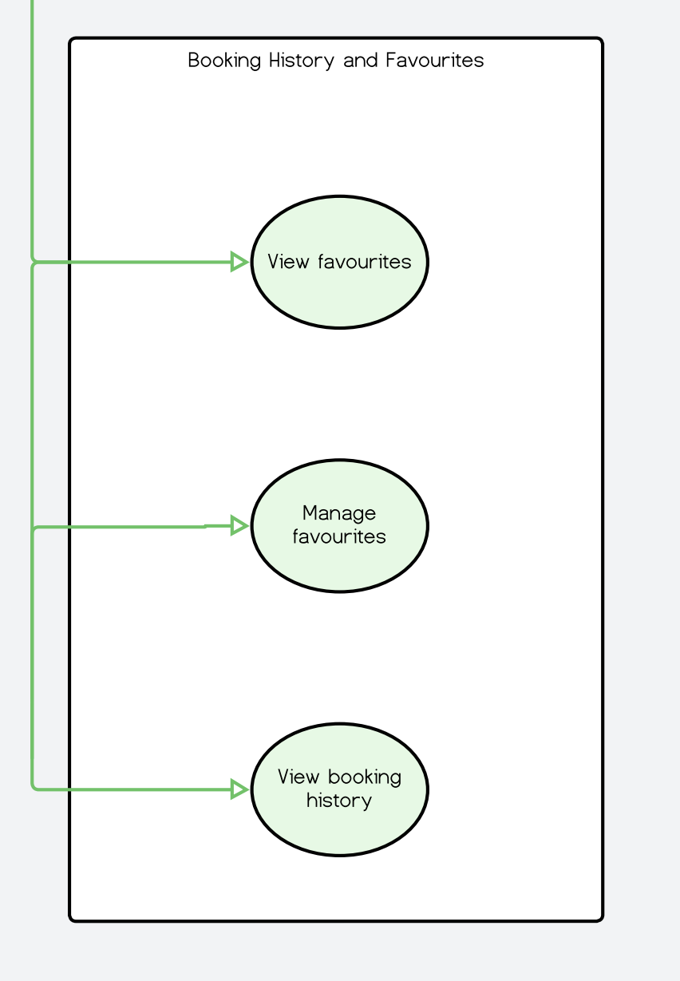
Use Case Diagram(Booking History & Favourites)

Slide 13
abcd
efgh
Class Diagram

Slide 14
Class Diagram
Divisions of classes:
User Hierarchy
Hotel & Rooms
Booking & Payment
Review, Rating & Favourites
Service Classes

Slide 15
Class Diagram
Divisions of classes:
User Hierarchy
Hotel & Rooms
Booking & Payment
Review, Rating & Favourites
Service Classes
Classes:
User
RegisteredUser
GuestUser
HotelAdmin

Slide 16
Class Diagram
Divisions of classes:
User Hierarchy
Hotel & Rooms
Booking & Payment
Review, Rating & Favourites
Service Classes
Classes:
Hotel
Room
RoomAvailability
Policy
Deal

Slide 17
Class Diagram
Divisions of classes:
User Hierarchy
Hotel & Rooms
Booking & Payment
Review, Rating & Favourites
Service Classes
Classes:
Booking
GuestDetails
Payment
Refund
PaymentGateway
Status(enum)

Slide 18
Class Diagram
Divisions of classes:
User Hierarchy
Hotel & Rooms
Booking & Payment
Review, Rating & Favourites
Service Classes
Classes:
Review
Rating
Favourite

Slide 19
Class Diagram
Divisions of classes:
User Hierarchy
Hotel & Rooms
Booking & Payment
Review, Rating & Favourites
Service Classes
Classes:
Filter
SearchService
BookingService
PaymentService
ReviewAndRatingService
RecommendationService

Slide 20
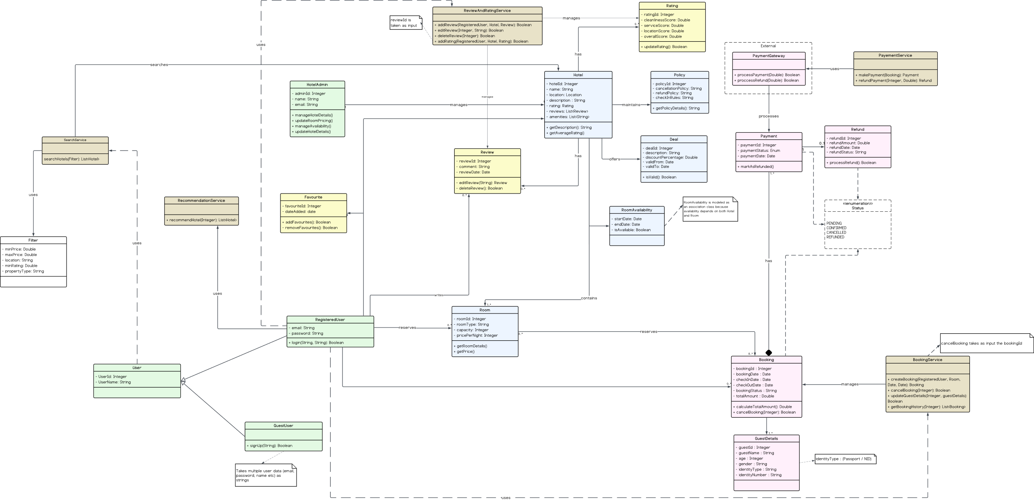
Trip.com Class Diagram

Slide 21
THANK YOU!
Questions?

