Slide 1
CSE326: INFORMATION SYSTEM DESIGN SESSIONAL

Slide 2
B1 Group-2
2105063 – Ramisa Tasnia
2105068 – Anika Morshed
2105071 – Tanzim Tousif
2105081 – Diganta Saha Tirtha
2105082 – Jahedul Islam Nayeem
2105084 – Dibya Jyoti Sarkar

Slide 3
4 core features of Hotel Booking Module:
Searching and availability checking
Reviews and ratings
Favourites and booking history
Booking confirmation and cancellation

Slide 4
Collaboration Diagram

Slide 5
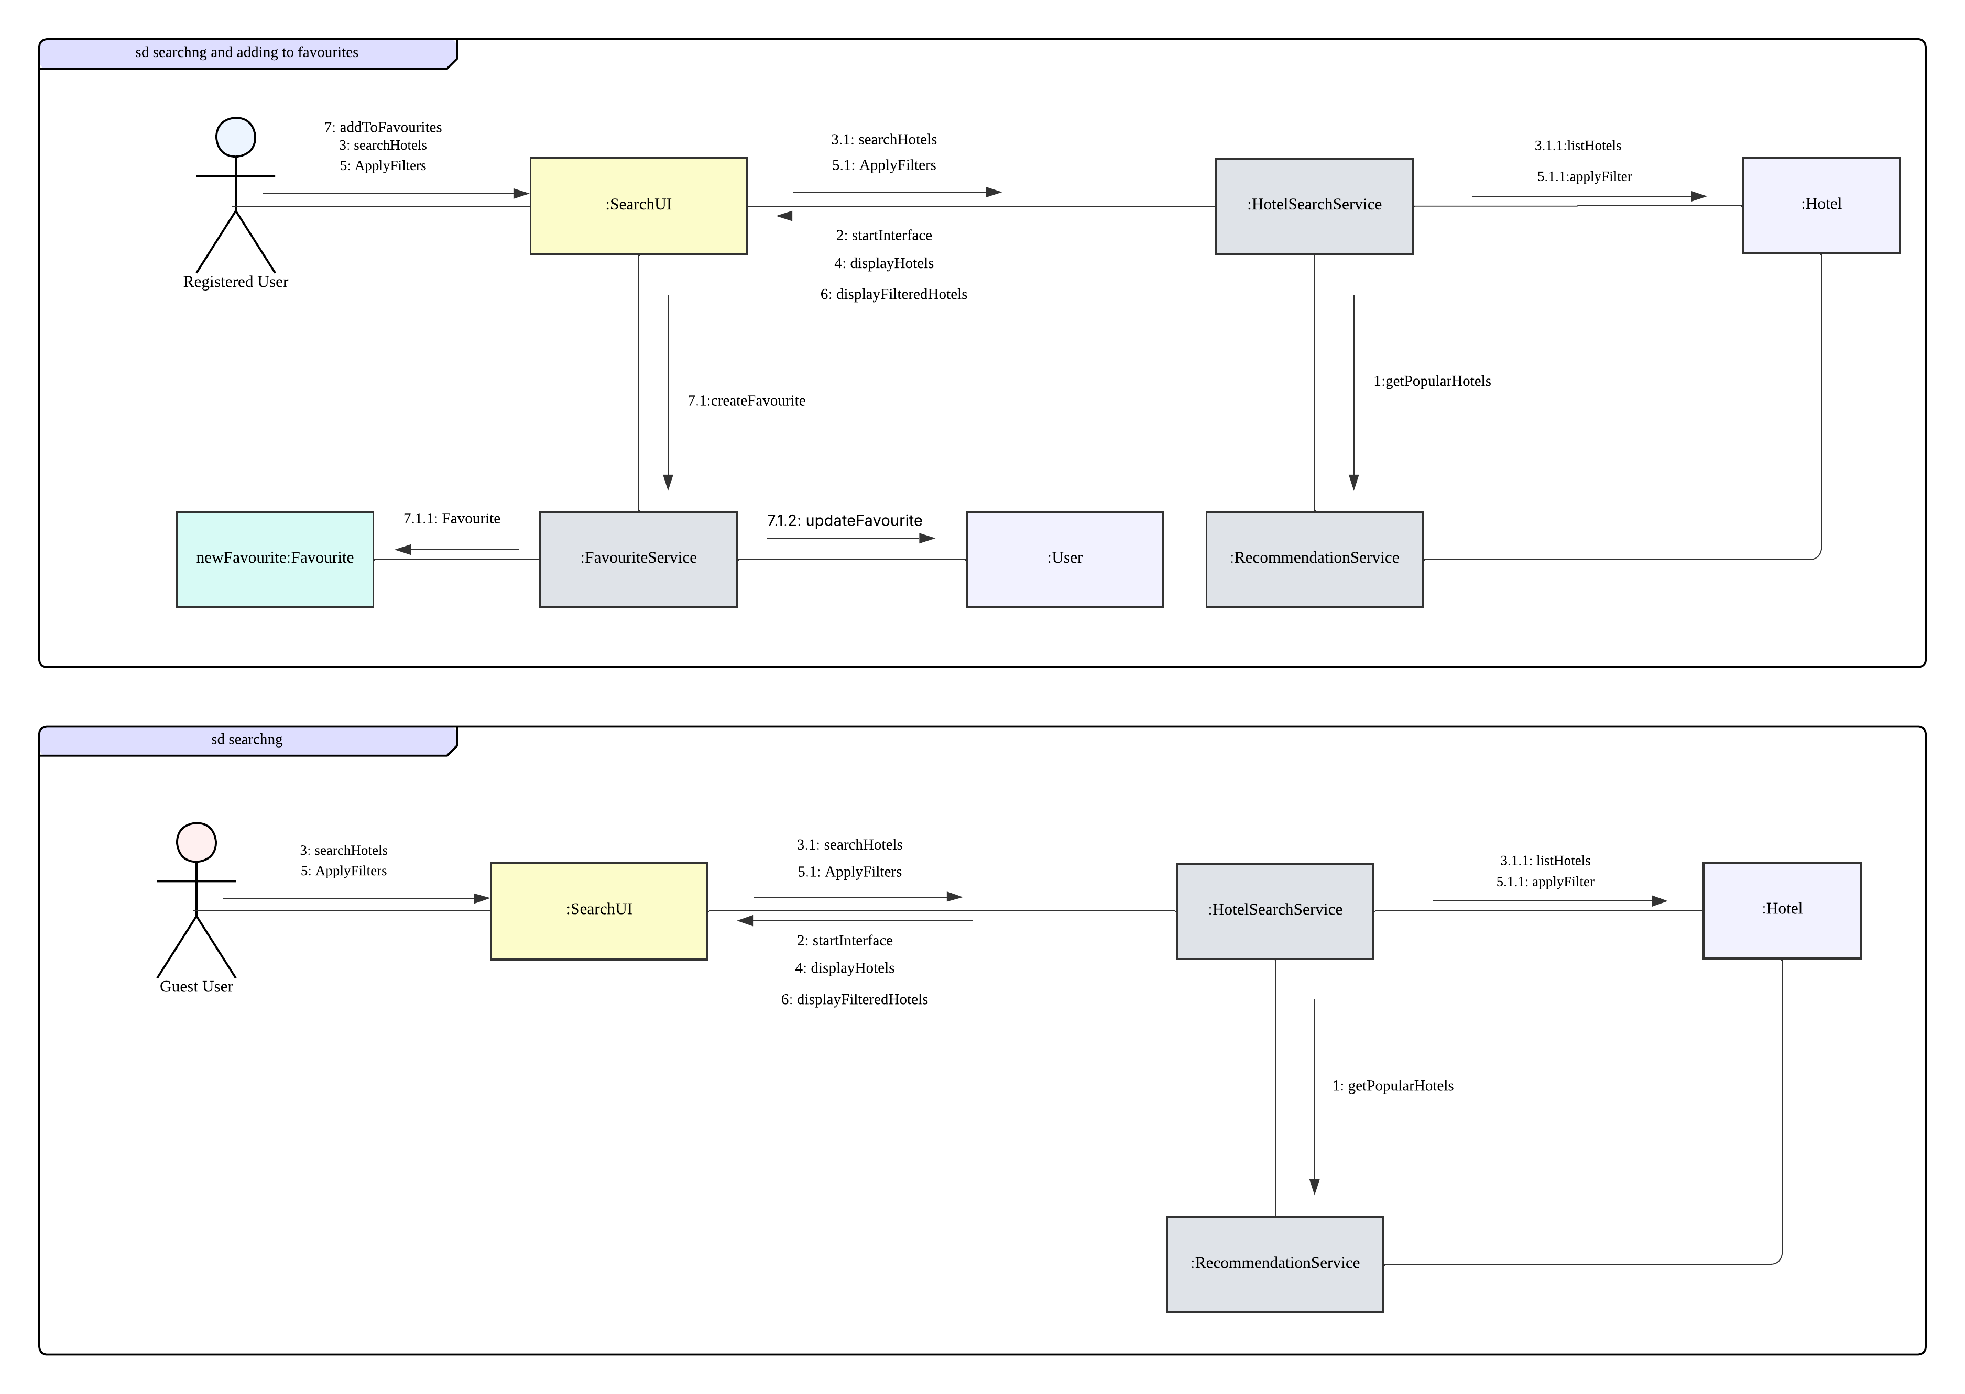
Search & Add to Favourites

Slide 6
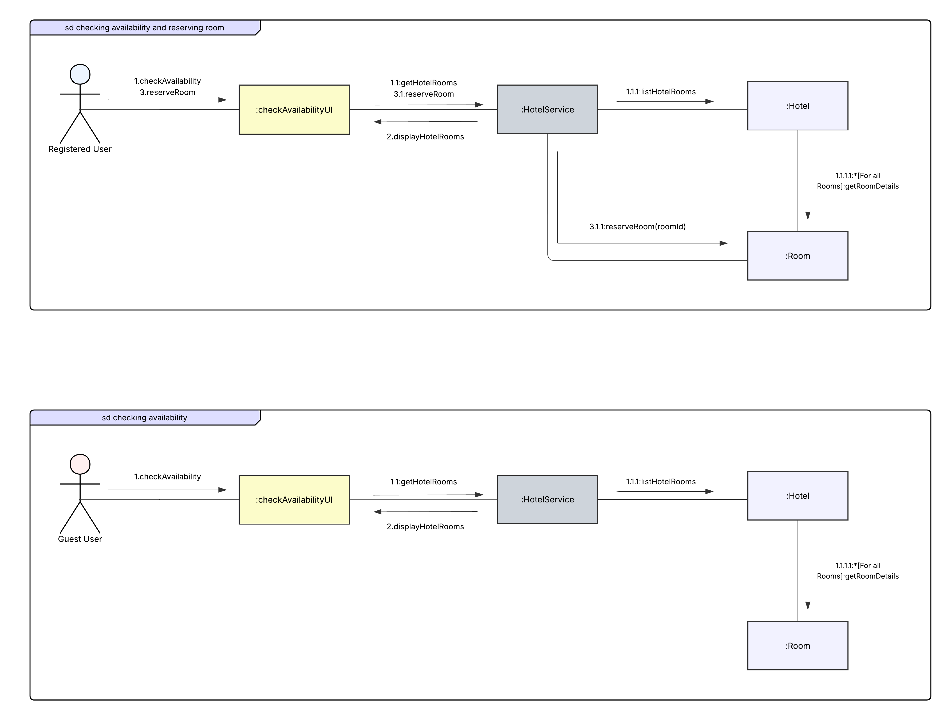
Check Availability

Slide 7
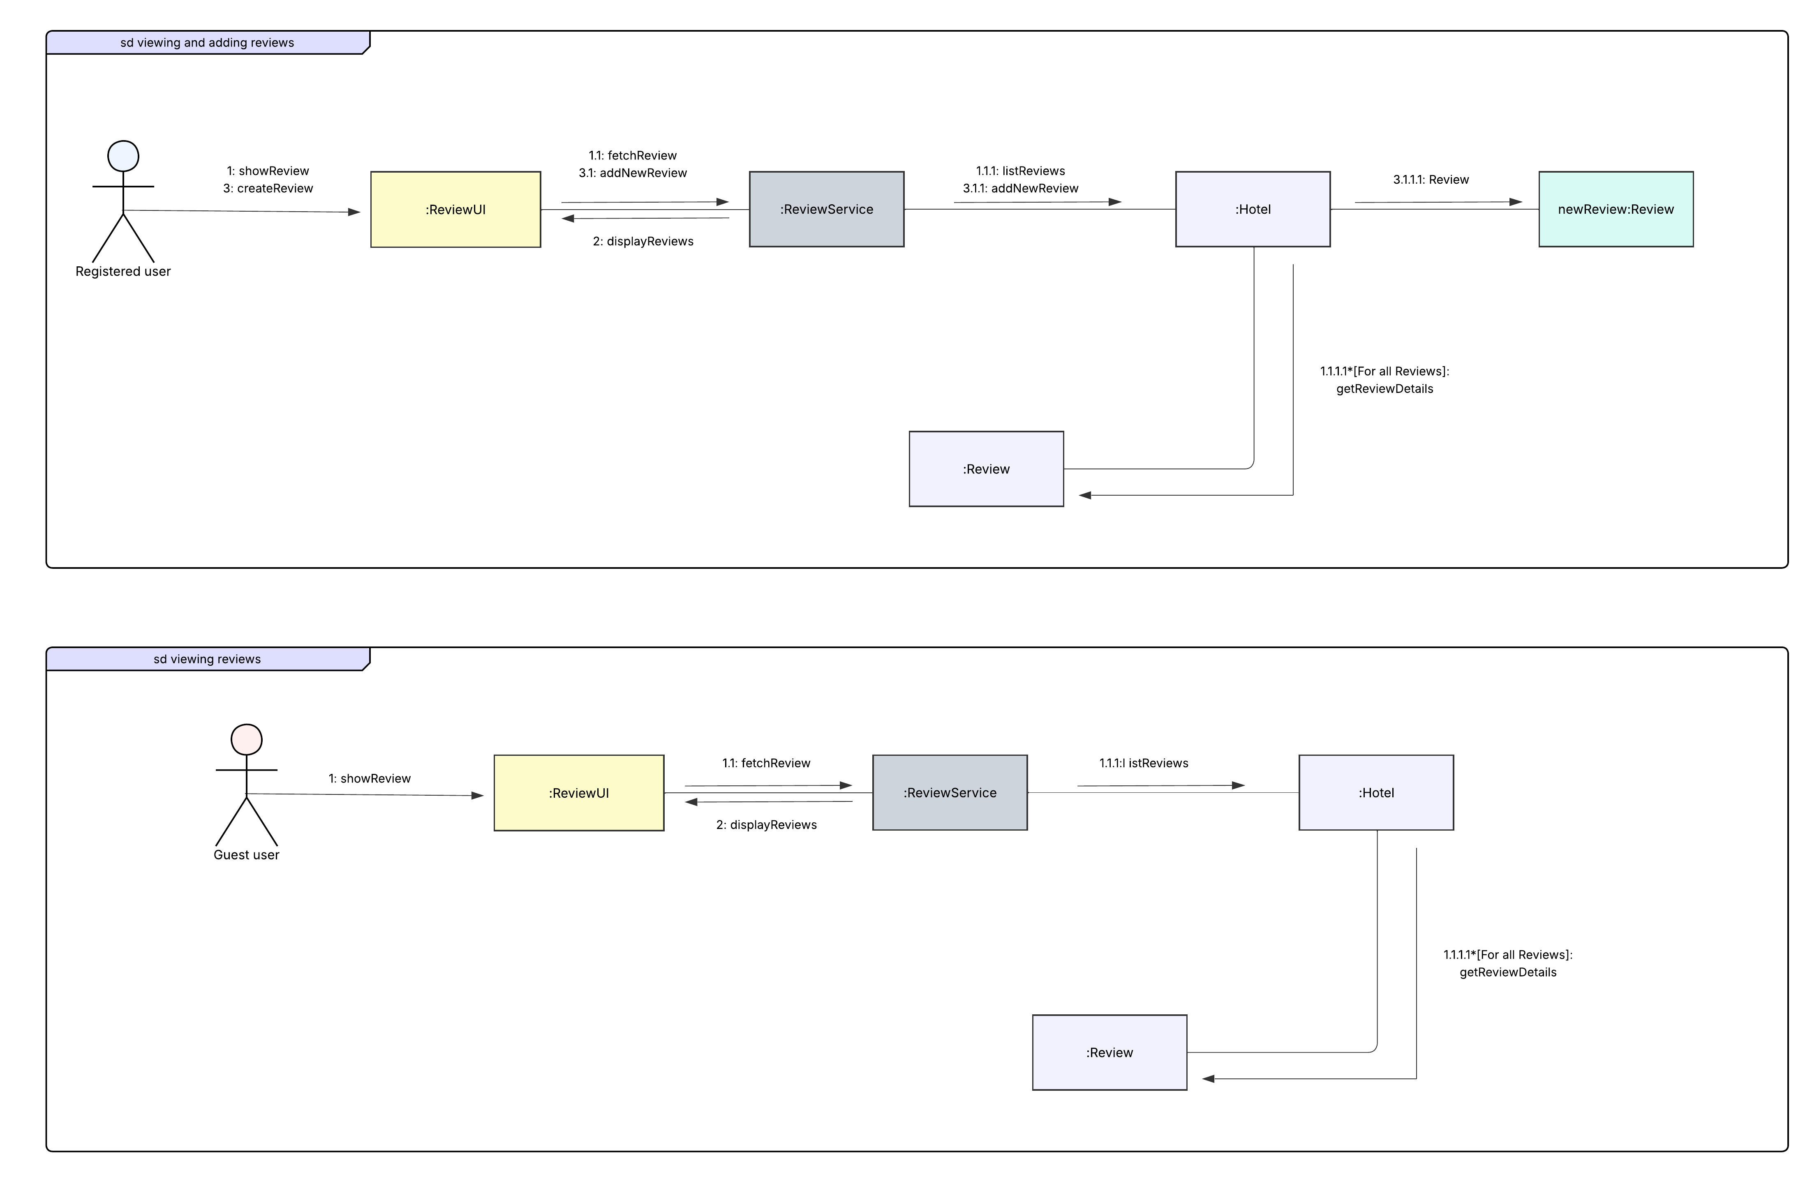
Viewing & Adding Reviews

Slide 8
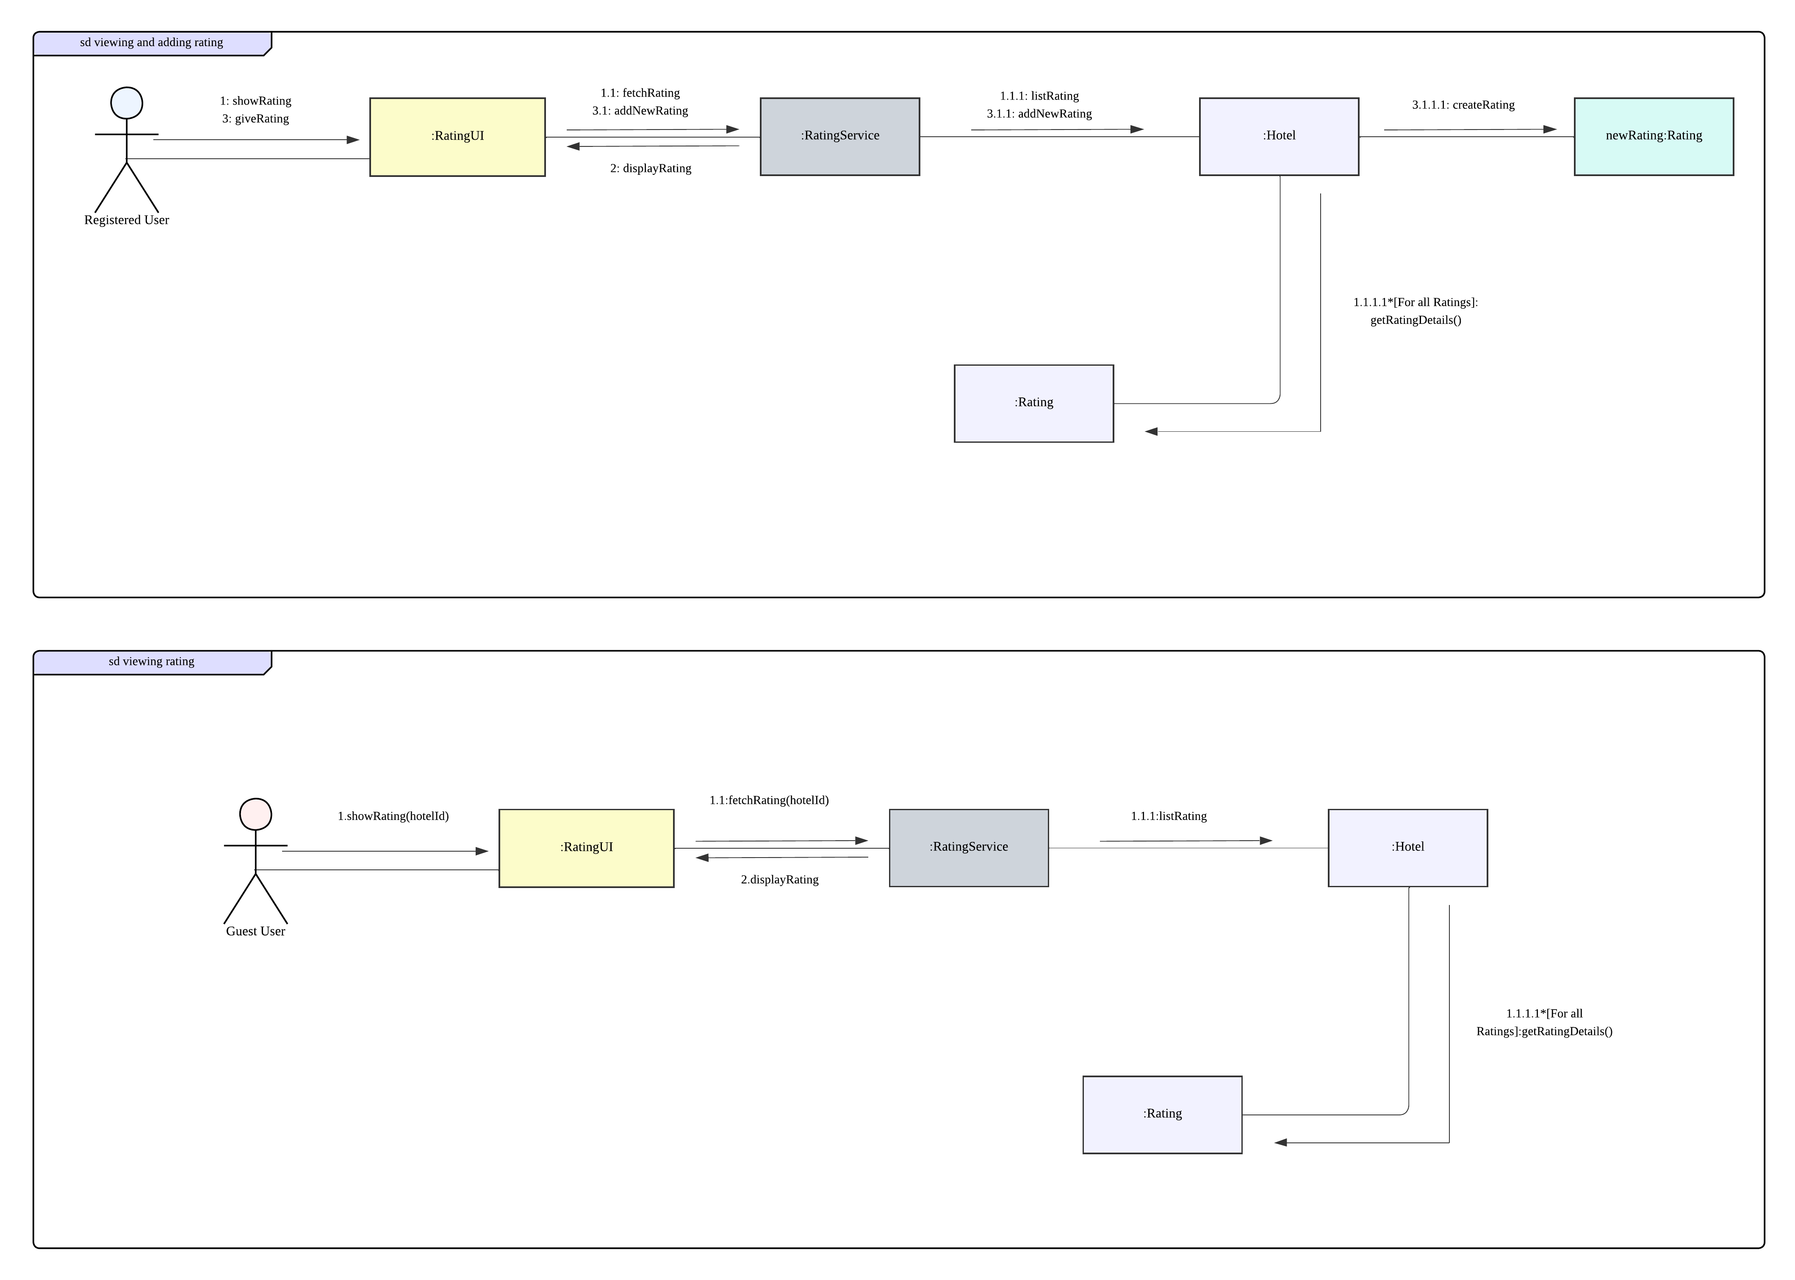
Viewing & Adding Ratings

Slide 9
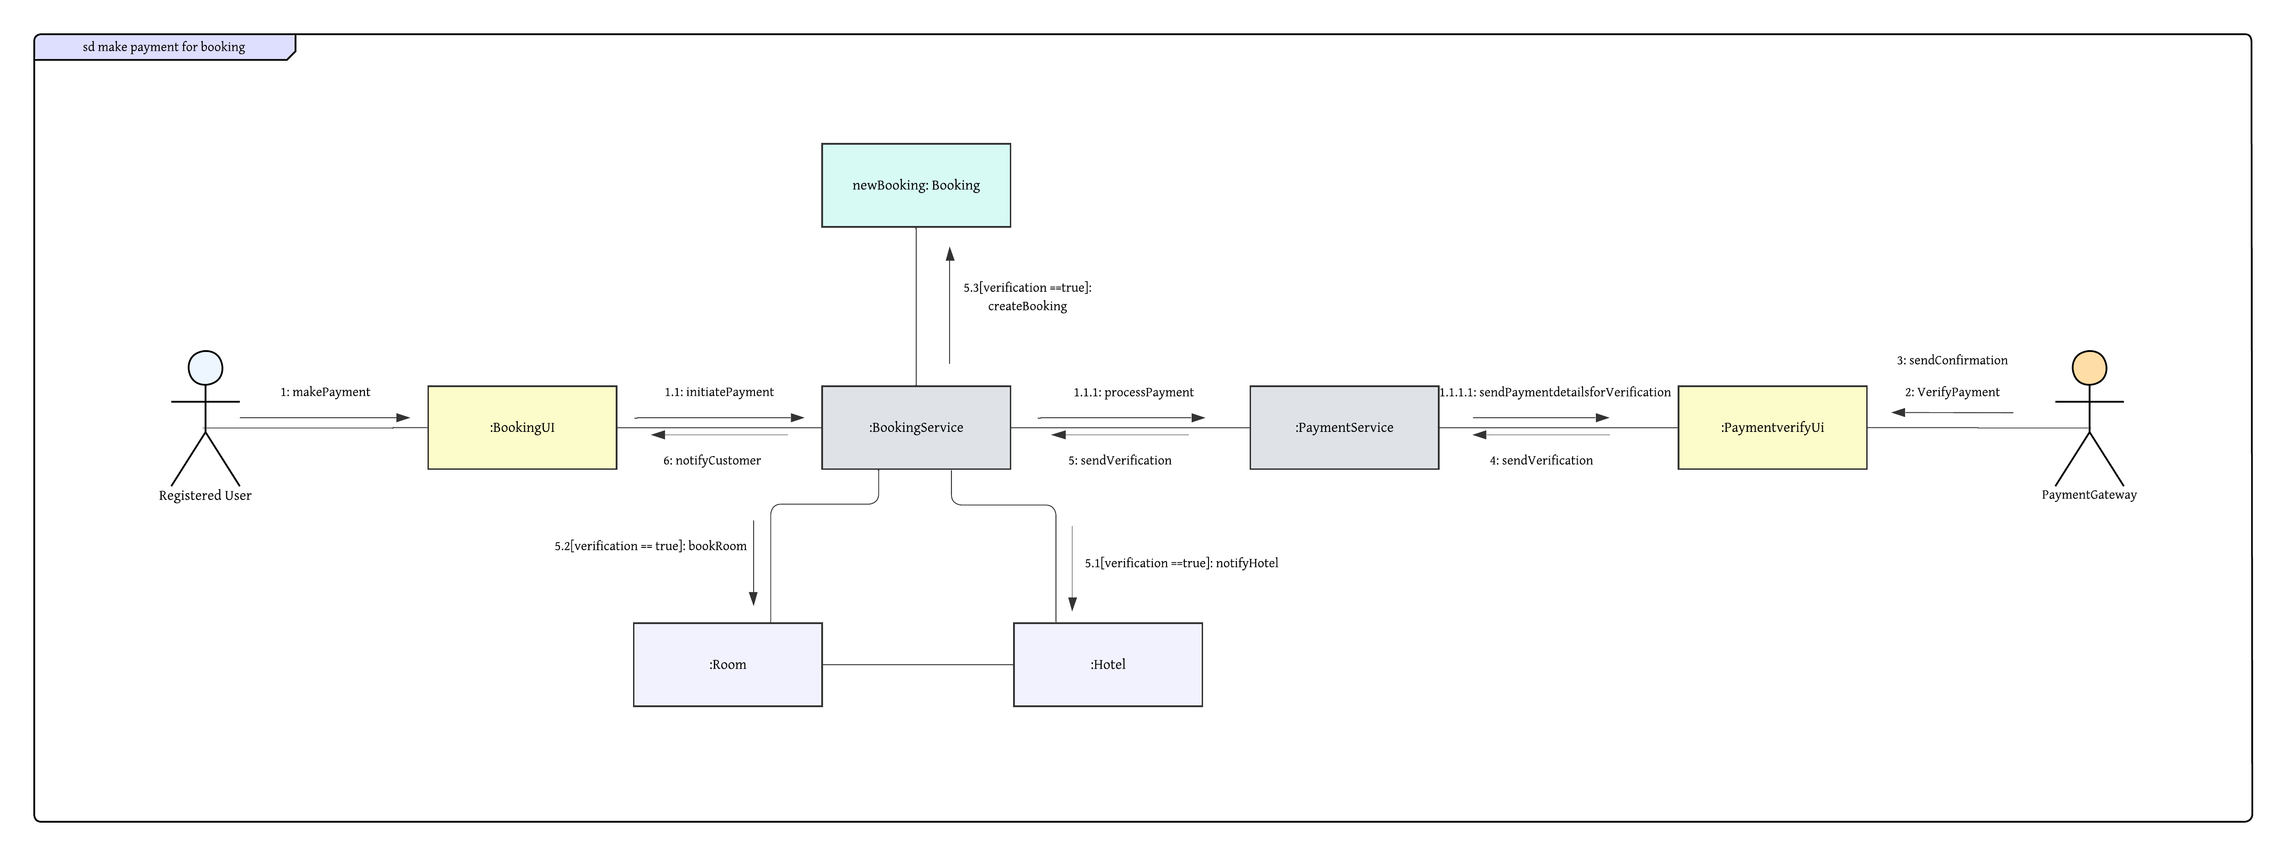
Payment

Slide 10
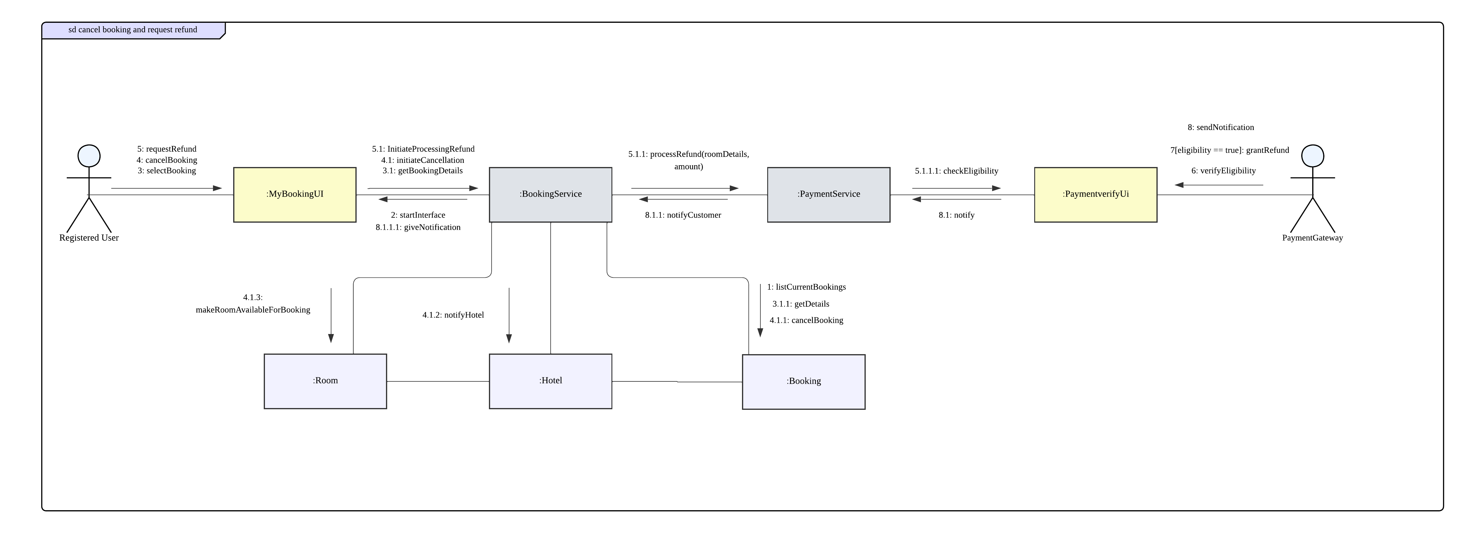
Cancellation & Refund

Slide 11
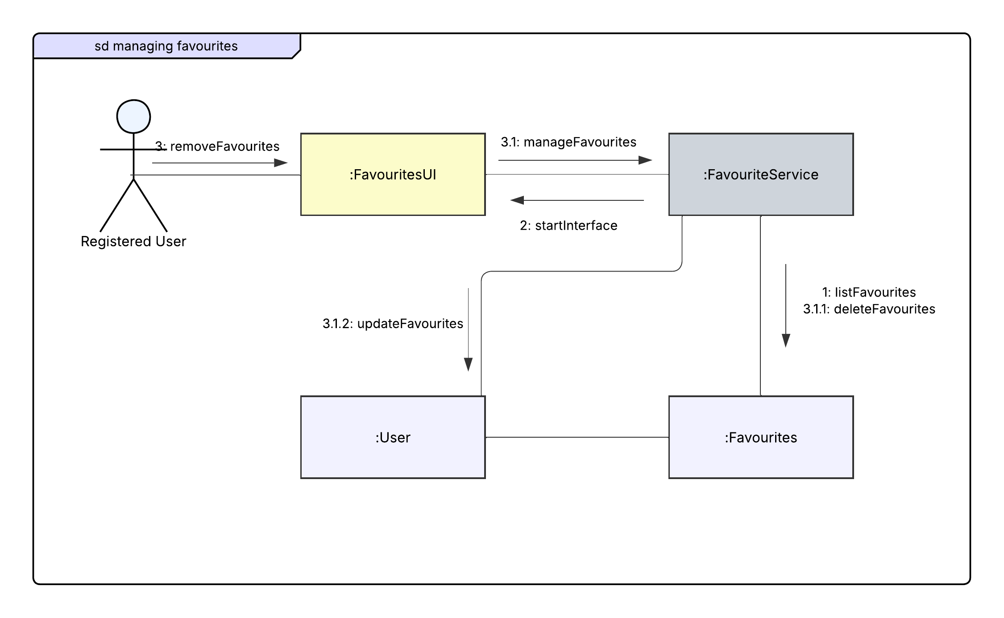
Managing Favourite

Slide 12
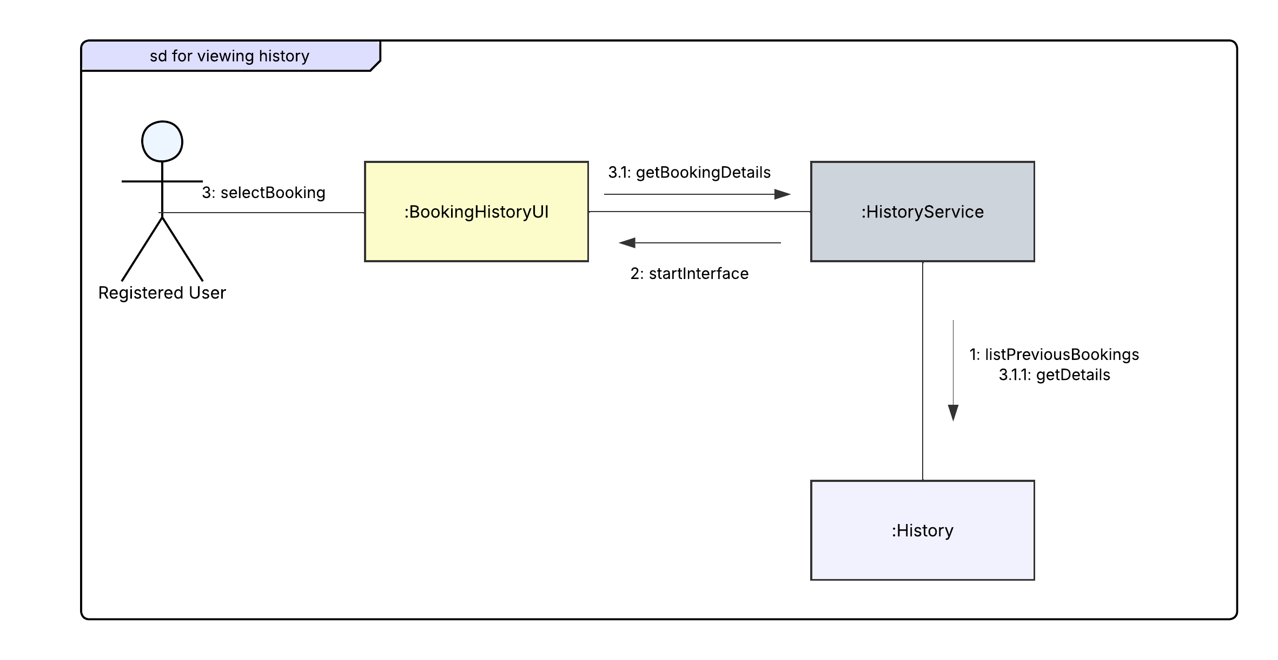
Booking History

Slide 13
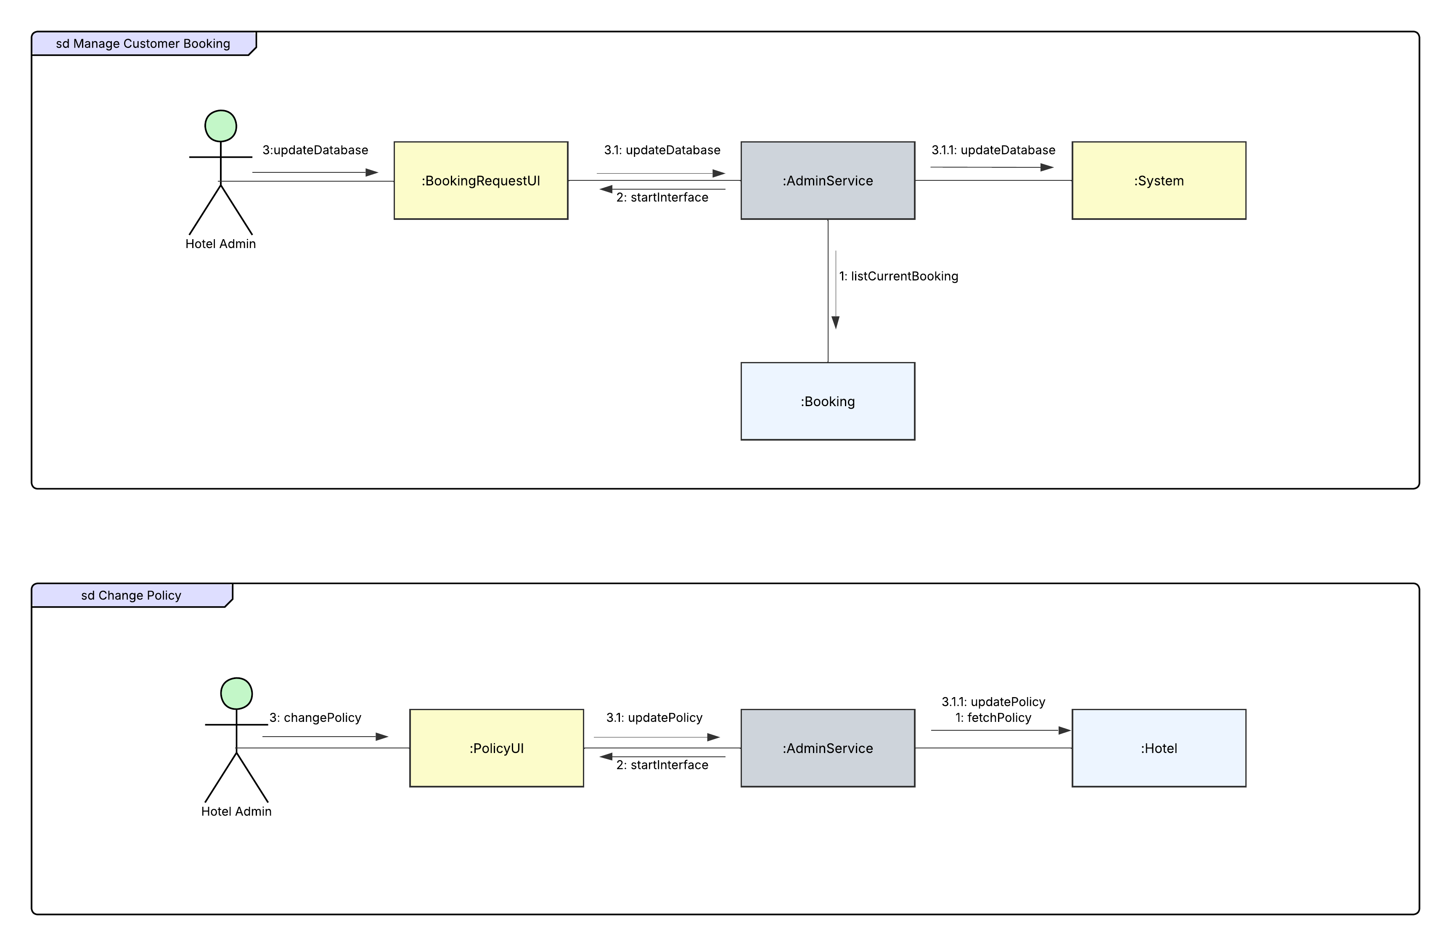
Booking & Policy Management

Slide 14
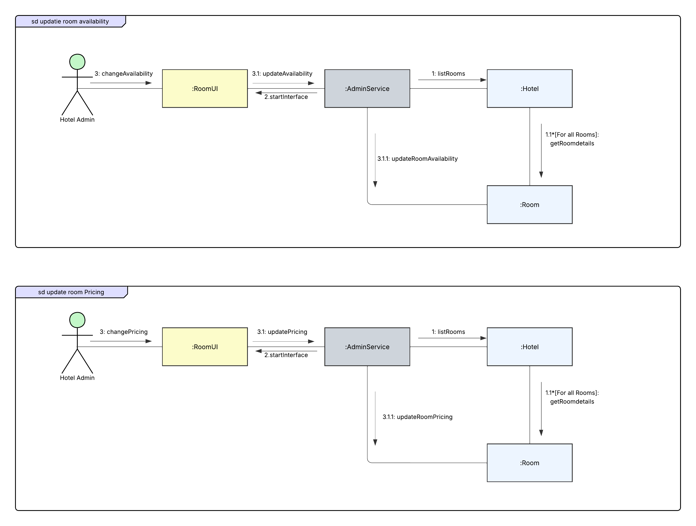
Availability & Pricing Management

Slide 15
Thank you
2105081 – Diganta Saha Tirtha
Our Diagram

