Slide 1

Ambient intelligence lab
Department of software engineering
Daffodil international university
Supervised by
K. M. Imtiaz Ud-Din
Assistant professor
Department of software engineering
Presentation date : 11/10/2018

Slide 2
An environment supporting
end-user driven composition of
collaborative web and IoT services

Slide 3
Contributors:
ID: 151-35-937
ID: 151-35-843
ID: 151-35-960
ID: 151-35-924

Slide 4
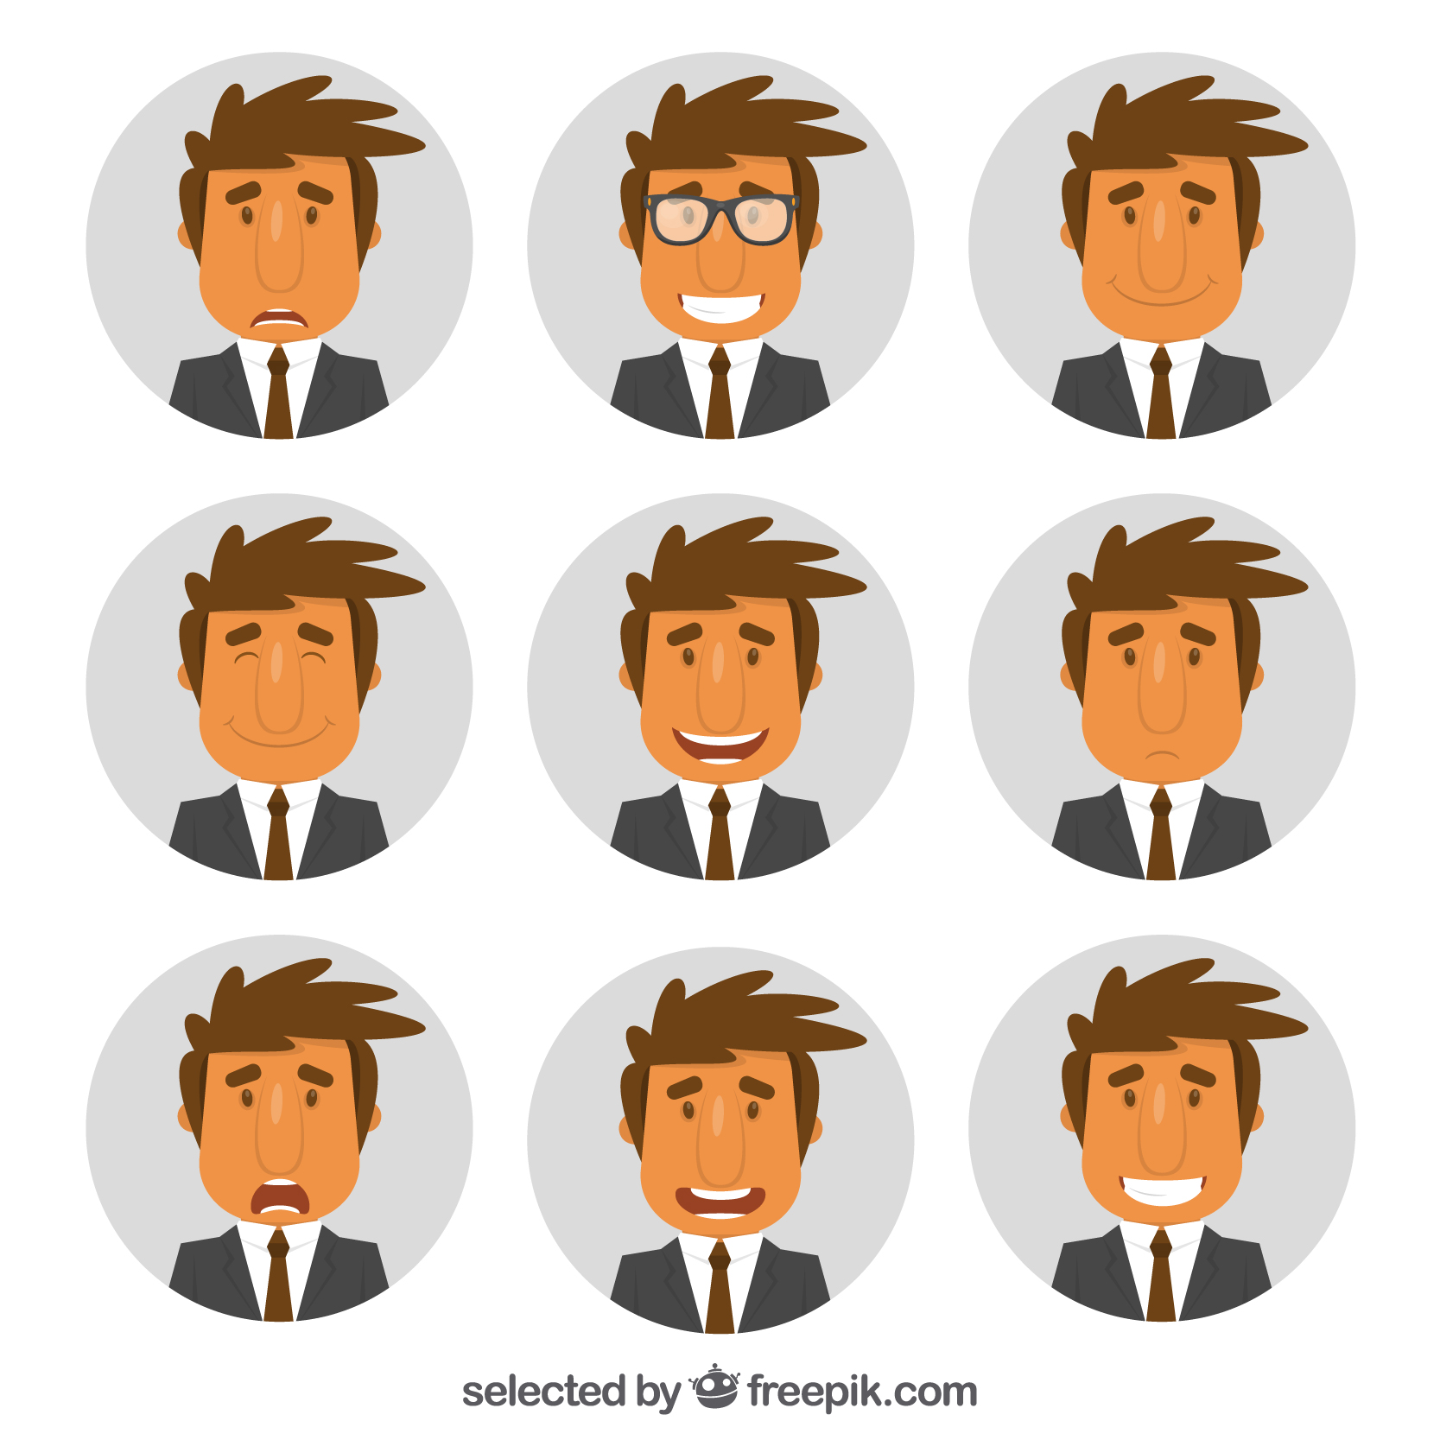


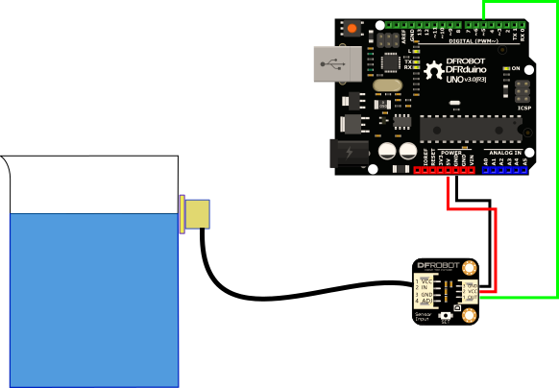

Slide 5
Mr. X
Reservoir
Water pump
Water level

Slide 6


Reservoir
Water pump

Slide 7

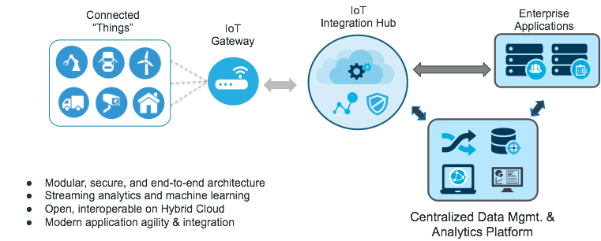
Problem statement
Personalized
service
IoT and web service
collaboration

Slide 8
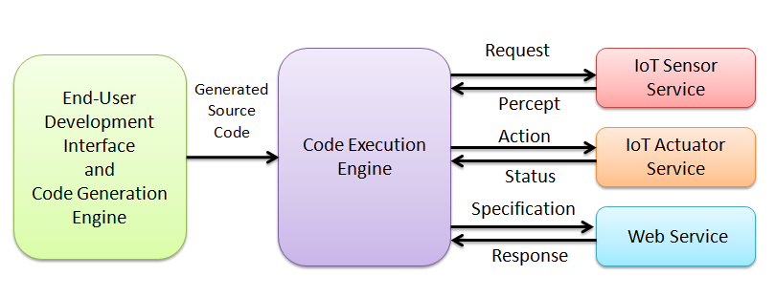
Proposed architecture
IoT and web services

Slide 9
Limitations:
Sensors and Actuators
→ Static tag pattern
→ Limitation in automatic code modification program.
→ No personalized web socket for MQTT.
Middleware
→ Complex UI/UX.
→ Components are not distributed.
→ Unable to learn from previous executions.
→ Stores garbage values.

Slide 10
Sensor and Actuator: Static tag pattern
S 07 US WTC32
S-Sensor
Or
A-Actuator
Represents role in each project
In which project sensor will perform
Sensor ID
Each sensor can take place in different projects but we can not determine which sensor is from which project.

Slide 11
Sensor and Actuator: Limitation in automatic code modification
The code modification program only identifies lines of codes if they are written in a specific pattern.

Slide 12
Sensor and Actuator: No personalized web socket for MQTT
We don’t have any web socket for transferring data by MQTT. So we are using third party service cloud MQTT.

Slide 13
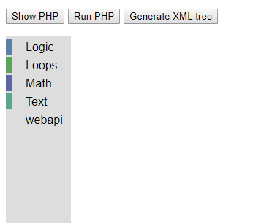
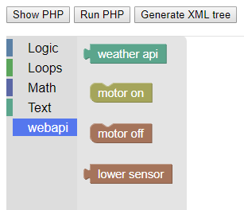
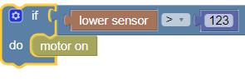
Interface for end-user
development
Custom blockly blocks

Slide 14
Reference
Kovatsch, M., Mayer, S., & Ostermaier, B. (2012). Moving Application Logic from the Firmware to the Cloud: Towards the Thin Server Architecture for the Internet of Things. 2012 Sixth International Conference on Innovative Mobile and Internet Services in Ubiquitous Computing.
Valsamakis, Y., & Savidis, A. (n.d.). PersonalApplicationsintheInternetofThings ThroughVisualEnd-UserProgramming. 2018 Springer Verleg .
Microsoft Flow. (2018). Microsoft [online] Available at : https://docs.microsoft.com/en-us/flow/
Philips Hue. (2018). Philips [online] Available at : https://www2.meethue.com/en-us

Slide 15
Questions ?

