Slide 1
Online Bangla music suggester
Name: Owahidul Islam Roman
ID: 151-35-986

Slide 2
Purpose
Make a connection between people
No such a site which is all about in Bengali songs related

Slide 3


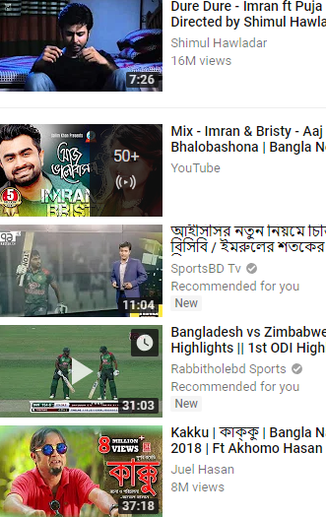




Development Tools
Non-functional Requirements
Proposed System
Existing System
Functional Requirements
System should have two types of searching option
- All user can search songs by song name
- All user can search songs based on some categories
Visitor can see latest songs and most viewed songs list
System should suggest songs to the user based on his/her
choice
Authenticate User can react on a particular song
Authenticate User can comment on a particular song
Authenticate User can create a playlist
Admin can add, delete, update songs
Admin can remove users.
D
Performance
Scalability
Security
Usability
Auditing & Logging
Availability
Search type
General Search
More specific search
Hey bring me a song
PHP(Laravel)
HTML
CSS
JavaScript
Bootstrap
C
B
Auto reload mode
Hey bring me a song
System will bring out that song
System will recommend songs based on user choice
A
Auto reload mode
Nice one
What is happening?

