Slide 1




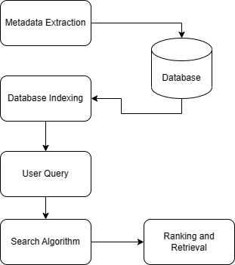
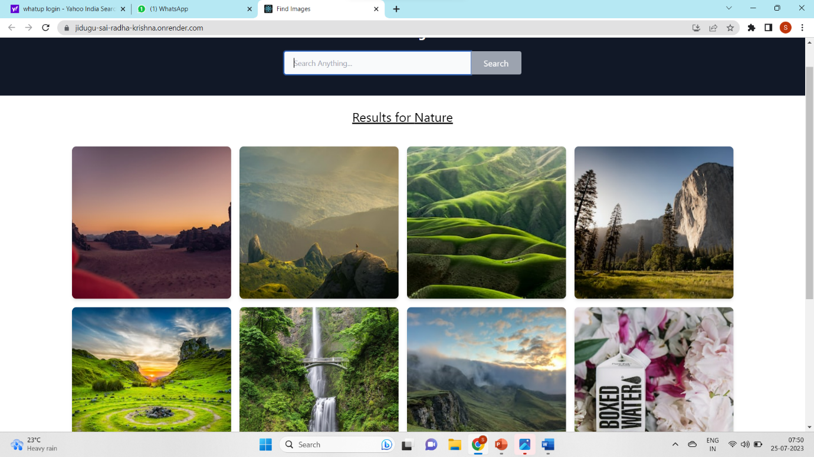
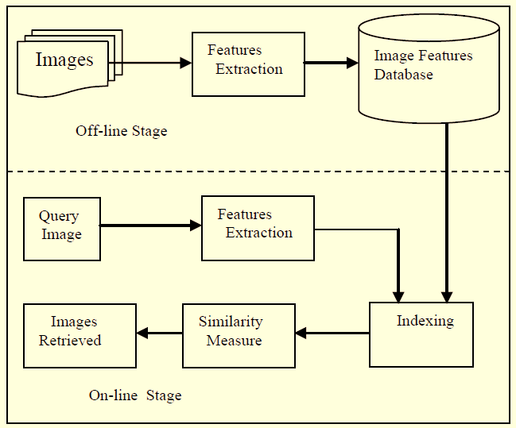
Empowering Image Searching with Advanced Content Analysis and Meta Data Integration
Introduction
Approach and Tools used
Image Searching using Metadata
Images, especially in humanities and social sciences research, provide significant insights into research, often providing depth and better insights into data. Images capture the experience and viewpoint of the researcher and can be powerful storytelling tools. While working in the field, V2V researchers gather a considerable number of images. However, managing image data from multiple users can be challenging unless adequately classified or annotated and with effective retrieval mechanisms. However, with the scope for easy uploading of image data and automated image searching techniques such as combining metadata-based search with content-based image retrieval (CBIR) techniques, a more comprehensive and accurate image searching experience is possible.
We have used a combination of CBIR algorithms and image extraction using Metadata
CBIR Algorithm:
Feature Extraction: Analyse query and database images to extract visual features (e.g., colour histograms, texture descriptors, shape info, or CNN-based representations).
Feature Representation: Convert images into numerical feature vectors encoding their visual characteristics for similarity comparison.
Distance Metric: Define a similarity measure (e.g., Euclidean, Cosine) for feature vector comparison.
Similarity Measurement: Calculate the similarity between query and database images using the chosen distance metric.
Ranking and Retrieval: Rank and present top-ranked images as search results based on similarity.
Metadata and Database:
Metadata Extraction: Extract metadata from database images to enhance the search process.
Database Indexing: Create an index for metadata to facilitate faster and easier searches.
User Query and Search:
User Query: Comprehend user requests with keywords, location, or relevant metadata.
Search Algorithm: Implement a search algorithm (e.g., string matching, full-text search) to compare the user's query with database information.
Ranking and Retrieval: Rank and retrieve images considering relevance to the user's query, using metrics like keyword match frequency or image popularity.
Objective
Our primary goal here is to provide an automated and advanced image search engine for the V2V community, which give researchers a platform for sharing, storing and retrieving images using metadata/ content analysis, annotating keywords into the image as metadata, and blurring human faces as additional privacy protection. In addition, it can show publicly accessible photos with geo-location on a map. .
Image Searching through CBIR
Result
CBIR & Exif Metadata
CBIR, short for "Content-Based Image Retrieval," is a technique for searching and retrieving images from a database based on their visual content.
It relies on the image’s inherent features and characteristics of search processes rather than textual descriptions or metadata.
The main goal of CBIR is to efficiently find visually similar images to a query image, making it useful when users lack specific keywords or textual information.
Standard visual features used in CBIR include colour, texture, and shape. Applications of CBIR span various fields, including image databases, art collections, medical imaging, and surveillance. The effectiveness of CBIR depends on the quality of feature extraction and matching algorithms.
As CBIR systems constantly evolve, advancements in machine learning and computer vision contribute to enhancing their accuracy and efficiency. Exif metadata, short for "Exchangeable Image File Format," refers to a standardized set of data that is embedded within digital image files, such as JPEGs and TIFFs. This metadata contains information about the image and the circumstances under which it was taken, capturing details about the camera settings, date and time, and other technical and descriptive information related to the image.
Diganta Panda¹, Jidugu Sai Radha Krishna³ , Elham Mohammadi², Prof. Priyadarshi Patnaik¹, Prof. Pulak Mishra¹, Prof. Simron Singh²
¹ Indian Institute of Technology, Kharagpur; ² University of Waterloo, Canada, ; ³Sastra University

