Slide 1
Streamlit

Slide 2
Your first app
Streamlit, like voila, panel, shiny and flask, is computational web server development framework.
At this moment, dash seems to be the most popular solution for python dashboarding.
However, streamlit seems to be gaining traction. Streamlit is very easy to learn.

Slide 3
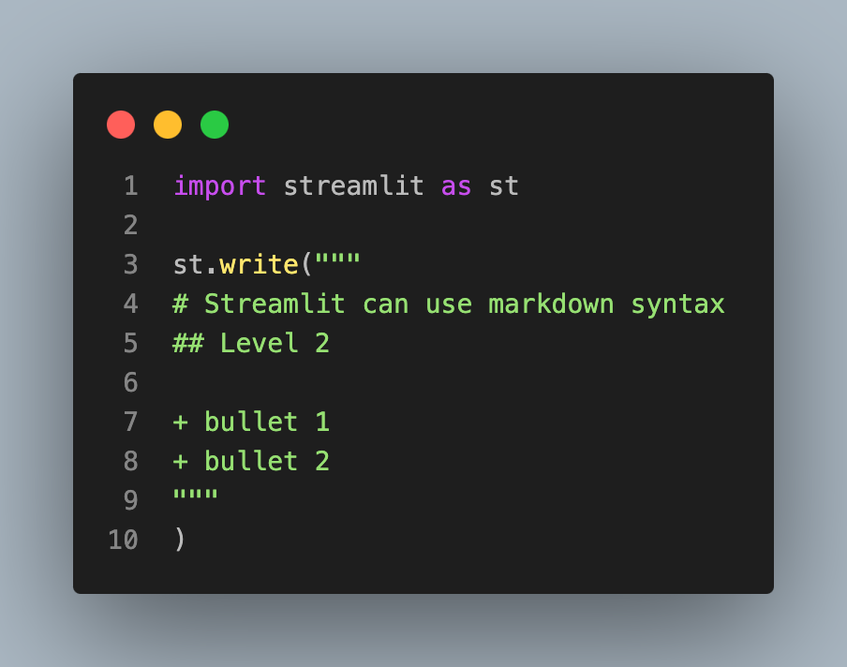
Initialization
Installation
pip install streamlit
Building
Create a file, say app1.py, with the following code:

Slide 4
Compiling the site
Open up a terminal in the directory of your app and type
streamlit run app1.py
It should pop up a browser with your app running!

Slide 5
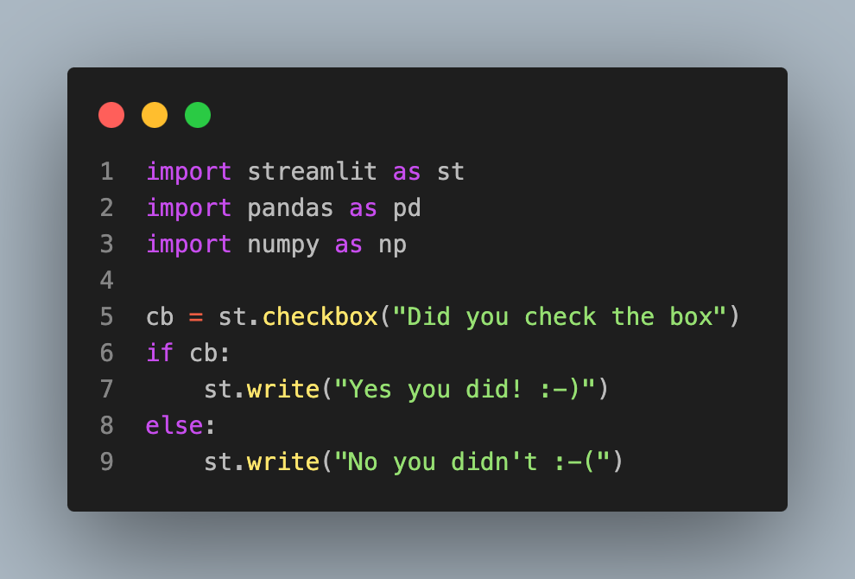
Input / output
Streamlit is very easy for programming I/O

Slide 6
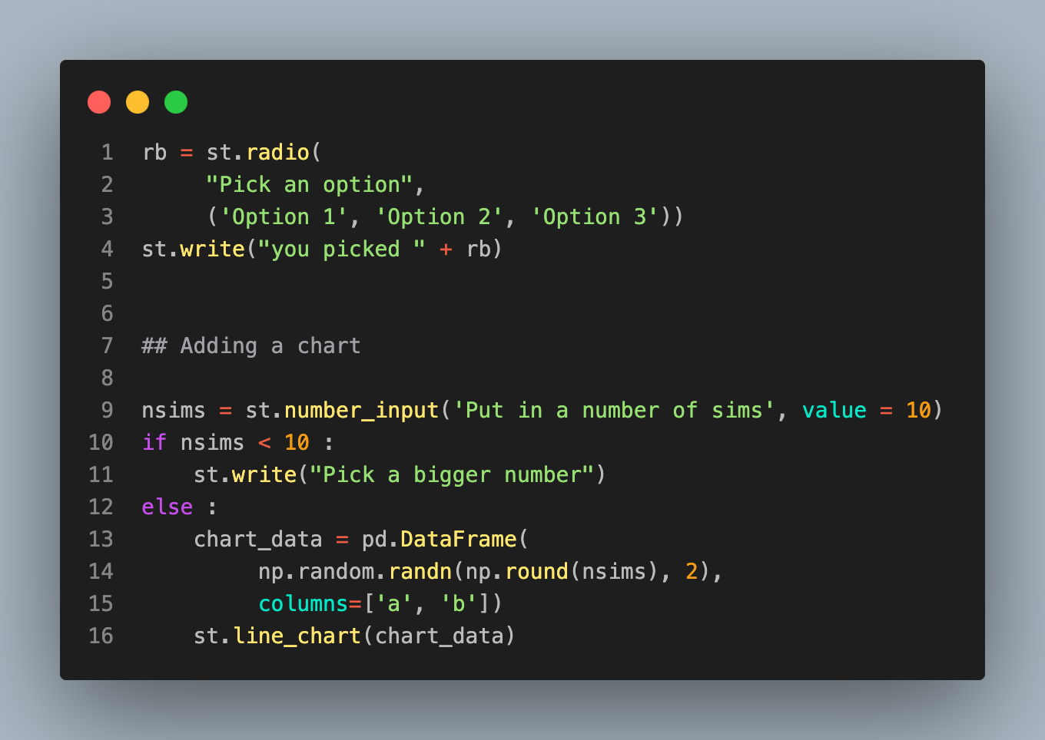

Slide 7
simply save this in a file, say app2.py
type streamlit run app2.py
Also, the app has a button that allows you to deploy it to the streamlit hosting service.

Slide 8
Multipage apps
It's easy and possible to have multi-page apps. Simply
Create a directory, say multi-page
Create a root file in that directory, say home.py
Create a subdirectory called pages
Put the subpages as files in the pages directory
Navigate to multi-page then streamlit run home.py

