Slide 1









z
Introduction
OUR MISSION AT TAPRIWALA …
To inspire moments of optimism.
To bring joy and happiness to people.
To create value and make a difference in society.
1. Maanas Verma​ 18122011
2. Sourabh Kandari 18122023
3. Aaditya Goverdhan

Slide 2
SWOT Analysis

Slide 3
z
Strong, experienced staff
Locally adapted food menus
Serving delicacies created by the freshest local ingredients
Prices are cheaper than competitors
Partnerships with best brands AND LOCAL VENDORS
Children targeting
OUR STRENGTHS

Slide 4
z
Unhealthy food menu
Limited funds available
Costs rising due to increases in food cost
WEAKNESSES

Slide 5
z
Increasing demand for healthier food
Home meal delivery
Introduce Energy Drinks.
Increasing demand
Increase the distribution network
Popularize fewer known products Bottled water consumption growth.
OPPORTUNITIES

Slide 6
z
Current Service Providers and Brands
Currency fluctuations, Taxes, Inflation
Saturated Fastfood markets
A main competitor may lower its price.
THREATS

Slide 7
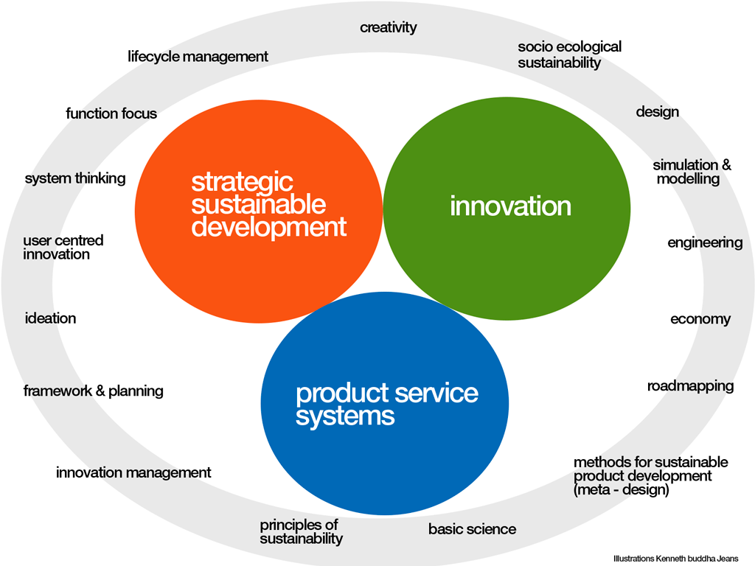
z
I am tired, I want to eat Vada Pav from roadside, but don’t have that time.
Now I just have to open Tapriwala App and select that tapriwala from whom I want to eat.
I order it and it came in just 15-20 mins.
I am Happy
Product Service

Slide 8
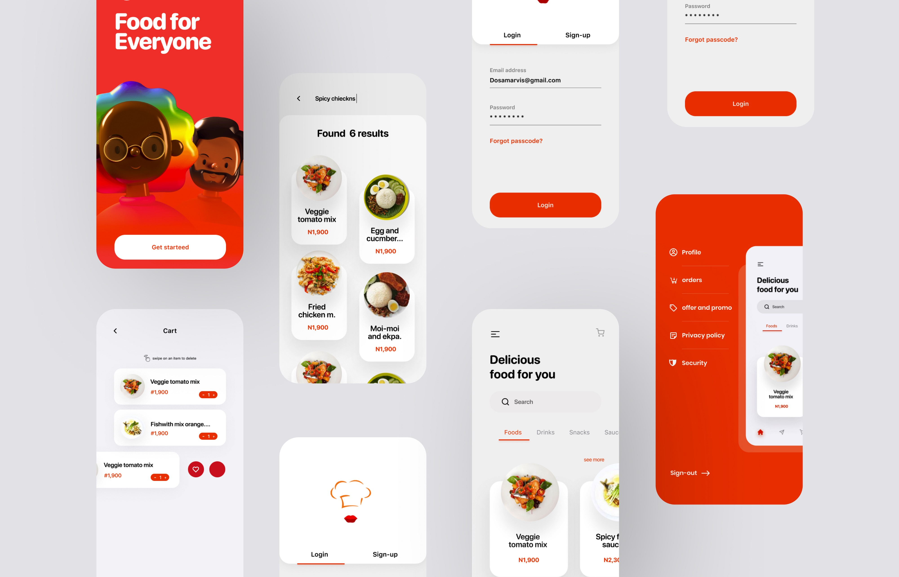
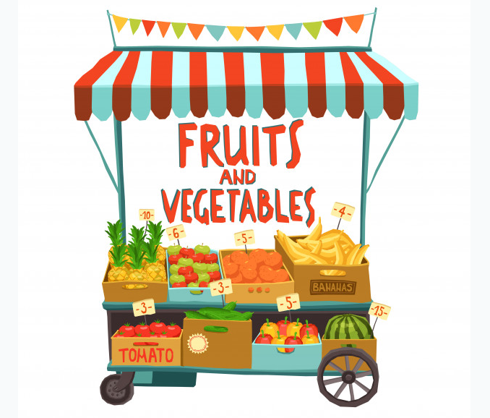

Tapriwala
Tapriwala
Tapriwala

Slide 9
TAPRIWALA : The Spirit Of Local Food
z
At TAPRIWALA, our mission is to connect local food markets and Consumers by offering instant pickups and delivery service.
Connecting Local Shops with Consumers would mean more options to choose from, offering more flavors and at best cost. So, you can enjoy the True Spirit Of Local Food i.e., tasty food at Cheap Price.
All shops affiliated to TAPRIWALA will have to follow strict hygiene guidelines to ensure customers always get the best possible delivery.
We follow a For the People, by the People, and to the People model which means not only will the shops on our platform consist of local vendors only but also anyone interested to be a part of TAPRIWALA team, can be a delivery employee given, they meet a few basic requirements.
TAGLINE + MOTIVES:

Slide 10
SUCCESS OR FAILURE?
PROS
More Flavors
Employment Opportunities
Best Price
Best Offers
CONS
Limited Funds
Highly Competitive Market
Food generally is not healthy
Negative Perception of people towards hygiene in small shops

Slide 11
Thank you

