Slide 1


COMPUTER VISION LAB
Two class classification of heart sound signals using the discrete wavelet transform features
Submitted By: Digesh Dansana (121CS0158)
Ashutosh Das (121CS0159)
Rajdeep Das (121CS0160)
Sourav Das (121CS0161)
Submitted To: Dr. Puneet Kumar Jain
Department of Computer Science and Engineering NATIONAL INSTITUTE OF TECHNOLOGY ROURKELA
APRIL 2024

Slide 2

OBJECTIVE
Classifying heart sound signals as Normal or Abnormal using the Discrete Wavelet Transform Features.
INTRODUCTION
This project comprises a fascinating area of study that combines the principles of biomedical engineering with the power of data analysis to improve the diagnosis and treatment of heart diseases. Our focus is on the analysis of heart sound signals with the help of discrete wavelet transform features.
Our project aims to classify heart sound signals into two classes, typically normal and pathological, using the extracted features. By leveraging the power of DWT and machine learning algorithms, we can develop a system that can accurately diagnose heart conditions based on the analysis of heart sound signals alone and it unlocks possibilities for early detection and treatment of heart diseases, ultimately improving patient outcomes.

Slide 3
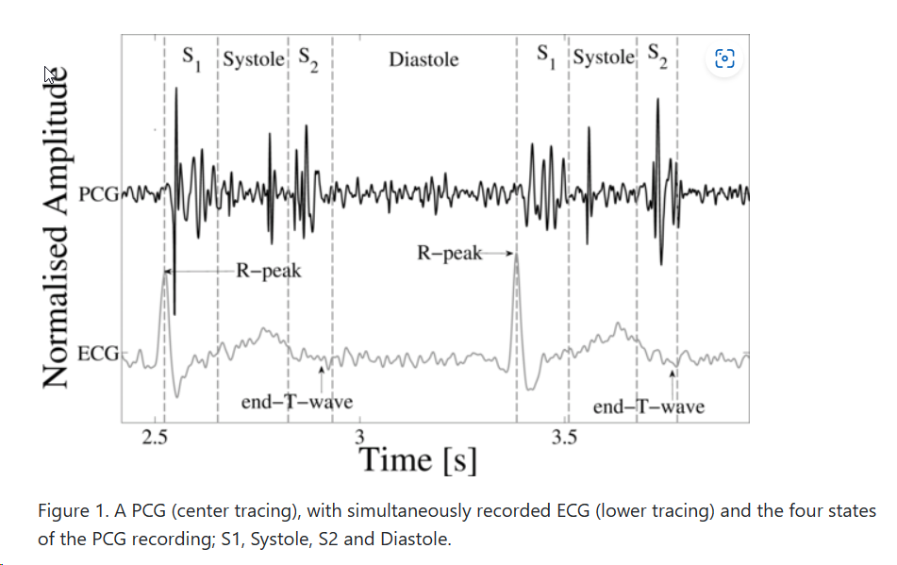
During the cardiac cycle, the heart firstly generates the electrical activity and then the electrical activity causes atrial and ventricular contractions. This in turn forces blood between the chambers of the heart and around the body. The opening and closure of the heart valves is associated with accelerations-decelerations of blood, giving rise to vibrations of the entire cardiac structure (the heart sounds and murmurs) Figure 1 illustrates a short section of a PCG recording.

Slide 4
Discrete Wavelet Transform (DWT)
The Discrete Wavelet Transform (DWT) analysis offers a unique approach to analyzing heart sound signals, distinguishing it from other methods through its ability to capture both time and frequency information, which is crucial for accurately interpreting the signals and distinguishing between normal and pathological states.
Dual Representation
Energy of DWT Coefficient
Automated Diagnosis
The ability of the DWT to represent both time and frequency allows for a more comprehensive analysis of signals, enabling the identification of features at various scales and locations within the data.
The energy of the DWT coefficient is a significant factor in differentiating between healthy and unhealthy heart sound samples. Unhealthy samples typically exhibit much lower energy than healthy samples, making it a reliable differentiating factor.
DWT analysis can be used for automated detection of cardiac diseases, making it a valuable tool in regions with a shortage of medical professionals. It allows for the early and quick automated diagnosis of cardiac diseases without requiring prior medical or professional training.

Slide 5






PROPOSED METHODOLOGY/ALGORITHM
Data Collection and Preparation
The method starts with the collection and preparation of the data required for analysis.
Data Preprocessing
Preprocessing of the data is carried out to ensure its suitability for further analysis.
Feature Extraction for Deep Learning Model
Further feature extraction is performed specifically for the deep learning model, enhancing its ability to classify the features effectively.
Model Creation and Training
A model is created and trained using the extracted features and the preprocessed data.
Classification using 3 models (with Random Forest, AdaBoost and 1D-CNN Model with sigmoid activation function)
The features are extracted by the 1D CNN model then the extracted features given to the random forest classifier AdaBoost classifier and the fully connected layer (sigmoid) respectively.
Comparison of performance of the 3 models
The extracted features are fed to the 3 models and respective accuracy scores are analyzed.

Slide 6
Data Collection and Preparation
Loading the audio file and resampling it
This is done in order to ensure that the audio data is at a consistent sample rate, which is necessary for further preprocessing and analysis.
Decomposition using Haar wavelet
The resampled audio data is then decomposed using the Haar wavelet ('haar') with a decomposition level of 5. This is done using the pywt.wavedec function, which performs a multilevel wavelet decomposition.
Wavelet Coefficients
The result is a list of wavelet coefficients, where the first element is the approximation coefficients array, and the following elements are the detail coefficients arrays at each level of decomposition.

Slide 7
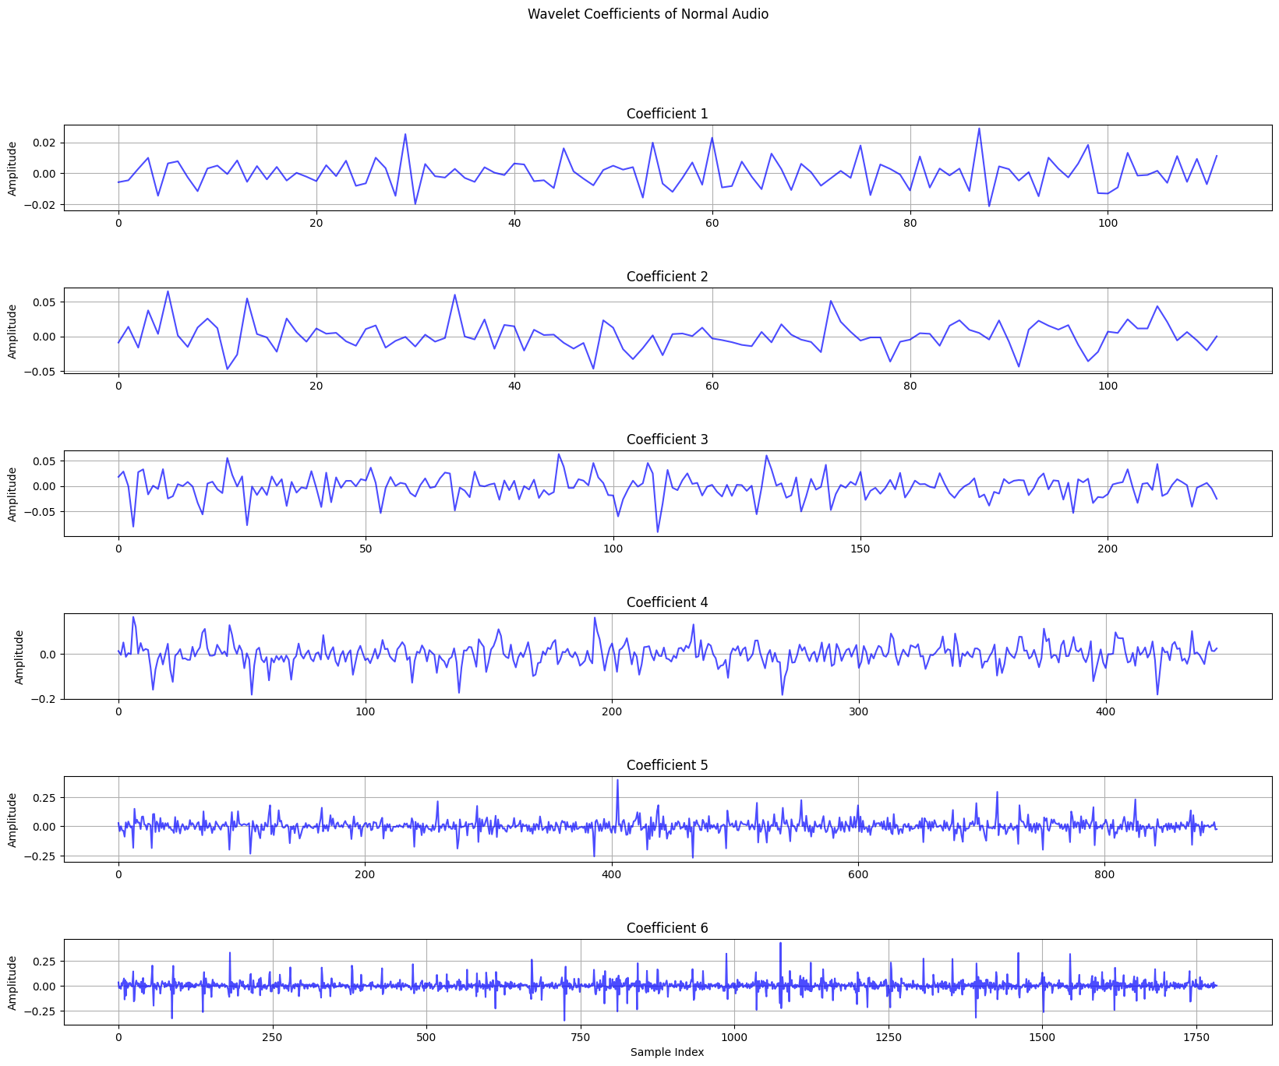
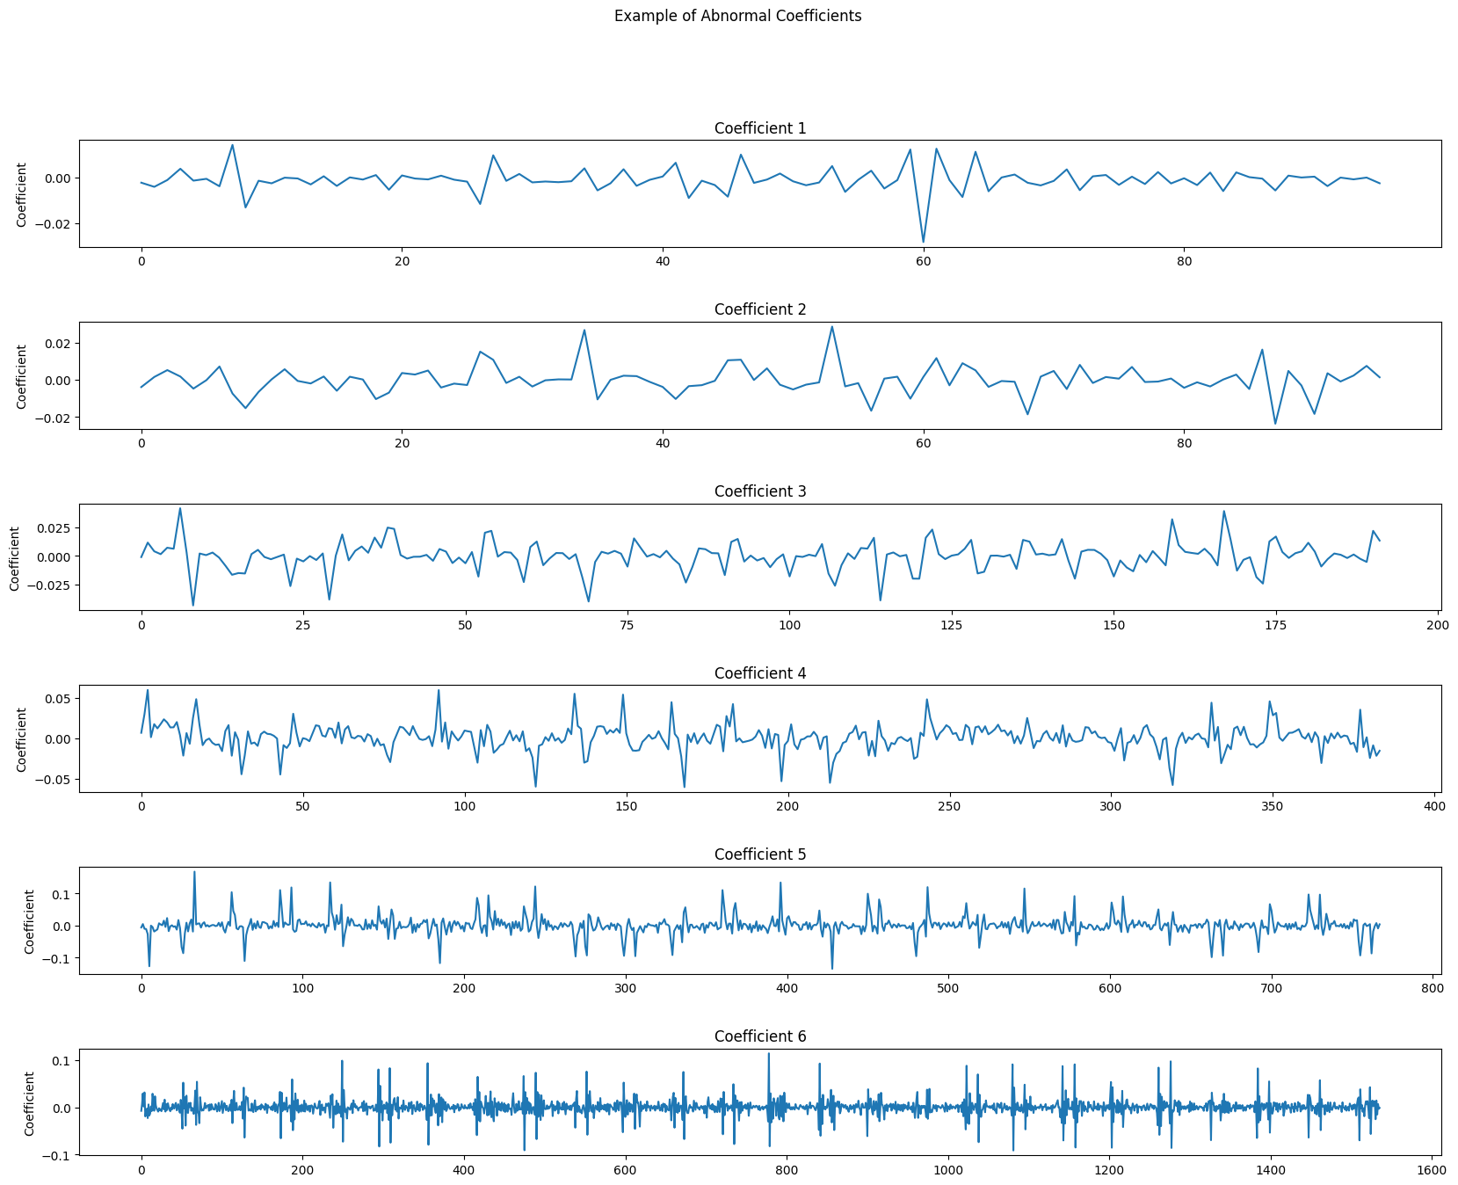
Plotting the wavelet coefficients, we get-
We can also plot the wavelet coefficients for Abnormal Audio..
Fig 1. Wavelet Coefficients of Normal Audio
Fig 2. Wavelet Coefficients of Abnormal Audio

Slide 8
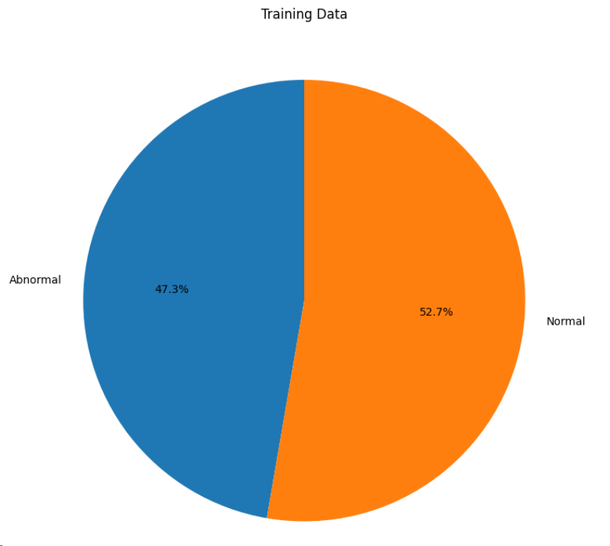
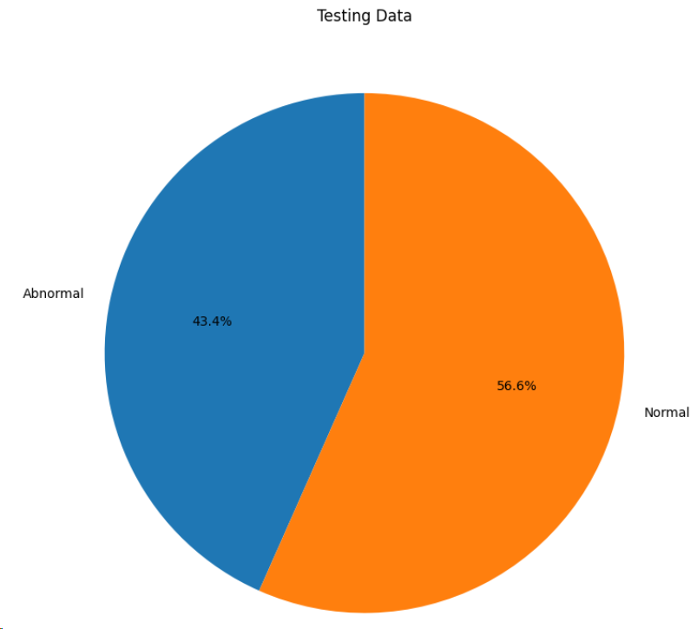
Data Preprocessing
Audio Files Categorized into Normal and Abnormal
A dataset of audio files and their corresponding labels where the audio files are categorized into two classes (normal and abnormal) based on their directory names is prepared.
Traversal of Directory Trees
The os.walk() function is particularly useful for this task as it allows for easy traversal of directory trees, including subdirectories, and can efficiently process files based on their extensions or other criteria.
Fig 3. Training Data Pie Chart for Normal and Abnormal
Splitting the Training and Testing Dataset
The train_test_split function is used to divide the dataset (AudioFiles and AudioLabels) into training and testing subsets. The test_size=0.2 parameter specifies that 20% of the data will be allocated to the test set, while the remaining 80% will be used for the training set.
Fig 4. Testing Data Pie Chart for Normal and Abnormal

Slide 9
Feature Extraction
Features are extracted from audio files using a wavelet transform and then these features are applied to both training and testing datasets. The wavelet_transform function is applied over each file in X_train and X_test and the trimmed wavelet_coefficients are appended to train_features and test_features respectively.
wavelet_transform: This a function to calculate the DWT of the audio files. The wavelet coefficients are concatenated into a single array and then are trimmed to the first 10,000 elements using slicing. The output of this function are the trimmed wavelet coefficients obtained after performing DWT.

Slide 10
Model Creation, Training and Classification
We have designed three Models and compared their performance. The three models are:
A 1D CNN model is designed to extract features and then these extracted features are given to : (i) Random Forest Classifier (ii) AdaBoost Classifier The third model is a complete 1D CNN model that uses Sigmoid function for Binary classification i.e. classify the sounds as Normal or Abnormal.
Detail Description of 1D CNN Model : Three 1D CNN Layers with 256, 128 and 64 neurons respectively. Each layer has a kernel of size 3, with a dropout of 0.4 and relu as activation function.
Max Pooling of 2 is performed.
After the 3 convolution layers there are 4 Fully connected layers with 128, 64, 8 and 1 neurons respectively and binary cross entropy is used as loss function.

Slide 11
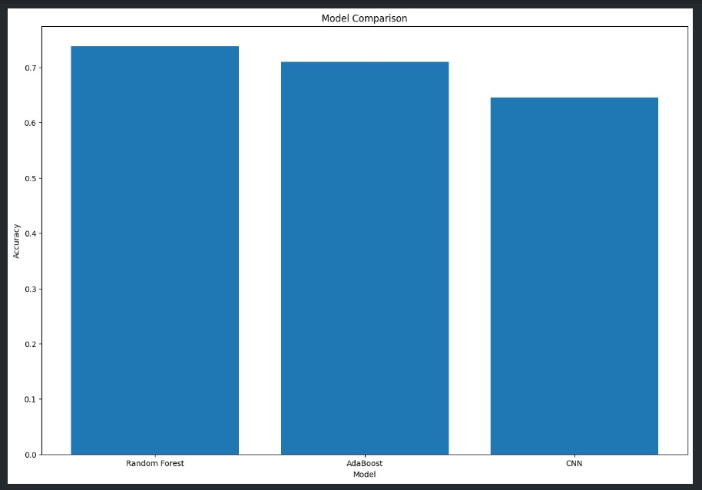
Comparison of performance of the 3 Models
Fig 5. Accuracy Scores of the 3 Models
The given graphs shows us the accuracy scores of the 3 models.

Slide 12
RESULT
The method successfully classified audio files into two categories: "Abnormal" and "Normal" using a combination of wavelet transform for feature extraction and a deep learning model for classification with an accuracy of 64%-73%
CONCLUSION
The proposed method demonstrated the effectiveness of combining wavelet transform with deep learning for audio classification tasks. The wavelet transform provided a compact and informative representation of the audio data, which was crucial for the deep learning model to learn the distinguishing features between "Abnormal" and "Normal" audio files. The use of a CNN model allowed for the extraction of hierarchical features from the audio data, enhancing the model's ability to classify the audio files accurately.
REFERENCE
https://physionet.org/content/challenge-2016/1.0.0/
https://en.wikipedia.org/wiki/Discrete_wavelet_transform

