Slide 1

SMART INDIA HACKATHON 2026
TITLE PAGE
Problem Statement ID –7-L
Problem Statement Title- AI-Powered Academic Dropout Prediction and Intervention System
Theme- AI for Education and Human Development
PS Category- Software
Team ID-84
Team Name - JASPON

Slide 2
IDEA TITLE
JASPON
Jaspon: AI-Powered Intervention System for Student Dropout Prevention.
Combines attendance, grades, and engagement data into one early-warning dashboard.
Built for real classroom use — a quick daily check, not a complex analytics tool.
Explains why a student is at risk, not just a score — attendance drop, failed tests, low engagement.

Slide 3
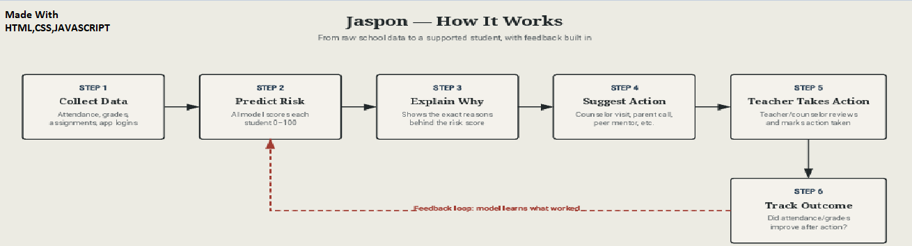
TECHNICAL APPROACH
JASPON
A working demo website which is built, tested and contains teacher dashboard , student risk view, live "mark done" action tracking and overview charts are all functional.

Slide 4
FEASIBILITY AND VIABILITY
JASPON
Works with what school already have designed to plug into existing ERP/attendance systems instead of replacing them.
Data already exists in school attendance register and marksheets are already collected so no new infrastructures need to start.
Low-cost to run — lightweight model, doesn't need expensive hardware or constant retraining.

Slide 5
IMPACT AND BENEFITS
JASPON
Students: Get help before falling too far behind. A real second chance instead of quietly dropping out.
Teachers: Save time no need to manually track 40+ student's attendance and grades by hand.
Parents: Get notified earlier, so they can support their child sooner.
Institutions: Identify at-risk students early and provide timely academic support to improve retention and overall performance.

Slide 6
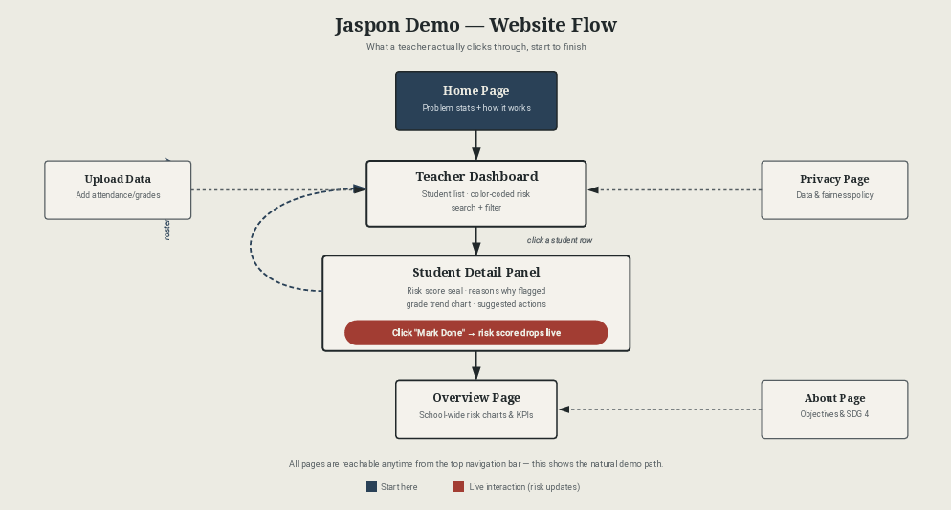
RESEARCH AND REFERENCES
JASPON
https://astonishing-creponne-99a1db.netlify.app

