Slide 1
Multidimensional DBSCAN in Spark
Ashish Mohapatra - axm160031
Vipul Jarmale - vxj160130
Koulick Shankar Paul - ksp160330
Akash Deo - apd160330
Rohit sindhu - rks160030

Slide 2
About DBSCAN
A popular class of unsupervised learning algorithms is Cluster Analysis.
Most of these algorithms are sensitive to initialization of data and the number of iterations run on the dataset.
Most of them find spherical clusters and fail to find clusters of other shapes.
DBSCAN overcomes these and several other disadvantages.
Implementing the same in Scala enables us to run DBSCAN on a Spark cluster where the data points are distributed across different nodes.

Slide 3
About DBSCAN (contd…)
It is a density-based clustering algorithm: given a set of points in some space, it groups together points that are closely packed together, marking as outliers points that lie alone in low-density regions.
For the purpose of DBSCAN clustering, the points are classified as core points, border points and noise points, as follows:
A point p is a core point if at least minPts points are within distance ε (ε is the maximum radius of the neighborhood from p) of it (including p). Those points are said to be directly reachable from p.
A point q is directly reachable from p if point q is within distance ε from point q and p must be a core point.
A point q is reachable from p if there is a path p1, ..., pn with p1 = p and pn = q, where each pi+1 is directly reachable from pi (all the points on the path must be core points, with the possible exception of q).
All points not reachable from any other point are noise points.

Slide 4
About DBSCAN (contd…)
Reachability is not a symmetric relation since, by definition, no point may be reachable from a non-core point, regardless of distance.
Two points p and q are density-connected if there is a point o such that both p and q are density-reachable from o. Density-connectedness is symmetric.
A cluster then satisfies two properties:
All points within the cluster are mutually density-connected.
If a point is density-reachable from any point of the cluster, it is part of the cluster as well.

Slide 5
Advantages of DBSCAN
DBSCAN can find arbitrarily shaped clusters.
DBSCAN does not require one to specify the number of clusters like Kmeans or Kmeans++.
DBSCAN has a notion of noise, and hence is robust to outliers.
DBSCAN requires just two parameters and is mostly insensitive to the ordering of the points in the database.
The parameters minPts and ε can be set by a domain expert, if the data are well understood.

Slide 6
disadvantages of DBSCAN
Border points that are reachable from more than one cluster can be part of either cluster, depending on the order the data are processed. For most data sets and domains, it has little impact on the clustering result.
The quality of DBSCAN depends on the distance measure used in the function regionQuery(P,ε).
DBSCAN cannot cluster data sets well with large differences in densities, since the minPts-ε combination cannot then be chosen appropriately for all clusters.
If the data and scale are not well understood, choosing a meaningful distance threshold ε can be difficult.

Slide 7
Project source code and how we made it work
We reused the DBSCAN over Spark project source code from:
https://github.com/alitouka/spark_dbscan
Entire project was in SBT format and it was having build and other issues.
We converted the whole project into Maven.
We started working on the dependencies and added pom.xml
Faced versioning issues as well. So we used 2.10 and 2.11 versions for SCALA
Overall, we are using 2.11 SCALA compiler

Slide 8
how we made it work (contd…)
We included two logging libraries in the code.
apache.spark.internal.Logging
slf4j.LoggerFactory
After using these logging libraries, the code started to run.
The multidimensional input file we got from project source, was giving 4 clusters.
We downloaded more input files from Kaggle which are 2 and 4 dimensional respectively and ran further tests.

Slide 9
how we made it work – steps
Create a Maven project
Change pom.xml (attachment is in the email) - please make sure that the spark-core version is the one installed in your system.
Change to Scala Nature
Change scala-compilation
Deleted scala-library
Renamed java to scala
Copy everything inside the .../main folder from the source project and pasted into the .../main folder of the created project
Build the project.
Fix any errors, if any. (especially version mismatches which were fixed in the pom.xml file.)
Create the jar file of the project, by exporting from the file menu. While exporting, check all the 'Options' (not mandatory).

Slide 10
how we made it work – steps (contd…)
We need these 2 jar files: (attachments are in the email.
scopt_2.10-3.7.0.jar (needed for scopt)
spark-core_2.11-1.6.0.jar (needed for org.apache.spark.logging)
Here we need the input CSV file.
Open cmd. Go to the directory where 'spark-submit' is present.
Run the below command: bin\spark-submit --jars C:\Users\KOULICK\Desktop\scopt_2.10-3.7.0.jar,C:\Users\KOULICK\Desktop\spark-core_2.11-1.6.0.jar --class org.alitouka.spark.dbscan.DbscanDriver --master local C:\Users\KOULICK\Desktop\CS6350_Project_F17.jar --ds-master local --ds-jar C:\Users\KOULICK\Desktop\CS6350_Project_F17.jar --ds-input C:\Users\KOULICK\Desktop\csv_files\HR_comma_sep_2.csv --ds-output C:\Users\KOULICK\Desktop\output --eps 25 --numPts 30 This link tells what parameters we need to use: https://github.com/alitouka/spark_dbscan/wiki/Using-Spark-DBSCAN-as-a-standalone-application

Slide 11
Distance to nearest neighbor (eps)
This can be found out using the class named DistanceToNearestNeighborDriver.
It calculates distance from each point to its nearest neighbor within the same partition, so, for a small fraction of points this distance will not be accurate.
However, this inaccuracy doesn't affect the overall distribution of distances too much.

Slide 12
Counting point’s neighbors
This can be found using the class named NumberOfPointsWithinDistanceDriver.
It calculates how many points lie within the specified epsilon-neighborhood.

Slide 13
2D Visualization in Python – matPLOTLIB code
import numpy as np
import sysimport time
import matplotlib.colors as clr
import matplotlib.pyplot as plt
moons = np.genfromtxt(‘/FILE_PATH/'+sys.argv[1]+'/input.csv', delimiter=',', names=['x', 'y’])
plt.figure(1)
plt.scatter(moons['x'],moons['y'],color='r’)
parts = np.genfromtxt(‘/FILE_PATH/'+sys.argv[1]+'/output.csv', delimiter=',', names=['x', 'y', 'c’])
colors = ['black','red','green','blue','purple’]
plt.figure(2)
plt.scatter(parts['x'],parts['y'],c=parts['c'], cmap=clr.ListedColormap(colors), lw=0)
plt.xlabel('X Axis’)
plt.ylabel('Y Axis’)
timestr = time.strftime("%Y%m%d-%H%M%S")
plt.savefig(‘/FILE_PATH/'+sys.argv[1]+'/'+timestr)

Slide 14
Visualization results
We tried to 2D plot in Matlab different parts of input data files.
Results are shown in the following slides.

Slide 15
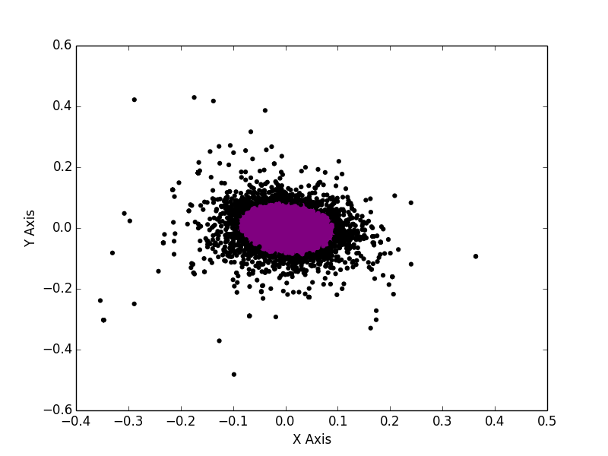
2 attributes used from multidimensional data file

Slide 16
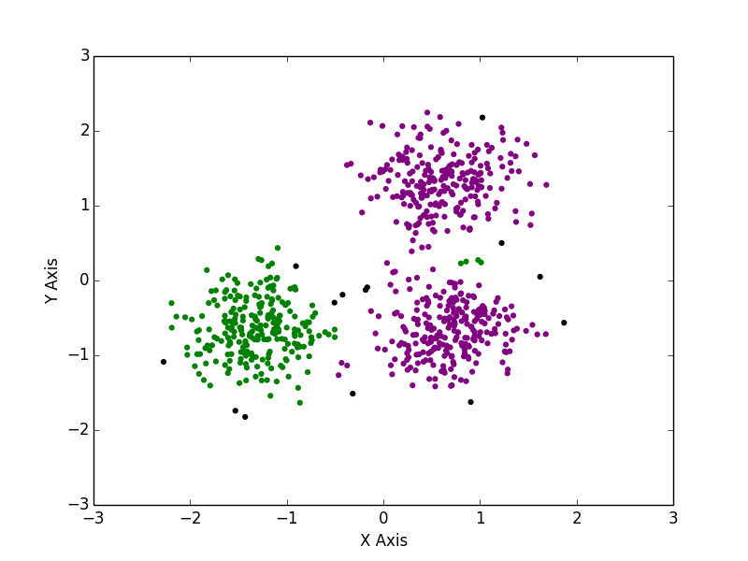
2D data downloaded from kaggle

Slide 17
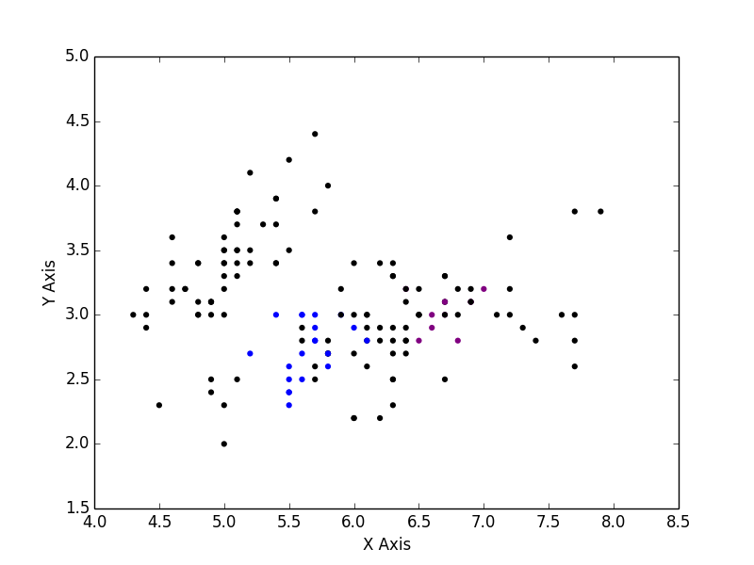
Col 1-2 of 4D data file from kaggle

Slide 18
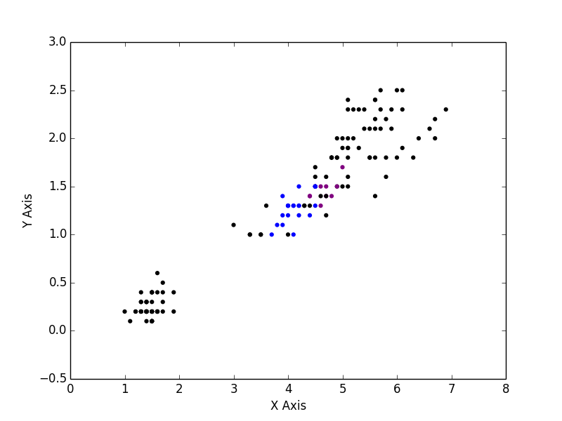
Col 3-4 of 4D data file from kaggle

Slide 19
Thank you!

