Slide 1

Onboarding Process
Digitalization of Business Processes
2025 Spring
Claudio Schwaiger, Jasmin Winter, Gilles Müller

Slide 2
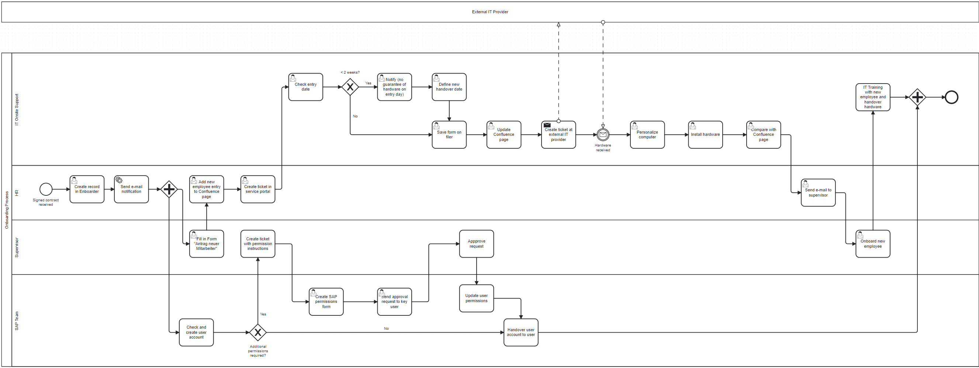

Current Onboarding Process

Slide 3
Participants & pain points
IT Onsite Support
HR
Supervisor
SAP Team
External IT Provider
Too many manual steps and system handoffs
Lack of automation or centralized tracking
No data digitalized (manual entries throughout the process)
Dependence on external IT provider
Long waiting times for filled out requirements
No feedback or final quality check
Delays in starting new employees
High workload for HR, IT and managers
Poor first impression of the new team member on the company

Slide 4
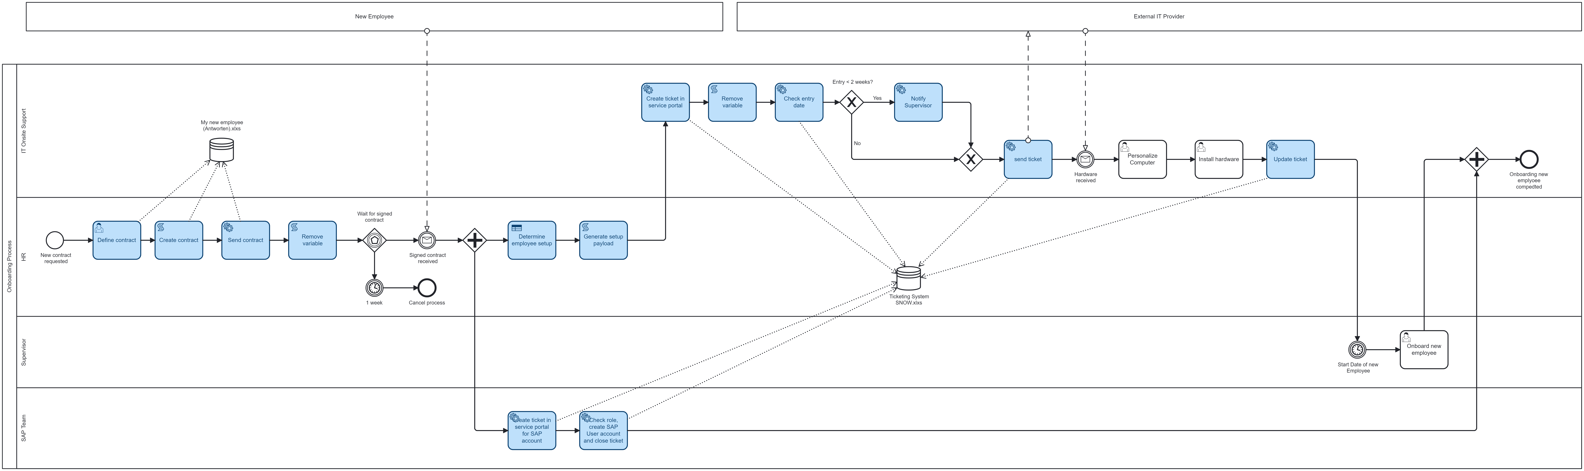
Digitalized Onboarding Process

Slide 5
General improvements
Automated workflow reduces manual steps and errors
Centralized ticket system ensures better tracking and consistency
Improved handling of short-notice hires with auto-alerts
Clear responsibilities across HR, IT, and SAP
Defined process end enables reporting and control
Scalable setup for future growth

Slide 6
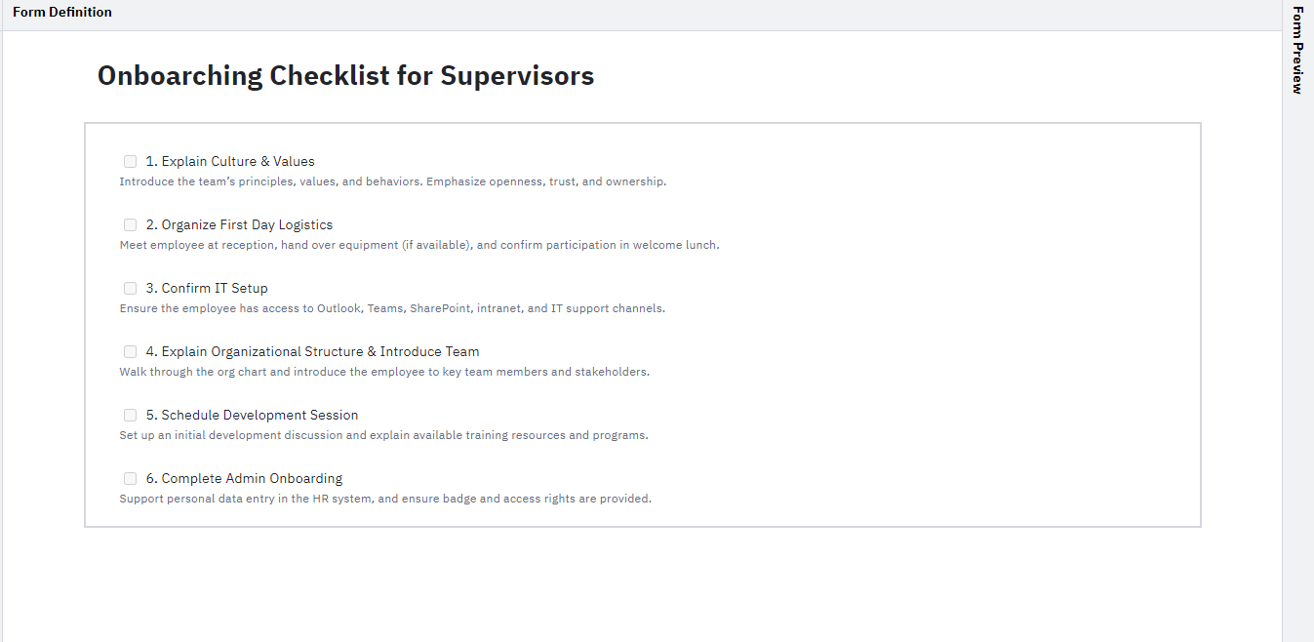
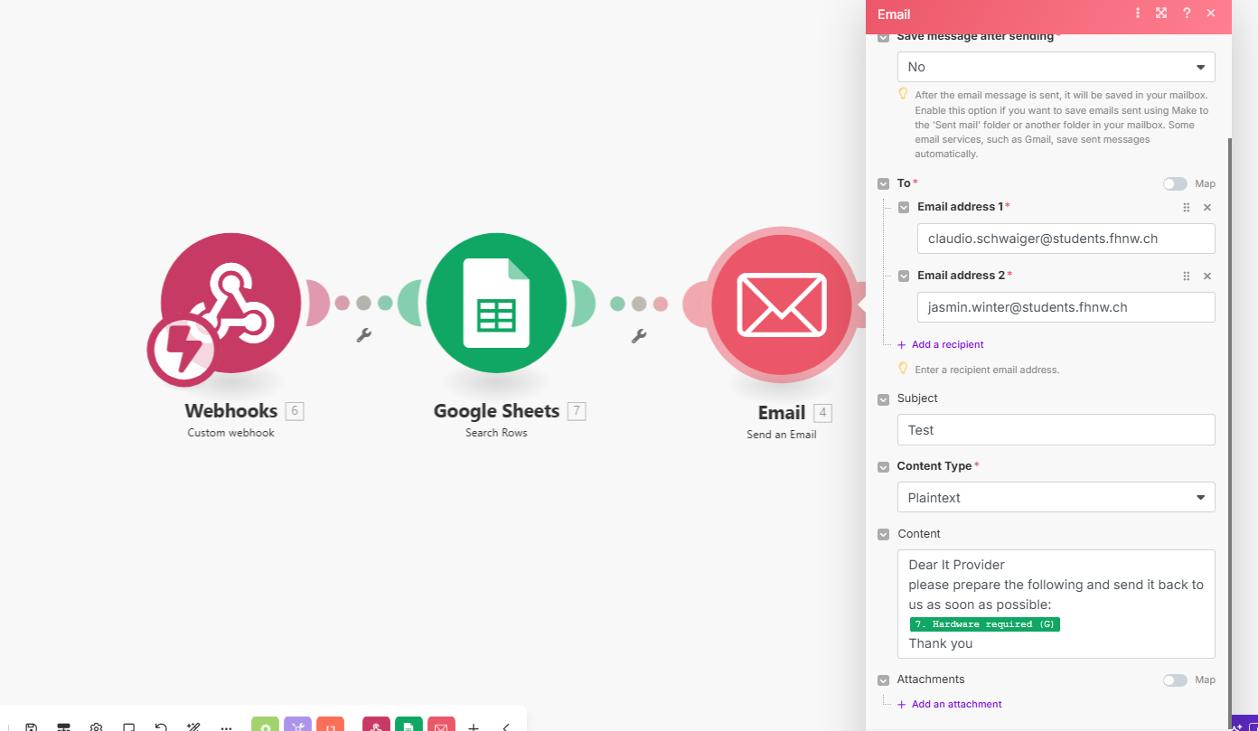
Advantages & Tools
Automated logic replaces manual review
Human escalation only when needed (via supervisor notification)
Dynamic update to Google Sheets without scripting
Easily pluggable into any BPMN process with Camunda
Make
Camunda Modeler
Google Sheets (as request/ticket database)

Slide 7
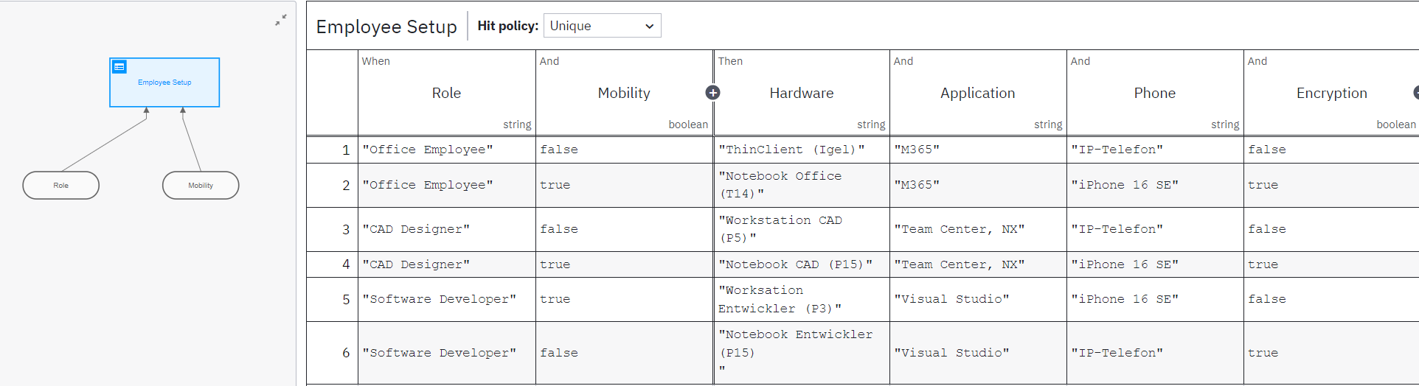
Decision Model and Notation

Slide 8
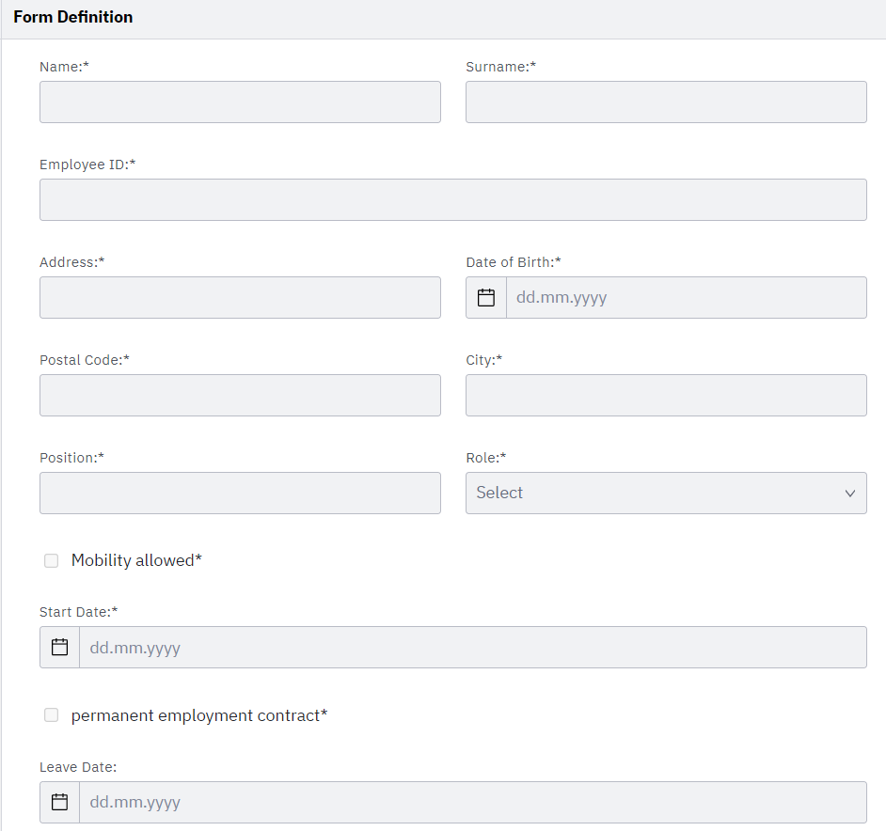
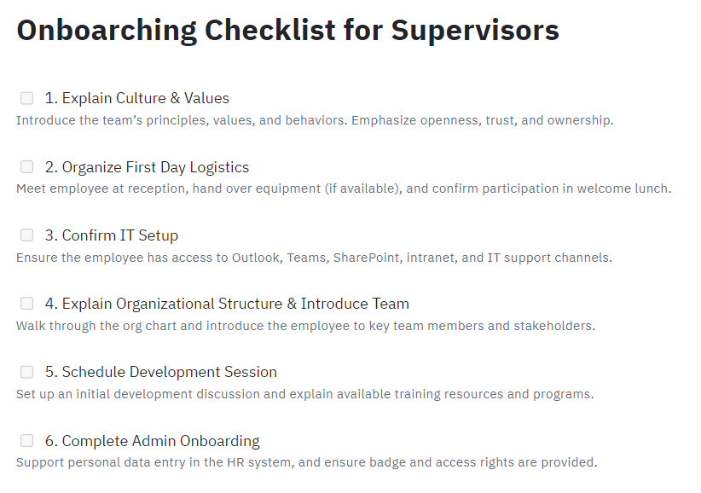
Forms

Slide 9
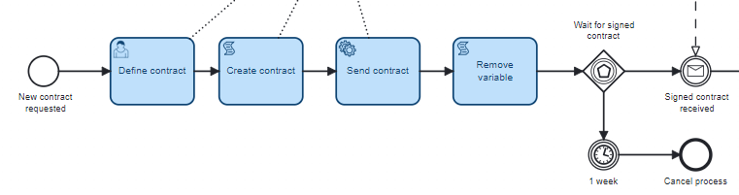
Digitalisation in detail
Fillable pdf → Camunda Forms
Data can be processed further
Contract is set up through the Camunda Forms
Contract is sent directly after completion
After 1 week of no received contract
→ Process is canceled automatically

Slide 10
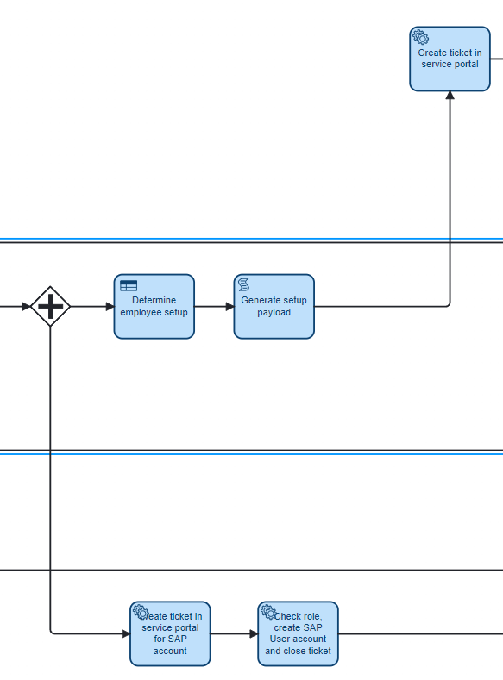
Digitalisation in detail
Employee setup is determined automatically via DMN decision
Required hardware, applications and encryption need are derived from job role
Logic is fully configurable (e.g. CAD roles get high-spec hardware)
Setup payload is generated for downstream processing
Information is sent to the ticketing system (Make + Google Sheets)
No manual form filling or interpretation required

Slide 11
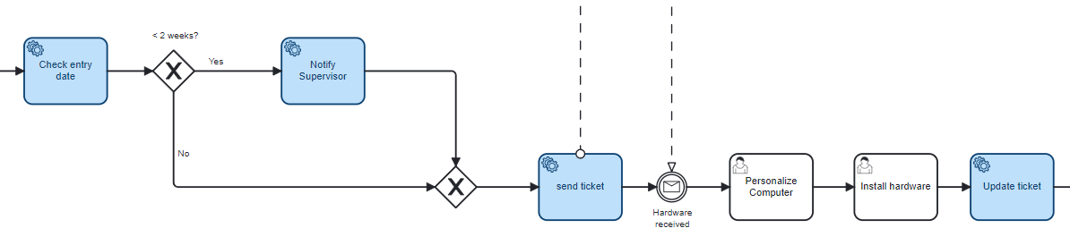
Digitalisation in detail
The process now automatically checks whether the onboarding request was submitted early enough.
If the start date is too soon, the system informs the supervisor and pushes the delivery date forward to ensure feasibility.
All updates are applied directly in the central Google Sheet – no manual review needed.
Camunda continues the process based on the result.
This ensures realistic delivery timelines and reduces coordination effort.

Slide 12
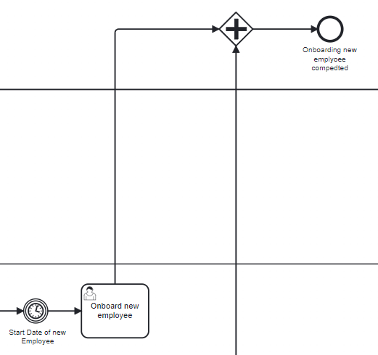
Digitalisation in detail
A checklist supports the supervisor in last step of the onboarding process of the new employee
Camunda marks the onboarding process as completed
Ensures formal closure and complete transparency

Slide 13
Thank you
Digitalization of Business Processes
2025 Spring

