Slide 1
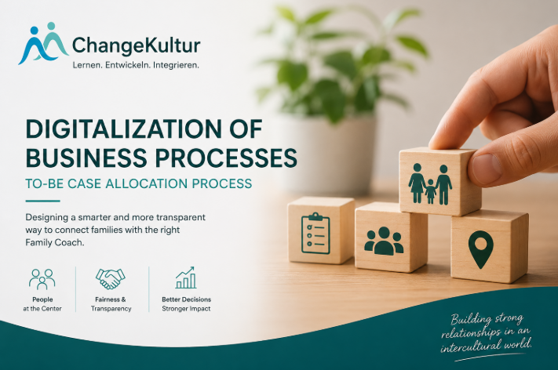
CHANGEKULTUR – CASE ALLOCATION PROCESS
Digitalization of Business Processes · FHNW · 2026
Team: Cedric Iseli Dionis Mrlaku
Kanika Mukhija
Pallavi Gowda
Shakunthala Reddy Patlolla
Supervisors: Andreas Martin, Charuta Pande, Devid Montecchiari
Notes:
This project was done in collaboration with Lebensmittel Netzwerk Basel. Which aims to strengthen regional and organic food sourcing in communal catering.
LMN works closely with canteens and regional farms to understand current procurement patterns and explore how more products especially vegetarian and organic can be sourced locally.
To support this goal, procurement data was collected from several canteens, covering what products are purchased, in which quantities, at what prices, and from which suppliers.

Slide 2



Who is CHANGEKULTUR?
Family Coaching
Youth & Integration
Swiss-wide Reach
Providing structured coaching to vulnerable families across Switzerland
Supporting youth development and multilingual integration programs
A Zürich-based NGO operating with a growing network of family coaches
The Challenge: Matching the right coach to the right family - quickly and fairly.
28.05.2026
DigiBP/26SS_Tierpark_Bern

Slide 3

Meet Maria - A Family in Need-Journey Begins
The Situation Maria, mother of two , recently relocated to Basel. She speaks English and Hindi. Social services refer her to ChangeKultur for family coaching support. The Request An administrator at ChangeKultur receives the case. They now need to find the most suitable family coach - someone with the right language, workload and distance. The Problem In the current system, this of manual effort, phone calls, and guesswork.
Before a family in need gets support,too much time is lost in manual coordination.
This is the problem we set out to solve.

Slide 4

How Case Allocation Works Today (AS-IS)
1
2
3
4
5
Case Received
Manual Search
Phone Calls
Judgement Call
Inform Family Coach
Via email / walkins / phone call
Case coach checks family coaches one by one
Check availability manually
Assign based on Case coach intuition
Notify manually
No Selection Criteria

Slide 5





Pain Points
Manual Process
No Transparency
No Distance Calc
Manual search across multiple family coaches takes days of Case coach time
No audit trail of why one coach was chosen over another
Travel time between client and coach is manually calculated.
Subjective Matching
No Structured Data
Selection depends on personal knowledge - no selection criteria
Case and coach info is scattered across emails, calls, and team notes.

Slide 6
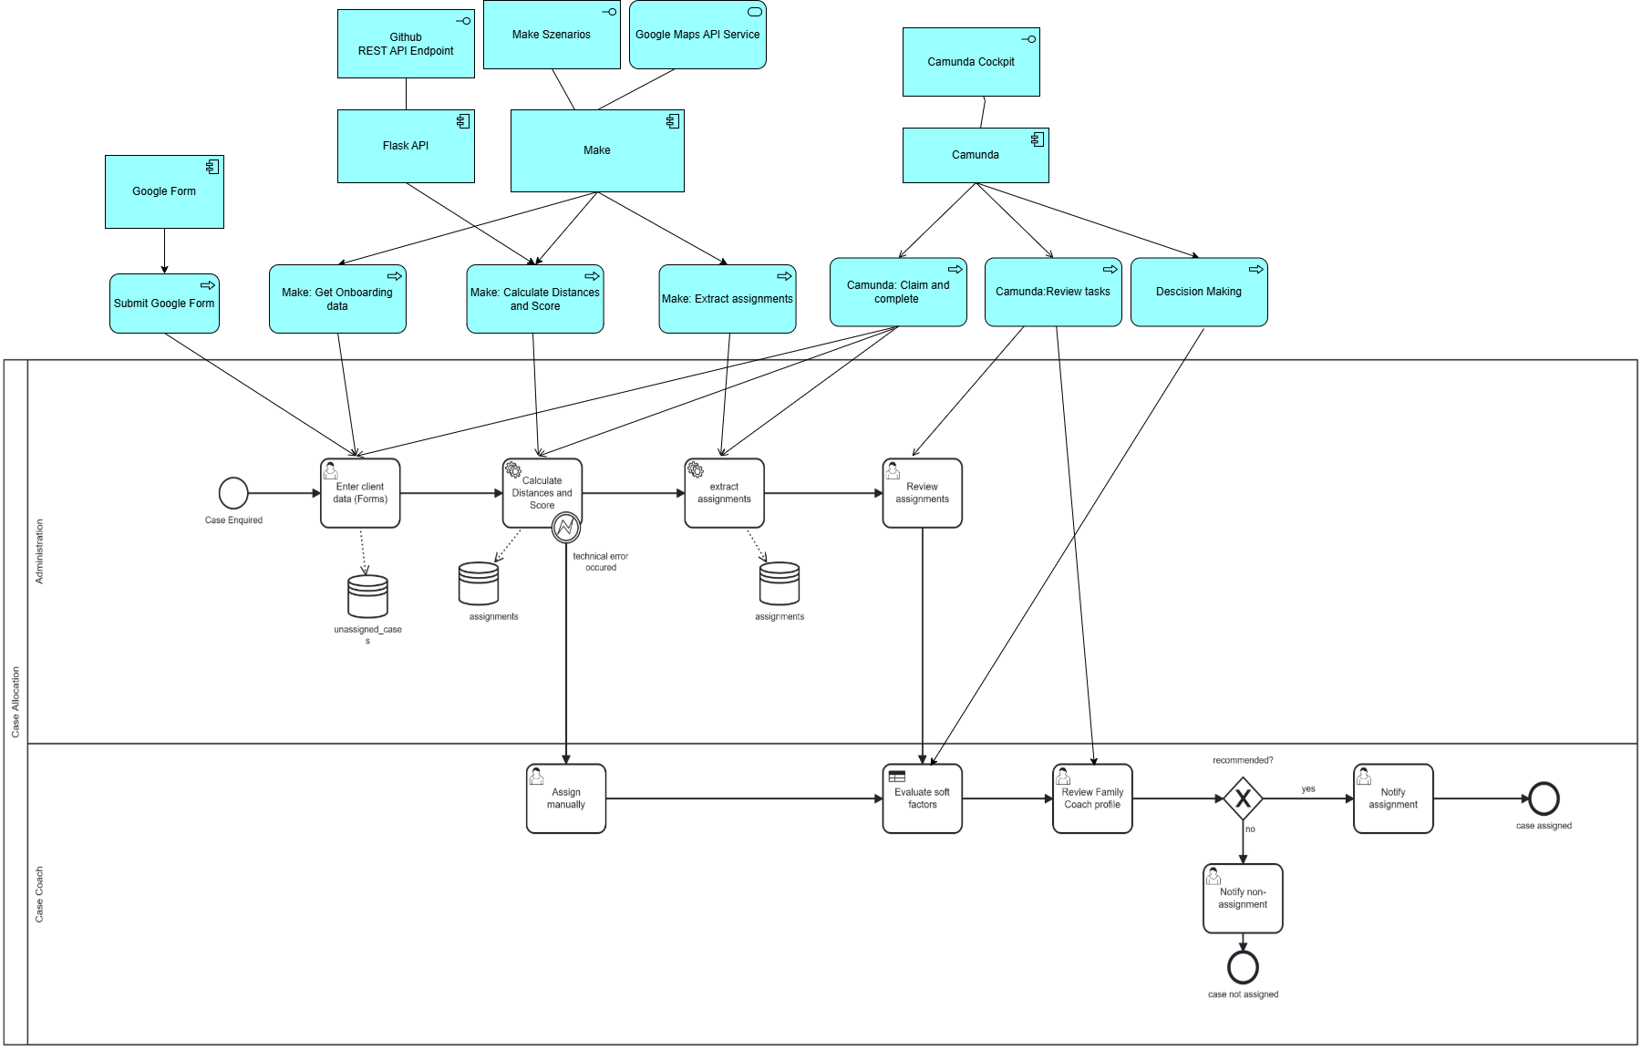
TO-BE Process

Slide 7
TO-BE : The Technology Stack
We transformed a slow, opaque, manual process into a transparent, automated, and human-verified workflow - helping families get support faster.
Camunda
Make
Google Forms
Workflow Engine
Integration Layer
Data Entry
Models and orchestrates the entire BPMN process
Connects Google Sheets, Maps API, Flask and Camunda
Structured onboarding form for case administrators
Flask API
Google Maps API
Scoring Engine
Distance Calculation
Python script that calculates composite match scores
Real driving distance & duration per coach-client pair
DigiBP/26SS_Tierpark_Bern
28.05.2026

Slide 8
TO-BE: 6-Step Automated Workflow
1
2
3
Enter Case Data
Auto-Score
Review Shortlist
Google Form → DB
Distance + Skills + Language + Capacity
Admin checks top matches
4
5
6
Soft Factor Eval
Coach Review
Client Notified
DMN decision logic applied
Case Coach approves or loops
Automated email sent

Slide 9
Value added by Our TO-BE Process
01 - Composite Scoring Engine
02 - Human Judgement Supported by Automation
A custom Python Flask API evaluates every possible case–coach pair simultaneously. Language · Skills · Capacity · Travel Time Each dimension gets a sub-score. The total composite score ranks coaches objectively, no gut feeling involved.
It recommends the best coach based on objective data, but the Case Coach still reviews the match before allocation.
The human review adds professional judgement.
Automation supports the decision, it does not replace the human.

Slide 10
ROADMAP- From Prototype to Production
Now
Next
Future
Google Sheets as lightweight DB
Migrate to relational DB (PostgreSQL)
ML-based coach recommendation
Flask API on dev hosting
Stable cloud API deployment
Coach availability calendar integration
Rule-based scoring logic
Weighted scoring configuration
Mobile app for coaches

Slide 11

THANK YOU
Notes:
This project was done in collaboration with Lebensmittel Netzwerk Basel. Which aims to strengthen regional and organic food sourcing in communal catering.
LMN works closely with canteens and regional farms to understand current procurement patterns and explore how more products especially vegetarian and organic can be sourced locally.
To support this goal, procurement data was collected from several canteens, covering what products are purchased, in which quantities, at what prices, and from which suppliers.

