Slide 1
Patient Discharge Process after Total-Hip-Replacement Surgery
Digitalization of Business Processes in Healthcare
Elisa Hemmig, Dominique Jud, Ramon Winkler, Justin Jouwena

Slide 2
Problem
Post-surgery care for highly complex and multi-disciplinary process
In Switzerland, approximately 16,000 THR surgeries annually

Slide 3
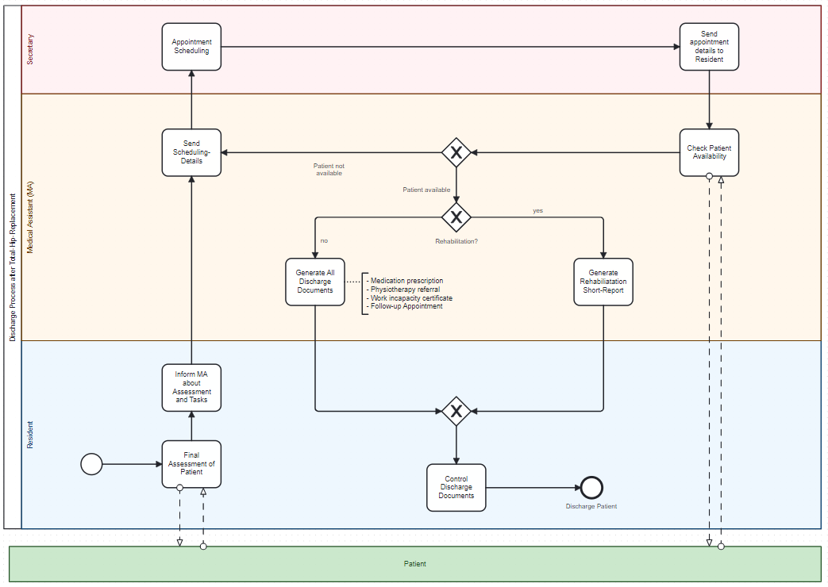

Slide 4
Solution
Digital Assistant
A centralized system ensures seamless data sharing and minimizes errors caused by fragmented workflows.

Slide 5
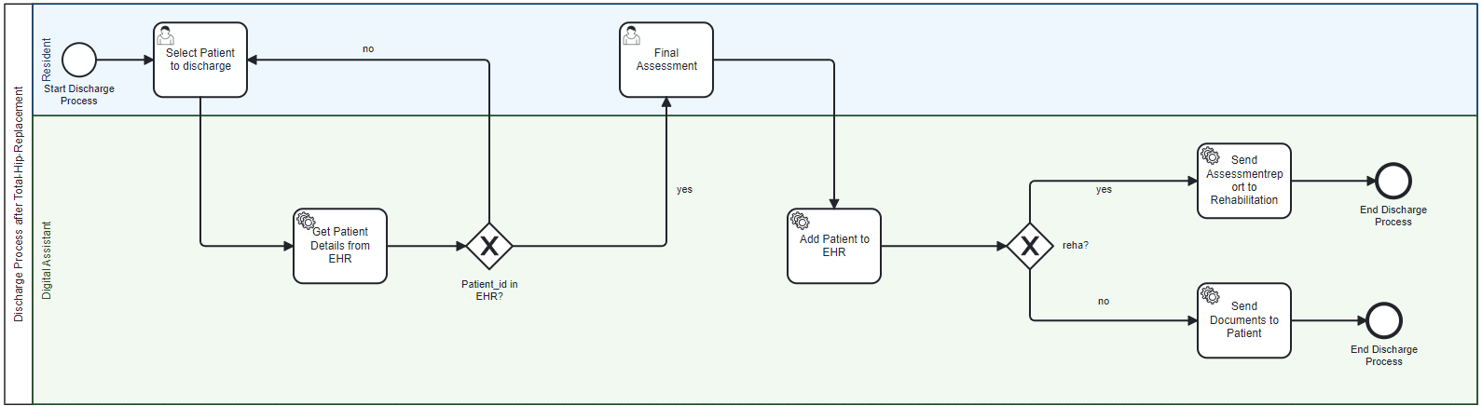

Slide 6
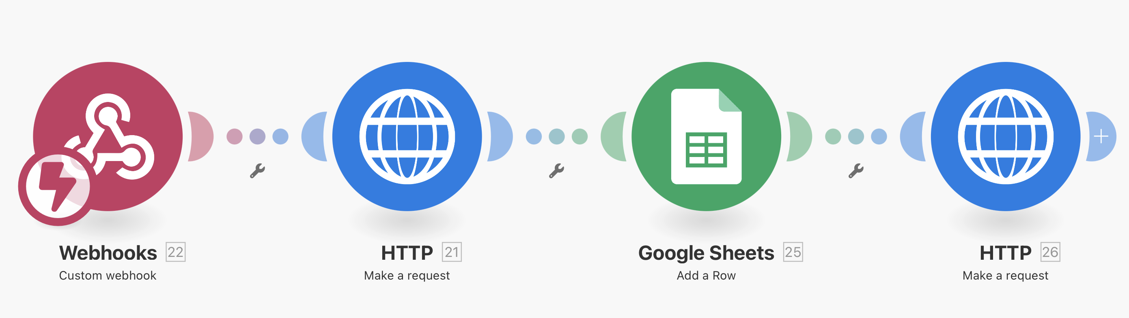
Implementation – Make as an external worker to add patient details
Patient data base:
Basic patient information
Prescribed medication
Physiotherapy required?
Mobility and gait status
Working and home office status

Slide 7
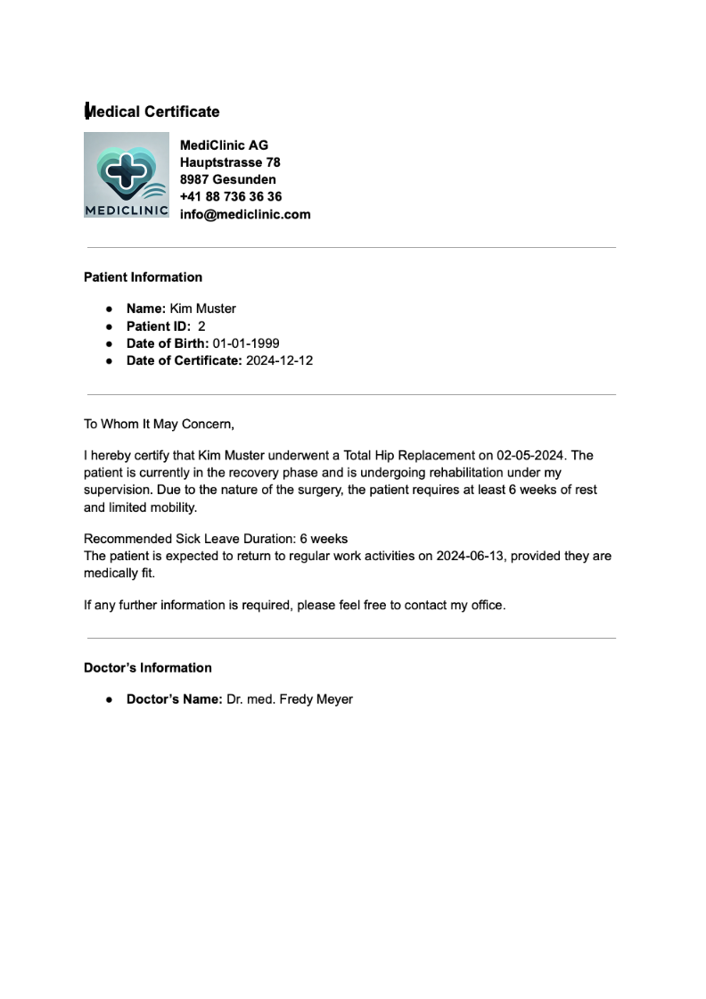
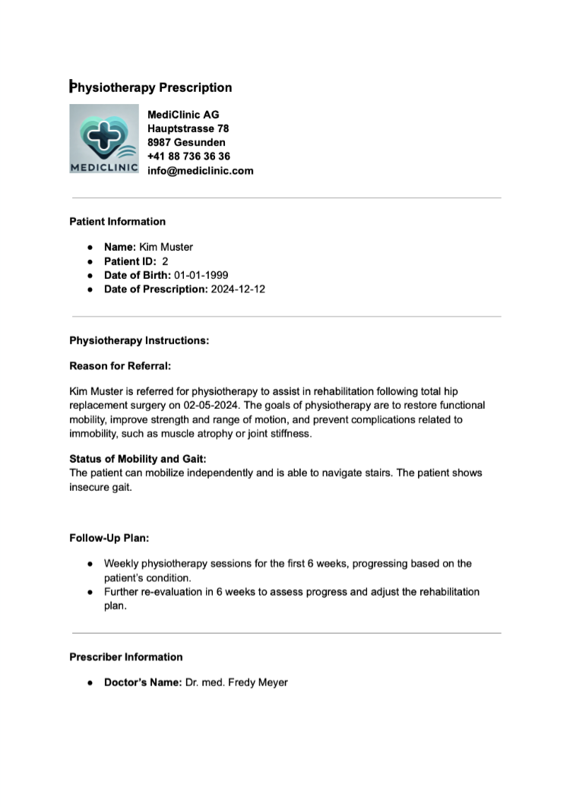
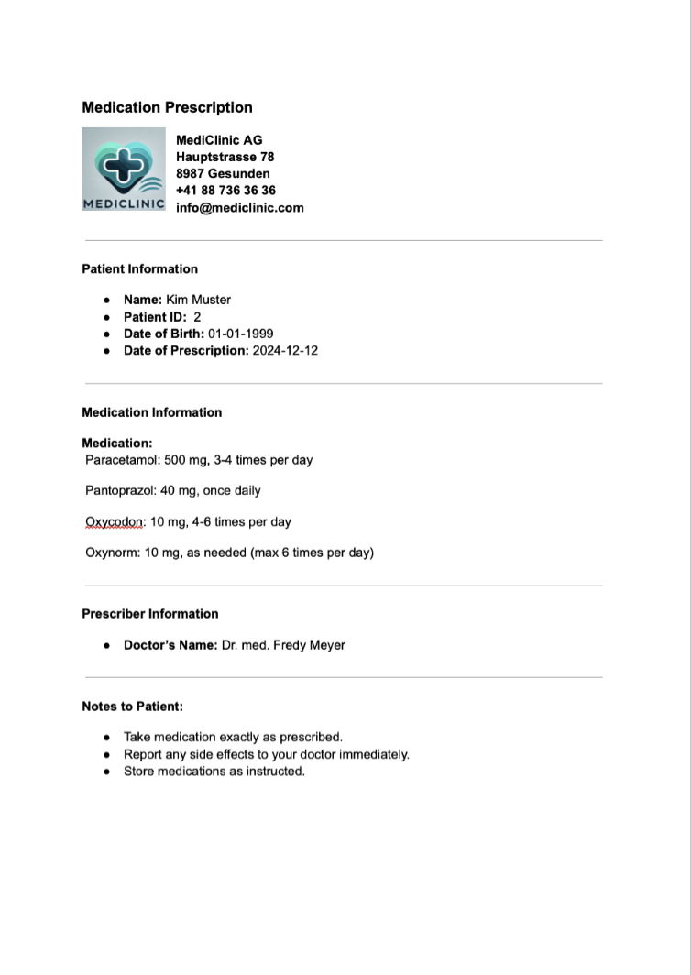
Implementation – Make as an external worker to generate and send documents
Generate and send:
Medication prescriptions
Physiotherapy prescriptions
Medical certificates

Slide 8
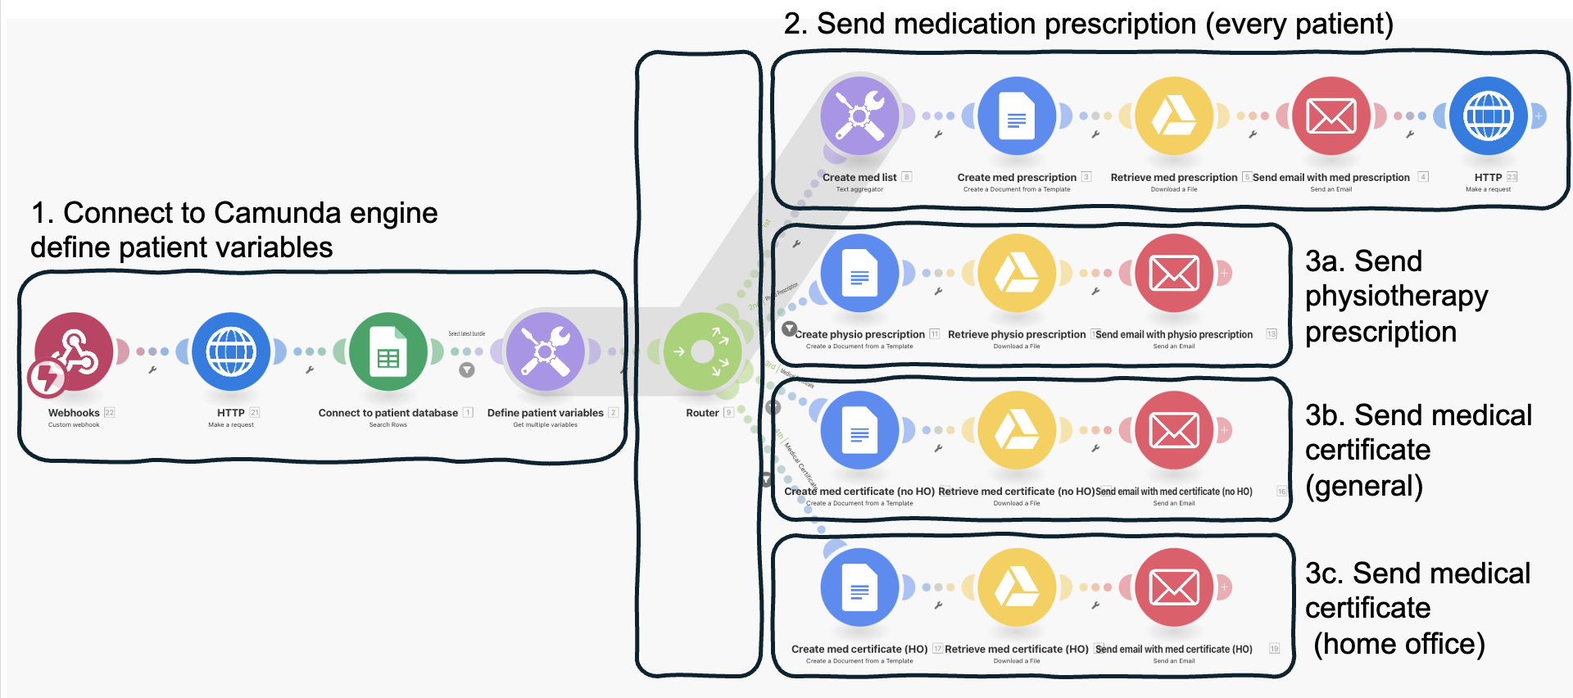
Implementation – Make as an external worker to generate and send documents

Slide 9


Implementation Flask App
Simulates an existing hospital database to retrieve patient data.
Hosted on Deepnote, exposing connection.
Creates a report from the received data using an LLM.
Builds a pipeline to extract relevant information.
Connects to Zephyr on Hugging Face to generate the report.
Sends the final report via the Google API.

Slide 10
Benefits & Vision
Streamlined Workflow: A unified digital system eliminates inefficiencies and reduces manual workload.
Faster Discharge: Automation of document preparation ensures quicker discharge decisions.
Improved Accuracy: Standardized input forms and automated outputs minimize errors in documentation.
Enhanced Patient Autonomy: Self-scheduling follow-ups empower patients and reduce administrative burden.
Reduced Bottlenecks: Seamless communication between stakeholders avoids delays in the discharge process.
Time Savings: Automated workflows allow staff to focus on high-value patient care tasks

