Slide 1
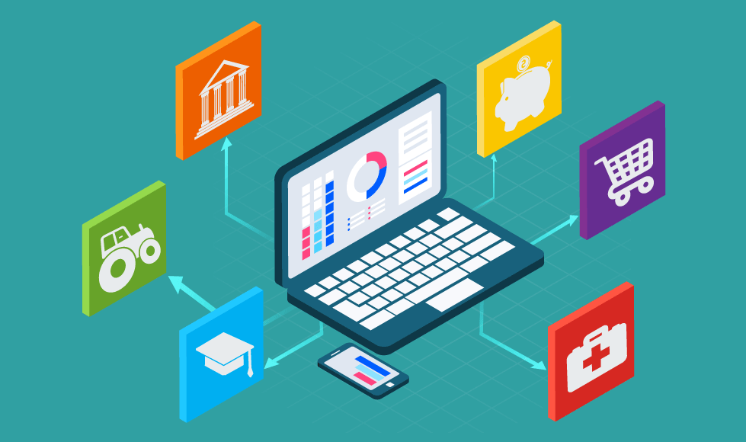
Group Assignment DigiBP Rhein
Pamela Streisguth, Sebastian Kluthe, Teyfik Agac
https://woxapp.com/industries/digitalization-solutions-development/

Slide 2
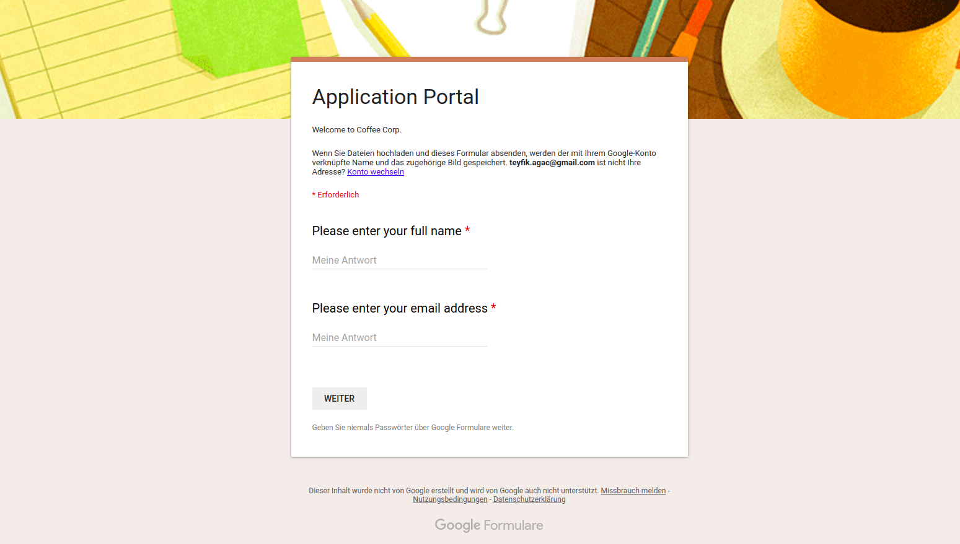
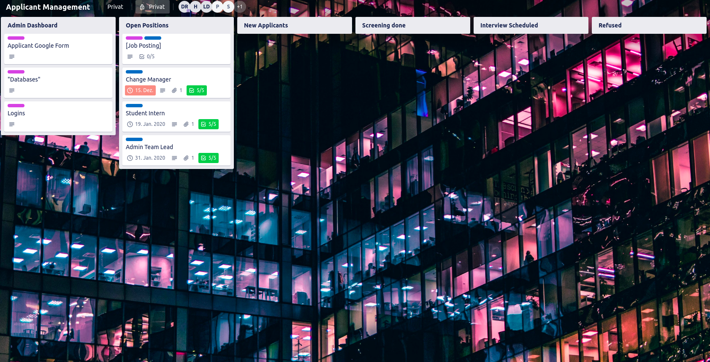
Introduction
Optimization of recruitment-process
Developed two platforms:
Applicant-side
Human Resources Tool
DigiBP Pamela Streisguth, Sebastian Kluthe, Teyfik Agac
12/18/2019
1

Slide 3
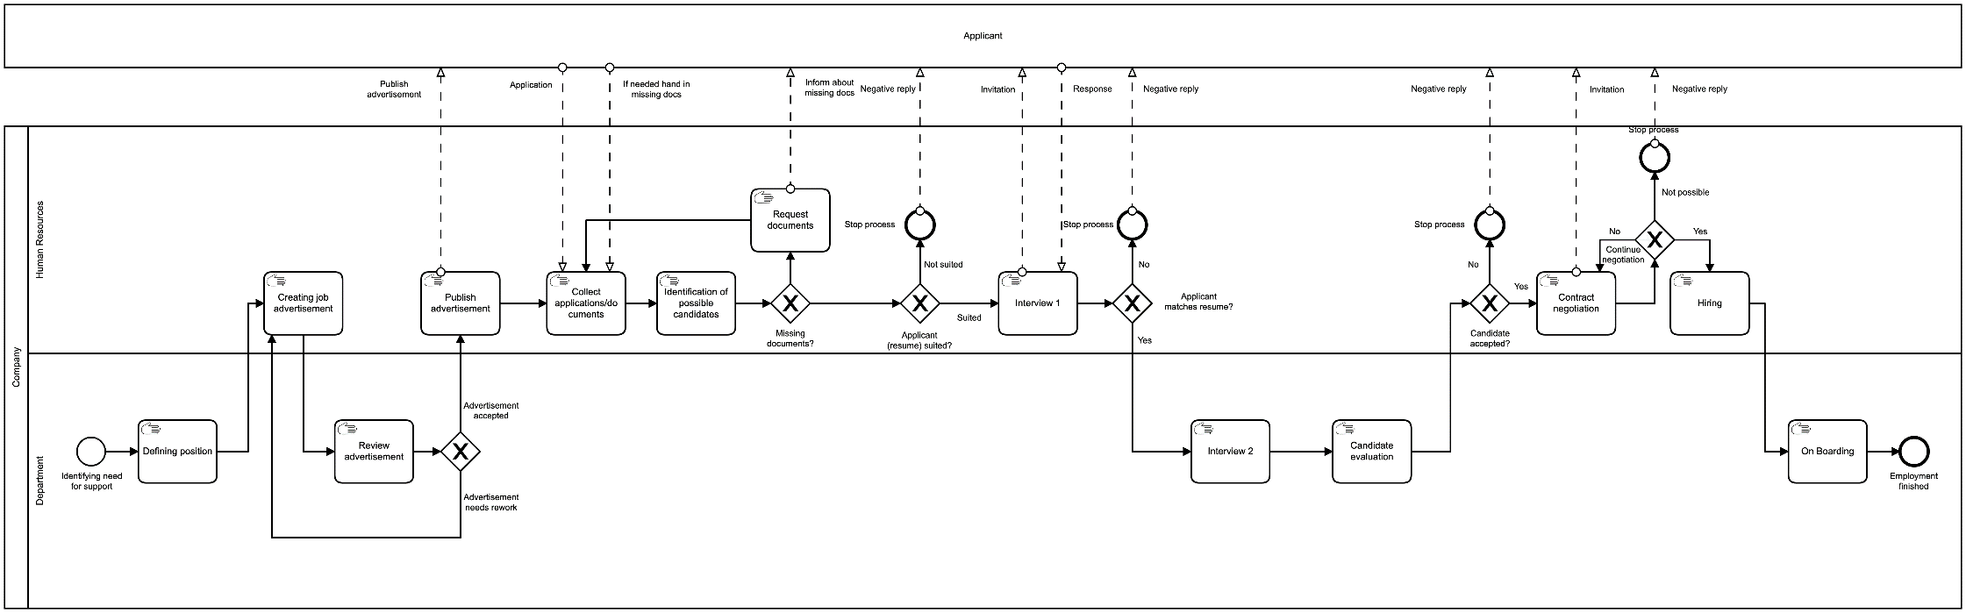
As-Is
Analyze the given process
Two lanes on company side
One lane for the applicant
DigiBP Pamela Streisguth, Sebastian Kluthe, Teyfik Agac
12/18/2019
1

Slide 4
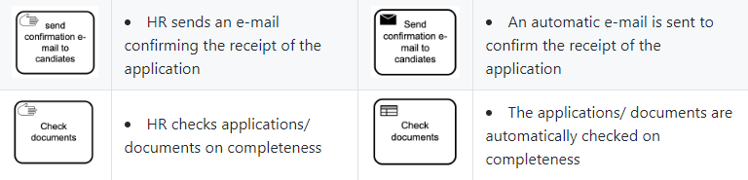
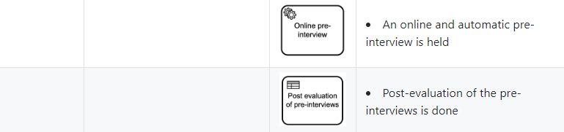
Methods
Taking each step of As-Is and investigate on optimization potential
Some steps were added to the process which allow automation/improvement
DigiBP Pamela Streisguth, Sebastian Kluthe, Teyfik Agac
12/18/2019
1

Slide 5
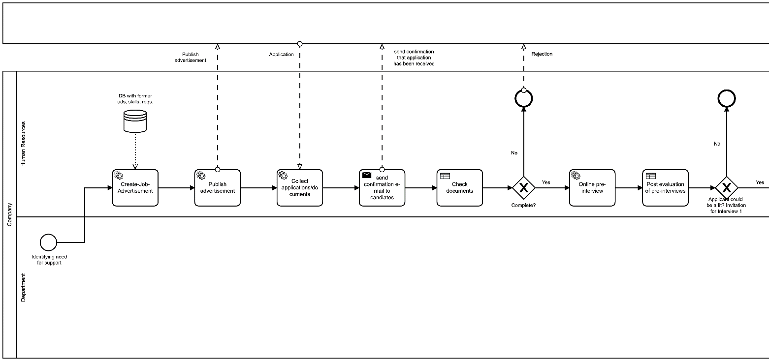
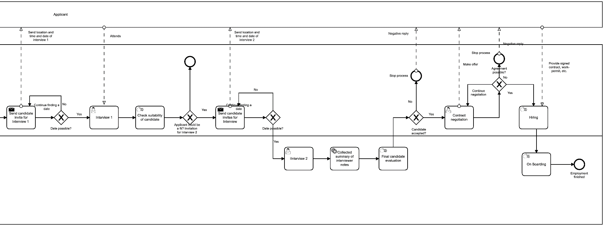
To-Be
Clear separation of individual steps
Larger model for a faster and more efficient process
DigiBP Pamela Streisguth, Sebastian Kluthe, Teyfik Agac
12/18/2019
1

Slide 6
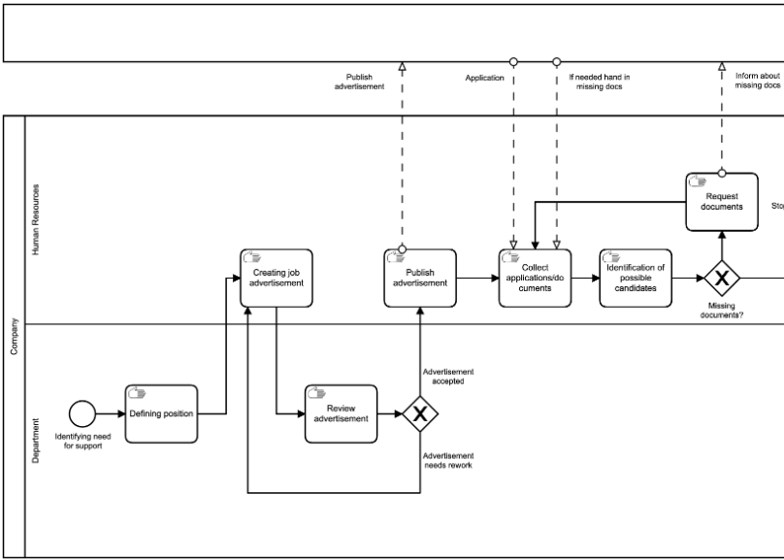
Focus
Evaluating the potential for automation
Focus on application part of the whole process
Lots of repetition
Most used steps of the process
Limited potential for automation in later parts of the recruitment
DigiBP Pamela Streisguth, Sebastian Kluthe, Teyfik Agac
12/18/2019
1

Slide 7
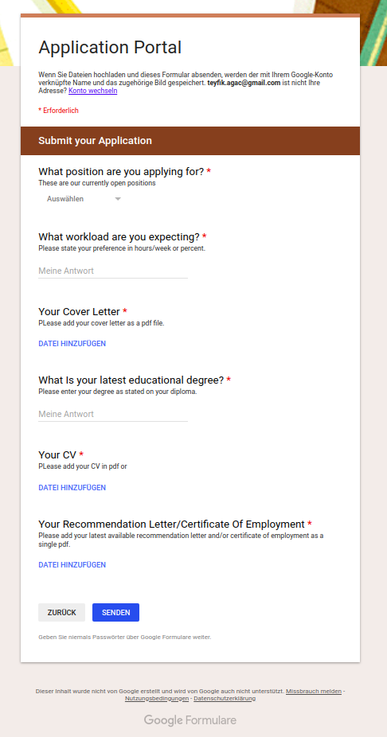
Applicant-side
Applicants can apply via Google form
Ensure getting a complete application by labeling the fields as mandatory
Application with attachments gets automatically transferred to a storage and a database is updated with the new entries to the storage
DigiBP Pamela Streisguth, Sebastian Kluthe, Teyfik Agac
12/18/2019
1

Slide 8
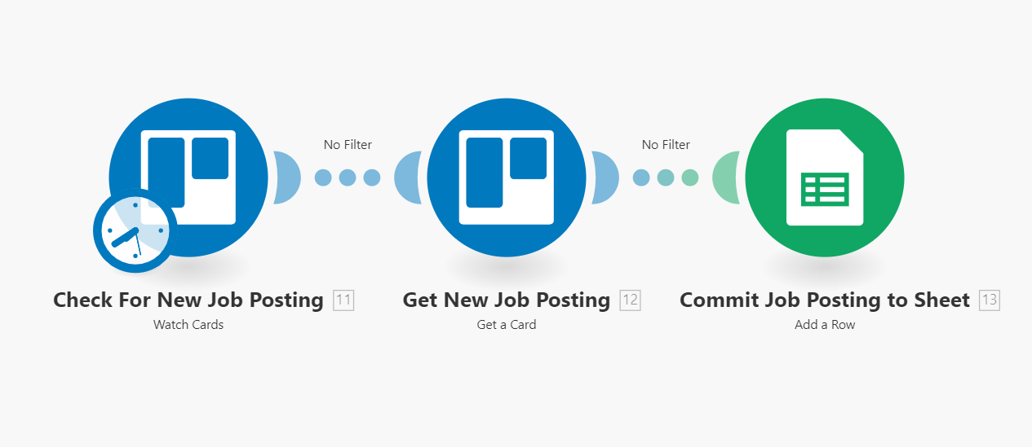
Human Resources Tool
Job postings are added as cards in Trello
New posting gets written in a Google-sheet
Connected to the form for applicants
DigiBP Pamela Streisguth, Sebastian Kluthe, Teyfik Agac
12/18/2019
1

Slide 9
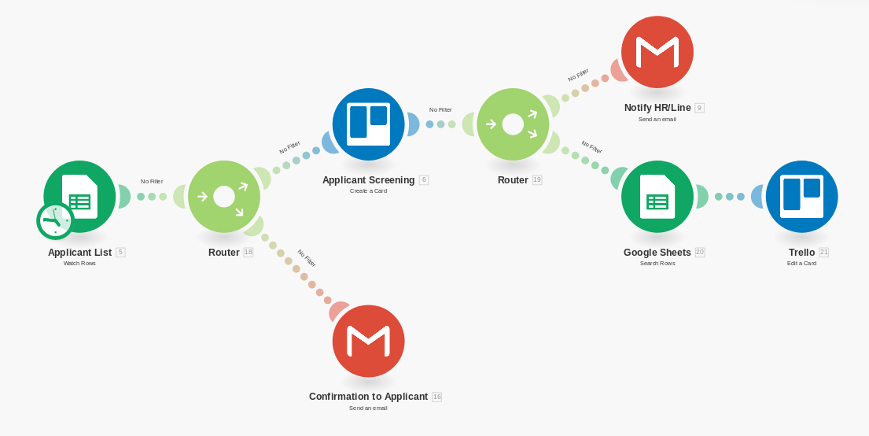
Human Resources Tool
Applicant gets a confirmation via mail
After applying the candidate gets access to a chatbot for a pre-interview
DigiBP Pamela Streisguth, Sebastian Kluthe, Teyfik Agac
12/18/2019
1

Slide 10
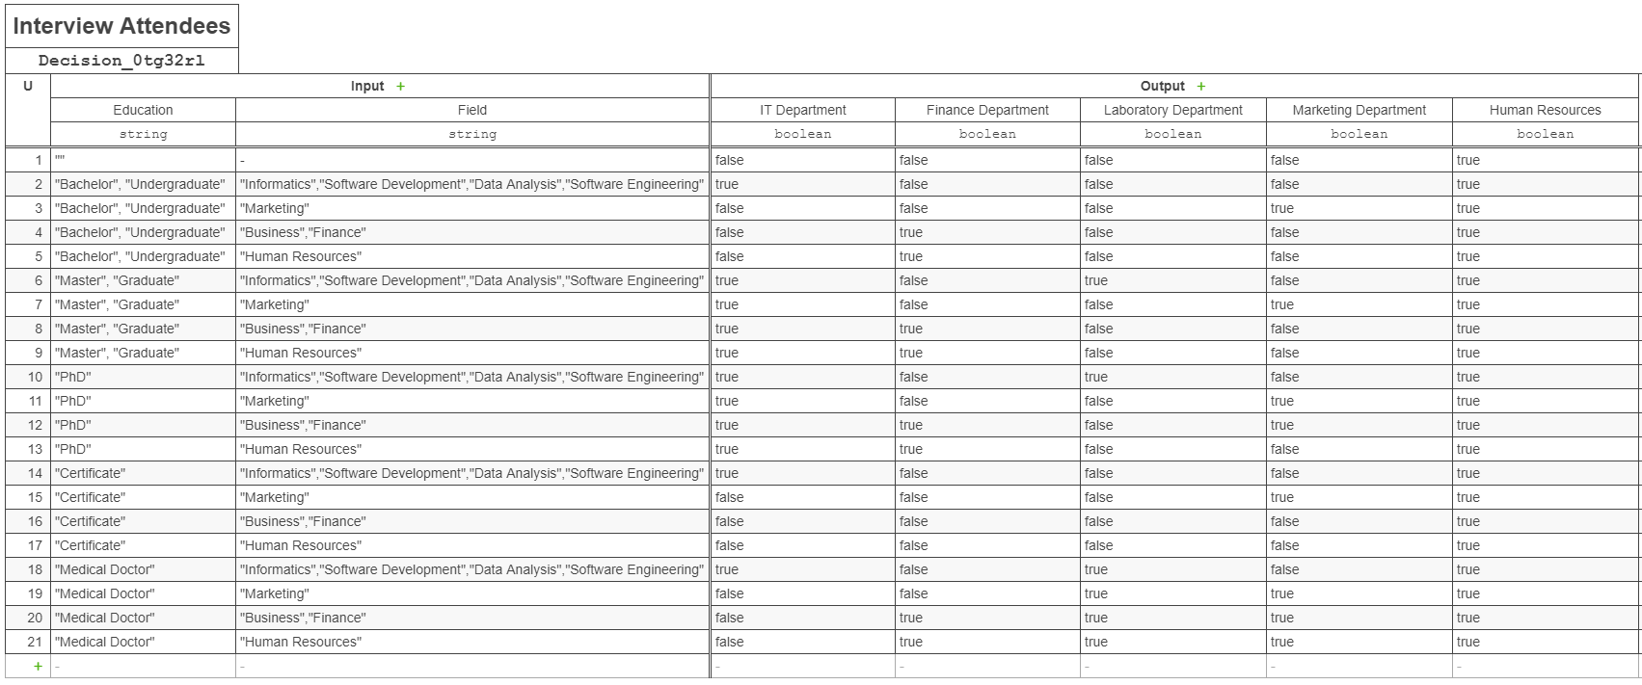
Outlook
Implementing a DMN to decide who attends the interviews
DigiBP Pamela Streisguth, Sebastian Kluthe, Teyfik Agac
12/18/2019
<number>

Slide 11
Outlook
Build infrastructure for automated job-postings
Implement a Decision Support System (DSS) for evaluation of applicants
Implement a grading system for attachments of applicants
Assigning scores for specific keywords and certification/diploma
DigiBP Pamela Streisguth, Sebastian Kluthe, Teyfik Agac
12/18/2019
<number>

