Slide 1

Group Assignment DigiBP Danish Blue
Isar Gammoh, Luca Mueller, Nicola Raemy, Pooja Bisht

Slide 2
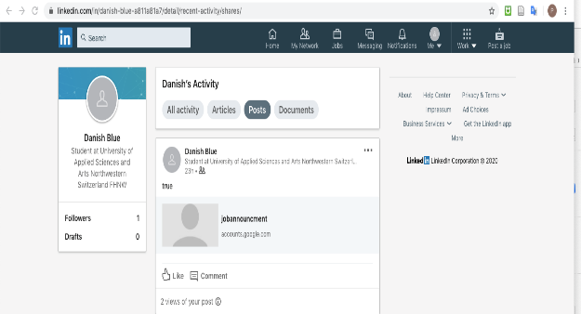
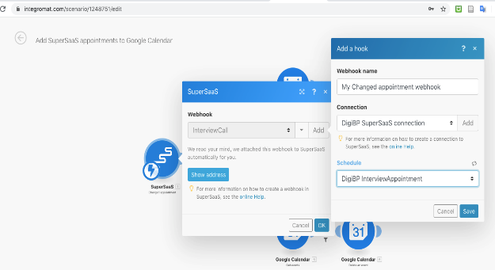
Introduction
Optimization of a regular recruitment process
Developed three major adjustments:
Publication of a job via LinkedIn
Dialogflow and DMN for a first selection
Implementation of a booking system and automated E-Mail communication to minimize coordination effort
DigiBP Luca Müller, Nicola Raemy, Isar Gammoh, Pooja Bisht
04.06.2020
2

Slide 3
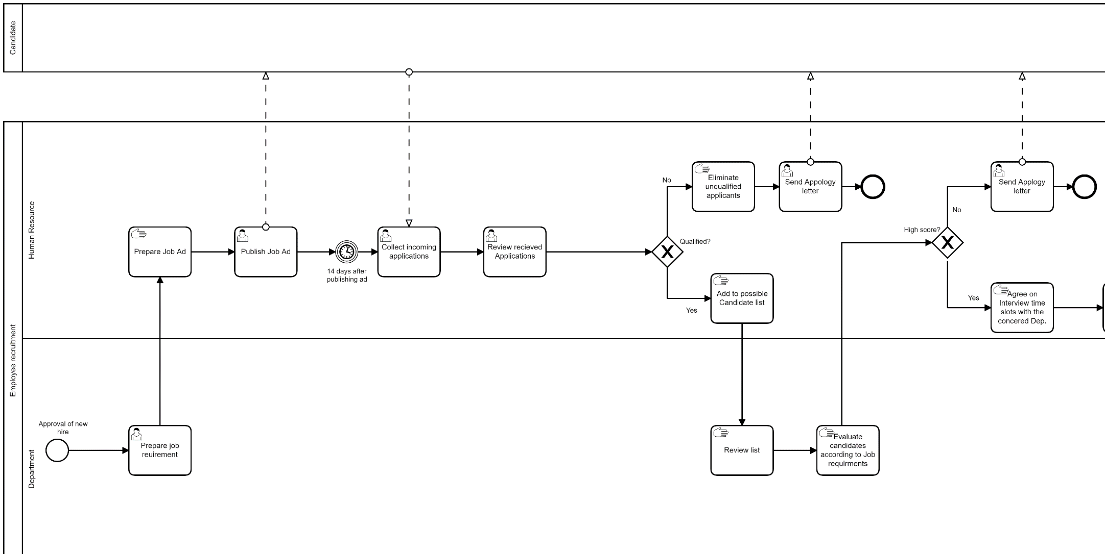
As-Is (Part I)
Time consuming and lengthy
To many manual steps
Inefficient
DigiBP Luca Müller, Nicola Raemy, Isar Gammoh, Pooja Bisht
04.06.2020
3

Slide 4
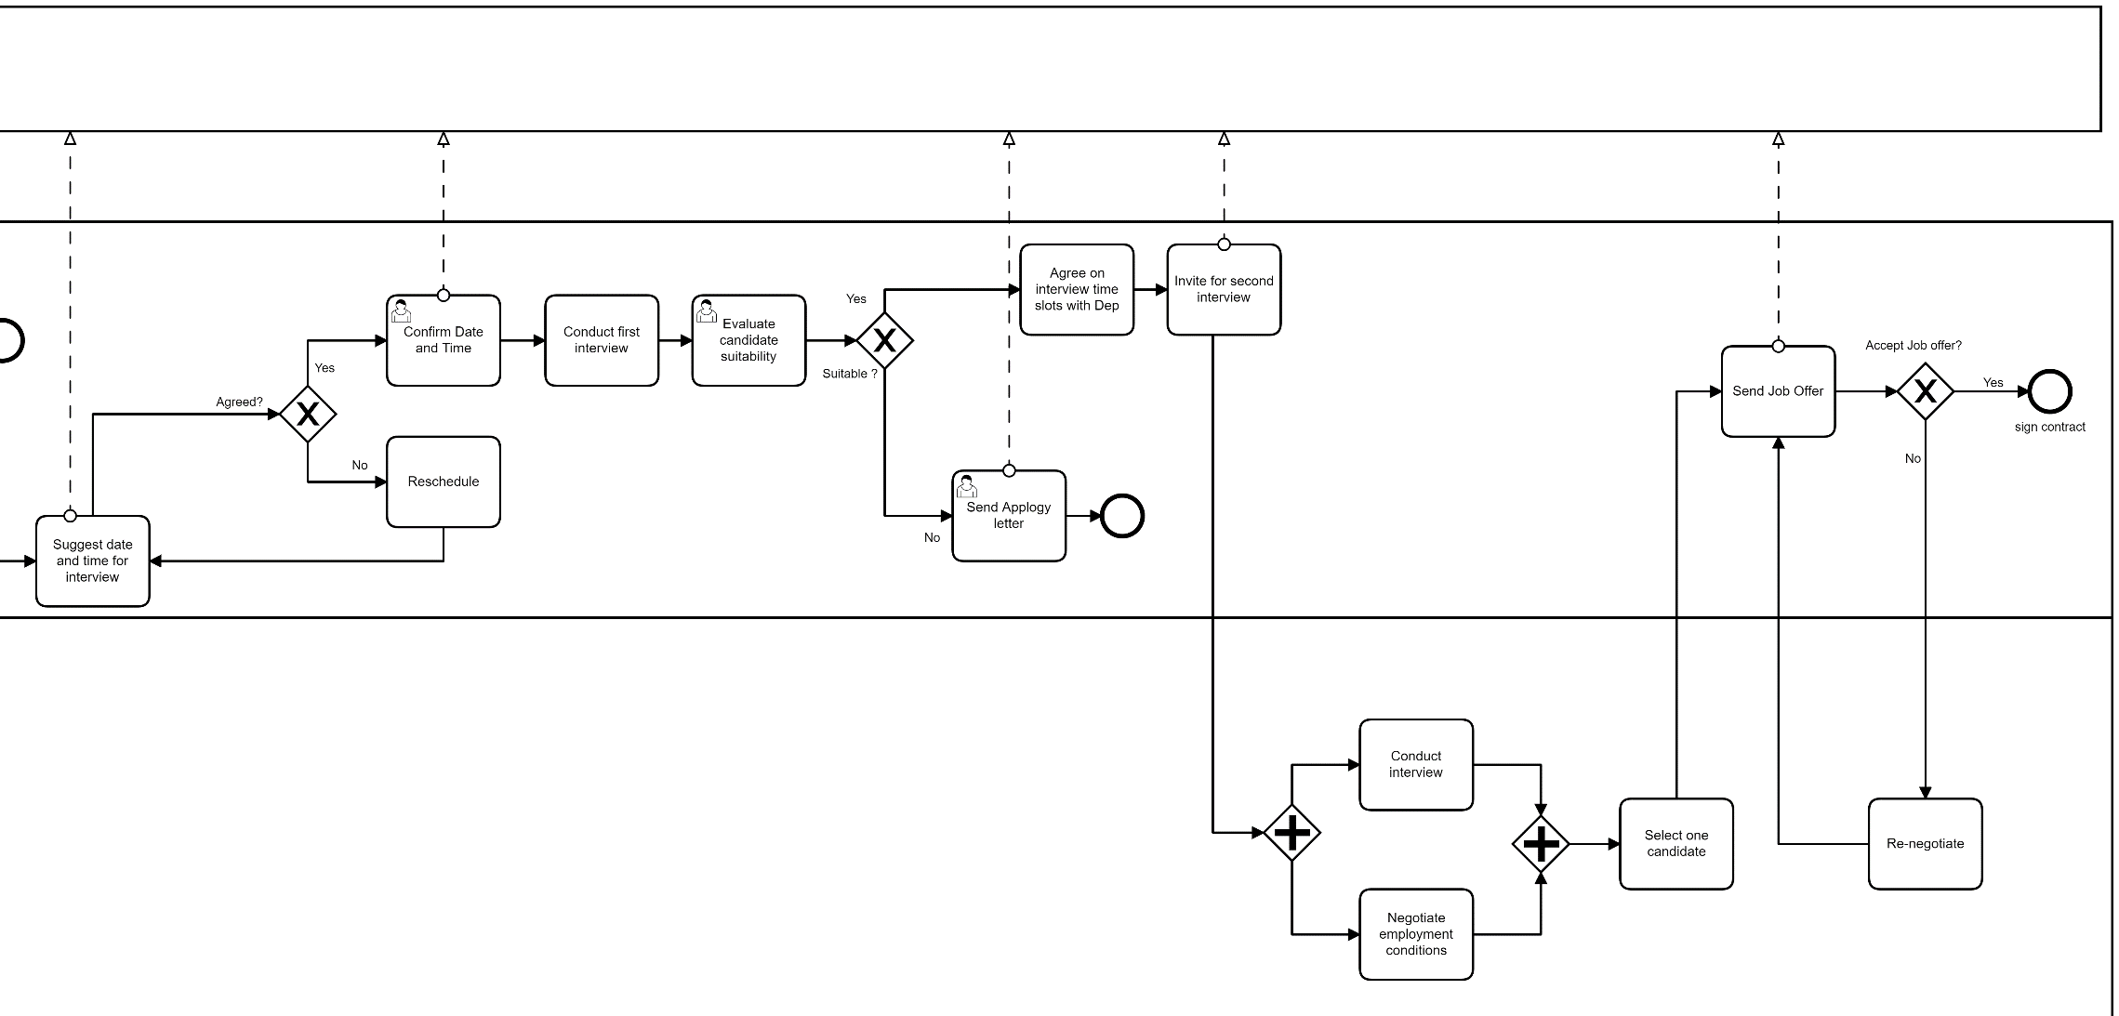
As-Is (Part II)
Time consuming and lengthy
To many manual steps
Inefficient
DigiBP Luca Müller, Nicola Raemy, Isar Gammoh, Pooja Bisht
04.06.2020
4

Slide 5
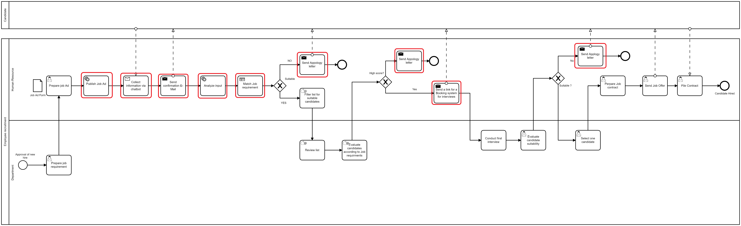
To-Be
Simplification of the process through automated workflows
Areas with biggest potential for improvement
DigiBP Luca Müller, Nicola Raemy, Isar Gammoh, Pooja Bisht
04.06.2020
5

Slide 6

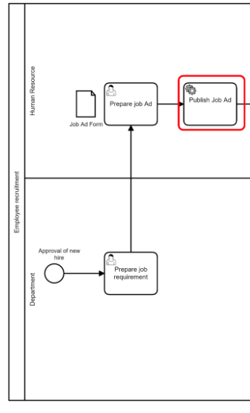
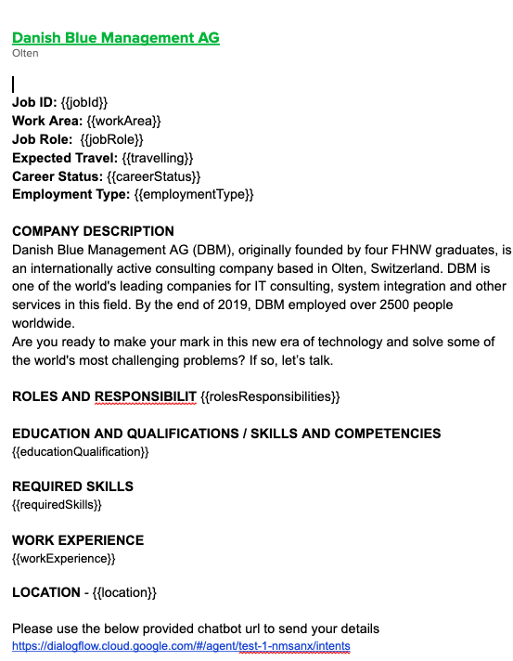
Publish Job Ad
DigiBP Luca Müller, Nicola Raemy, Isar Gammoh, Pooja Bisht
04.06.2020
6

Slide 7

Dialogflow (Isar)
xxxxx
xxxxx
Axxxx
DigiBP Luca Müller, Nicola Raemy, Isar Gammoh, Pooja Bisht
04.06.2020
7

Slide 8
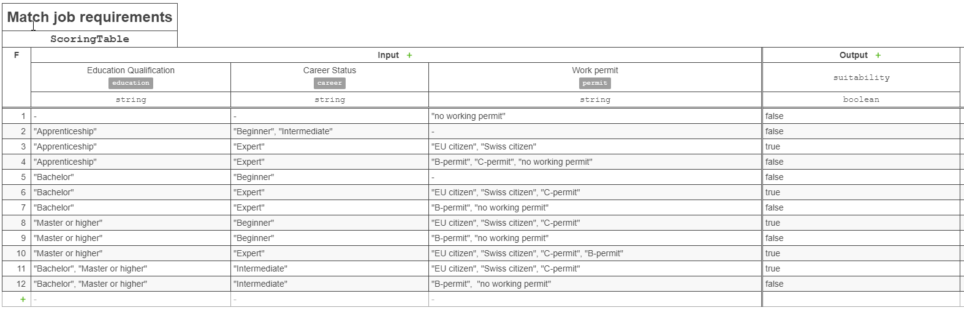
Candidate Screening (DMN)
a basis on which DBM can be built
DigiBP Luca Müller, Nicola Raemy, Isar Gammoh, Pooja Bisht
04.06.2020
8

Slide 9


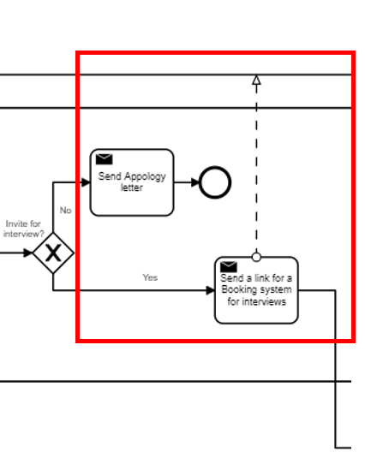
Automated E-Mail communication
Confirmation of reception
Invitation to interview (via booking system)
Apology letter
Based on dialogflow & dmn output in the “DB” (google sheets)
Integromat scenarios
DigiBP Luca Müller, Nicola Raemy, Isar Gammoh, Pooja Bisht
04.06.2020
9
Notes:
Simple but helpful and effective integration of the standardized communication
Confirmation of reception (of the application) ->Integromat watching new entries in google sheets
Based on DMN output an invitation to the booking system or an apology letter will be sent to the candidate
Replaces the standardized communications being sent

Slide 10

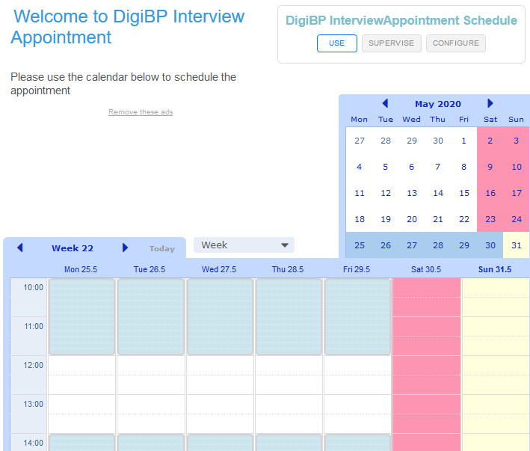
Booking System Part I
Supersaas url is sent to selected candidates along with password to access the url
Candidate required to create supersaas account and provide email, name and moble number
User can view available DigiBp calendar booking.
Based on available time slotes (2 per day of 2 hours each at 10.00 and 14.00) can create and delete bookings.
DigiBP Luca Müller, Nicola Raemy, Isar Gammoh, Pooja Bisht
04.06.2020
10

Slide 11

Outlook
Log process with many optimization possibilities
Implementation of RPA, conversational AI… implementation of further DMN tables (eg to evaluate candidates with job requirements), …
More time = more improvements
Group assignment was challenging, yet we all learned a lot
DigiBP Luca Müller, Nicola Raemy, Isar Gammoh, Pooja Bisht
04.06.2020
11

Slide 12
Thank you.

