Slide 1
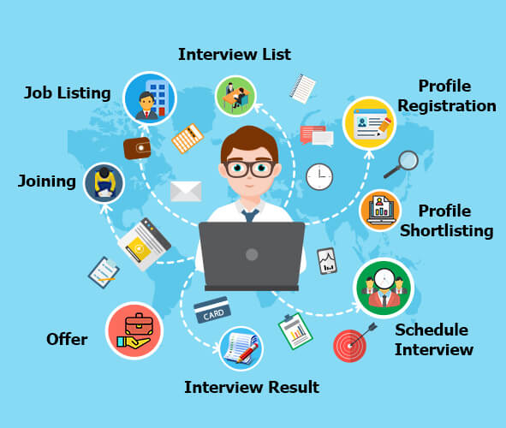
Group Assignment DigiBP Danish Blue
Luca Müller, Nicola Raemy, Isar Gammoh, Pooja Bisht

Slide 2
Introduction
Optimization of a regular recruitment process
Developed three major adjustments:
Publication of a job via LinkedIn
Dialogflow and DMN for a first selection
Implementation of a booking system and automated E-Mail communication to minimize coordination effort
Placeholder 1 for image (LinkedIn job advert or smt like this)
Placeholder 1 for image (booking system)
DigiBP Luca Müller, Nicola Raemy, Isar Gammoh, Pooja Bisht
04.06.2020
2

Slide 3
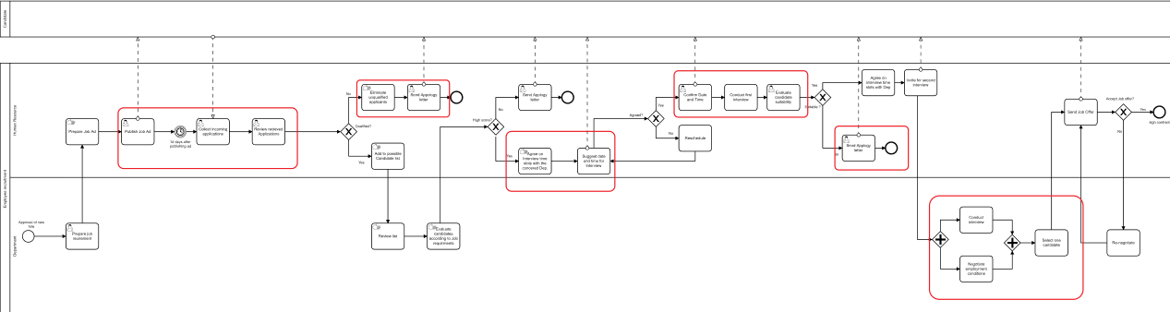
As-Is Process bottlenecks
DigiBP Luca Müller, Nicola Raemy, Isar Gammoh, Pooja Bisht
04.06.2020
3

Slide 4
Challenges in the As-Is process
This process reflects an inefficient and ineffective process, tasks are done manually. We can summarize the challenges as the following:
Receiving many resumes that in many times HR employees do not have the time to go through all of them.
Many of the received resumes are inadequate for the published job, revising those resumes will consume time that is vital for finding the right candidate(s).
Arranging interviews between managers and candidates can be a hassled job for HR employees, this task includes many steps of back and forth between the two parties.
sending apology emails also a time-consuming job, especially when there is a number of rejected candidates.

Slide 5
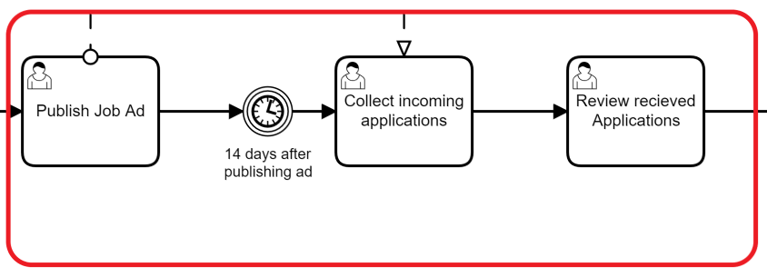
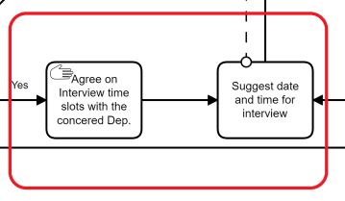
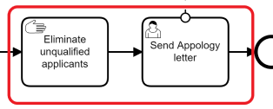
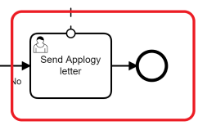
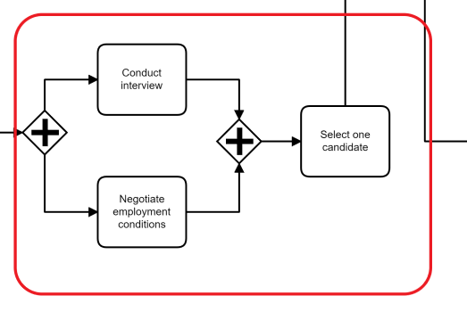
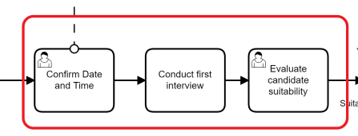
Closer look at the bottlenecks in the As-Is Process

Slide 6
Optimization of the To-Be Process
The Optimization of the recruitment process happed on to aspects, one aspect is optimising the process itself by eliminating unnecessary tasks and repetitive tasks that may not have much of influence specially after automation.
The second aspect is by the automation of nine tasks within the process. Those nine tasks will eliminate the bottlenecks in the process and support the efficiency and effectiveness of the HR employees and managers.
DigiBP Luca Müller, Nicola Raemy, Isar Gammoh, Pooja Bisht
04.06.2020
6

Slide 7
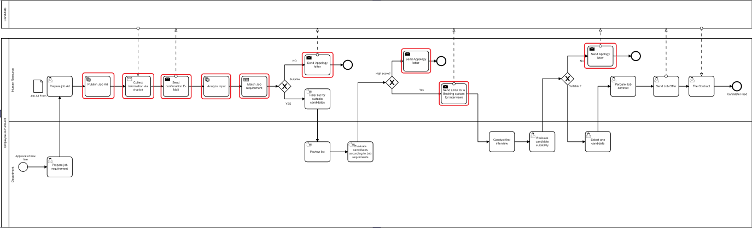
Automation Tasks in the To-Be Process
The optimization of the new process happened on two aspects one by optimising the process flow and the second aspect by the automation of some tasks in the process. the chosen tasks for automation happened according to some major factors:
1. Is the of time needed to accomplish this task.
2. If the task is considered a bottleneck task.
3. If it affects any human needed contact point in the process such as the "Interview task".
DigiBP Luca Müller, Nicola Raemy, Isar Gammoh, Pooja Bisht
04.06.2020
7

Slide 8
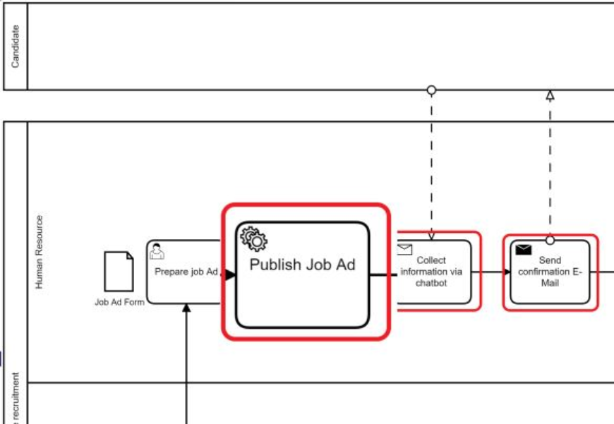
Posting Job Ad(Pooja)
DigiBP Luca Müller, Nicola Raemy, Isar Gammoh, Pooja Bisht
04.06.2020
8

Slide 9
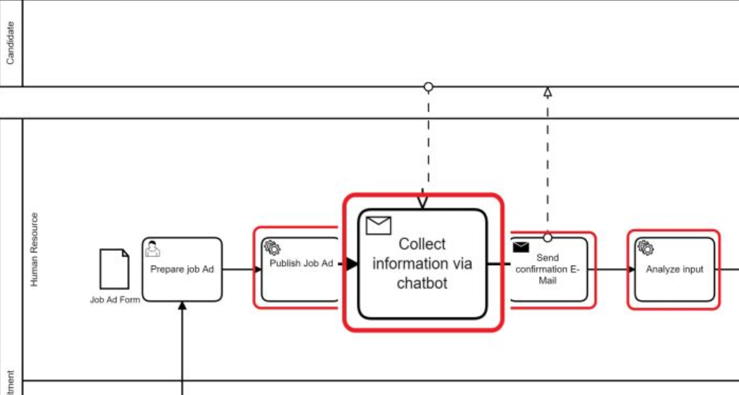
Chatbot
The purpose on the chatbot is to collect the basic needed information and qualification of applicants in order to automatically eliminate the inadequate applicants.
DigiBP Luca Müller, Nicola Raemy, Isar Gammoh, Pooja Bisht
04.06.2020
9

Slide 10

Demo of the Chatbot

Slide 11
Candidate Screening (DMN)
xxxxx
xxxxx
Axxxx
DigiBP Luca Müller, Nicola Raemy, Isar Gammoh, Pooja Bisht
04.06.2020
11

Slide 12


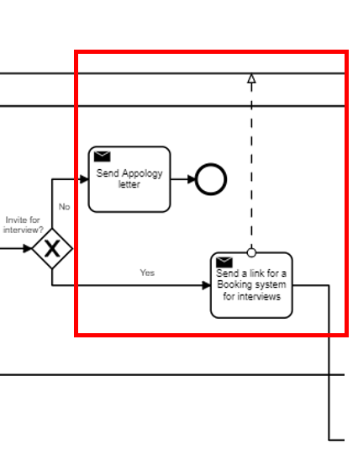
Automated E-Mail communication
Confirmation of reception
Invitation to interview (via booking system)
Apology letter
Based on dialogflow & dmn output
Integromat scenarios
DigiBP Luca Müller, Nicola Raemy, Isar Gammoh, Pooja Bisht
04.06.2020
12
Notes:
Simple but helpful and effective integration of the standardized communication
Confirmation of reception (of the application) ->Integromat watching new entries in google sheets
Based on DMN output an invitation to the booking system or an apology letter will be sent to the candidate
Replaces the standardized communications being sent

Slide 13
Booking System Part I
DigiBP Luca Müller, Nicola Raemy, Isar Gammoh, Pooja Bisht
04.06.2020
13

Slide 14
Outlook
(mention the user task on the very last of our process)
Evaluate candidates with job requirements (usage of a second DMN)
xxxxxx
xxxxxxx
xxxx
DigiBP Luca Müller, Nicola Raemy, Isar Gammoh, Pooja Bisht
04.06.2020
14

