Slide 1

Group Assignment DigiBP Danish Blue
Isar Gammoh, Luca Mueller, Nicola Raemy, Pooja Bisht

Slide 2
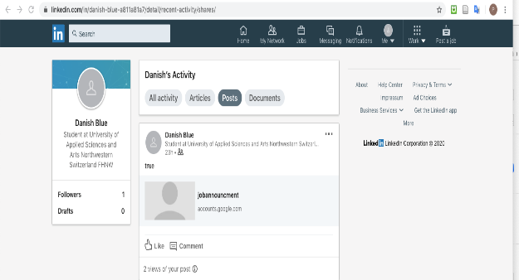
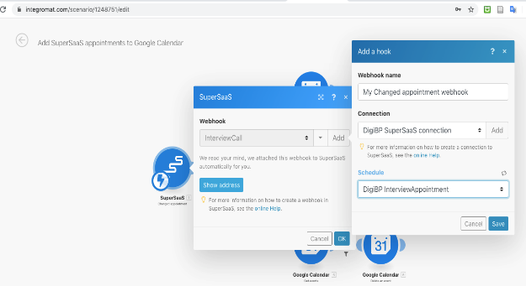
Introduction
Optimization of a regular recruitment process
Developed three major adjustments:
Publication of a job via LinkedIn
Dialogflow and DMN for a first selection
Implementation of a booking system and automated E-Mail communication to minimize coordination effort
DigiBP Luca Müller, Nicola Raemy, Isar Gammoh, Pooja Bisht
04.06.2020
2

Slide 3
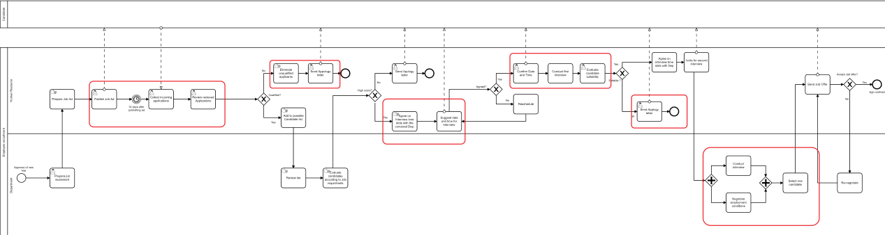
As-Is Process bottlenecks
DigiBP Luca Müller, Nicola Raemy, Isar Gammoh, Pooja Bisht
04.06.2020
3

Slide 4
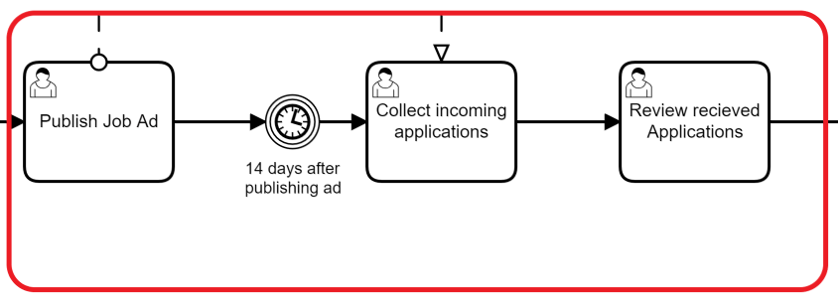
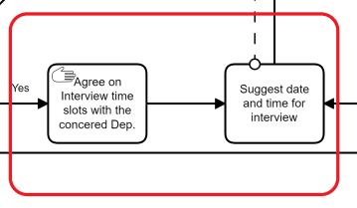
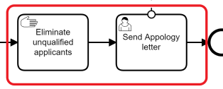
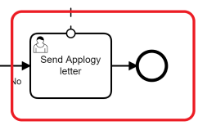
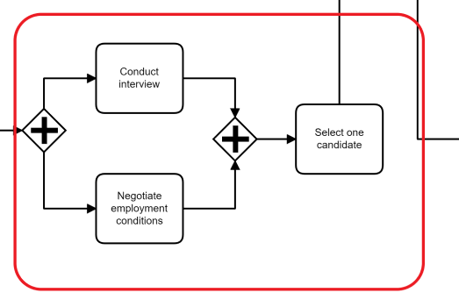
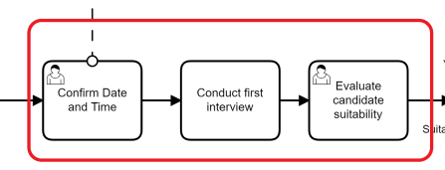
Closer look at the bottlenecks in the As-Is Process

Slide 5


Challenges in the As-Is process
Inefficient and ineffective, mostly manual tasks.
Challenges:
Workload is too big
Too many unsuitable applications
Time-consuming interview scheduling
Standardized communications take up too much time
Notes:
This process reflects an inefficient and ineffective process, tasks are done manually. We can summarize the challenges as the following:
Receiving many resumes that in many times HR employees do not have the time to go through all of them.
Many of the received resumes are inadequate for the published job, revising those resumes will consume time that is vital for finding the right candidate(s).
Arranging interviews between managers and candidates can be a hassled job for HR employees, this task includes many steps of back and forth between the two parties.
sending apology emails also a time-consuming job, especially when there is a number of rejected candidates.

Slide 6
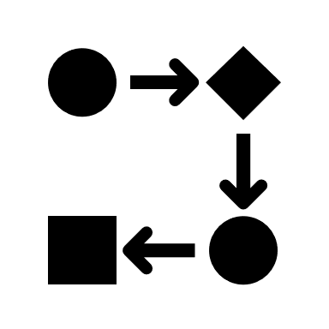

Optimization of the To-Be Process
Workflow optimization
Automation
DigiBP Luca Müller, Nicola Raemy, Isar Gammoh, Pooja Bisht
04.06.2020
6
Notes:
The Optimization of the recruitment process happed on to aspects, one aspect is optimising the process itself by eliminating unnecessary tasks and repetitive tasks that may not have much of influence specially after automation.
The second aspect is by the automation of nine tasks within the process. Those nine tasks will eliminate the bottlenecks in the process and support the efficiency and effectiveness of the HR employees and managers.

Slide 7
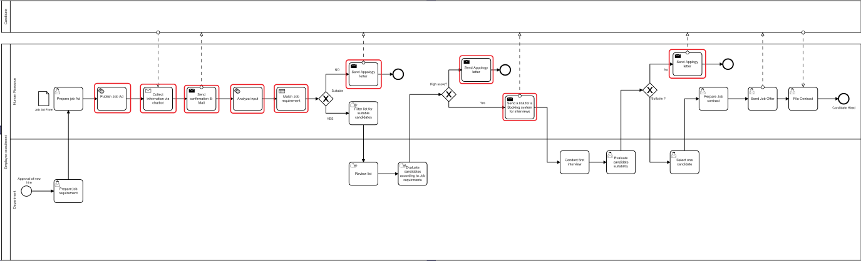
Automation Tasks in the To-Be Process
1. Time needed to accomplish this task.
2. Bottleneck tasks
3. Maintain human role
DigiBP Luca Müller, Nicola Raemy, Isar Gammoh, Pooja Bisht
04.06.2020
7
Notes:
The optimization of the new process happened on two aspects one by optimising the process flow and the second aspect by the automation of some tasks in the process. the chosen tasks for automation happened according to some major factors:

Slide 8

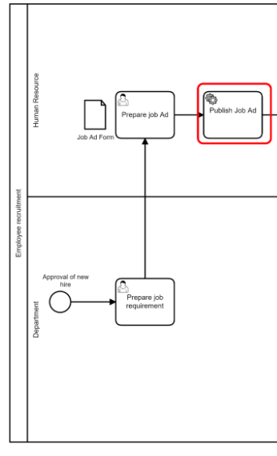
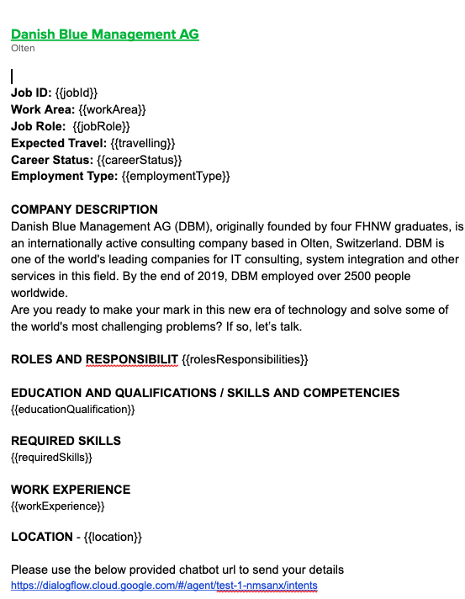
Publish Job Ad
DigiBP Luca Müller, Nicola Raemy, Isar Gammoh, Pooja Bisht
04.06.2020
8

Slide 9

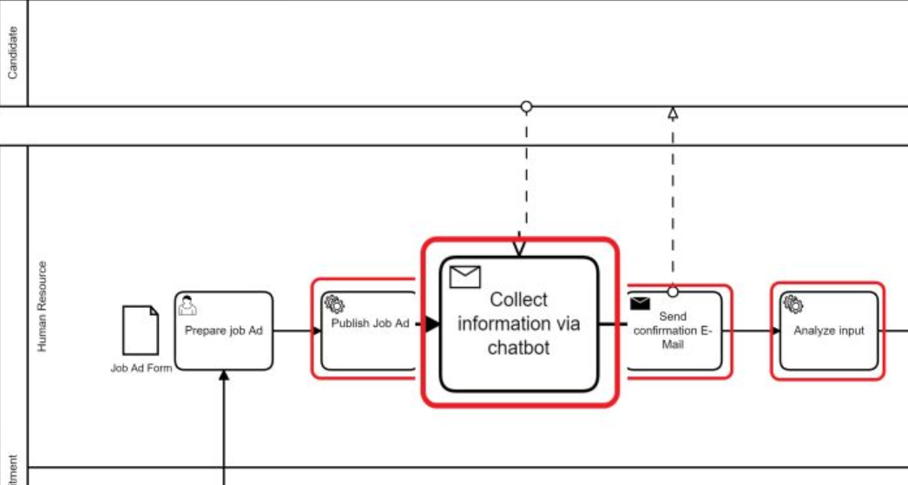
DigiBP Luca Müller, Nicola Raemy, Isar Gammoh, Pooja Bisht
04.06.2020
9
Notes:
The purpose of the chatbot is to collect the basic needed information and qualification of applicants in order to automatically eliminate the inadequate applicants.

Slide 10

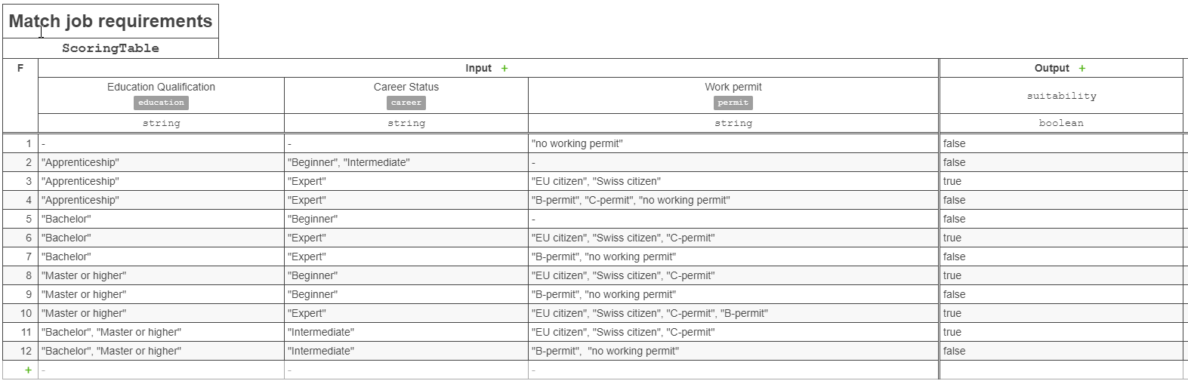
Candidate Screening (DMN)
a basis on which DBM can be built
DigiBP Luca Müller, Nicola Raemy, Isar Gammoh, Pooja Bisht
04.06.2020
10

Slide 11


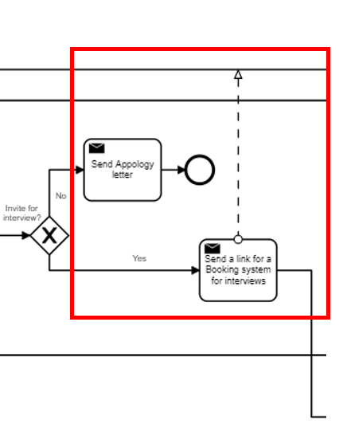
Automated E-Mail communication
Confirmation of reception
Invitation to interview (via booking system)
Apology letter
Based on dialogflow & dmn output in the “DB” (google sheets)
Integromat scenarios
DigiBP Luca Müller, Nicola Raemy, Isar Gammoh, Pooja Bisht
04.06.2020
11
Notes:
Simple but helpful and effective integration of the standardized communication
Confirmation of reception (of the application) ->Integromat watching new entries in google sheets
Based on DMN output an invitation to the booking system or an apology letter will be sent to the candidate
Replaces the standardized communications being sent

Slide 12

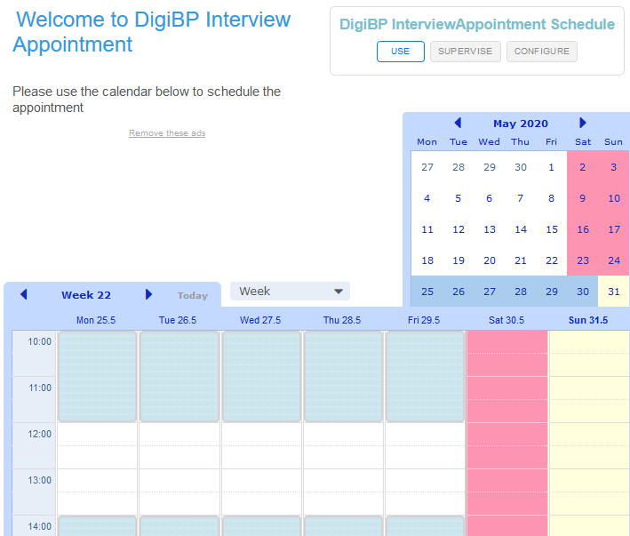
Booking System
Supersaas url is sent to selected candidates along with password to access the url
Candidate required to create supersaas account and provide email, name and moble number
User can view available DigiBp calendar booking.
Based on available time slotes (2 per day of 2 hours each at 10.00 and 14.00) can create and delete bookings.
DigiBP Luca Müller, Nicola Raemy, Isar Gammoh, Pooja Bisht
04.06.2020
12

Slide 13

Outlook
Log process with many optimization possibilities
Implementation of RPA, conversational AI… implementation of further DMN tables (eg to evaluate candidates with job requirements), …
More time = more improvements
Group assignment was challenging, yet we all learned a lot
DigiBP Luca Müller, Nicola Raemy, Isar Gammoh, Pooja Bisht
04.06.2020
13

Slide 14
Thank you.

