Slide 1
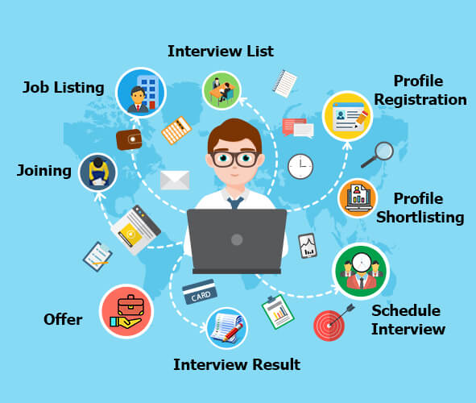
Group Assignment DigiBP Danish Blue
Luca Müller, Nicola Raemy, Isar Gammoh, Pooja Bisht

Slide 2
Introduction
Optimization of a regular recruitment process
Developed three major adjustments:
Publication of a job via LinkedIn
Dialogflow and DMN for a first selection
Implementation of a booking system to minimize the coordination effort
Placeholder 1 for image (LinkedIn job advert or smt like this)
Placeholder 1 for image (booking system)
DigiBP Luca Müller, Nicola Raemy, Isar Gammoh, Pooja Bisht
04.06.2020
2

Slide 3
As-Is
xxxxxx
xxxxx
xxxxx
DigiBP Luca Müller, Nicola Raemy, Isar Gammoh, Pooja Bisht
04.06.2020
3

Slide 4
To-Be
Simplification of the process through automated workflows
xxxxxxxx
DigiBP Luca Müller, Nicola Raemy, Isar Gammoh, Pooja Bisht
04.06.2020
4

Slide 5
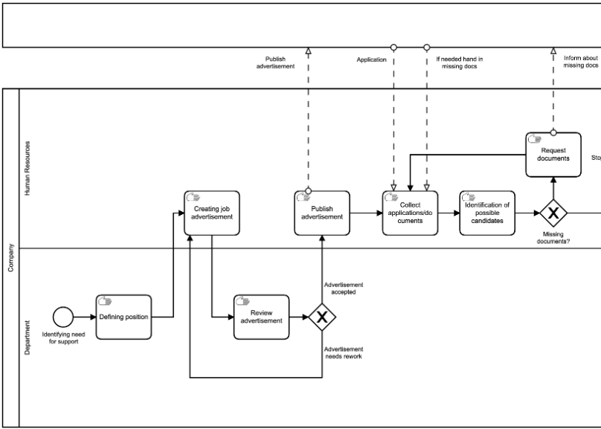
Procedure To-Be
Evaluating the potential for automation
Focus on application part of the whole process
Lots of repetition
Most used steps of the process
Limited potential for automation in later parts of the recruitment
DigiBP Luca Müller, Nicola Raemy, Isar Gammoh, Pooja Bisht
04.06.2020
5

Slide 6
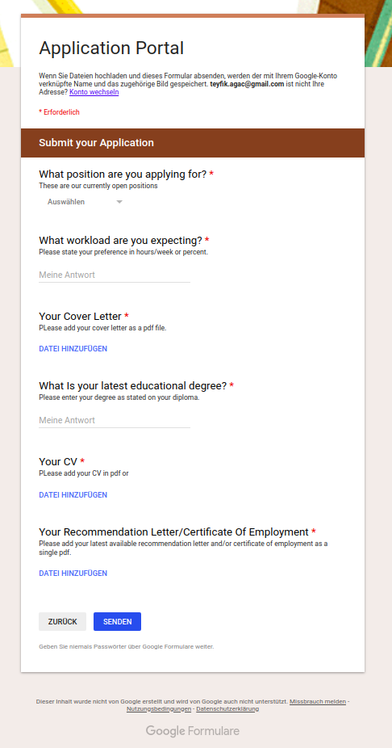
Starting point (Pooja)
Applicants can apply via LinkedIn form
Ensure getting a complete application by labeling the fields as mandatory
Application with attachments gets automatically transferred to a storage and a database is updated with the new entries to the storage
DigiBP Luca Müller, Nicola Raemy, Isar Gammoh, Pooja Bisht
04.06.2020
6

Slide 7
Dialogflow (Isar)
xxxxx
xxxxx
Axxxx
DigiBP Luca Müller, Nicola Raemy, Isar Gammoh, Pooja Bisht
04.06.2020
7

Slide 8
Candidate Screening (DMN)
xxxxx
xxxxx
Axxxx
DigiBP Luca Müller, Nicola Raemy, Isar Gammoh, Pooja Bisht
04.06.2020
8

Slide 9
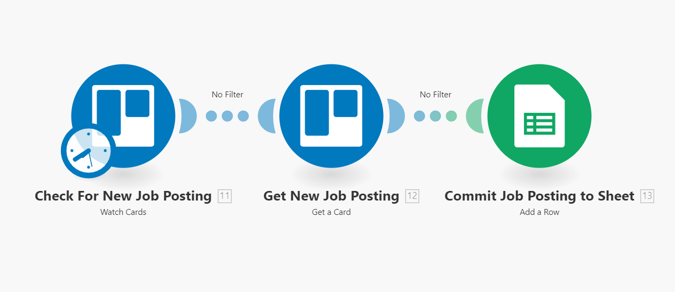
Booking System Part I
Job postings are added as cards in Trello
New posting gets written in a Google-sheet
Connected to the form for applicants
DigiBP Luca Müller, Nicola Raemy, Isar Gammoh, Pooja Bisht
04.06.2020
9

Slide 10
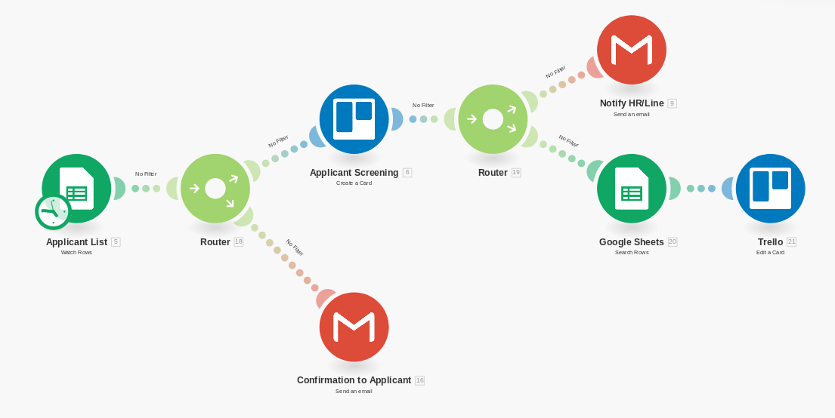
Booking System Part II
Applicant gets a confirmation via mail
After applying the candidate gets access to a chatbot for a pre-interview
DigiBP Luca Müller, Nicola Raemy, Isar Gammoh, Pooja Bisht
04.06.2020
10

Slide 11
Outlook
(mention the user task on the very last of our process)
Evaluate candidates with job requirements (usage of a second DMN)
xxxxxx
xxxxxxx
xxxx
DigiBP Luca Müller, Nicola Raemy, Isar Gammoh, Pooja Bisht
04.06.2020
11

