Slide 1
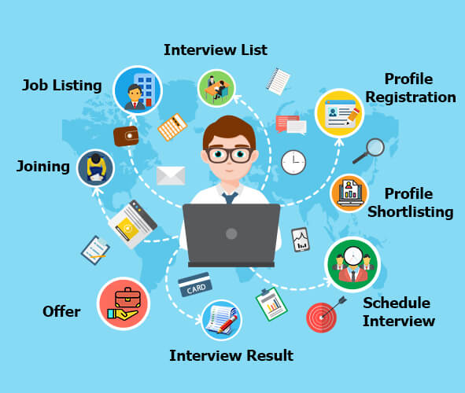
Group Assignment DigiBP Danish Blue
Luca Müller, Nicola Raemy, Isar Gammoh, Pooja Bisht

Slide 2
Introduction
Optimization of a regular recruitment process
Developed three major adjustments:
Publication of a job via LinkedIn
Dialogflow and DMN for a first selection
Implementation of a booking system to minimize the coordination effort
Placeholder 1 for image (LinkedIn job advert or smt like this)
Placeholder 1 for image (booking system)
DigiBP Luca Müller, Nicola Raemy, Isar Gammoh, Pooja Bisht
04.06.2020
2

Slide 3
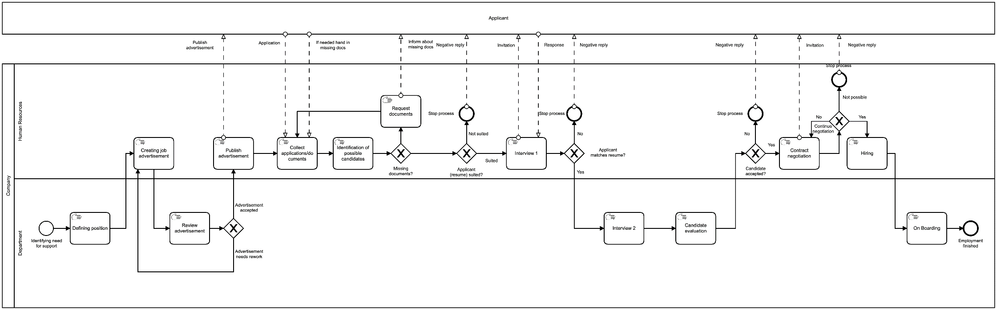
As-Is
Analyze the given process
Two lanes on company side
One lane for the applicant
DigiBP Luca Müller, Nicola Raemy, Isar Gammoh, Pooja Bisht
04.06.2020
3

Slide 4
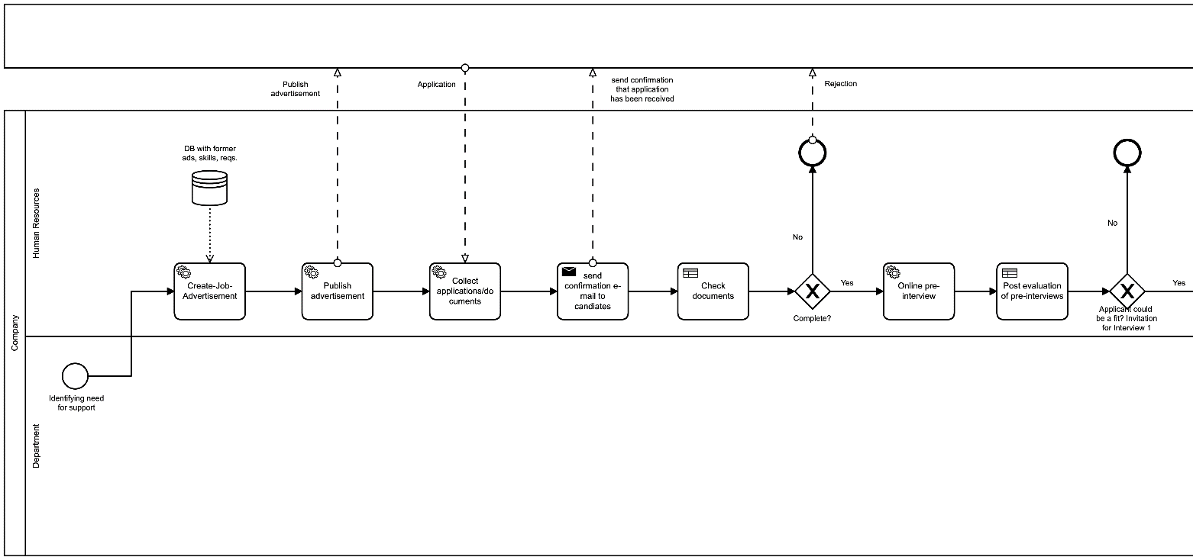
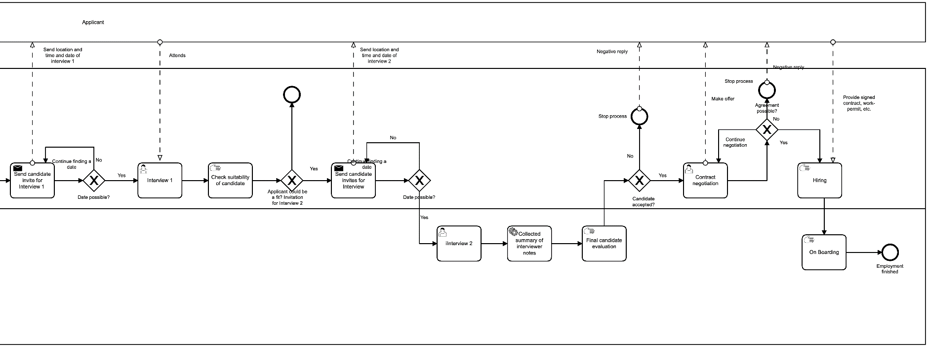
To-Be
Clear separation of individual steps
Larger model for a faster and more efficient process
DigiBP Luca Müller, Nicola Raemy, Isar Gammoh, Pooja Bisht
04.06.2020
4

Slide 5
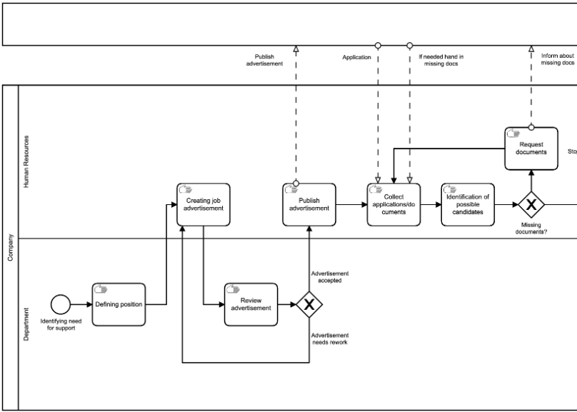
Procedure
Evaluating the potential for automation
Focus on application part of the whole process
Lots of repetition
Most used steps of the process
Limited potential for automation in later parts of the recruitment
DigiBP Luca Müller, Nicola Raemy, Isar Gammoh, Pooja Bisht
04.06.2020
5

Slide 6
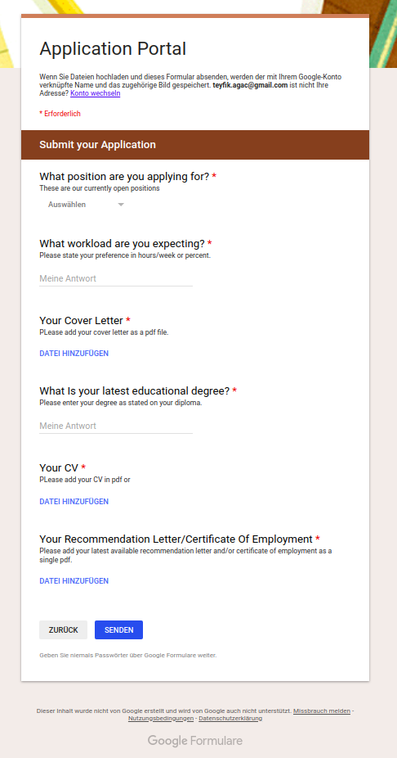
Starting point (Pooja)
Applicants can apply via Google form
Ensure getting a complete application by labeling the fields as mandatory
Application with attachments gets automatically transferred to a storage and a database is updated with the new entries to the storage
DigiBP Luca Müller, Nicola Raemy, Isar Gammoh, Pooja Bisht
04.06.2020
6

Slide 7
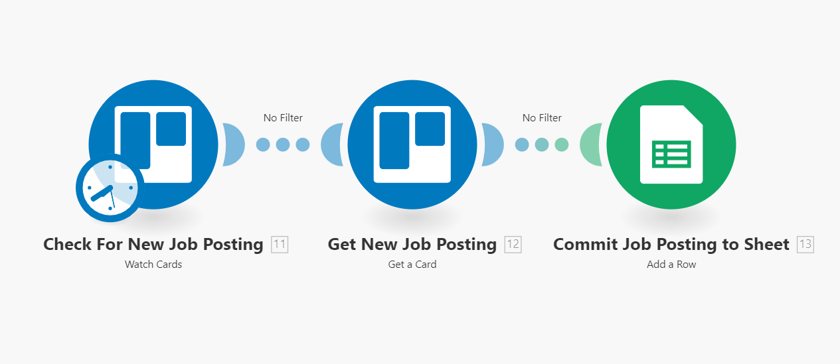
Human Resources Tool
Job postings are added as cards in Trello
New posting gets written in a Google-sheet
Connected to the form for applicants
DigiBP Luca Müller, Nicola Raemy, Isar Gammoh, Pooja Bisht
04.06.2020
7

Slide 8
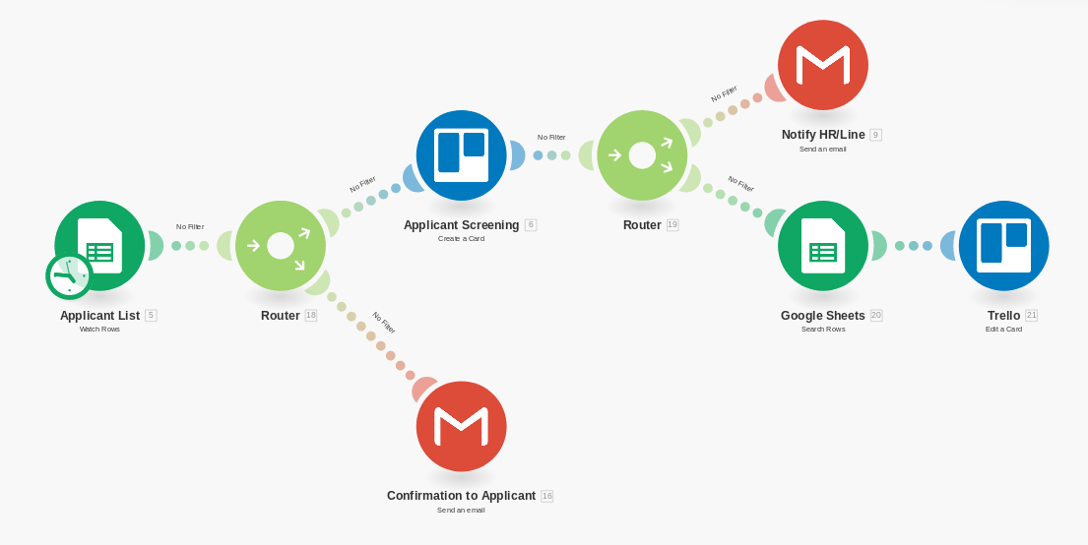
Human Resources Tool
Applicant gets a confirmation via mail
After applying the candidate gets access to a chatbot for a pre-interview
DigiBP Luca Müller, Nicola Raemy, Isar Gammoh, Pooja Bisht
04.06.2020
8

Slide 9
Outlook
(mention the user task on the very last of our process)
Build infrastructure for automated job-postings
Implement a Decision Support System (DSS) for evaluation of applicants
Implement a grading system for attachments of applicants
Assigning scores for specific keywords and certification/diploma
DigiBP Luca Müller, Nicola Raemy, Isar Gammoh, Pooja Bisht
04.06.2020
9

