Slide 1
Team Badener Fantoche
Kui Hong Lim (Charlene), Nino Bachmann,
Paul Tanner, Sergio Guarino,

Slide 2
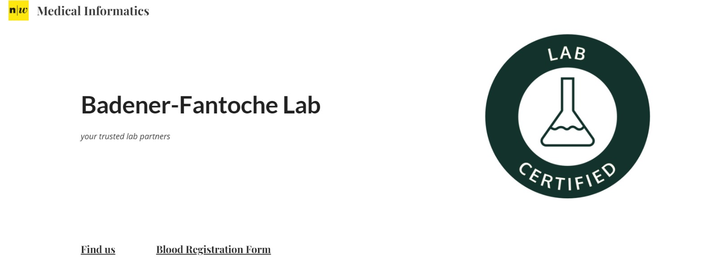
Badener-Fantoche Laboratory
https://sites.google.com/view/team-badener-fantoche/home?pli=1

Slide 3

Badener Fantoche Laboratory
Medical Informatics (google.com)

Slide 4
Use Case – Clinical Laboratory
Focus is the clinical laboratory.
Primary service:
Pregnancy (hCG levels) and Blood type test.
Challenges of the traditional business process include:
Human error due to manual processes
Reliance on analog system for workflow
Time consuming manual tasks [1]

Slide 5
Traditional model
Manual tasks
Registration
Invoice creation and price calculation
Manual data entry in business process
Sending invoice and results manually
The employees involves:
Laboratory technician to run tests, check and compile results
Physician to validate test result and consult customer
Accountant for invoicing the customer and sending letters
Administration employee for sending results and invoices

Slide 6
Manual Process model

Slide 7
Design Process
Key aims:
Reduce cost
Increase efficiency
Increase reliability
How can this be achieved:
Digitalization of registration process
Aiding in the manual diagnostic process with decision table
Automation of invoicing process
Automation of result reporting process
Creating a digital collaborative workflow system from beginning to end

Slide 8
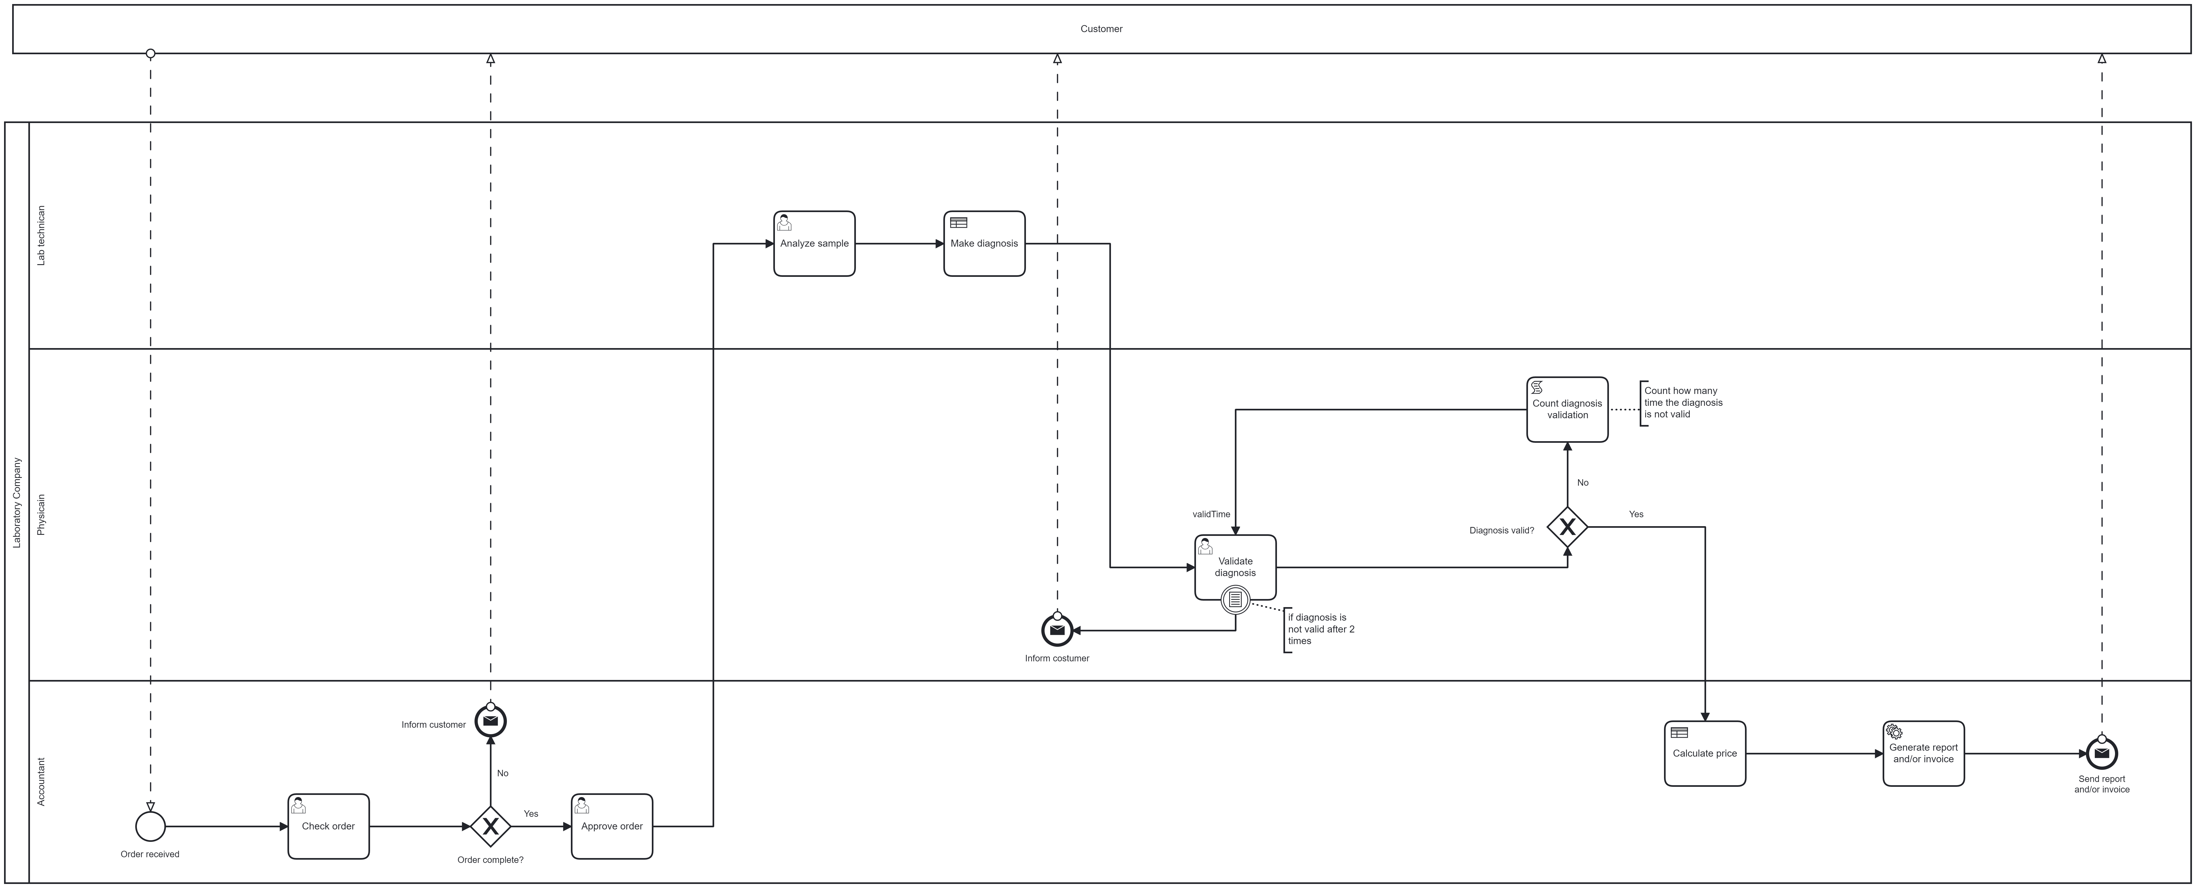
BPMN Model

Slide 9
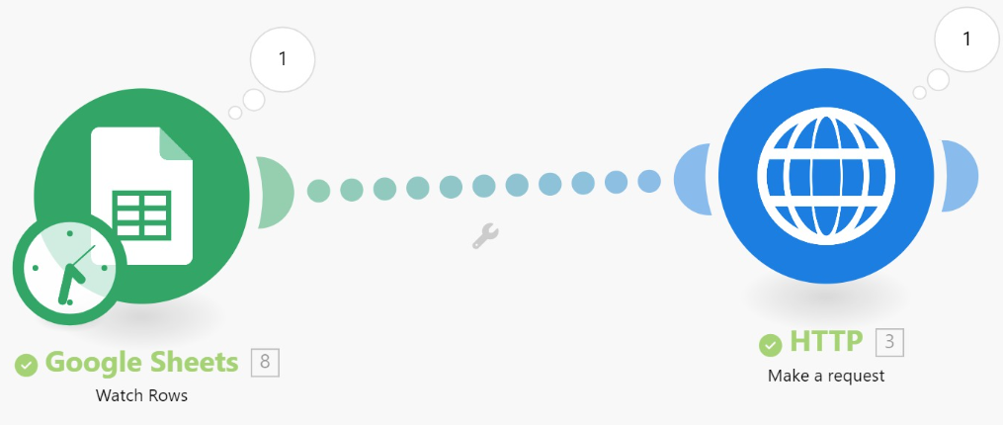
Process Implementation
Blood Sample Registration and creation of UID through Website
Forms and Google sheets used to record and save data
Make triggers start event in Camunda
Form checked by Accountant to approve or cancel instance

Slide 10
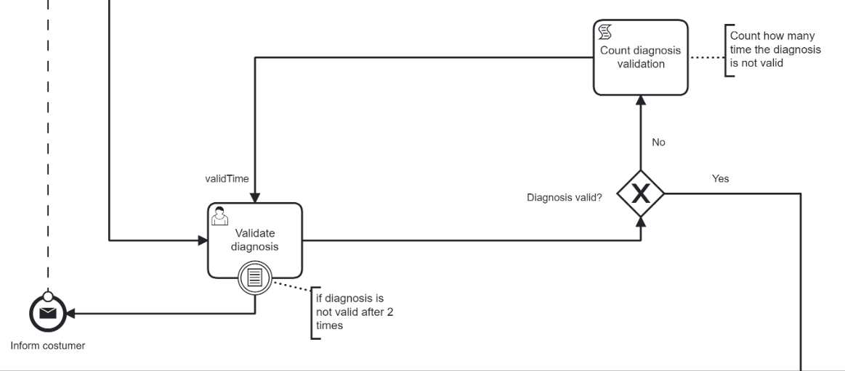
Lab Technician runs test
Lab Technician fills out form on Camunda with details of blood test
Decision Table then makes diagnosis
Physician validates results
Request made to Lab to redo test if invalid
If invalid twice then condtional boundary event is triggered and order is cancelled

Slide 11
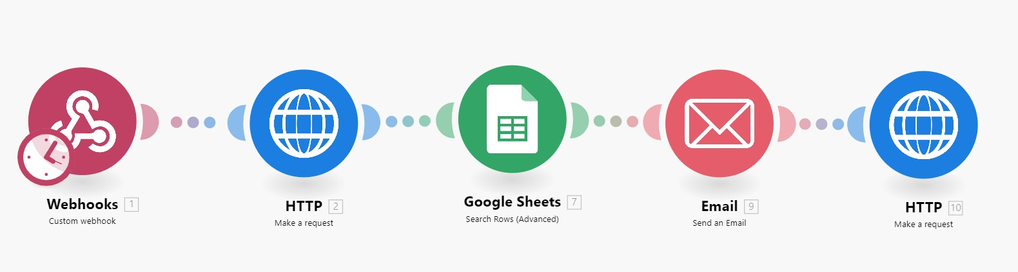
Report and invoice are generated automatically using Price decision table
Webhooks utilized to send business ID and process instance ID to Make
Request then made to Camunda for calculated price and test results
Report with invoice then sent to customer with email

Slide 12
Demonstration

Slide 13
Conclusion and evaluation
Outcomes
Free up employees for more productive tasks
Creation of streamlined digital workflow system with Camunda, Make and Google Workspace
Automation of key tasks: Registration, invoicing, and report generation
Benefits
Reduction in overhead costs
Faster workflow
Reduction in human error
Improved reliability with less reliance on analog systems

Slide 14
Future
Create a secure database for data analytics
Include a decision table for tests covered by insurance
Integrate a bar code scanner
Implementation of regulatory standards

