Slide 1

Medical Appointment
Digitalization of Business Processes
Fabio Ruckstuhl, Faruk Doganci, Paulo Humberto Braga de Melo, Jessica Hofmann

Slide 2
The case
Process
Medical appointment management
Problem
Schedule
Re-schedule
Cancelation
by Phone
Confirmation
by Post
Scope
Appointment scheduling
Notes:
Our group has decided to model and enhance a Bachelor Thesis of one team member. The thesis focuses on appointment scheduling tools especially in heathcare. At current state, most of hospitals and medical clinics are using phone as a medium to schedule, re-schedule or cancel appointments. This is perceived as an expense that can be eliminated through digitalization.

Slide 3
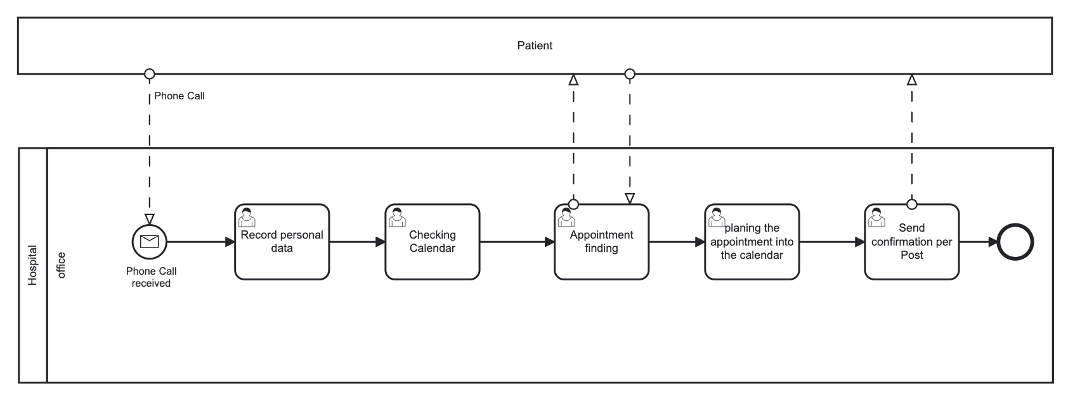
As-is process
Notes:
The process starts with a phone call from the patient to the secretary of the respective hospital. First, the secretary records all the needed personal data from the patient. After this is done, the secretary checks the availability of the doctors within their calendars and suggest an appointment date. If the first appointment suggestion is fine for the patient the next step will be executed. If not, the appointment finding goes back and forth until both sides are satisfied. The secretary sets the appointment into the calendar of the respective doctor and sends a confirmation per post to the patient

Slide 4
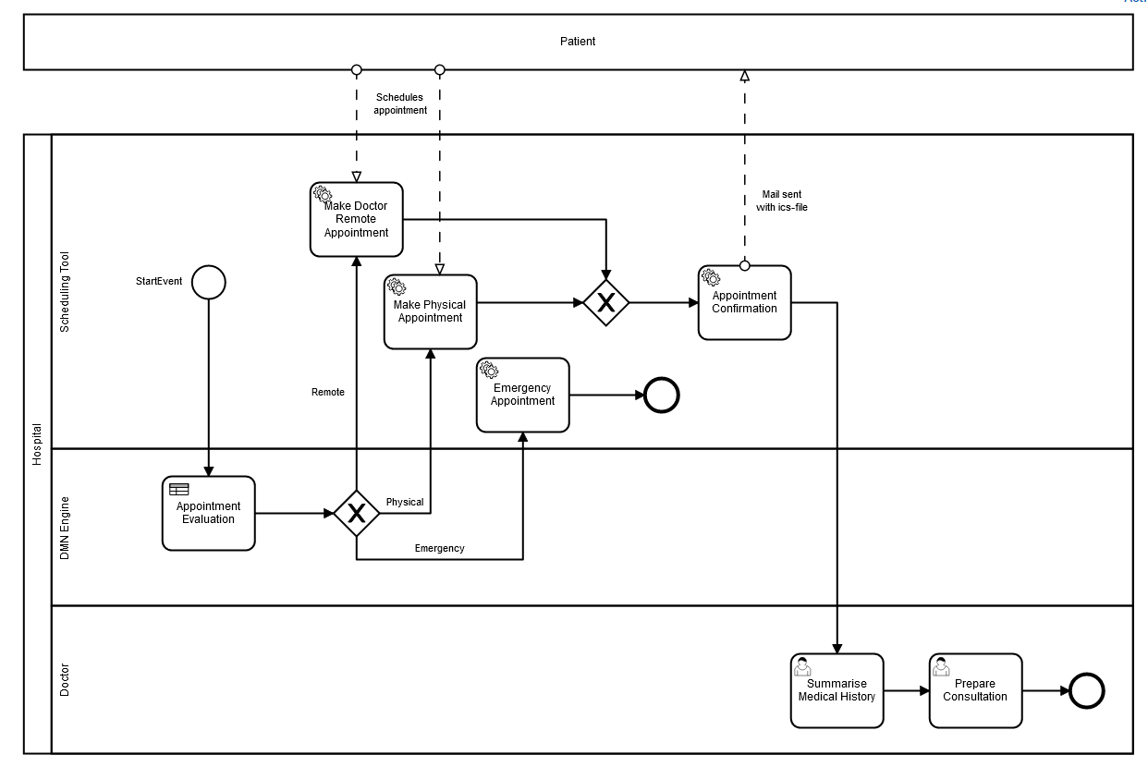
Digitalized to-be process

Slide 5
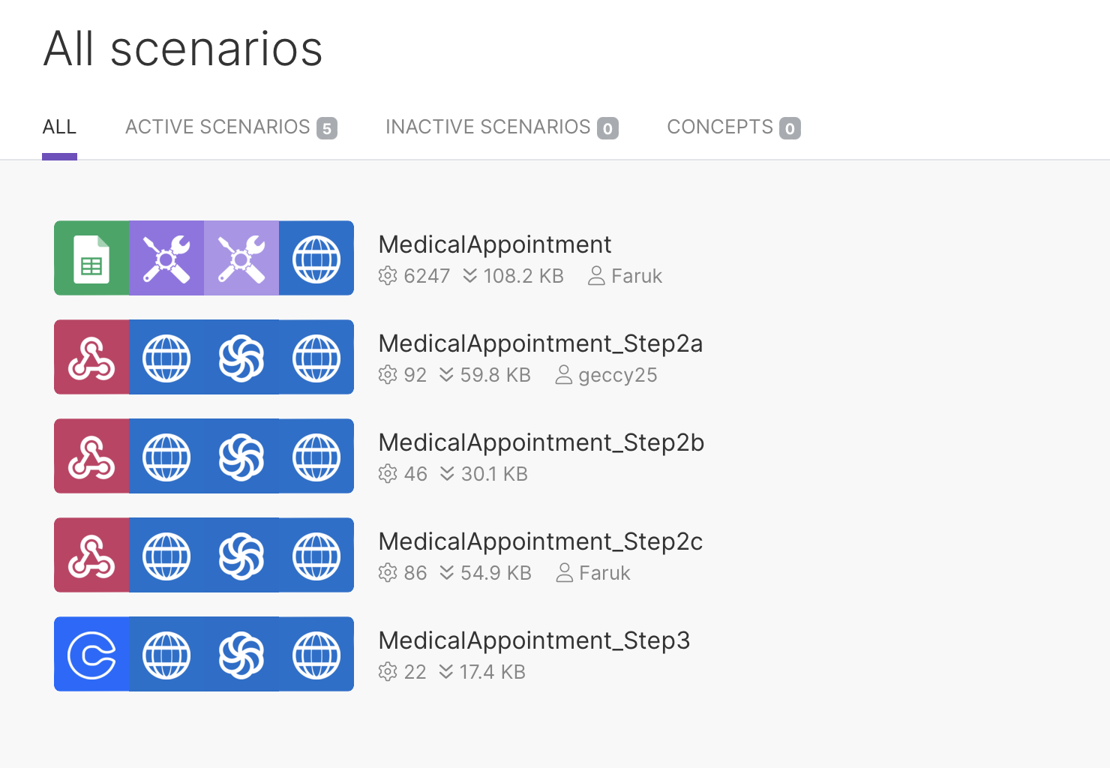
Implementation
BPMN and DMN model developed in Camunda Platform v7.17
Web Services Integrated
Process Automation with MAKE.COM (Integromat)
Webhooks to support task automations
External Tasks (Topic Integration)
Google Forms for Patient Appointment Registration (inc. form validation)
Calendly Web Service Integrated for appointment scheduling
Sendinblue Service Integrated for dynamic notifications
Demo:
Medical Appointment Scheduling
Integrated Scenarios – MAKE
Camunda

Slide 6
Benefits
Hospital administration could benefit from this process due to its efficiency and automation
The whole process runs through a single tool
Less manual efforts, no more manual checks to be performed and letters to be sent out
Time-consuming appointment search on the phone is no longer required
Gain time to focus on added-value tasks
Enabled traceability of process activities and KPIs
The appointment management takes place in real time e.g. the confirmation
The service can be extended to other sectors of the business and potentially to other industries

Slide 7
Considerations
User experience would be improved when the solution is implemented on a single web location (e.g., hospital´s website) although there are benefits in having a modular solution
Implementing a Re-scheduling and Cancelation option would add value to the digitized process (not implemented due to project scoping).
A secure single-source data storage complying with data protection regulation is recommended
The number of requests and features can be easily scaled with a premium MAKE license
The actual implementation will require a formal validation/testing of the solution
A training on the to-be process should be provided to all business stakeholders

Slide 8
Learnings
The BPMN was at first more complicated than the actual situation
MAKE as a very useful tool for task and process automation -> adds value to another practical needs as well
Concrete insights on how to operationalize processes instances using Camunda and Service Integrations using APIs
At first, we made one Make Scenario for the whole process, we ended up with 5 Scenarios
Struggling with Google Calendar resulted in using Calendly
Struggling with Gmail resulted in using Sendinblue (Templates)

Slide 9

Thank you!
Questions ?

