Slide 1
Digitalization in the Clinical Laboratory Digi Lab Pro
Digitalization of Business Processes
MSc in Medical Informatics & Business Information Systems
Javier Pose
Kevin Schär
Timo Schöpflin
Pascal Zimmerli
Philippe Schwank
Notes:
Welcome everybody. We are excited to present you our new digital solution for the analysis processing process in clinical laboratories. We will do that along a concrete use case based on an implementation of one of our customers who gave us the permission to publish their final solution.

Slide 2


Goals
Reducing Paperwork and generating Digital Data
Better and secure Management of Patient Data
Improved Visualization and Analysis of Data
Automated Decision-Making where possible
Added Safety and Hygiene through hands-free Automation
MSc in Medical Informatics & Business Information Systems
Notes:
In order to undrestand the context of the use case, we first want to present you the goals that were addressed with this specific project.
- One of the goals was to reduce the paper produced within the process and generate digital data. This also addressed the issue of redundancy through maitaining information paper based and simultaniously in the Laboratory Information Management System.
- A futher objective was to have a better and more secure management of patient data, through a the central control of the data
- Also the project wanted to improve the visualiation of infromation and provide a better foundation for analysing data.
- In order to relieve the workload of clinical employees, the project also had the scope to provide automated decision-making where prossibe
- Finally, the digitalisation and automation aims to increase safety and hygiene through hands-free automation

Slide 3
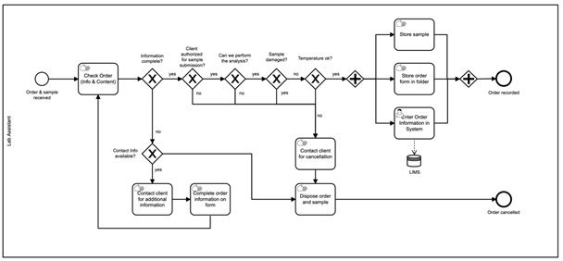
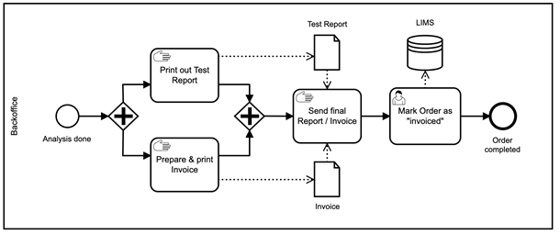
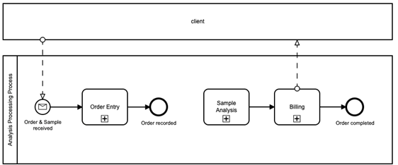
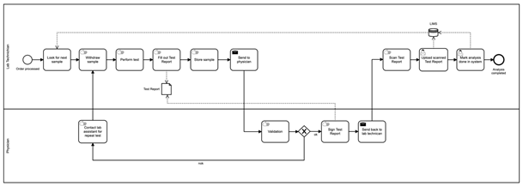
Old Process
Many Manual Task
Interdependent Decision
Redundant Information
High Workload for Physician
MSc in Medical Informatics & Business Information Systems
Notes:
Here you can see the previous AS-IS process of Digi Lab Pro before we implemented the new digital process.
The overall process was composed by three subprocesses which you see here: Order Entry, Sample Analysis, Billing Process.
The circles and colors point out to the main characteristics of the process.
For instance, we can observe that the processes are cleary dominated by many manual tasks.
The blue circle indicates interdepend decisions that were done manually.
The redundant information metnioned before is depicted in orange here.
Also imporant to highlit is the green circle in the analysis process. Because here Digi Lab Pro observed elevated waiting times, because physician usually having a high workload, so that they were not able to have the work done in a meaningful pace of time.

Slide 4



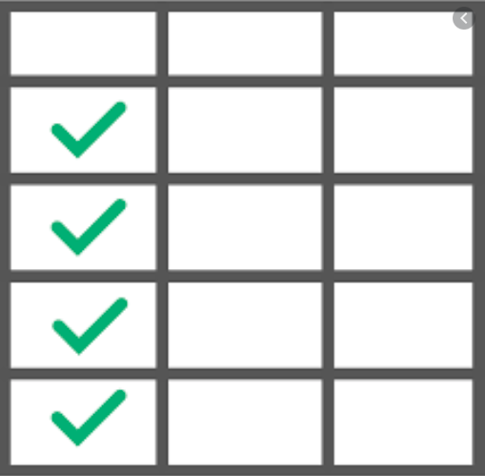
Digitalization
Instruments:
Online Forms
Automated Communication
Decision Tables
Recommendation Engine
Outcome and additional Benefits:
Reduction from 24 to 8 manual Tasks
Possibility for Clients to track their Orders
MSc in Medical Informatics & Business Information Systems
Notes:
For our implemented solution, we mainly made use of this four instruments:
Online forms for restrict the possible input of incorrect data and reduce manual checking tasks.
Also, online forms have the advantage that the information is directly introduced into the system.
The automated mails, has the effect that no more time consuming contacts with the customer has to be conducted.
Decision tables were used for automate the interdependent deicisions
Finally, Artificial Intelligence tasks has been implemented in order reduce the workload of the physicians in the context of the analysis processing process
The outcome of the final solution resulted in a reduction of manual task from 24 to 8 tasks.
Additionally the new process enables the clients to track their orders. This resulted in a grwoth of customer satisfaction for digi lab pro.
I will now hand over to Pascal, that will introduce you to some highlits of the new process. We will also later on make a live demo, so that you can have better impression about our innovative product.

Slide 5
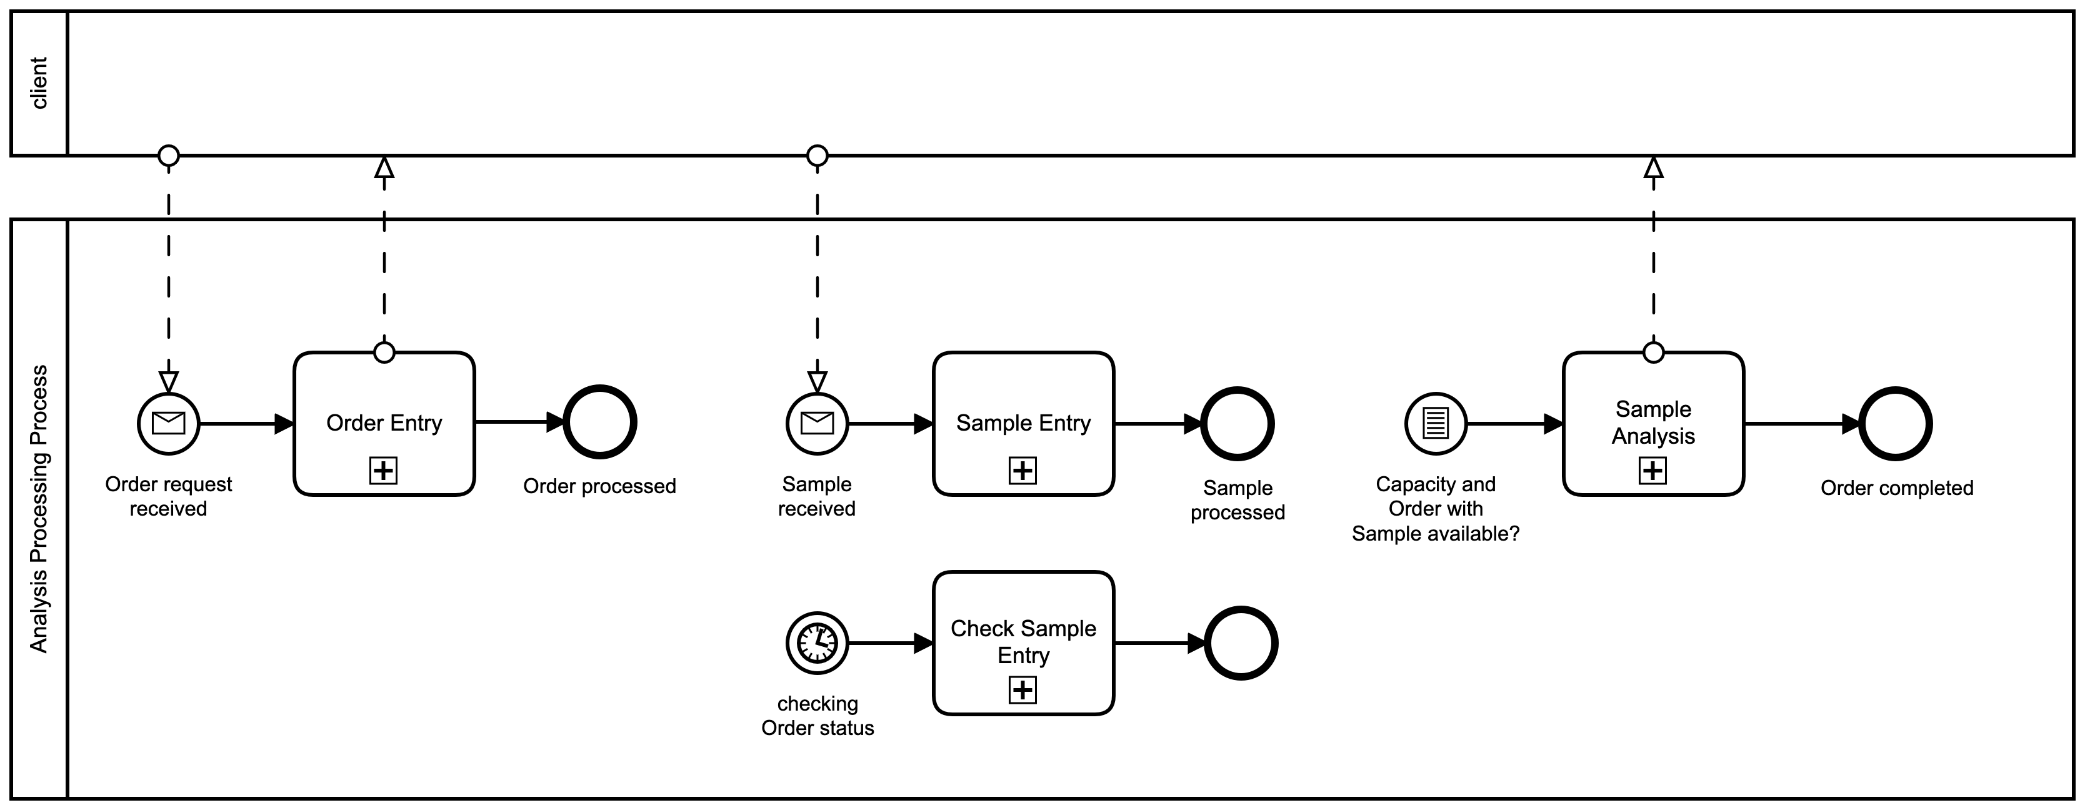
New Process
MSc in Medical Informatics & Business Information Systems
Notes:
This slides shows an overview of the subprocesses of the new process of Digi Lab Pro after the digialisation. Every subprocess will be briefly presented in the following slides.

Slide 6
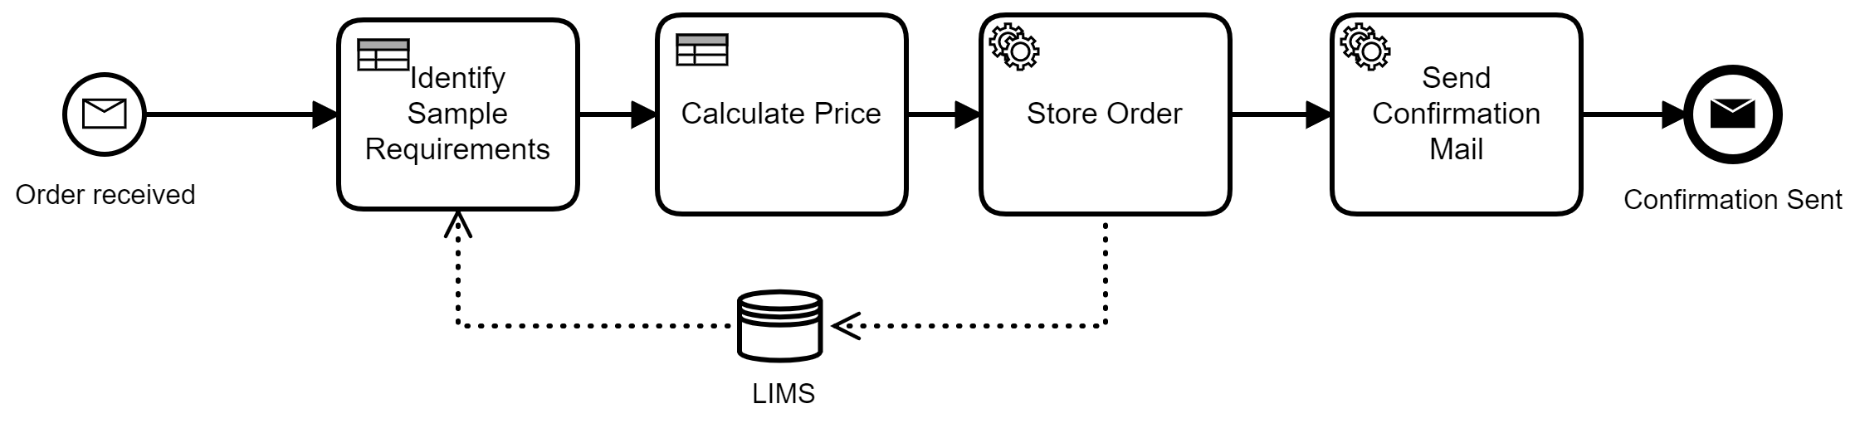
Order Entry
MSc in Medical Informatics & Business Information Systems
Notes:
The first step of the digitalised business model is taken by the customer when registering the sample for analysis. For this purpose, the customer is provided with an online form in which he enters the type of analysis with the desired processing priority. The system then automatically processes the registration of the analysis. The chosen analysis is assigned to the specific sample type. The system also calculates the estimated price depending on the chosen analysis and priority. Finally, a confirmation is sent to the customer by email.

Slide 7
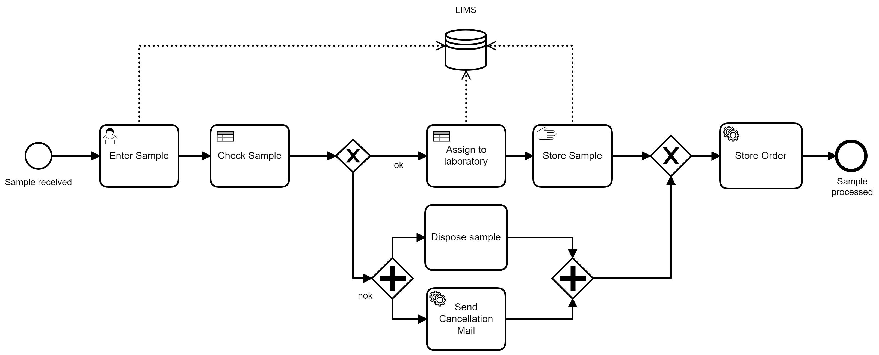
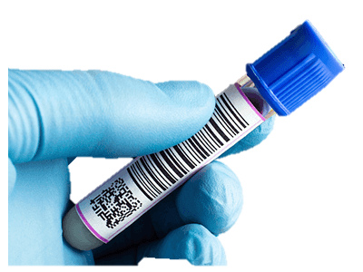
Sample Entry
MSc in Medical Informatics & Business Information Systems
Notes:
A QR code is attached to the confirmation mail which can be glued onto the sample by the customer. On delivery of the sample, the lab technician can easily scan the QR code and identify the sample which can also be done in all following process steps. He can then check if the correct sample was delivered and if something is damaged or the temperature indicator is not ok. If everything is good the sample is automatically assigned to a responsible laboratory department and will be stored temporarily, the data will be stored in the LIMS. If something should not be ok, the customer receives an automatically generated cancellation email with the corresponding reason and the sample is disposed of.

Slide 8
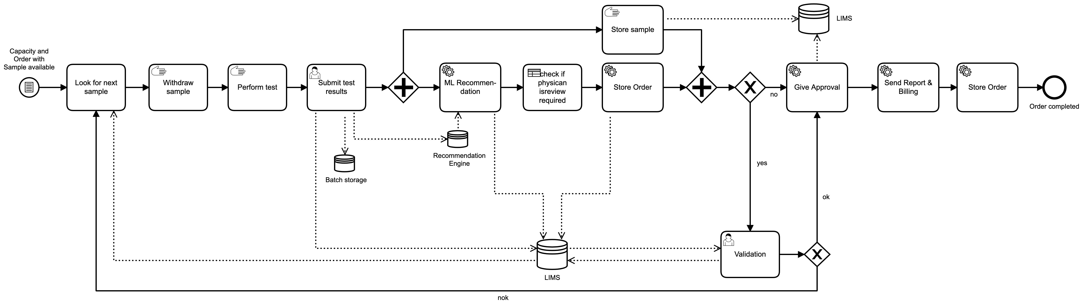
Analysis
MSc in Medical Informatics & Business Information Systems

Slide 9
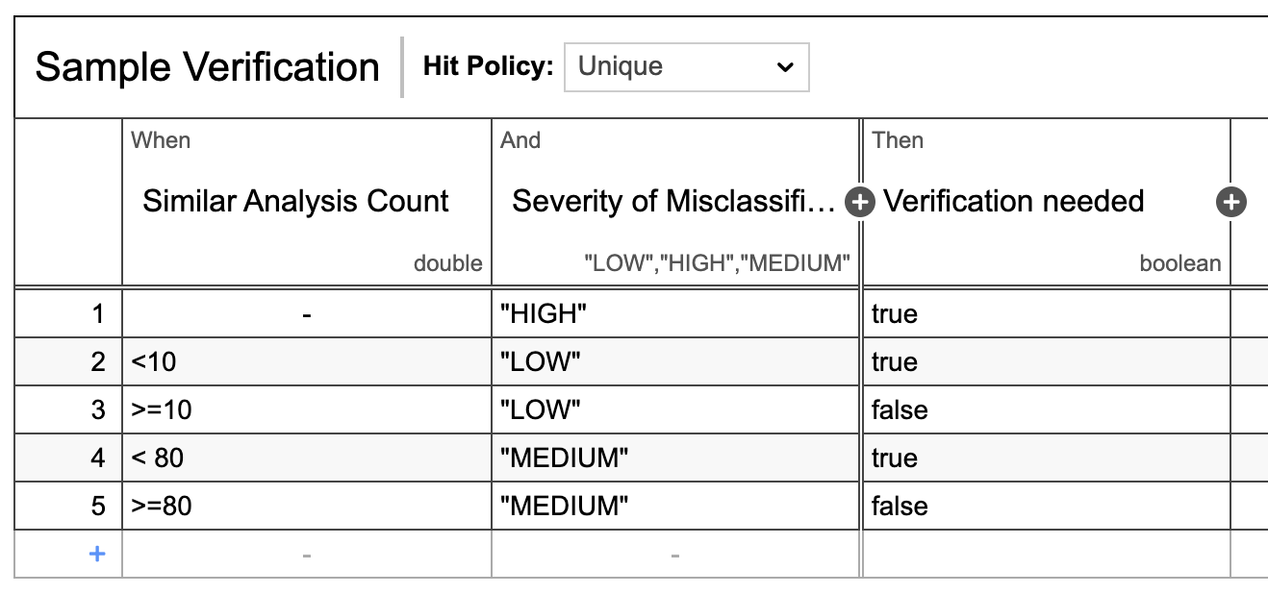
Analysis
Self-learning Recommendation Engine reduces physician workload.
MSc in Medical Informatics & Business Information Systems

Slide 10



Demo
MSc in Medical Informatics & Business Information Systems

Slide 11

Conclusion
Reducing Paperwork and generating Digital Data
Better and secure Management of Patient Data
Improved Visualization and Analysis of Data
Automated Decision-Making where possible
Added Safety and Hygiene through hands-free Automation
MSc in Medical Informatics & Business Information Systems

Slide 12
Outlook
Improve Automation by Robotics
Provide Process Insights by advanced Analytics / Visualization
Combine Data of all Lab Partners to improve Recommendation Engine
MSc in Medical Informatics & Business Information Systems

