Slide 1

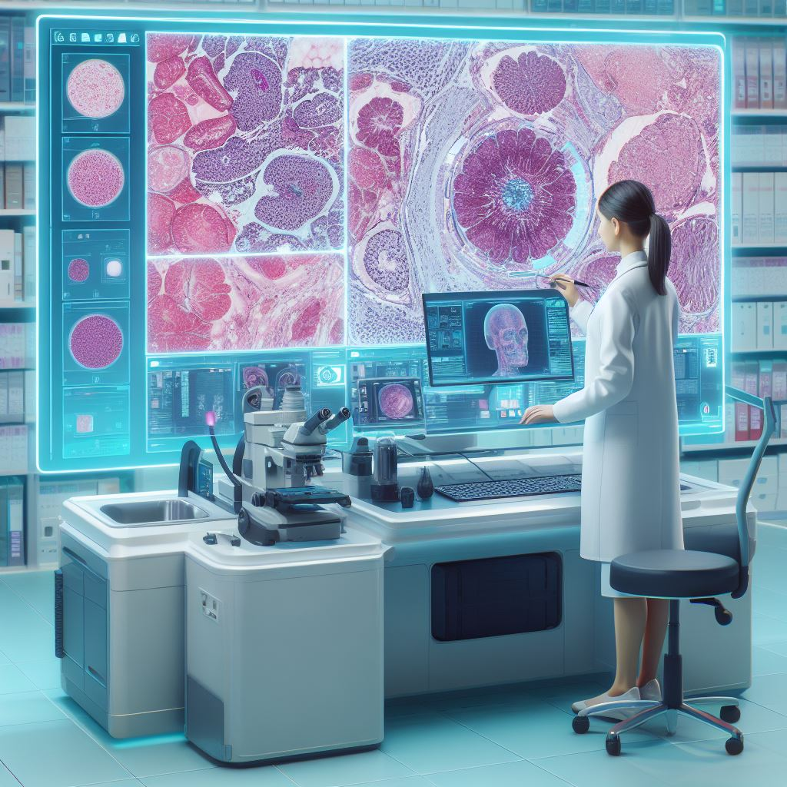

Digitalization of Business Processes in Healthcare
Improving Histopathology Analysis Process by Digitalization
Team Ovamaltine:
Divya Sarah Abraham
Saengrawi Gogniat
Aleksandra Iskrzynska
Sunita Vijay Shelke

Slide 2


Overview
Challenges in histopathological analysis
AS-IS process
TO-BE process
ARTIDIS® nanomechanical Biomarker
AI Histopathological Image Recognition
Conclusion

Slide 3








Challenges in Traditional Histopathology Analysis
Time consuming
leading delay diagnosis
Sample preparation
Manual Microscopic Examination and Report analysis
Faster
More effective
More accurate process
Improve the histopathology process through digitalization and advanced technology.
Notes:
Brief outline of why histopathological processes are time-consuming:
Sample Preparation
Manual Microscopic Examination
Data analysis
The Urgent Need for Faster and More Efficient Methods:
Clinical Implications: Timely diagnosis is critical in the realm of healthcare, impacting treatment decisions and patient outcomes.
Resource Utilization: With a rising demand for pathology services, there is a pressing need for methods that optimize resource utilization and reduce the strain on healthcare systems.
Technological Advancements: Automated image analysis, machine learning algorithms, and artificial intelligence hold promise in expediting the interpretation of histopathological data, providing faster and more accurate results
Aim:
Improve the histopathology process through digitalization and advanced technology.
Utilize Artidis measurement ? and AI image recognition for faster, higher-performing analysis.
Goal is to satisfy all stakeholders with a more efficient and accurate process.

Slide 4
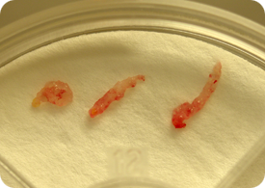
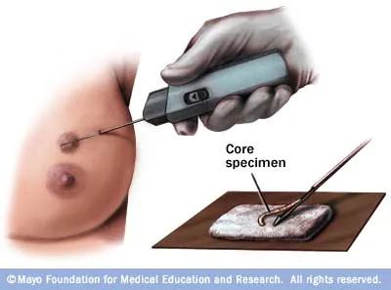

Specimen collection
Notes:
Divya

Slide 5
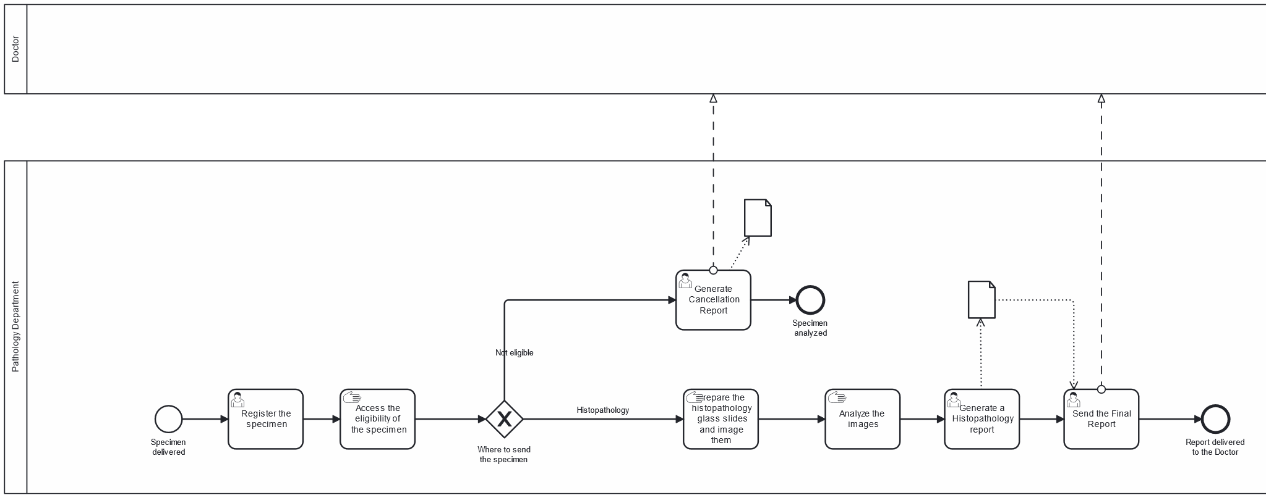
AS-IS process
Difficult to track the specimen status.
Manual tasks are time consuming and resource demanding. Some hospital, where is short of pathologist, can take longer than one month.
Notes:
The pathology department receives biopsy samples. Multiple samples can be received as a batch from a single patient. A clerk registers details about each sample which is saved in a database. The sample is then sent over to a lab technician who assesses the sample to check whether it is suitable for a histopathology analysis. If the sample is not suitable a cancellation report is prepared and sent to the doctor.
If the sample is suitable for histopathogy analysis, then a lab technician prepares the glass slides with the specimens and images them.
These images are then analysed by a lab technician and the results are documented.
Based on these results a Histopathology report is prepared. This report is then delivered to the doctor.

Slide 6








Tools
Model
Service Tasks
Data
Notes:
For modelling the process we used Camunda Platform 7
For service tasks we used: Deepnote notebook, python flask, smptlib (for emails), tensorflow (for machine learning model), and excel csv format for storing the data. Everything was going through http-connector

Slide 7


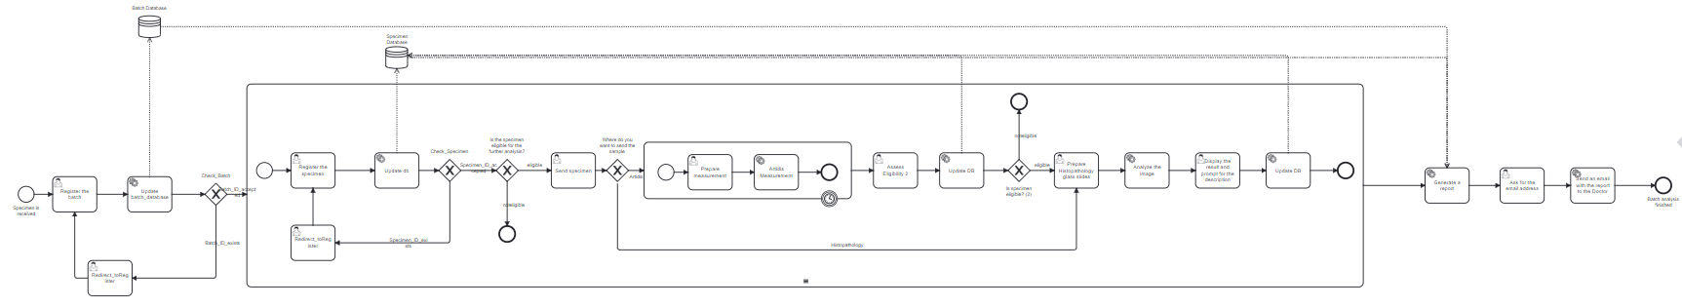


TO BE process
Notes:
Divya

Slide 8
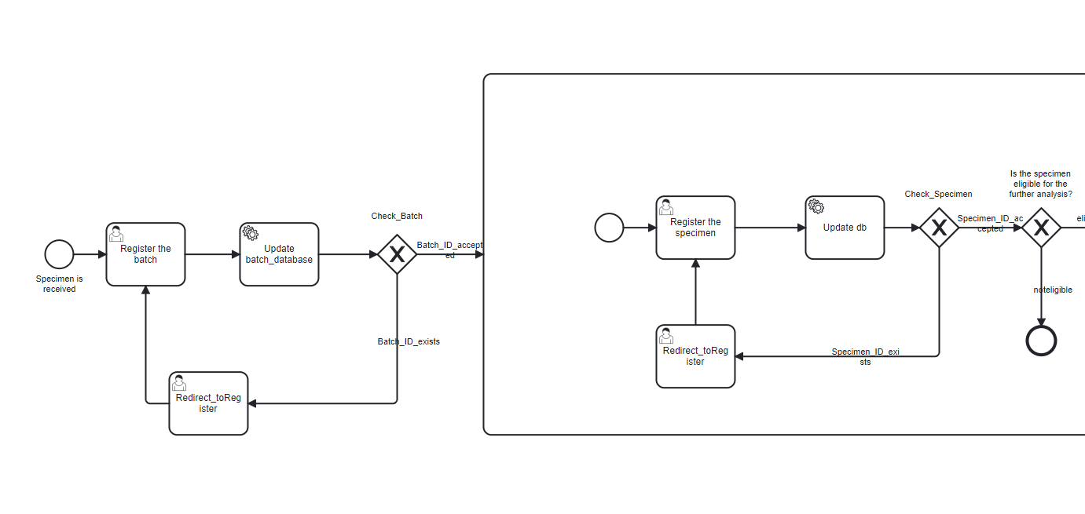
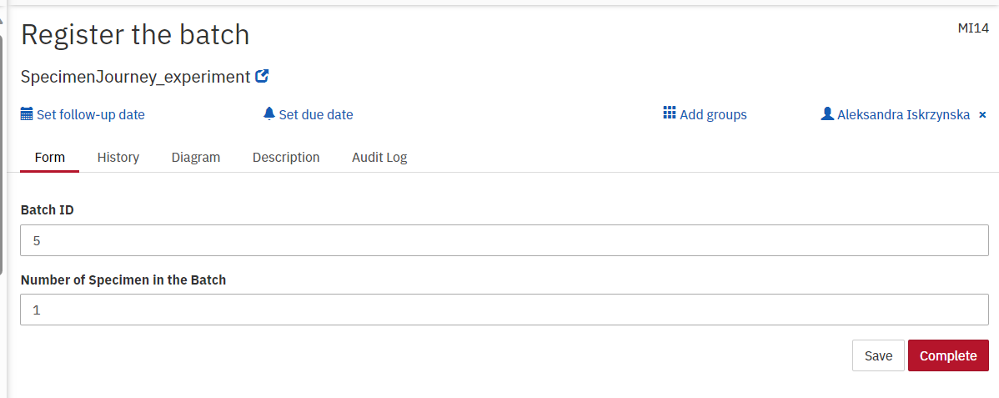
TO BE process
Notes:
Divya

Slide 9
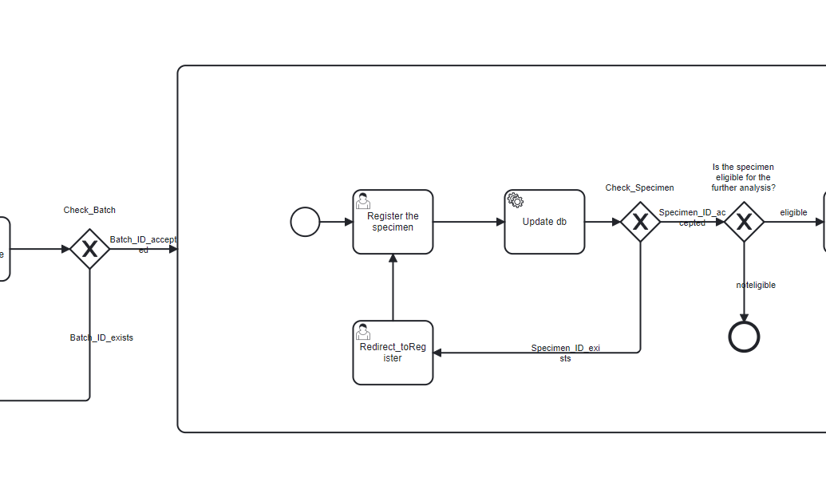
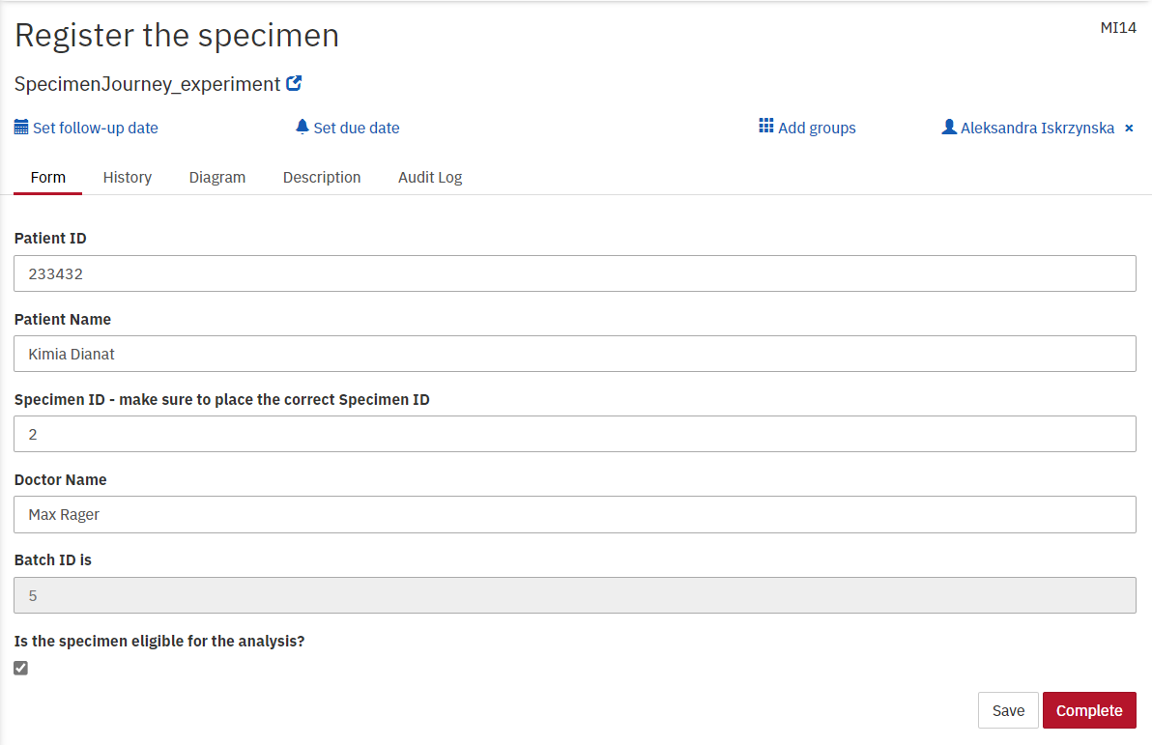
TO BE process
Notes:
Divya

Slide 10
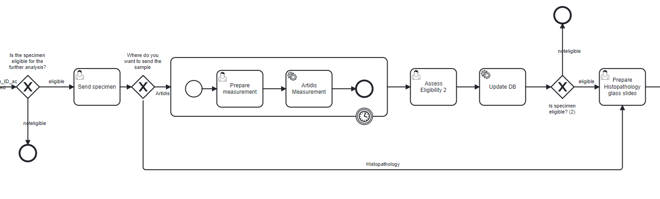
TO BE process
Notes:
Divya

Slide 11
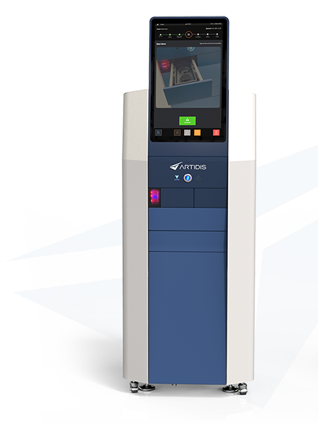
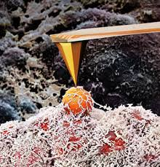

ARTIDIS® nanomechanical biomarker
Acquires a nanomechanical profile of the specimen in 3 hours
Defines the imminent aggressiveness of tumors
Scan the code
for more background
Notes:
The presence of soft cells which can deform and squeeze through the blood or lymph system and form new tumors in other parts of the body
- The heterogeneity of the tumor tissue, which is in turn linked to permeability to cancer treatment

Slide 12
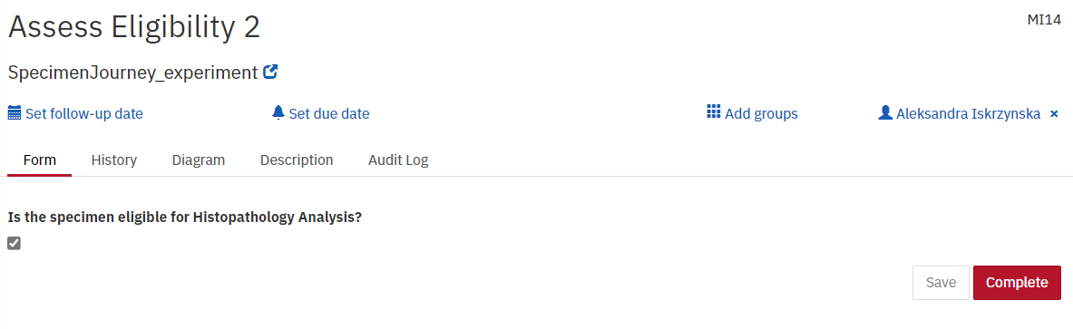
TO BE process
Notes:
Divya

Slide 13
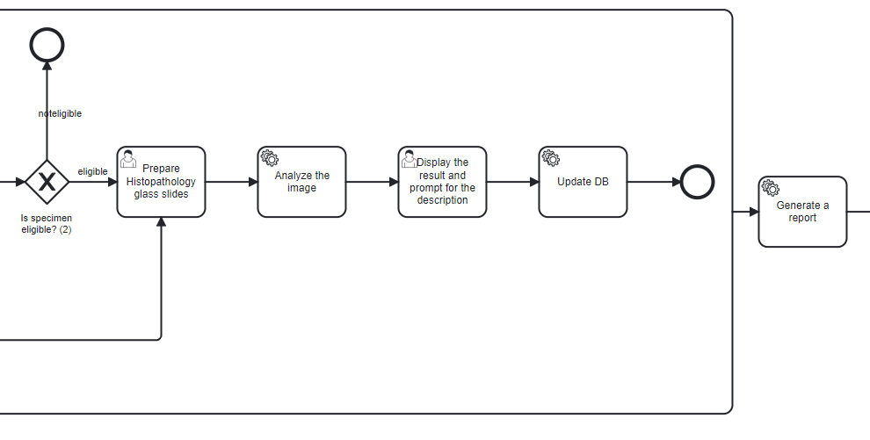
TO BE process
Notes:
Divya

Slide 14
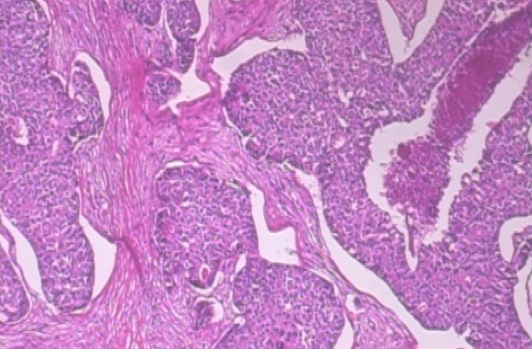
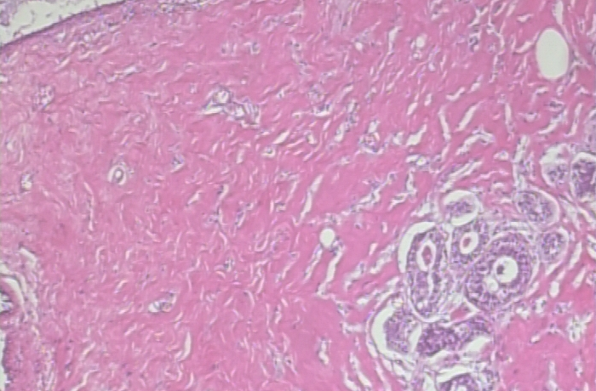
Histopathological Image Classification
Malignant
Benign
1995 images (B: 625, M: 1370)
Accuracy on the test data: 0.80
Source: https://web.inf.ufpr.br/vri/databases/breast-cancer-histopathological-database-breakhis/
[1] Spanhol, F., Oliveira, L. S., Petitjean, C., Heutte, L., A Dataset for Breast Cancer Histopathological Image Classification, IEEE Transactions on Biomedical Engineering (TBME), 63(7):1455-1462, 2016
Notes:
- improved accuracy in identifying subtle features, differentiating between benign and malignant tissues, and detecting abnormalities that might be challenging for the human eye.

Slide 15
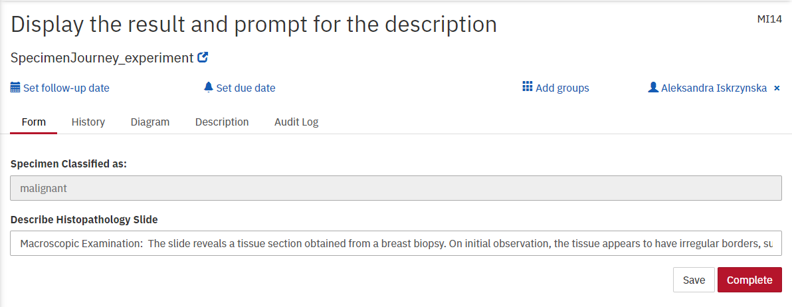
TO BE process
Notes:
Ola

Slide 16
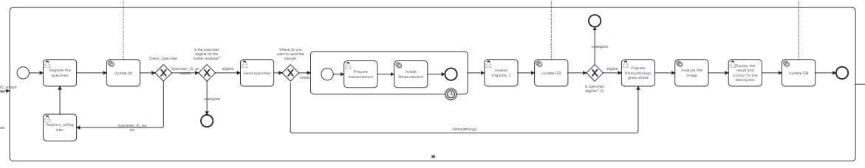

TO BE process
Notes:
Ola

Slide 17
TO BE process
Notes:
Ola

Slide 18
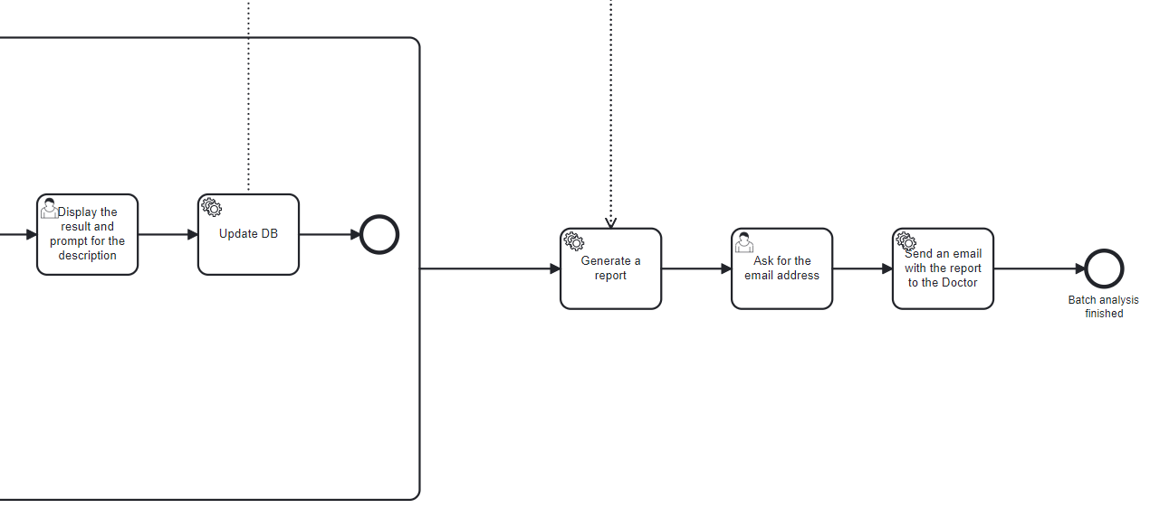

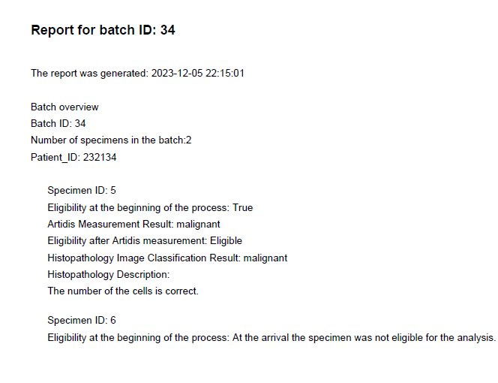
TO BE process
Notes:
Divya

Slide 19
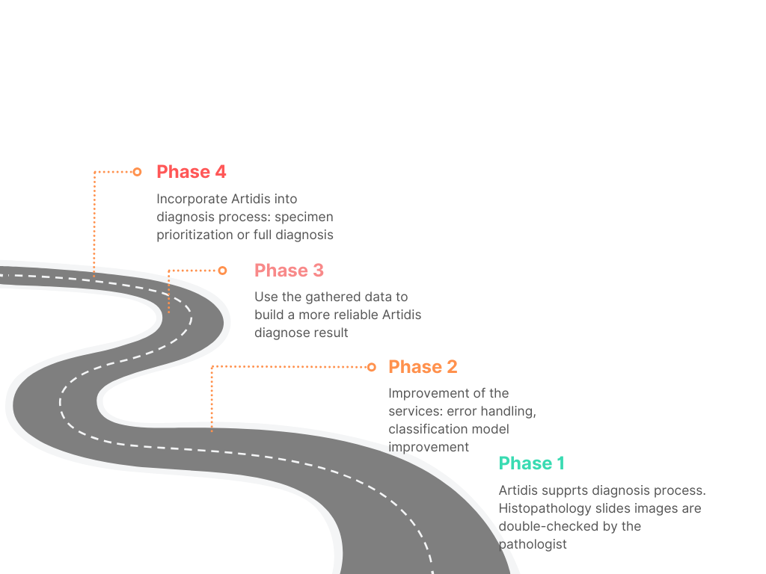
Vision
Notes:
Saengrawi
Aim:
Improve the histopathology process through digitalization and advanced technology.
Utilize Artidis measurement ? and AI image recognition for faster, higher-performing analysis.
Goal is to satisfy all stakeholders with a more efficient and accurate process.
Business Advantages of digitising the Pathology Lab process:
Efficiency gains through process improvements
Reduce operational costs through better resource utilisation and automation
Deliver consistent quality
Easier to integrate other processes
Fosters collaboration

Slide 20
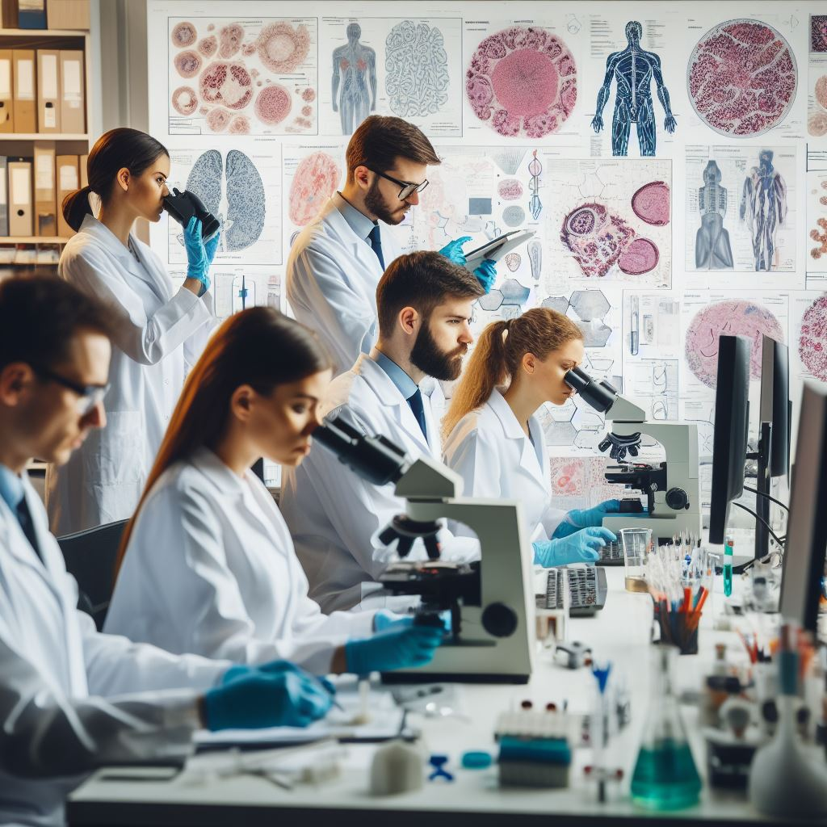
Enhancing Breast Cancer Histopathology Analysis
Project Overview
Notes:
Saengrawi

Slide 21
Digitalization of Business Processes in Healthcare
Thank you
Q&A
Team Ovamaltine:
Divya Sarah Abraham
Saengrawi Gogniat
Aleksandra Iskrzynska
Sunita Vijay Shelke

