Slide 1

Swiss Student Enrolment
Gebretsadik Elias
Hügli Andreas
Hernadi Gabor
Gebretsadik Elias
Hernadi Gabor
Hügli Andreas

Slide 2
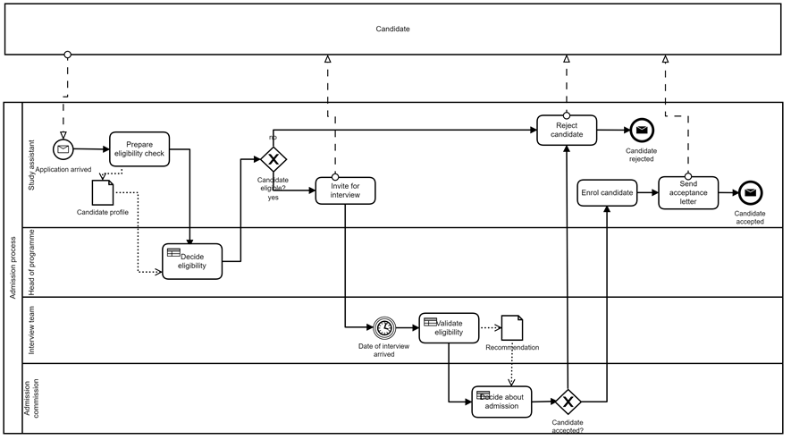
The current situation – “Stoneage”

Slide 3
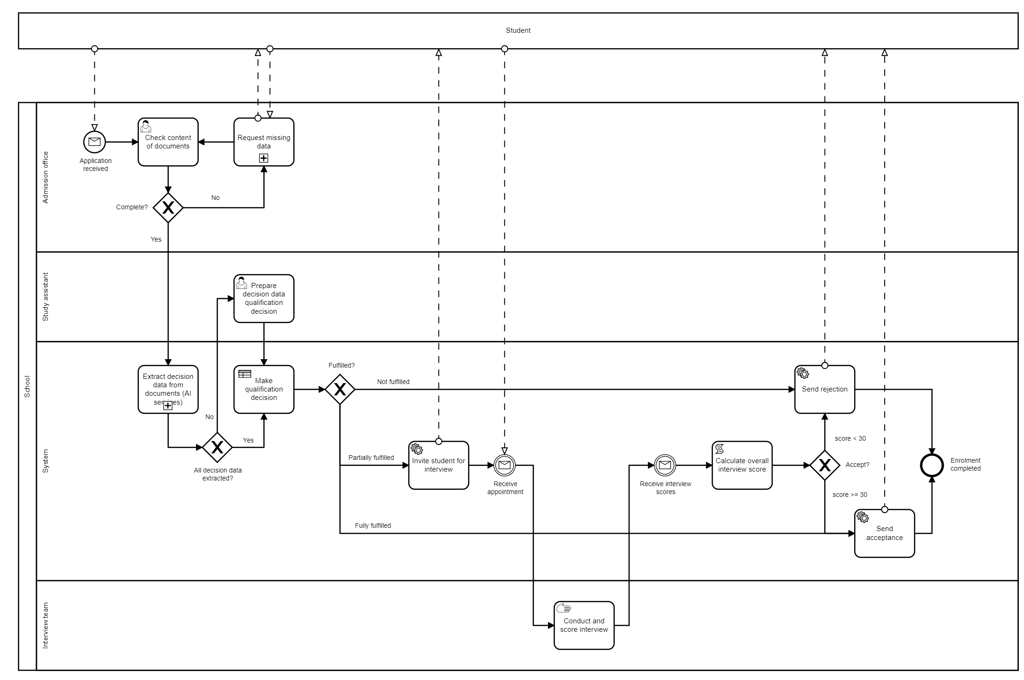





Our solution – “AInrolement”
Notes:
Our solution, where automization, AI and people go hand in hand to efficiently improve the whole process
-

Slide 4
New features
Less people-intensive
Automated qualification decision
Automated appointment scheduling
Score algorithm for interviews
Automated communication
Adaptable for new programmes / universities
Adoptable for internationalisation
Fully scalable

Slide 5





Thank you

