Slide 1
Just Me

Slide 2
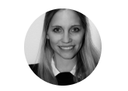
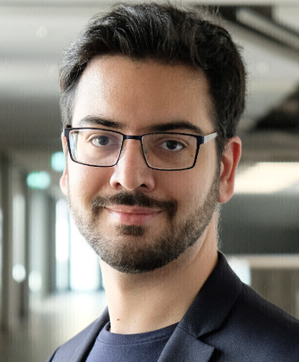
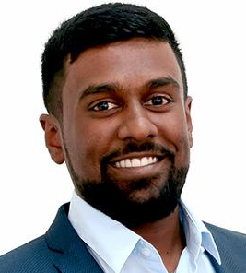

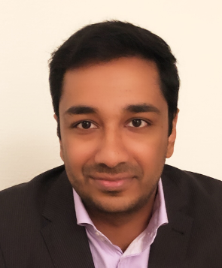
Our Team
CEO & Process Owner
Head of Engineering
Head of Marketing & Sales
Senior Business Analyst
Senior Business Analyst

Slide 3
Today’s society
Mega trends
Gender shift
Neo Ecology
Individualized
Connectivity
Globalized

Slide 4
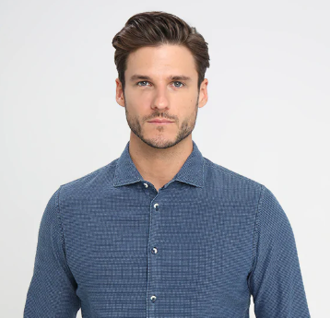
Title?
Max
Age: 30
Financial Background: Middle Class
Job: Business Analyst
Character: Eco-friendly, Human rights activist, busy schedule,
Challenging Body structure
Max’s shopping behaviour
Online Shopper
Enjoys individualized clothing
Eco friendly and tailor made

Slide 5
Our Idea
Fast and easy access to eco friendly and fairly produced clothes.
Customers should be able to find clothes in all price classes → Mass market

Slide 6
Max is going on a shopping tour

Slide 7
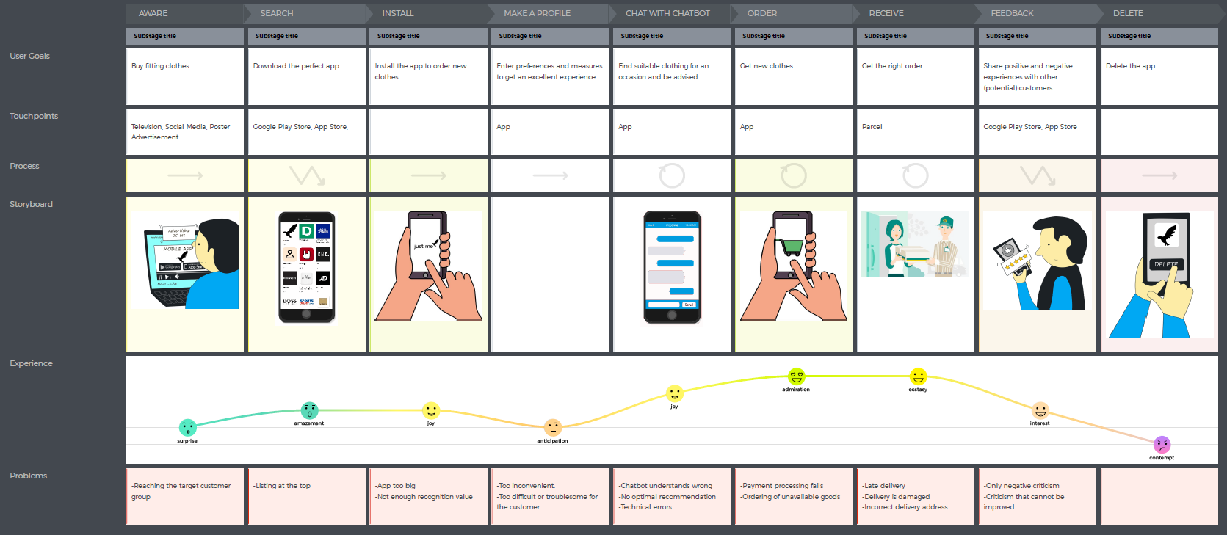

Slide 8
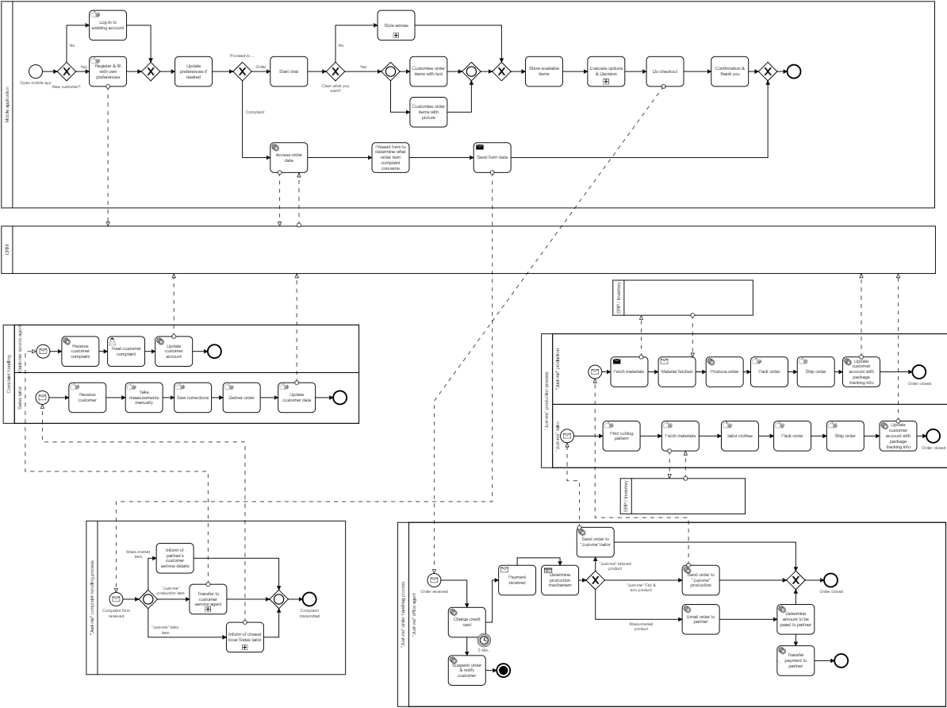

Slide 9
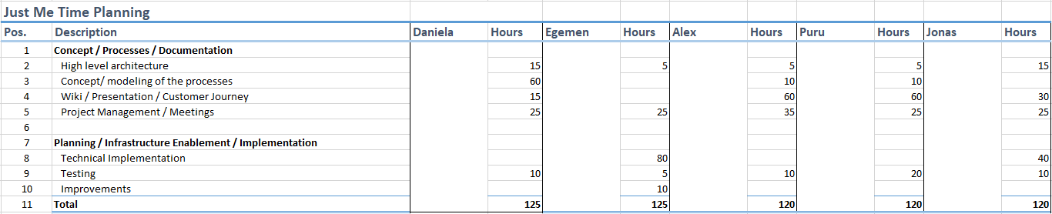
Project Approach
Requirements
Design
Implementation
Verification
Maintenance

Slide 10
Major Challenges
Coordination between project members
Time Planning
Technical Implementation
Know How sharing

Slide 11
Q&A

Slide 12
Back Up Slides

