Slide 1

BananaAnalytics
presented by anton, david, felix and rahel

Slide 2
Project team (rahel)

Slide 3
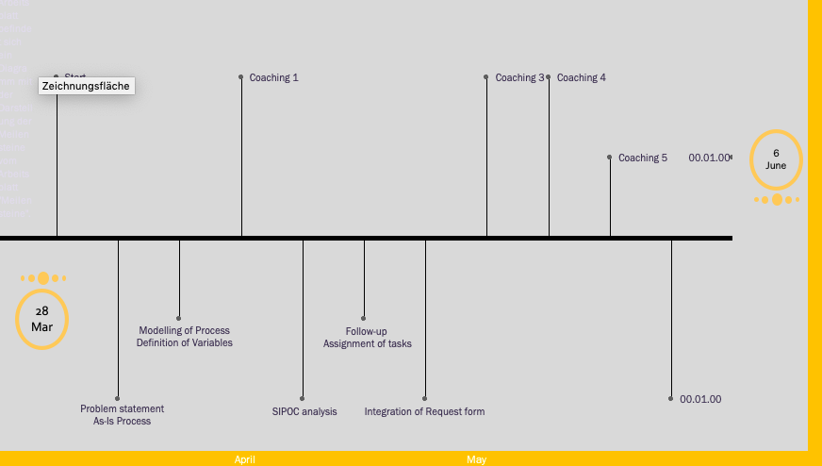
what did we do?
Notes:
1st: As-Is presented by David
2nd: Solution presented by Anton
3rd: Business oportunities presented by Felix

Slide 4
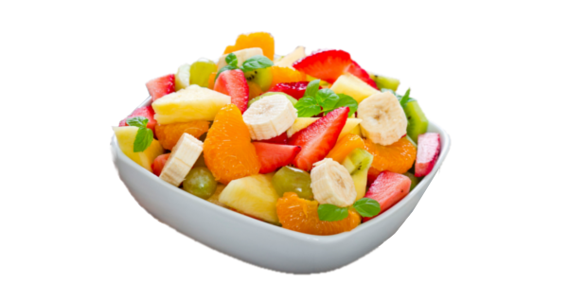
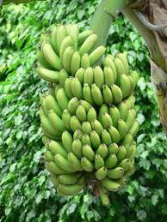


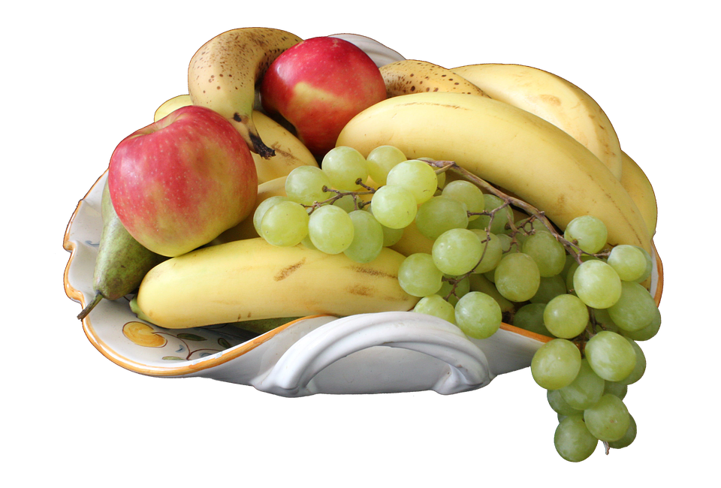
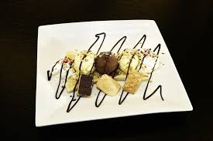
Problem (david)
Notes:
The bananatree are the data from the end-client. The auditor just needs specific information, represented by single bananas. And in the end, they are used for different analytics…

Slide 5
As-is

Slide 6
Solution (Anton)

Slide 7
Business idea (Felix)

Slide 8


