Slide 1


Initial form
Upload form
Metadata edit
Request Metadata edit
Request data upload
Fullfilment message
Confirmation

Slide 2

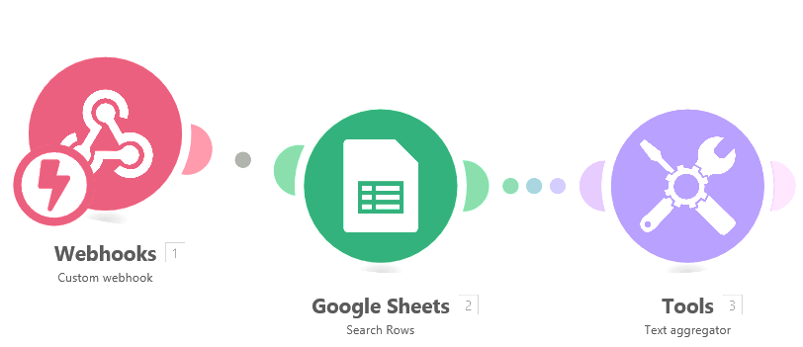



indirect integration
direct integration

Slide 3
direct integration
indirect integration

Slide 4
Very Gratifying
Satisfy
Neutral
Bad
Horrible

