Slide 1
Digitalisation of the Business Processes Business Process : Student Prospects Onboarding Process
Date: 06. June 2018
Authors: Daniel Horn, Daniel Werner, Fabian Feiler, Lia Flück, Puneeth Suresh
Supervisors: Knut Hinkelmann, Andreas Martin, Emanuele Laurenzi, Prajakta Diwanji

Slide 2
Agenda
Introduction
Problem Statement, Vision and Mission
Process description
Task types
Event types & other elements
Users & Groups
Automation & Service Integration
Automation
Service Integration
Demo / User Guide

Slide 3
Introduction

Slide 4

Problem Statement
What study program fits best to me taking into account:
My personality
My education path
My professional experience
My career goals

Slide 5


Vision
Bringing the right prospective student with the best fitting study program together to foster the potential and satisfaction for students, study program class environment and therefore as a consequence the society in economics and cultural aspects.

Slide 6
Mission
and to foster conscious decisions :

Slide 7
Goals

Slide 8
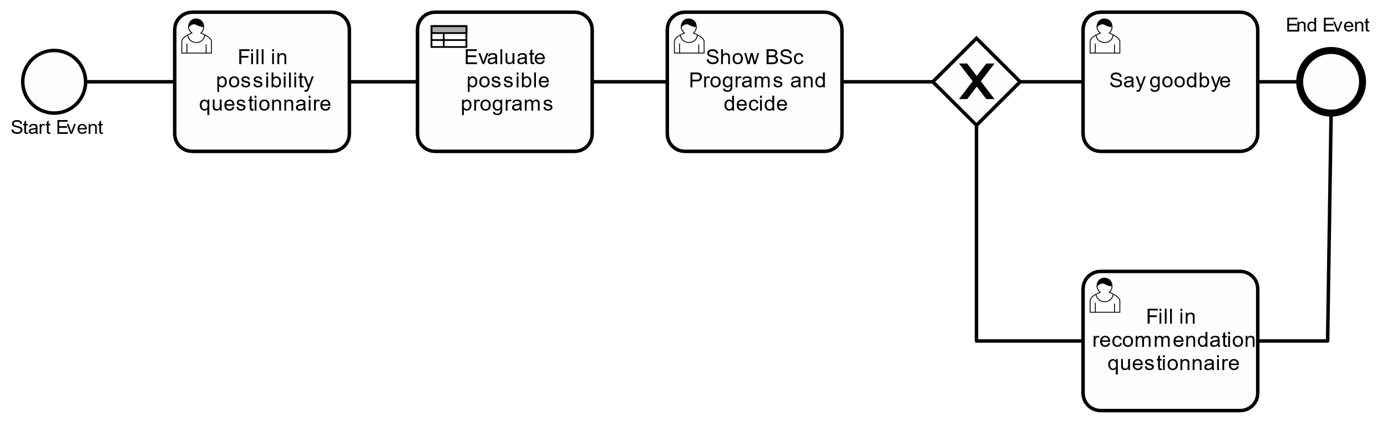
Process Description
- Swimmlanes und Database fehlen.

Slide 9
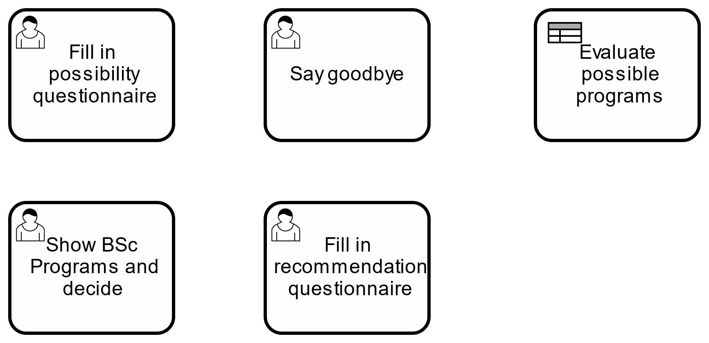
Task Types

Slide 10

Event Types and other Elements

Slide 11
User & Groups
- Swimmlanes in the Background and the roles above.

Slide 12
Automation & Service Integration

Slide 13
All services and its integration

Slide 14
Demo / User Guide

Slide 15
//TODO Prinzscreens
Forms of User tasks

