Slide 1

Digitalization of the Business Processes (SS19) e-Retail CC Clothing Company Team Morcote: Loris, Oliver, Shambu, Yannick
Notes:
- We are glade that you managed to be here today

Slide 2
Situation assessment 1/2
Just physical stores
No alignment of Business and IT
No scalable Business Model
Unefficient, manual processes

Slide 3
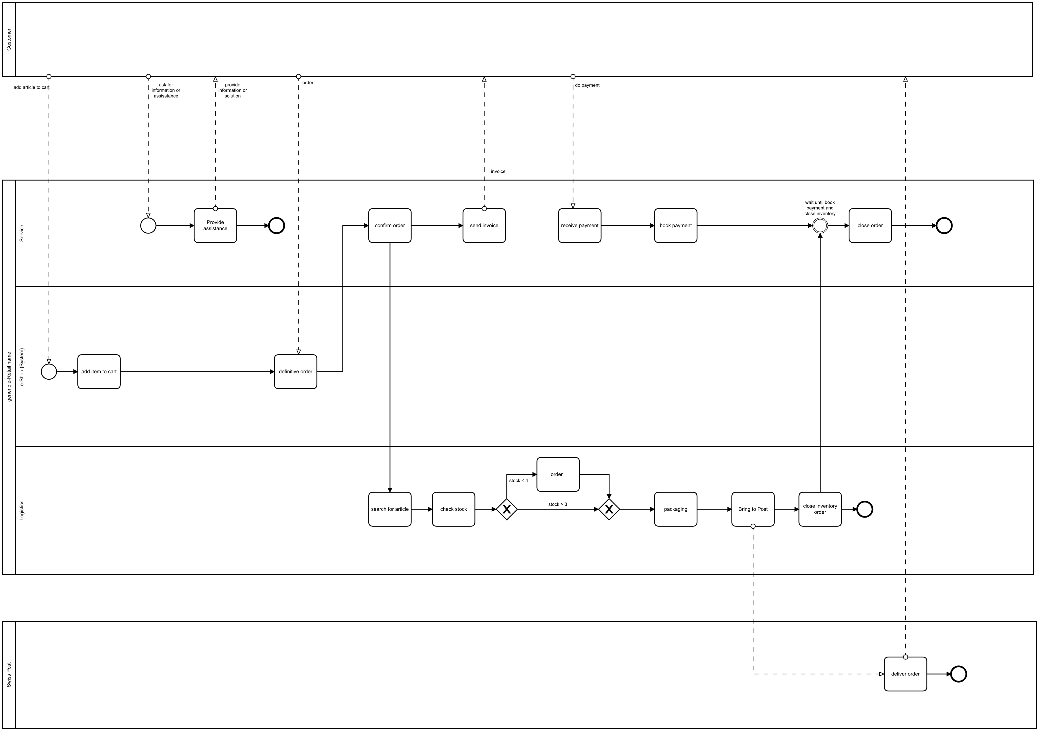
Situation assessment 2/2

Slide 5
Objectives: Digitalisation and Automation
Webshop
Order processing and confirmation
Order assistant (AI)
Inventory Management
Sending confirmation

Slide 6
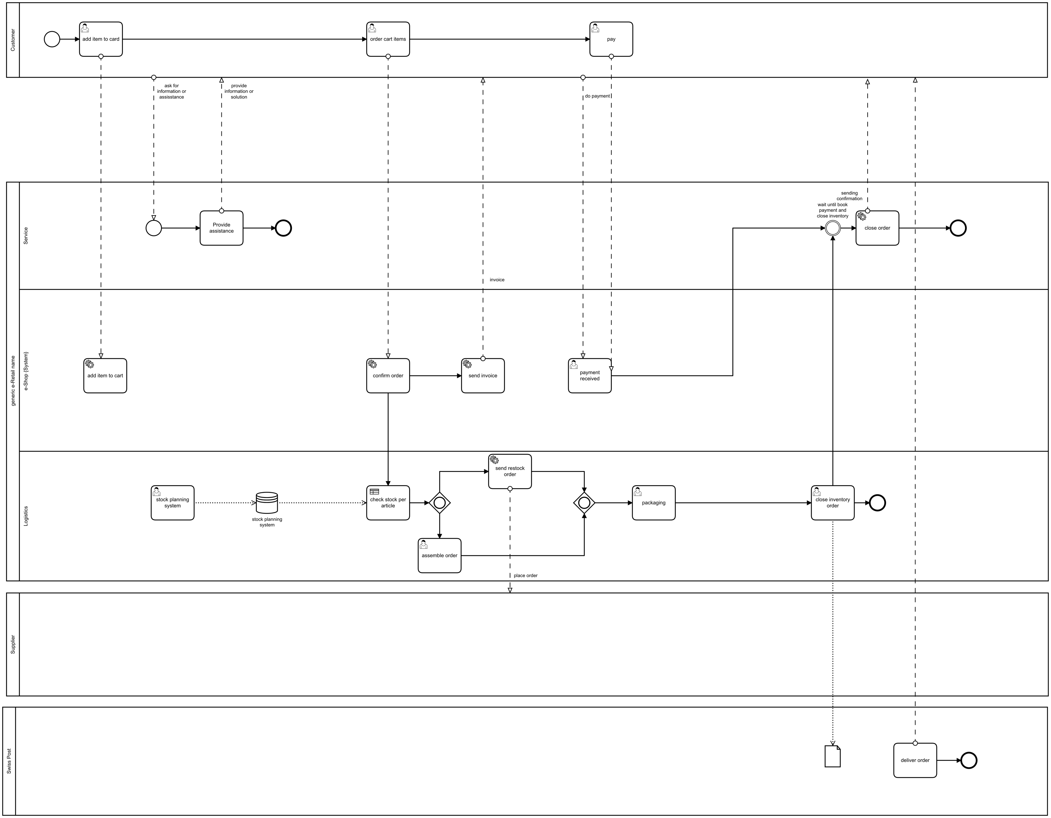
New processes

Slide 8
Decisions in «integromat»

Slide 9
CC Clothing Company Showcase Team Morcote: Loris, Oliver, Shambu, Yannick
Notes:
- We are glade that you managed to be here today

