Slide 1

Digitalization of the Business Processes (SS19) e-Retail “CC - Clothing Company” Team Morcote: Loris, Oliver, Yannick, Shambhu
Notes:
- We are glade that you managed to be here today

Slide 2
Agenda
Situation Assessment
Objectives
Technlogy Stack
Architecture
Demo

Slide 3
Situation assessment 1/2
Physical stores
Non-scalable Business Model
Inefficient manual processes
No alignment of Business and IT

Slide 4
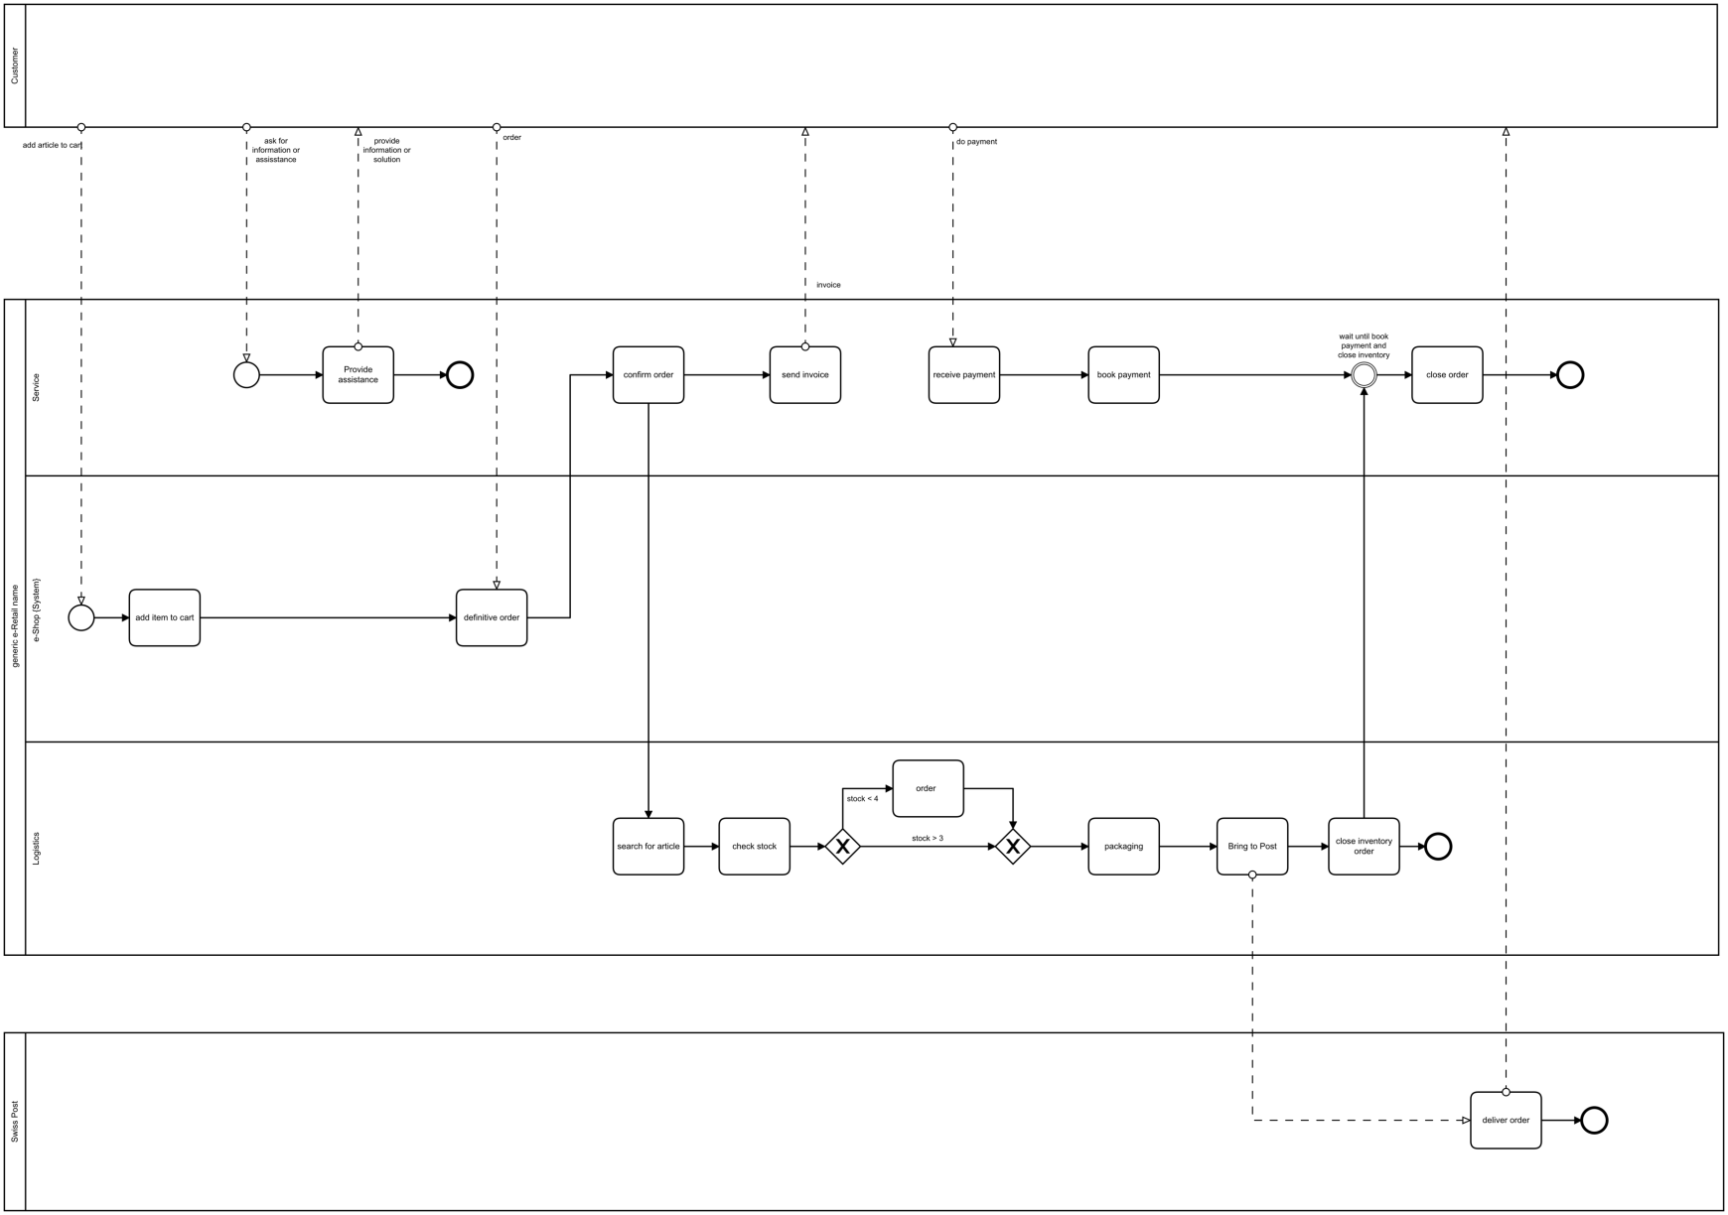
Situation assessment 2/2

Slide 5
Objectives: Digitalisation and Automation
Webshop
Order processing and confirmation
Customer loyalty program
Inventory management

Slide 6
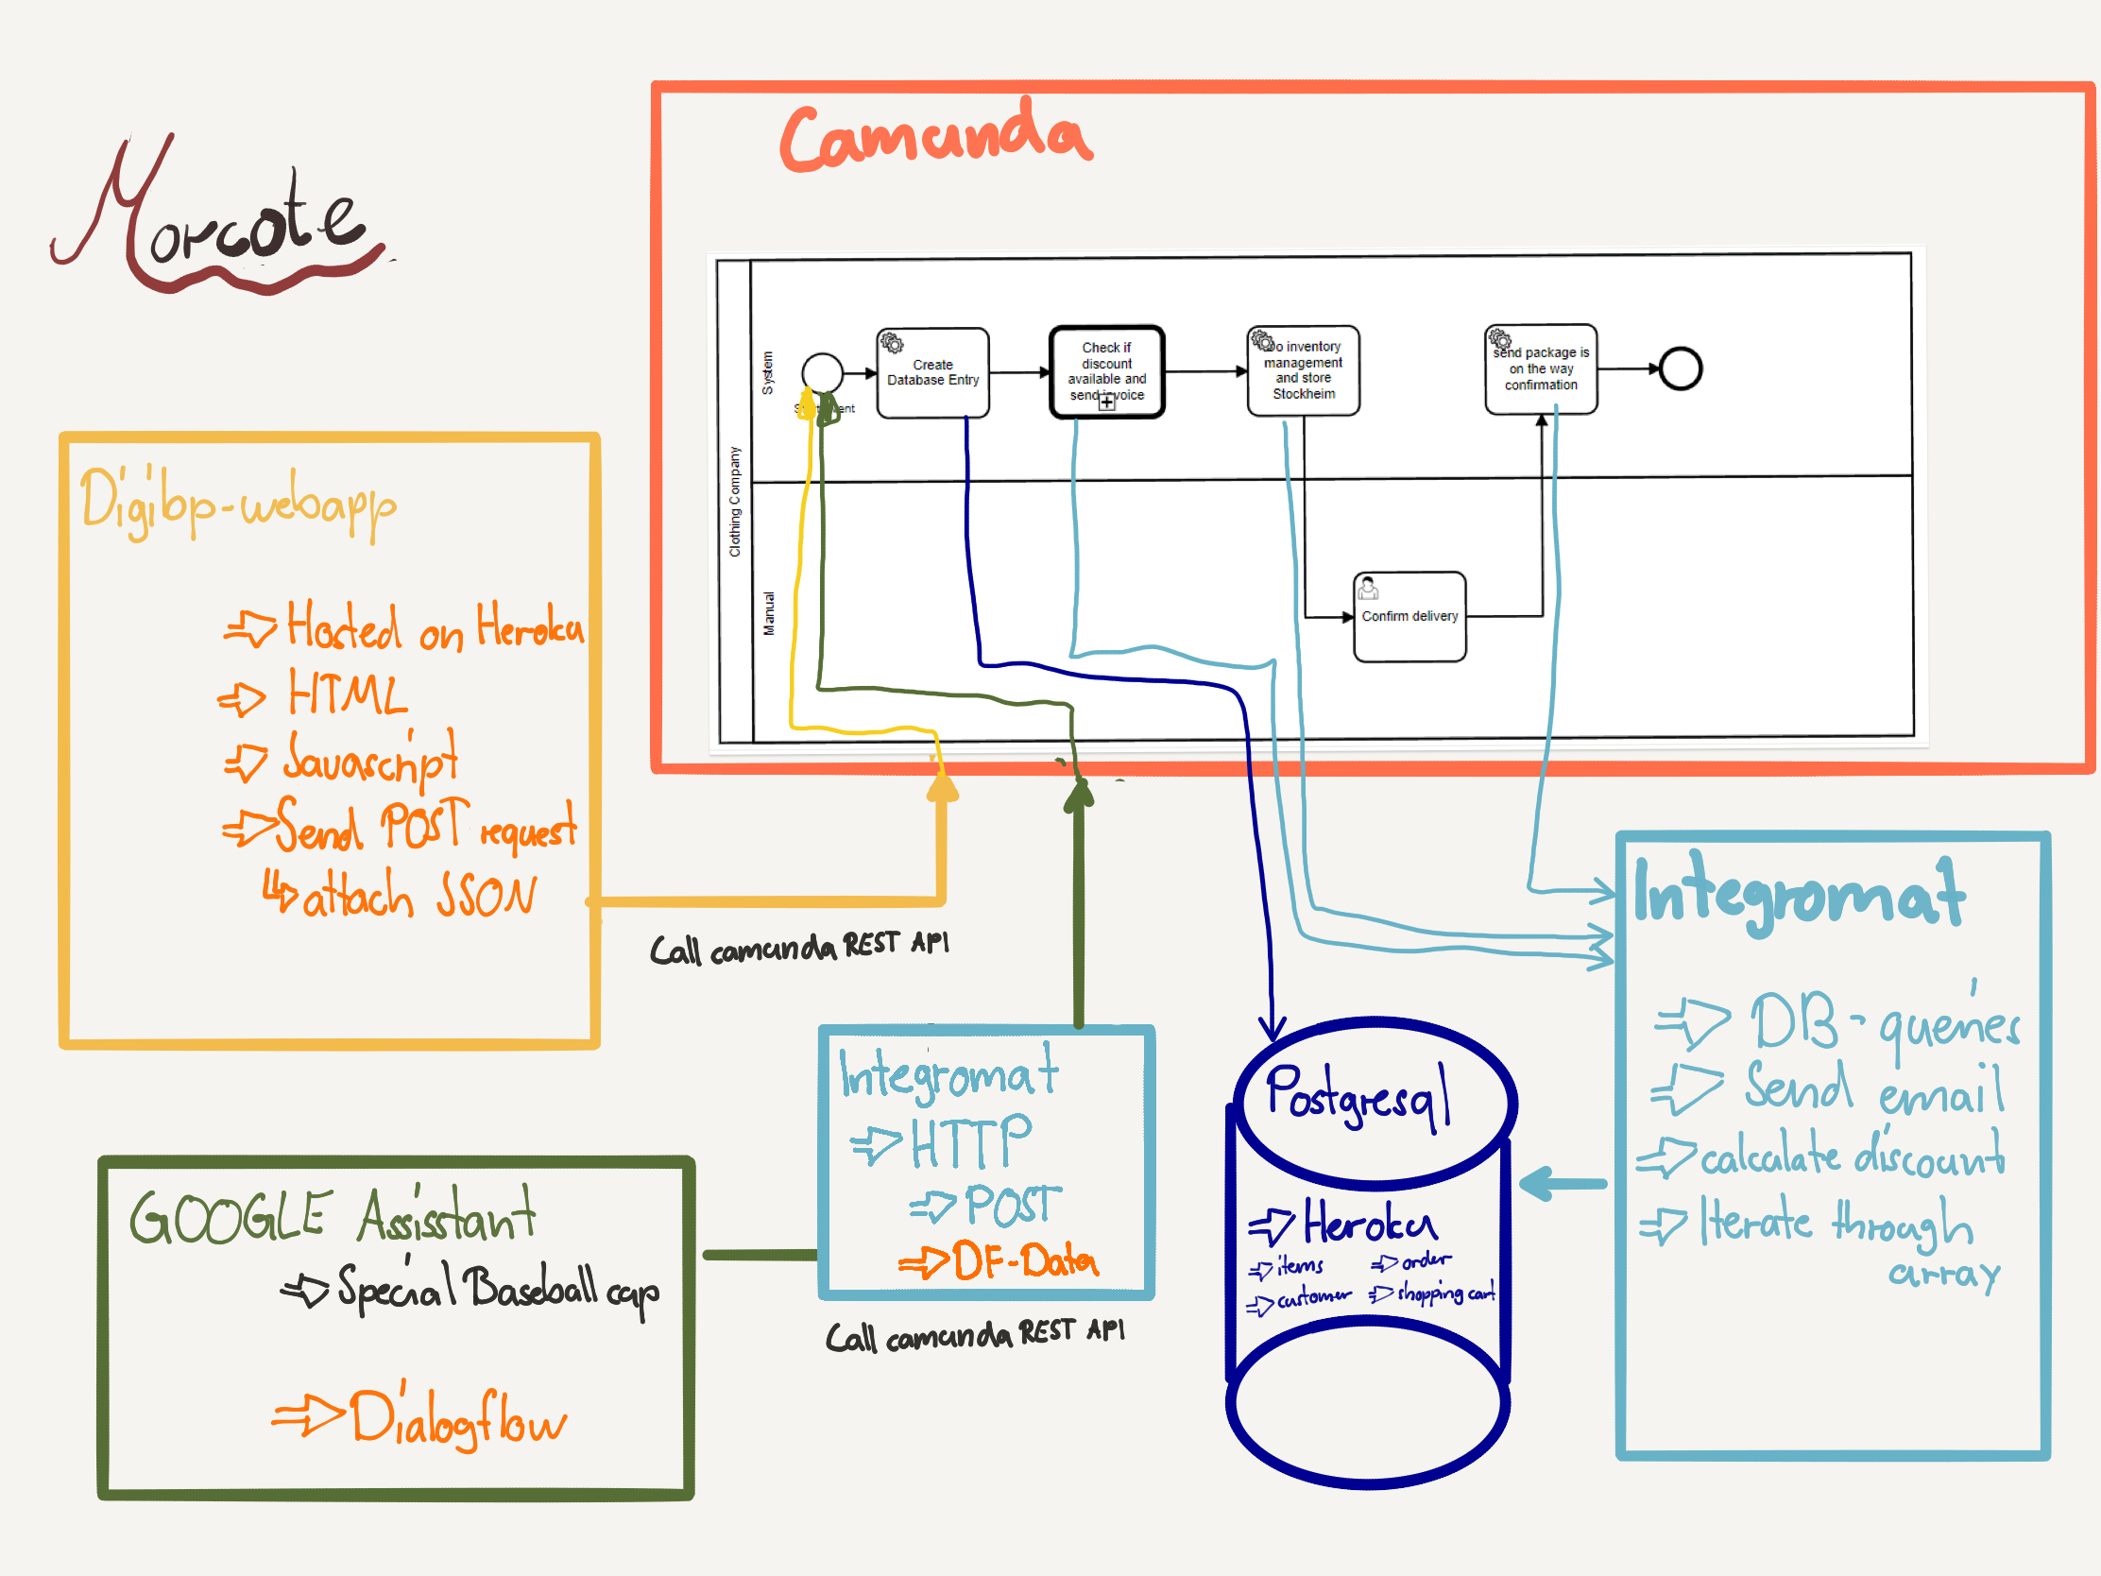
Technical overview

Slide 7

Demo

Slide 8
Thanks You !!!
Questions?
Notes:
- We are glade that you managed to be here today

