Slide 1

Digitalization of the Business Processes (SS19) e-Retail CC Clothing Company Team Morcote: Loris, Oliver, Shambhu, Yannick
Notes:
- We are glade that you managed to be here today

Slide 2
Situation assessment 1/2
Just physical stores
No alignment of Business and IT
No scalable Business Model
Inefficient, manual processes

Slide 3
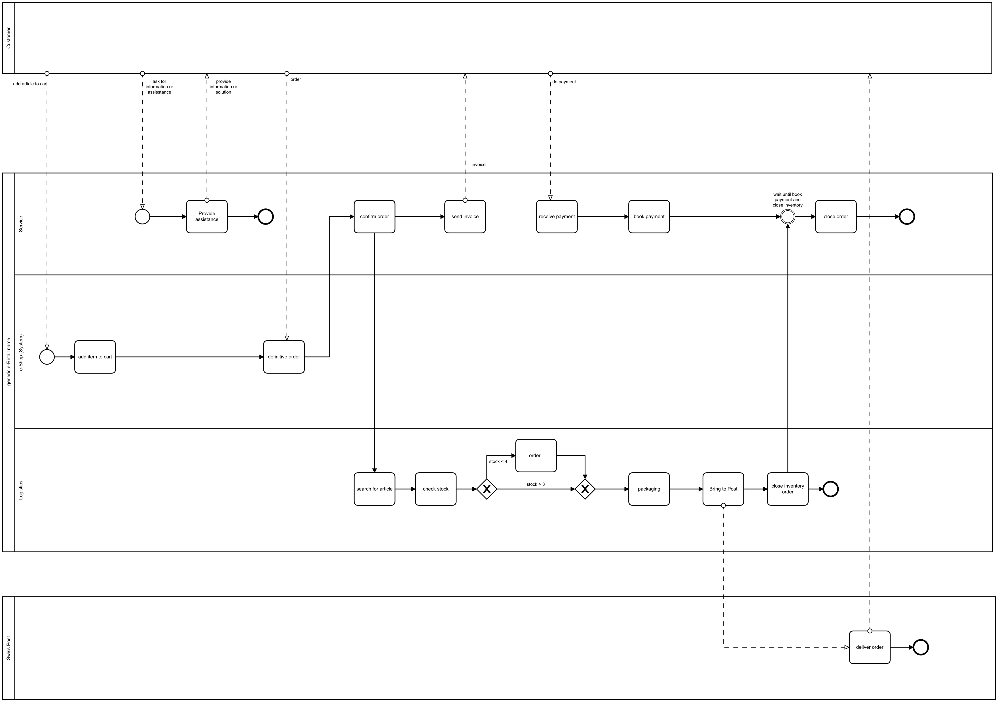
Situation assessment 2/2

Slide 4
Objectives: Digitalisation and Automation
Web shop
Order processing and confirmation
Customer loyalty program
Inventory management

Slide 5
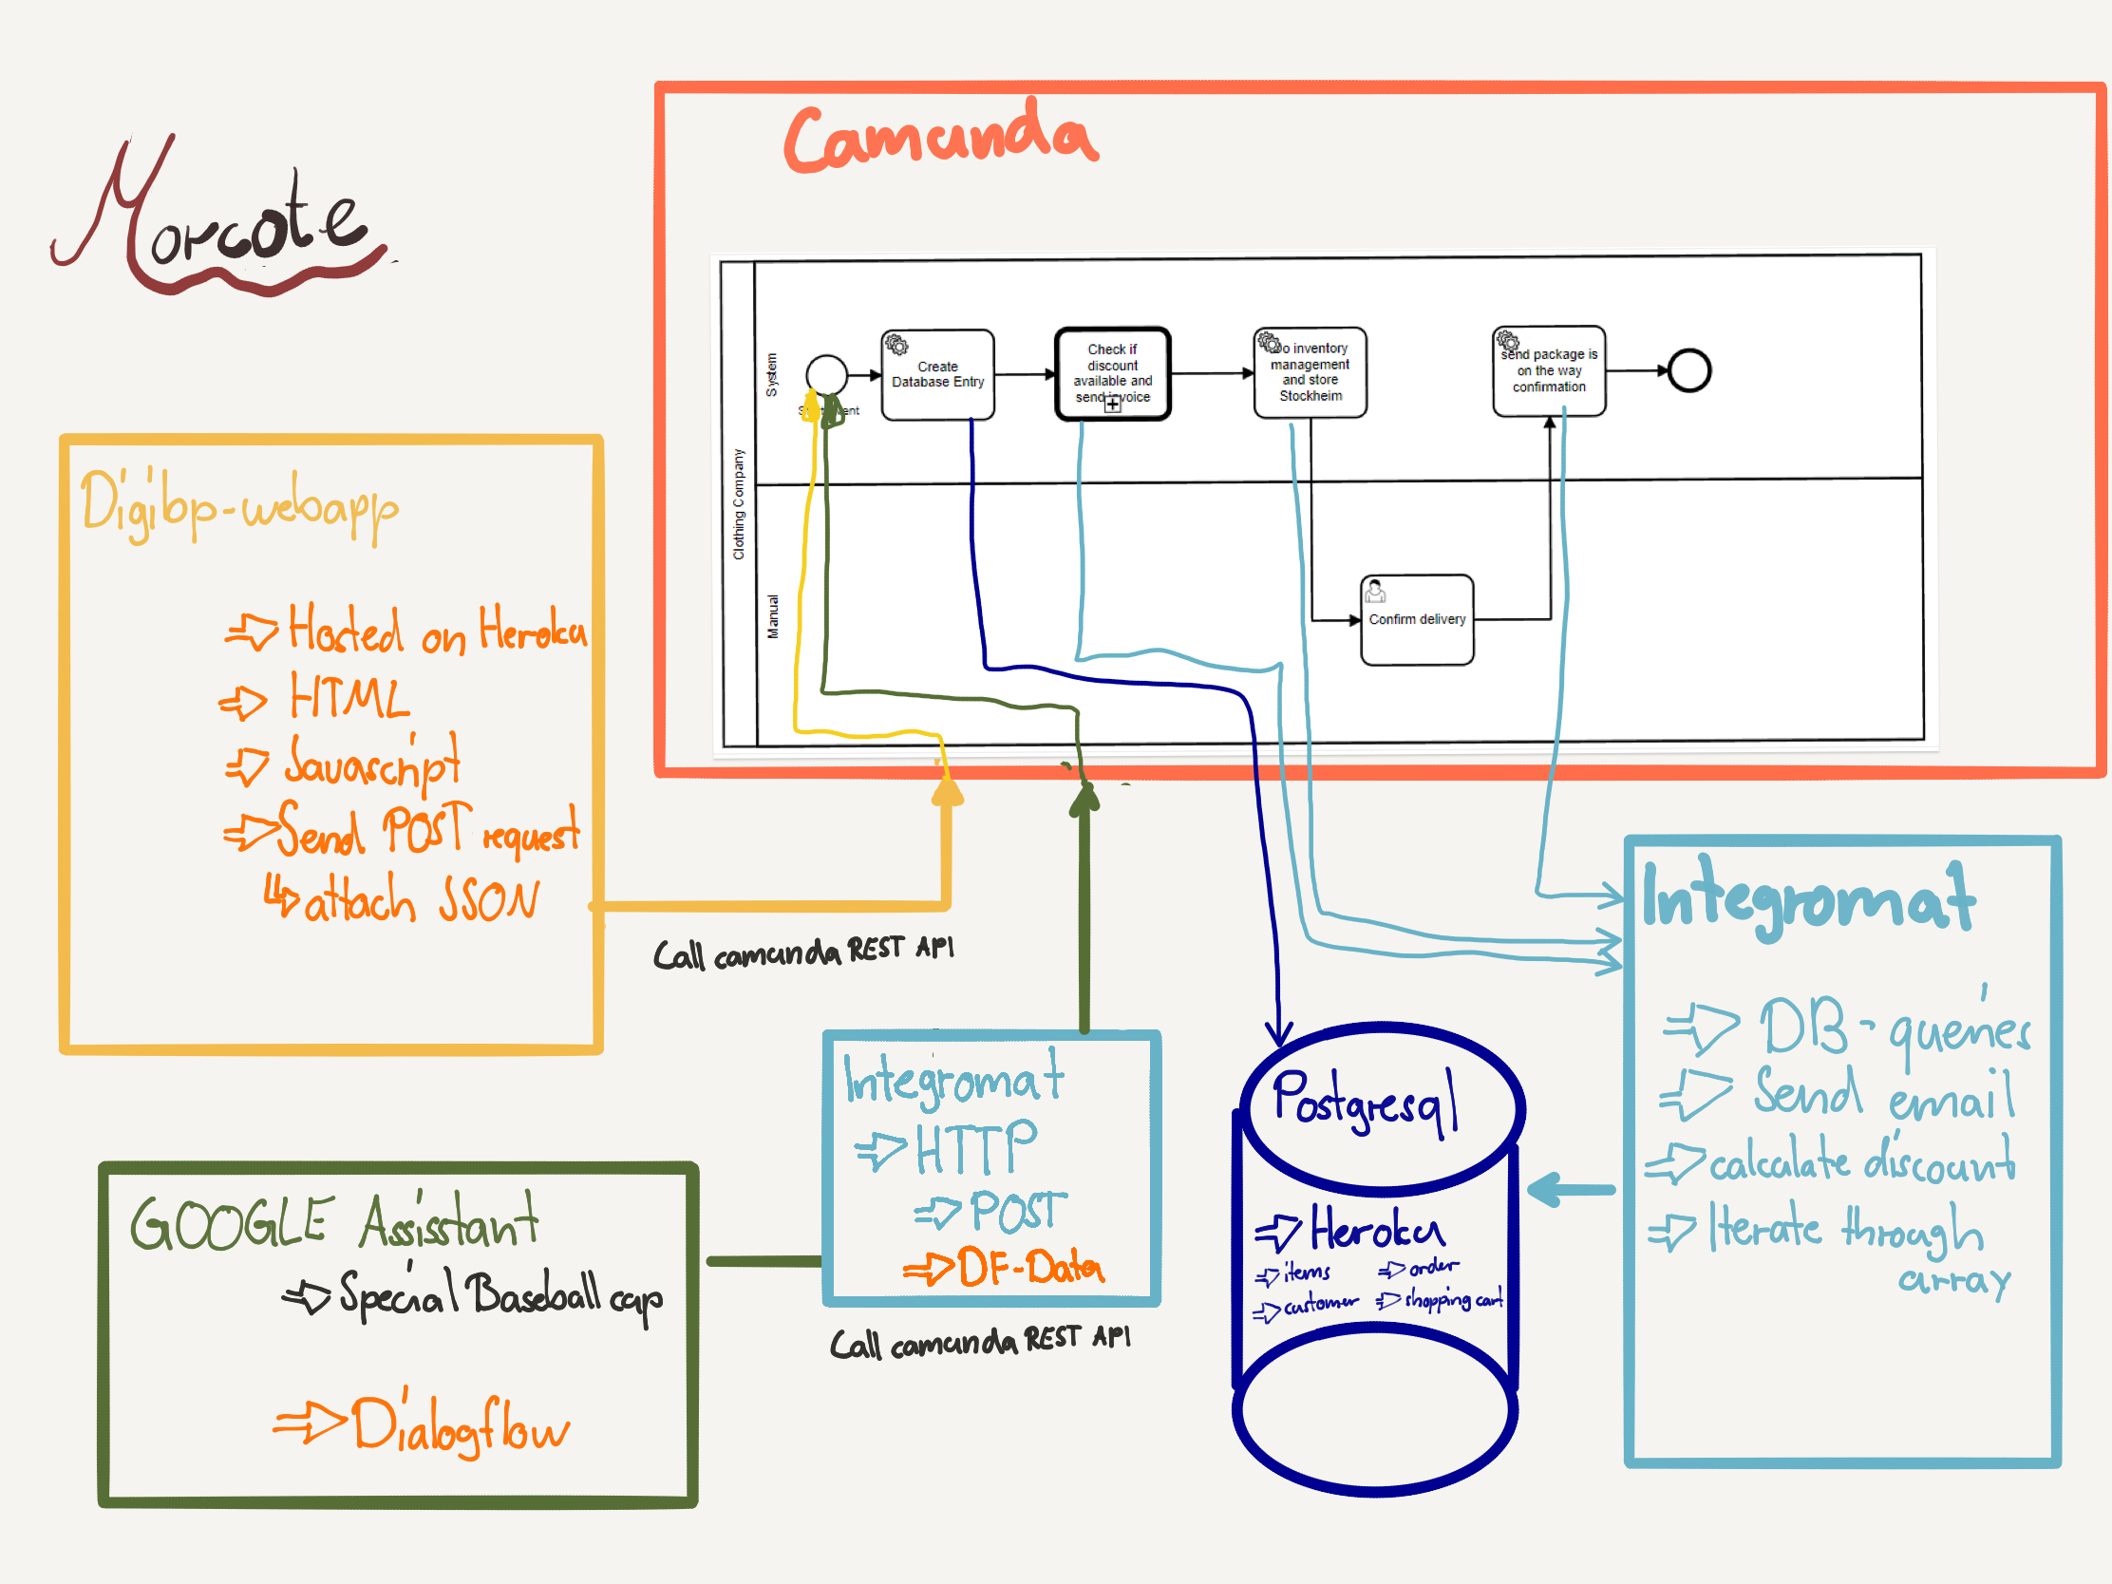
Overview

Slide 6
e-Retail
CC Clothing Company Showcase
https://digibp-webapp.herokuapp.com/ Team Morcote: Loris, Oliver, Shambhu, Yannick
Notes:
- We are glade that you managed to be here today

