Slide 1

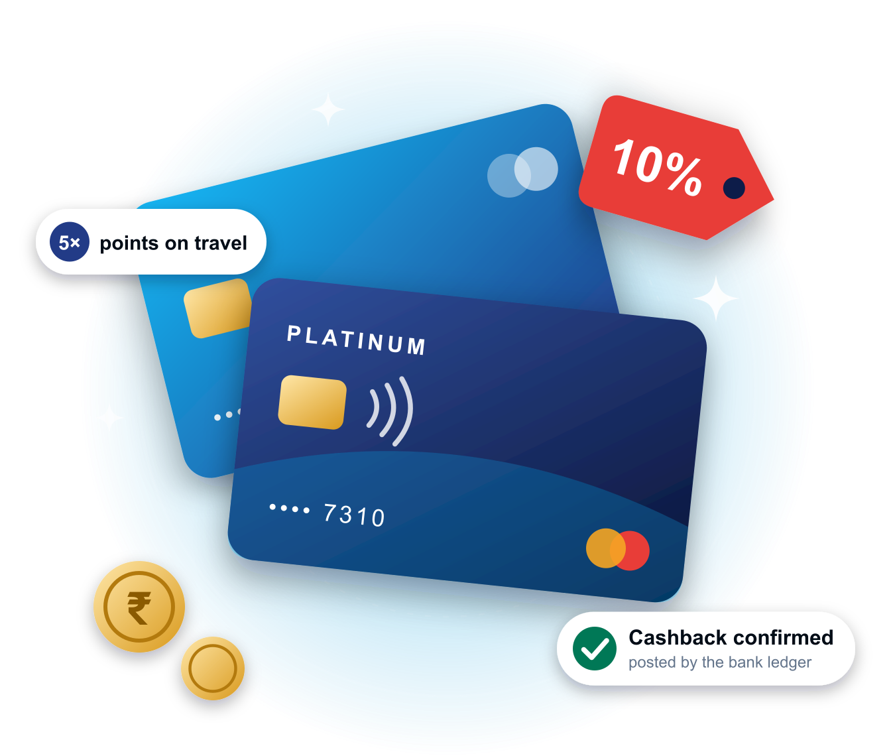
DigiDelight
Prepared for In-Solutions Global (ISG)
DIGICRM · LOYALTY & OFFER ORCHESTRATION
One governed layer for every offer on ISG’s card programmes
Bring in, manage, target, deliver and measure offers and coupons of every format — while ISG keeps the offer ledger.
10 offer formats
Ledger stays with ISG
Live demo today
Product demo and discussion
Notes:
Open: DigiDelight builds DigiCRM. Today we show how DigiCRM can be the central offer layer ISG asked for in section 4A — and, importantly, how it respects ISG’s decision to keep the offer ledger.

Slide 2







What ISG asked for
THE BRIEF
A central layer to bring in, manage, target, deliver and measure offers and coupons of every format across bank card programmes — with a clear split of what is native, what comes from partners and what ISG provides.
01
02
03
04
05
Bring in
Manage
Target
Deliver
Measure
Brand portal, partner APIs, network feeds, bank team, bulk files
One standard record, approvals, versions and code pools
Eligibility, budgets, stacking and explainable ranking
Journeys, app hub, WhatsApp, email, SMS and push
Redemption, reconciliation and lift against holdouts
ISG’s ownership principle
DigiCRM is built to work exactly this way →
ISG keeps the system of record for eligibility, budgets, redemption and benefit payout. The partner platform provides content, ranking and delivery, connected to the ISG ledger through APIs.
Notes:
Section 4A asks for one layer across five verbs, and asks us to be explicit about who provides what. The ownership principle is the key design constraint — we agree with it, and our product has a mode built for it.

Slide 3













DigiCRM orchestrates — ISG’s ledger decides
OUR ANSWER
OFFER SOURCES
CARDHOLDER CHANNELS
DigiCRM Offer Orchestration
Brand & merchant portal
Bank app Offers Hub
Standard offer record & lifecycle
Content, creative & approvals
Partner APIs & network feeds
WhatsApp
Bank offers team
Eligibility, ranking & conflicts
Journeys & multichannel delivery
Email
CSV / SFTP bulk upload
SMS + landing page
ISG internal catalogue
Code vault · Reconciliation · Consent · Audit trail
Push & in-app
APIs: activate · confirm · budget · redemption events
ISG switch & settlement files
ISG Offer Ledger — system of record
Eligibility · budgets · redemption · benefit payout
Bank CMS posts payout
with maker-checker
Notes:
Read left to right: offers come in from any source, DigiCRM turns them into one standard record, decides who sees what, and delivers it. Read top to bottom: every money-touching decision — activation, budget, redemption, payout — is confirmed by ISG’s ledger through APIs. DigiCRM never posts to card accounts.

Slide 4



The ledger owner is set per programme
BUILT FOR ISG’S OWNERSHIP MODEL
A
B
C
Recommended for ISG
Offer orchestration
Full loyalty
Hybrid
External ledger — ISG
Owned ledger — DigiCRM
Ledger chosen per programme
ISG owns eligibility, budgets, redemption and payout. DigiCRM creates, governs, personalises, delivers and observes.
DigiCRM runs a double-entry points and cashback ledger, for engagement programmes where a bank prefers it.
ISG-ledger card offers and DigiCRM-run engagement rewards side by side, each recorded separately.
Locked once live
Stamped on every activity
Pending until ISG confirms
A programme’s ledger mode can’t be switched after it goes active.
Each activation and reward records which ledger owns it.
Timeouts and errors stay pending — never shown as success.
Notes:
Mode A is the ISG answer: DigiCRM is the orchestration layer, ISG is the ledger. The mode is locked once a programme is live and stamped on every activity, and an activation only turns active on an affirmative confirmation from ISG — a timeout stays pending. Modes B and C exist for banks that want DigiCRM-run engagement rewards alongside.

Slide 5










Every offer format, one standard record
OFFER FORMATS
Unique single-use code
Generic code
Commerce link
Card-linked offer
Instant discount
Code from a pool, one per cardholder, revealed on request
One shared code; eligibility checked at payment
Tracked deep link into the merchant site or app
ISG matches the transaction; DigiCRM targets and activates
Applied at checkout via the payment gateway
DigiCRM
DigiCRM
ISG
Roadmap
ISG
DigiCRM
ISG
DigiCRM
Cashback / multiplier
Brand / no-cost EMI
Gift card / e-voucher
Network offers
Activation / opt-in
ISG posts the benefit; DigiCRM sets rules and informs
ISG converts the EMI; DigiCRM targets and explains
From a supplier catalogue, for points or cash
Ingested from network feeds, then targeted
Cardholder taps Activate before the benefit applies
ISG
DigiCRM
ISG
DigiCRM
Partner
Roadmap
Partner
Roadmap
DigiCRM
Who provides it:
DigiCRM
native today
ISG
ISG / payment rails
Partner
brands, networks, aggregators
Roadmap
DigiCRM roadmap
Notes:
All ten formats ISG listed become one standard offer record in DigiCRM. Chips show the honest split: unique codes, generic codes and activation offers run natively today; card-linked, instant-discount, cashback and EMI offers rely on ISG rails for matching and posting, with DigiCRM handling targeting, activation and messaging. Commerce links, gift-card catalogues and network feed intake are roadmap items.

Slide 6









Offer lifecycle — governed from draft to archive
GOVERNANCE
Maker-checker: the requester can’t approve
Draft
Business / brand approved
Bank compliance approved
Scheduled
Live
Paused
Expired
Archived
Sealed versions
Maker-checker
Every change recorded
A live offer can’t be silently edited. Changes clone to a new version and go back through approval; redemptions are judged against the terms in force at the time.
The requester can’t approve their own offer, and one person can’t sign both the business and the compliance step.
Who changed what, when and why — every state change, approval, pause and edit lands in an immutable audit trail.
Live today: business → compliance approval steps. A dedicated brand-approval step and approval routing by source, funder or risk arrive with the brand portal (roadmap).
Notes:
This is ISG’s lifecycle from 4A.2, end to end. DigiCRM enforces it in code: published versions are sealed, edits go through a new version and re-approval, and every transition is audited. Be clear that today the two approval steps are business and bank compliance; the brand-approval step comes with the brand portal.

Slide 7

Any source → one standard offer record → checks
BRINGING OFFERS IN
SOURCES
INTAKE CHECKS
Standard offer record
Brand & merchant portal
De-duplicate across sources
Offer ID & version
Funder & funder type
Partner & network feeds
Schema & business rules
MID / TID, MCC, UPI VPA, domains
Offer type & redemption method
Bank offers team
Benefit, cap & minimum spend
Validity & time-of-day rules
Merchant IDs vs ISG merchant data
Banks, products, BINs, networks
Channels & geography
CSV / SFTP bulk
Auto expiry & withdrawal
Limits per card / offer / budget
Stacking group & priority
ISG catalogue
Code pool or link template
Creative, T&C, languages, audit
Alert when a source feed fails
One record so offers from every source behave the same way.
Live
Offer builder, versioned record, eligibility, budget, stacking, channels, T&C, bulk code import
Roadmap
Partner & network feeds, CSV/SFTP intake, dedupe, merchant master, multi-funder allocation
Notes:
Every source lands in the same standard record using ISG’s minimum field list from 4A.2. Today offers are created in the Offers Studio builder and coupon codes come in by bulk import; the automated intake pipeline for partner feeds and files, de-duplication, merchant master validation and multi-funder records is Phase 1 of the roadmap.

Slide 8


Rules first, then ranking — always explainable
TARGETING
1 Consent & purpose
Default-deny for marketing; checked per channel
Offer simulator
2 Eligibility
Bank · product · BIN · network · segment · card status
Run any cardholder through the real production pipeline and see exactly why an offer qualifies or fails.
3 Suppression
Section 3 suppression rules override every offer
4 Validity
Window, time-of-day, expiry
Consent: WhatsApp marketing
5 Limits & budget
Per card, per offer and total budget
Eligible: Platinum credit, BIN in list
6 Stacking
Exclusivity — no two cashbacks on one transaction
Not suppressed
7 Ranking
Relevance · funder economics · fatigue
Budget: cap reached → next offer
Winner: Dining 10% cashback
8 Explained winner
Decision trace saved for audit
Ranking today is deterministic and explainable. ML next-best-offer scoring is on the roadmap.
Notes:
Every candidate offer passes the same ordered gates: consent before anything, then eligibility, then ISG’s Section 3 suppression rules, validity, limits and budget, then stacking. Only survivors are ranked, and the winner is stored with a trace of why. The simulator runs this exact pipeline in a rolled-back transaction, so what it says is what production will do.

Slide 9
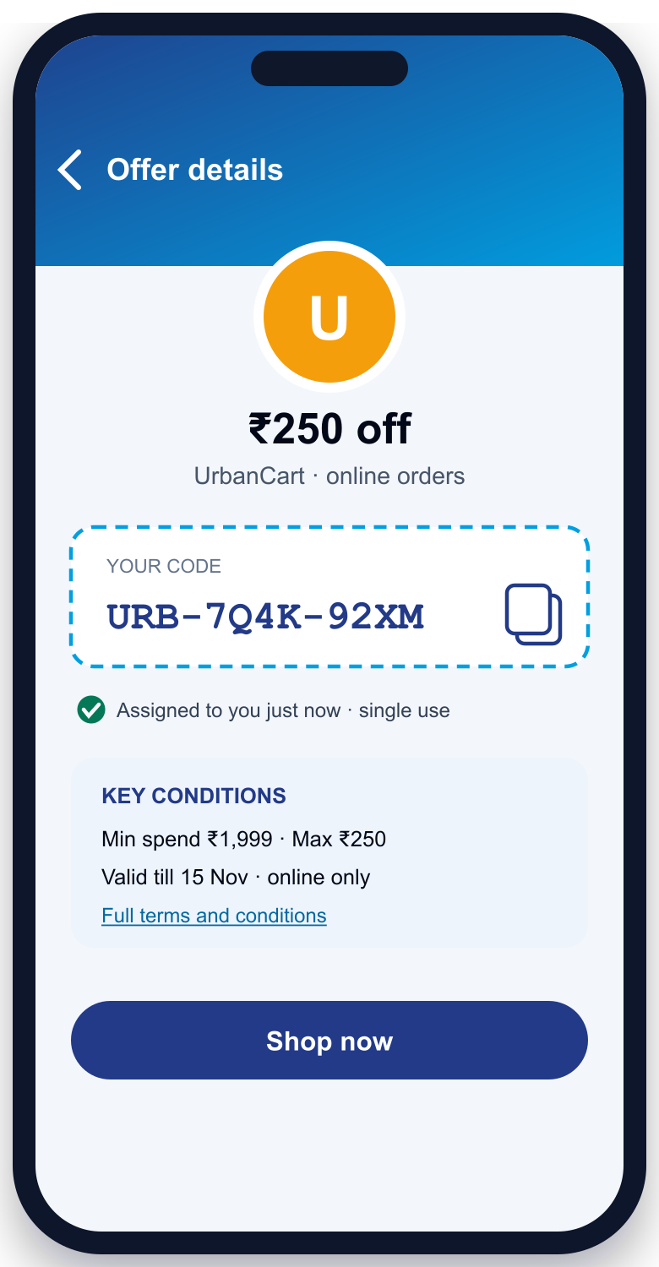




Codes are assigned at reveal — never at send
CODE INVENTORY
Message goes out with no code inside
0
Campaigns, journeys and WhatsApp carry the offer, not the code.
codes inside any message
Cardholder opens a trusted session
Authenticated app session or a single-use link tied to that cardholder.
1
Eligibility re-checked live
code per eligible cardholder
Consent, limits, budget and validity checked again at the moment of reveal.
Encrypted
One code allocated atomically
at rest, with key rotation
Two parallel taps can never receive the same code; one per cardholder.
Reveal, copy and redemption logged
Rate-limited
Every event recorded and reconciled against redemptions.
claims per session & IP
Roadmap: device and bot signals, revocation and reissue, customer-managed keys in ISG’s KMS.
Notes:
This is the strongest part of the product for 4A.4. The code is only bound to a cardholder at reveal time, inside an authenticated session, after a live eligibility re-check — so codes aren’t wasted on unread messages and can’t be harvested. Allocation is atomic under concurrency, codes are encrypted at rest and never logged in plain text.

Slide 10


A card-linked cashback offer, step by step
END TO END
1
4
Sees offer, taps Activate
Pays at an enrolled merchant
Cardholder
2
7
Checks rules, records Pending
Shows benefit, notifies, tracks progress
DigiCRM
3
5
8
Confirms activation
Matches the txn from switch & settlement
Refund? Clawback event, reconciled
ISG ledger & switch
6
Posts cashback after maker‑checker
Bank CMS
DigiCRM never posts to card accounts and never shows a benefit as earned before ISG’s ledger confirms it.
Notes:
Walk the numbers. 1–3: activation is pending in DigiCRM until ISG confirms. 4–6: the purchase is matched on ISG’s switch and settlement data and the benefit is posted by the bank CMS with maker-checker. 7: DigiCRM receives the redemption event and tells the cardholder. 8: refunds and reversals flow back as clawback events and appear in reconciliation.

Slide 11
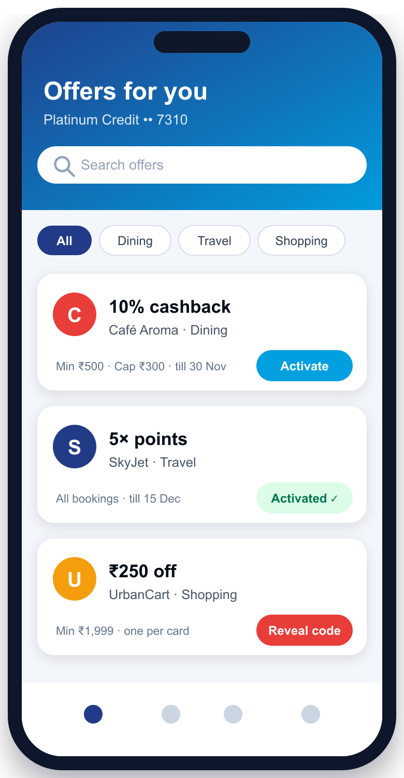




Deliver offers wherever cardholders are
DELIVERY SURFACES
Bank app Offers Hub
Live
Campaigns & journeys
Live
Personalised list: save, activate, reveal code, expiry reminders. Hosted today; embeddable SDK on the roadmap.
Transaction-triggered offers — e.g. a related merchant’s offer right after a purchase.
WhatsApp
Live
Email offer blocks
Live
Rich templates with header image and buttons, previewed before approval.
Builder blocks with dynamic benefit, expiry and progress fields.
SMS + landing page
Partial
Push & in-app
Live
Offer landing pages today; TRAI-whitelisted ISG/bank redirect domain on the roadmap.
Rich push and in-app banners and cards.
Notes:
Same offer, every surface. The Offers Hub is hosted today with save, activate and reveal; ISG asked for an SDK component, which is on the roadmap. Journeys can fire an offer straight after a transaction event. For SMS, ISG requires links on a TRAI-whitelisted bank or ISG domain — the redirect service for that is a roadmap item.

Slide 12
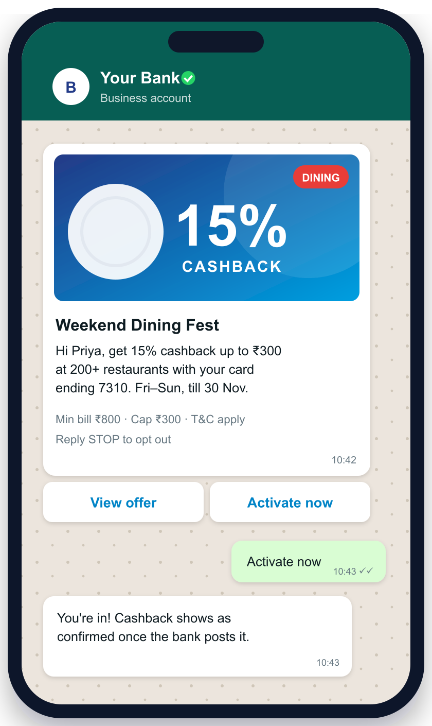




Multimodal content, governed end to end
CONTENT AND CREATIVE
One asset library
Images, GIFs, short video, carousels, HTML email blocks, WhatsApp templates, banners and rich push.
Variants by channel, tone and language
Copy variants per segment, including Indian languages — every variant goes through approval.
Dynamic fields at send time
Benefit, expiry, milestone progress and last-4 digits filled only from approved data.
A/B and multivariate testing
Creative and copy tested against holdout groups, not just against each other.
AI with a human in the loop
AI-drafted copy needs human approval; no cardholder data is sent to outside AI services.
Roadmap: automatic resizing and format checks to each channel’s specification.
Notes:
4A.3 is largely platform capability we already ship: asset library, channel and language variants with approval, dynamic fields from approved data, A/B against holdouts, and AI drafting behind human approval with a privacy boundary. The phone shows a real template style: the key conditions sit next to the benefit, and the reply after Activate does not promise cashback before the bank posts it.

Slide 13



Budgets, conflicts and reconciliation
MONEY CONTROLS
Example offer budget (illustrative)
Redeemed — 62%
Reserved — 16%
Cap reached → offer auto-pauses
Budgets
Stacking & exclusivity
Reconciliation queue
Live
Live
Live
Every redemption reserves budget first — no overspend, even under concurrency
Live tracking per offer
Auto-pause when the budget is exhausted
Stacking groups, exclusivity and priority
Deterministic tie-break with a traced winner
Section 3 suppression overrides every offer
Issued-not-redeemed and redeemed-not-posted
Late reversals and duplicate redemptions
Refunds and partial refunds claw the benefit back
Pacing (even, front-loaded, by event): roadmap
Conflict rules apply in the simulator too
Nightly ledger drift check
Notes:
Budgets are reserved before a benefit is granted, so two simultaneous redemptions can’t overspend, and the offer pauses itself when the cap is hit. Pacing strategies are roadmap. Stacking and exclusivity are enforced with a deterministic winner. The reconciliation queue surfaces mismatches between issued codes, redemptions and postings.

Slide 14


Bank-grade security and governance
TRUST
Isolation per bank
Immutable audit trail
Each bank is its own tenant; joining syndicated offers never exposes its data.
Every change, approval and decision trace is recorded.
Maker-checker everywhere
Versioned T&C
Offer approvals and ledger adjustments; no self-approval.
Approved T&C per offer; key conditions shown beside the benefit.
Codes encrypted, no PAN
Data minimisation
Tokens only; codes encrypted at rest with key rotation.
Decision traces strip restricted fields; brands get no cardholder data.
Consent first
Roadmap
AI guardrails
Default-deny marketing; separate consent at claim when a brand needs data.
Misleading-claim and dark-pattern checks, EMI cost disclosures, network brand-use rules
Human approval for AI copy; no cardholder data to outside models.
Notes:
A bank risk team will probe these first. Tenant isolation is a hard gate in our test suite, which is what makes cross-bank syndication safe: participating never grants access to another bank’s data. Maker-checker covers offers and ledger adjustments. Be explicit that the CCPA dark-pattern checks and EMI disclosure templates from 4A.10 are roadmap.

Slide 15
A clear split between DigiCRM, partners and ISG
WHO PROVIDES WHAT
Capability | DigiCRM | Partner | ISG
Offer content, creative & approvals | ● Native | — | Bank compliance sign-off
Standard offer record & lifecycle | ● Native | — | —
Eligibility, ranking & conflict rules | ● Native (pre-check) | — | ● Final financial eligibility
Journeys & channel delivery | ● Native | WhatsApp BSP, SMS gateway | —
Code vault & reveal | ● Native | Brands supply code pools | —
Offer ledger: budgets & redemption | Mirrors status | — | ● System of record
Transaction matching | Consumes events | — | ● Switch & settlement
Benefit payout | Never posts | — | ● Via CMS, maker-checker
Network & aggregator offer feeds | ◐ Intake — roadmap | ● Networks, aggregators | —
Trusted redirect & S2S tracking | ◐ Service — roadmap | — | ● Whitelisted domain
Funder settlement & invoicing | Reconciliation data | — | ● Settles funders
Brand & funder portal | ◐ Roadmap | Brands self-serve | —
● provides it ◐ DigiCRM roadmap — no role
Notes:
This answers ISG’s explicit question: what is native, what comes from partners and what ISG provides. The pattern: DigiCRM owns content, targeting and delivery; ISG owns every money-touching system of record; partners supply codes, feeds and channel transport. The half-filled rows are DigiCRM roadmap.

Slide 16
Coverage against ISG section 4A
WHERE WE STAND
25
line items live in DigiCRM today
8
handled by ISG or partners, by design
19
on the DigiCRM roadmap
DigiDelight self-assessment of the 52 line items in ISG’s section 4A, to be validated together in a workshop.
Notes:
Honest scorecard. The live items cluster where the risk is highest — code security, eligibility, lifecycle governance, consent and delivery. The roadmap clusters on the supply side (intake, links and tracking, brand portal) and on a few compliance checks. Offer it as a working draft to validate with ISG.

Slide 17
From pilot to full section 4A coverage
PATH TO GO-LIVE
Phase 0
Pilot on what is live
Phase 1
Supply side
Phase 2
Links and experience
Phase 3
Ecosystem and intelligence
One bank tenant, Mode A programme
ISG ledger API contract: activate, confirm, budget, redemption
Codes, activation and cashback offers
Offers Hub, WhatsApp, email, journeys
Partner and network feeds, CSV/SFTP intake
De-duplication and merchant master validation
Multi-funder offer record
Approval routing by source, funder and risk
Redirect service on ISG / bank domain
Opaque tokens and server-to-server postbacks
Hub SDK with search and categories
Budget pacing, fraud and bot signals
Brand and funder portal, min-group reporting
Incrementality and ROI by funder
ML next-best-offer ranking
Dark-pattern checks and EMI disclosures
Scope and sequencing to be finalised with ISG in a joint workshop.
Notes:
Phase 0 is a pilot that uses only what is live today plus the ISG ledger API integration — it proves the ownership model end to end. Phases 1 to 3 close the roadmap items from the scorecard. No dates on this slide: sequencing should be agreed with ISG.

Slide 18
What you will see today
LIVE DEMO
01
02
03
Two programmes, two ledgers
Build, simulate and approve an offer
Activate a card-linked offer
Card-linked cashback on an external ledger beside DigiCRM-run rewards.
Maker-checker approval and the simulator explaining eligibility, caps and stacking.
Stays pending until the ledger confirms — never shown as earned too early.
04
05
06
Reveal a single-use code
WhatsApp offer and journey
Reconciliation and audit
Assigned only on authenticated reveal; two parallel reveals get two different codes.
Rich template with image and buttons, triggered by a transaction event.
Exception queue, immutable ledger journal and full audit trail.
Notes:
Demo script, about 20 minutes. Uses the Nivaan Bank sample tenant (synthetic data). Keep the partner-confirmation step visible in step 3 — it is the clearest proof of the ownership principle.

Slide 19
NEXT STEPS
Let’s build ISG’s offer layer together
1
Validate the split
Joint workshop on the responsibility matrix and 4A scorecard.
2
Agree the ledger API
Activate, confirm, budget and redemption events with ISG’s ledger.
3
Pick a pilot
One bank and a first set of offers on what is live today.
Thank you
DigiDelight · digidelight.com
Notes:
Close with three concrete asks. The responsibility matrix and scorecard are working drafts — invite ISG to correct them.

