Slide 1
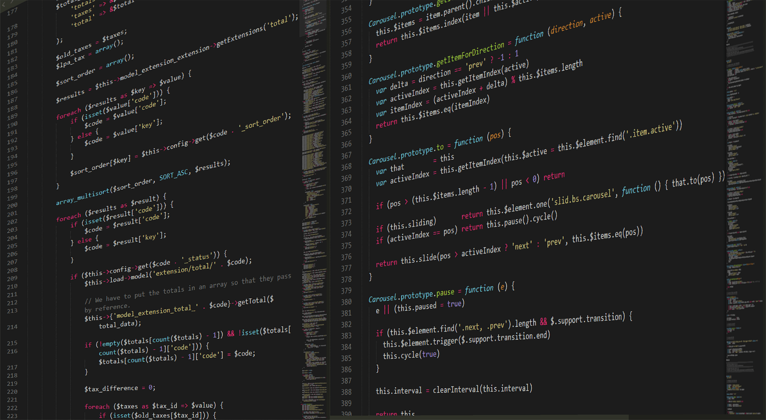
CS1010
https://github.com/DigiPie/cs1010_tut_c09

Slide 2
Today’s plan
Kahoot Quiz
Revision for mid-terms
Consultation

Slide 3

KAHOOT!
Quick quiz
Notes:
https://play.kahoot.it/#/k/afc591d5-bc40-48d1-a190-4c3d2b987cca

Slide 4
Mid-term
Date: 2 October, 2018 (Tuesday)
Time: 4pm to 6pm
Venue: MPSH 1 (Section B)
Scope: Units 1-12, Assignments 1-2, Tutorials 1-4
MCQs and Short Structured Questions
Duration: 90 minutes
Open Book (You can bring analog references)
Notes:
Mix of MCQs and short questions.

Slide 5
Tips for Mid-term and Practical Exam
Revise Problem Sets (again and again)
Do not use ++index or index--
Always put { and }
Name a bool variable with a prefix is_ or has_ as a convention.

Slide 6
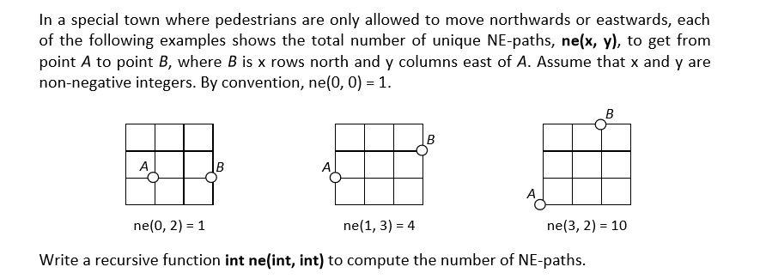
https://piazza.com/class/jkqlna92ju045j?cid=206
Notes:
https://github.com/DigiPie/cs1010_tut_c09/blob/master/Tutorial_5/ne.c

Slide 7
THE END
https://github.com/DigiPie/cs1010_tut_c09

