Slide 1
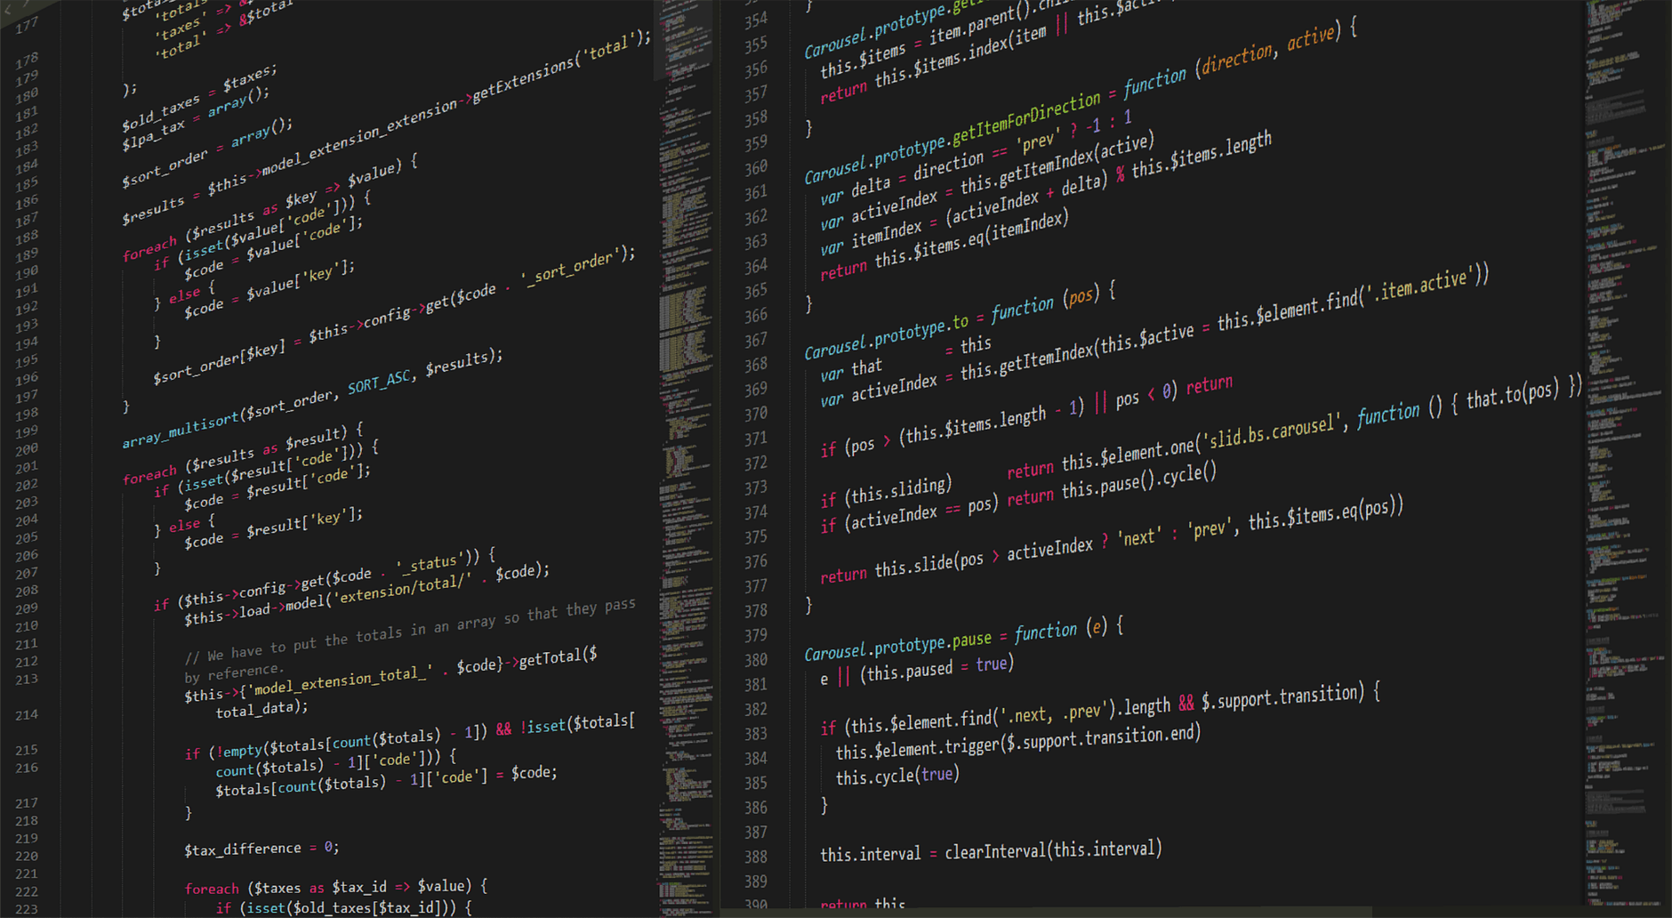
CS1010
https://github.com/DigiPie/cs1010_tut_c09

Slide 2
Today’s plan
Tutorial Segment
Kahoot!
Discussion of problem sets
Consultation

Slide 3

KAHOOT!
Quick quiz
Notes:
https://play.kahoot.it/#/k/53d7bee2-3224-4860-9cb3-268f0b7ca608

Slide 4
Problem sets
10.1, 10.2, 11.1, 11.2, 11.3, 12.1

Slide 5
Problem Set 10.1 (a) Negate the following logical expression, then apply De Morgan's Law to simplify the resulting expression.
(a) (x > 1) && (y != 10)
!((x > 1) && (y != 10))
!(x > 1) || !(y != 10)
(x <= 1) || (y == 10)

Slide 6
Problem Set 10.1 (b) Negate the following logical expression, then apply De Morgan's Law to simplify the resulting expression.
(b) !eating && drinking
!(!eating && drinking)
eating) || !drinking

Slide 7
Problem Set 10.1 (c) Negate the following logical expression, then apply De Morgan's Law to simplify the resulting expression.
(c) (has_cs2030 || has_cs2113) && has_cs2040c
!((has_cs2030 || has_cs2113) && has_cs2040c)
!(has_cs2030 || has_cs2113) || !has_cs2040c
(!has_cs2030 && !has_cs2113) || !has_cs2040c

Slide 8
Problem sets
10.1, 10.2, 11.1, 11.2, 11.3, 12.1

Slide 9
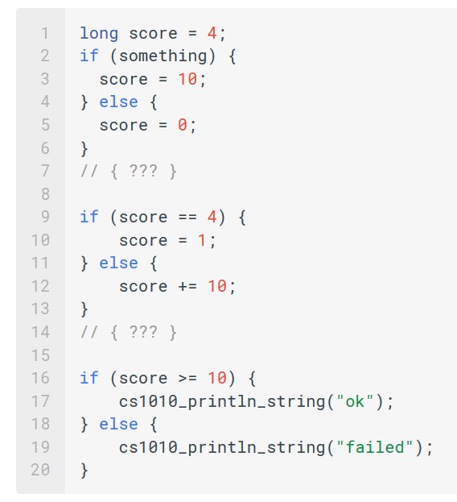
Problem Set 10.2 In the code below, replace ??? with the appropriate assertion.
7 // { score == … || score == … }
14 // { … }

Slide 10
Problem Set 10.2 In the code below, replace ??? with the appropriate assertion.
7 // { score == 10 || score == 0 }
14 // { score == … || score == … }

Slide 11
Problem Set 10.2 In the code below, replace ??? with the appropriate assertion.
7 // { score == 10 || score == 0 }
14 // { score == 20 || score == 10 }
Notes:
// score is never 4! So we always execute the false block

Slide 12
Problem Set 10.2 In the code below, replace ??? with the appropriate assertion. What will be printed?
7 // { score == 10 || score == 0 }
14 // { score == 20 || score == 10 }

Slide 13
Problem Set 10.2 In the code below, replace ??? with the appropriate assertion. What will be printed?
7 // { score == 10 || score == 0 }
14 // { score == 20 || score == 10 }
“ok” will always be printed.
Notes:
// Now, score is always >= 10, and "ok" will always be printed.

Slide 14
Problem sets
10.1, 10.2, 11.1, 11.2, 11.3, 12.1

Slide 15
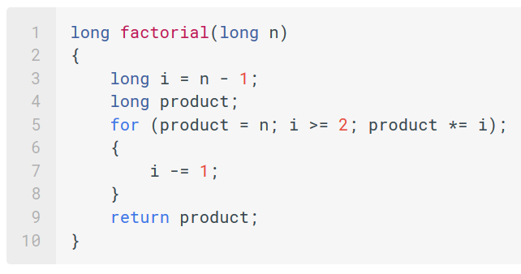
Problem Set 11.1 Does this code runs correctly?

Slide 16
Problem Set 11.1 Does this code runs correctly? No

Slide 17
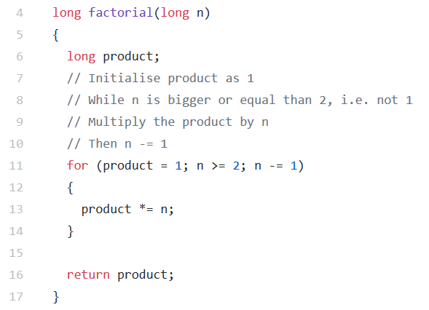
Problem Set 11.1 Solution (Code available on GitHub repo)

Slide 18
Problem sets
10.1, 10.2, 11.1, 11.2, 11.3, 12.1

Slide 19
Problem Set 11.2 Code available on GitHub repo
Rewrite the "Guess A Number" program so that it shows the user the number of guesses made before the correct guess is entered.
Rewrite the "Guess A Number" program with a while loop.
Extend the "Guess A Number" program so that it plays the game for five rounds with the user, and at the end, shows the user the average number of guesses over five rounds. (Hint: you should put the loop that reads the guess and prints feedback to the user into another function.)
What is the optimal strategy to play the game?
Notes:
The optimal stratagy is to always half the region of numbers that contain the answer (it will take 7 guesses at most).

Slide 20
Problem sets
10.1, 10.2, 11.1, 11.2, 11.3, 12.1

Slide 21
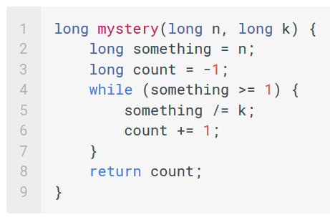
Problem Set 11.3 (a) Trace the following algorithm
What is the return value when:
n is 8 and k is 2?
n is 81 and k is 3?
n is 100 and k is 5?

Slide 22
Problem Set 11.3 (a) Trace the following algorithm
What is the return value when:
n is 8 and k is 2?
3
n is 81 and k is 3?
4
n is 100 and k is 5?
2

Slide 23
Problem Set 11.3 (b) What is the mathematical expression that our mystery function here is trying to compute?
It is: floor of log_k(n)

Slide 24
Problem Set 11.3 (c) Give a pair of inputs that would cause the function to return the wrong answer.

Slide 25
Problem Set 11.3 (c) Give a pair of inputs that would cause the function to return the wrong answer.
If n is 0, then the value returned would be -1 (it should be undefined).

Slide 26
Problem Set 11.3 (d) Give a pair of inputs that would cause the function to loop forever.

Slide 27
Problem Set 11.3 (d) Give a pair of inputs that would cause the function to loop forever.
If k is 1, then something over k never changes, so it would loop forever (it should be undefined).

Slide 28
Problem sets
10.1, 10.2, 11.1, 11.2, 11.3, 12.1

Slide 29
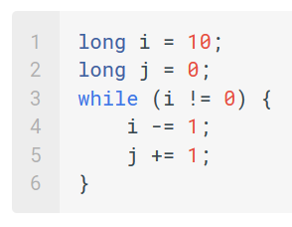
Problem Set 12.1 Give a pair of inputs that would cause the function to loop forever.
(a) Trace through the program. What is the value of j when the loop exits?
(b) Do you recognize any pattern on the relationship of i and j?
(C) What is the loop invariant?

Slide 30
Problem Set 12.1 Give a pair of inputs that would cause the function to loop forever.
(a) Trace through the program. What is the value of j when the loop exits?
10
(b) Do you recognize any pattern on the relationship of i and j?
{ i + j == 10 }
(c) What is the loop invariant?
{ i + j == 10 }

Slide 31
THE END
https://github.com/DigiPie/cs1010_tut_c09

