Slide 1
cs1010
Evan Tay | evantay@comp.nus.edu.sg
https://github.com/DigiPie/cs1010_tut_c09

Slide 2
Today’s plan
Unit 23: Binary Search
Unit 24: Sorting
Problem Set 24
Programming Exercise
Consultation

Slide 3
UNIT 23 BINARY SEARCH
Recap.

Slide 4
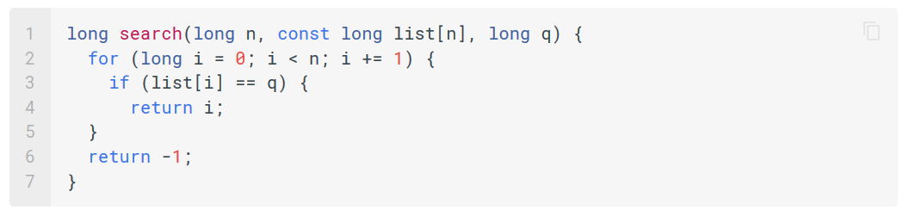
The most straightforward approach – Linear Search
Time complexity: O(n)
Cannot be sure q does not exist till n elements are checked

Slide 5
The most straightforward approach – Linear Search
But what if the list is already sorted?

Slide 6
What if the list is already sorted?
If the list is sorted in increasing order
Pick a random element x from the list.
Any element to the left of x <= x
Any element to the right of x >= x.
If the list is sorted in decreasing order
Pick a random element x from the list.
Any element to the left of x >= x
Any element to the right of x <= x.

Slide 7
What if the list is already sorted?
If the list is sorted in increasing order
Pick a random element x from the list.
Any element to the left of x <= x
Any element to the right of x >= x.
If looking for q,
If q == x, return position of x
Else if q < x, search left-side
Else (given q > x), search right-side

Slide 8
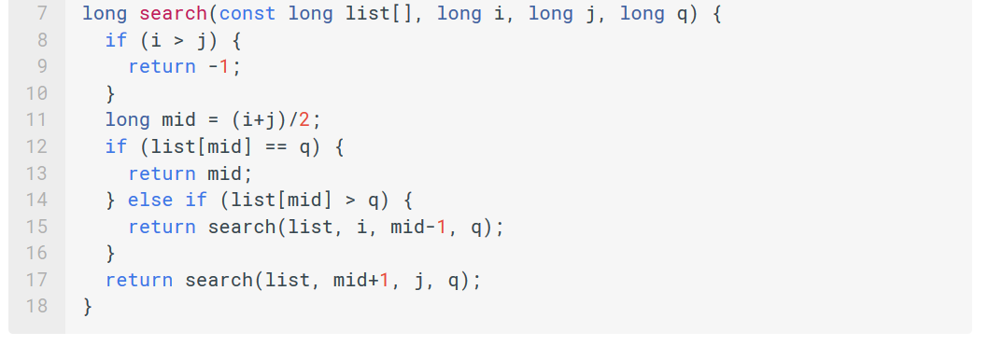
Binary Search

Slide 9
Binary Search
Time complexity: O(log2n)
Notes:
We start with n elements that could possibly contain q.
First iteration: Check n elements
Second iteration: Check n/2 elements
Third iteration: Check n/4 elements
...

Slide 10
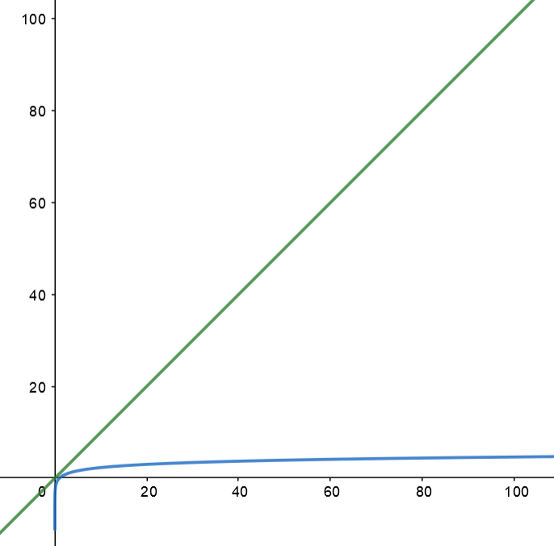
Linear Search vs Binary Search
Binary Search is much more efficient than Binary Search.
But only works if list is sorted.

Slide 11
UNIT 24 SORTING
Recap. PS 24.1. PS 24.2. PS 24.3.

Slide 12

Visualisation of sorting
https://visualgo.net/en/sorting

Slide 13
UNIT 24 SORTING
Recap. PS 24.1. PS 24.2. PS 24.3.

Slide 14
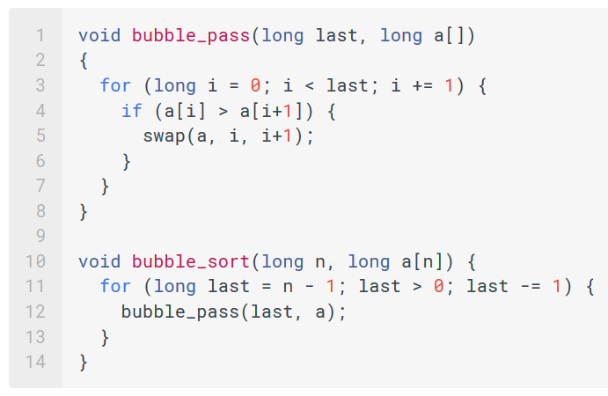
Problem Set 24.1
In this implementation, we always make n−1 passes. But it is possible to terminate early when a pass through the array does not lead to any swapping. Modify the code above to achieve this optimization.

Slide 15
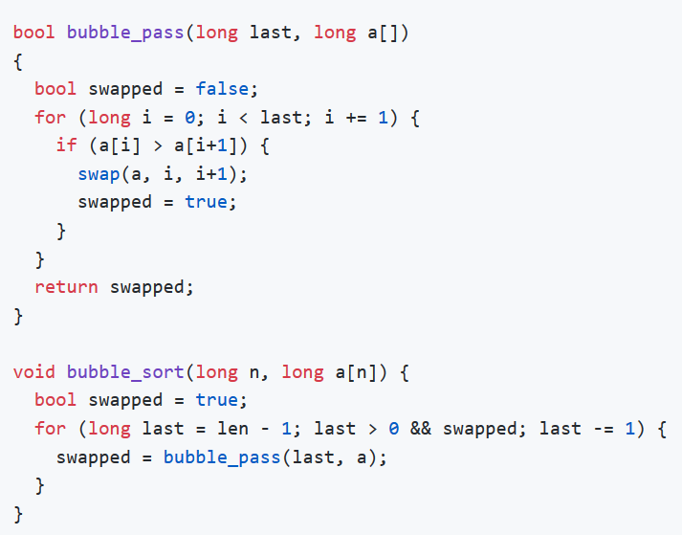
Problem Set 24.1
In this implementation, we always make n−1 passes. But it is possible to terminate early when a pass through the array does not lead to any swapping. Modify the code above to achieve this optimization.
Notes:
Add in a bool flag to track whether a swap was done during a pass.

Slide 16
UNIT 24 SORTING
Recap. PS 24.1. PS 24.2. PS 24.3.

Slide 17
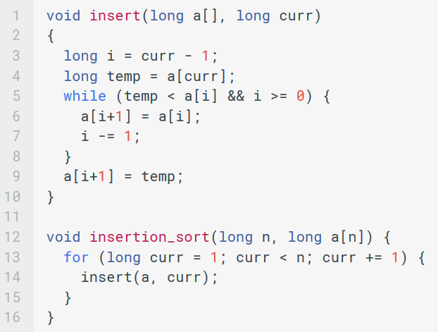
Problem Set 24.2
a) Suppose the input list to insertion sort is already sorted. What is the running time of insertion sort?

Slide 18
Problem Set 24.2
a) Suppose the input list to insertion sort is already sorted. What is the running time of insertion sort?
O(n)
Notes:
If the input is already sorted, then we would never enter the while loop on line 5. Hence insert becomes O(1).
Thus insertion sort runs O(n) times.

Slide 19
Problem Set 24.2
b) Suppose the input list to insertion sort is inversely sorted. What is the running time of insertion sort?

Slide 20
Problem Set 24.2
b) Suppose the input list to insertion sort is inversely sorted. What is the running time of insertion sort?
O(n^2)
Notes:
If the input is inversely sorted, then we enter the loop every time. Not only that, temp < a[i] is true for every i we check until i == 0.
So this is the worst case as for every element, we have to shift every elements to its left. It is still $O(n^2)$

Slide 21
Problem Set 24.2
Insertion Sort
Best time complexity:
O(n)
Worst time complexity:
O(n^2)

Slide 22
UNIT 24 SORTING
Recap. PS 24.1. PS 24.2. PS 24.3.

Slide 23
Problem Set 24.3
What is the loop invariant for the loop in the function insert?

Slide 24
Problem Set 24.3
What is the loop invariant for the loop in the function insert?
temp <= a[i+1]..a[curr].

Slide 25
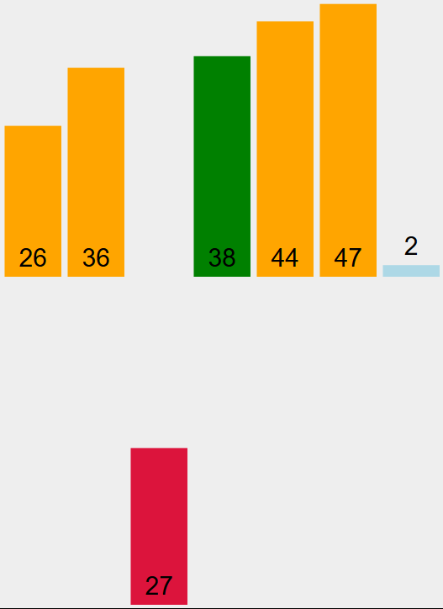
Problem Set 24.3
What is the loop invariant for the loop in the function insert?
temp <= a[i+1]..a[curr].
temp
a[i+1]
a[curr]

Slide 26
IN-CLASS EXERCISES

Slide 27
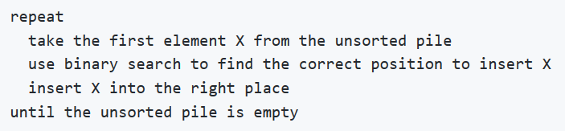
Implement Binary Search with Loop
Modify binary search so that it returns a position k such that a[k] <= q <= a[k+1]
-1 if q < a[0]
n-1 if q > a[n-1].
Basically, this is the position that we should insert k in to keep the array sorted.
Combine insertion sort with binary search

Slide 28
THE END
https://github.com/DigiPie/cs1010_tut_c09

