Slide 1
cs1010
Evan Tay | evantay@comp.nus.edu.sg
https://github.com/DigiPie/cs1010_tut_c09

Slide 2

Today’s plan
Unit 25: Tower of Hanoi
Unit 26: Permutations
Practical Exam 1
Q2: Newton
Q5: Square

Slide 3
TOWER OF HANOI
Unit 25

Slide 4
Tower of Hanoi
There are 3 pegs and n disks of various size that we can slide into any of the pegs. There are a few rules that we have to obey:
we can only move one disk at a time;
we can only move the topmost disk from one peg and place the disk on another peg;
no disk can be placed on top of a smaller disk.

Slide 5
Tower of Hanoi

Slide 6
Tower of Hanoi
void solve(long k, long source, long dest, long placeholder) {
if (k == 1) {
print(k, source, dest);
}
else {
solve(k - 1, source, placeholder, dest);
print(k, source, dest);
solve(k - 1, placeholder, dest, source);
}
}

Slide 7
Tower of Hanoi
void solve(long k, long source, long dest, long placeholder) {
if (k == 1) {
print(k, source, dest);
}
else {
solve(k - 1, source, placeholder, dest);
print(k, source, dest);
solve(k - 1, placeholder, dest, source);
}
}
T(k) = 2T(k − 1) + 1 = 4T(k − 2) + 2 + 1 = 8T(k − 2) + 4 + 2 + 1=...
T(k) = 2k − 1 + 2k − 2 +...+ 4 + 2 + 1 = 2k−1

Slide 8
Problem Set 25.1
Suppose that we add a new restriction to the Tower of Hanoi puzzle. Let's say that the disks are on Peg A (or Peg 1) to begin with, and we want to move the disk to Peg C (or Peg 3). We are only allowed to move a disk either to Peg B from another peg or from Peg B to another peg. In other words, we cannot move the disks between Peg A and Peg C directly.

Slide 9
Problem Set 25.1
Suppose that we add a new restriction to the Tower of Hanoi puzzle. Let's say that the disks are on Peg A (or Peg 1) to begin with, and we want to move the disk to Peg C (or Peg 3). We are only allowed to move a disk either to Peg B from another peg or from Peg B to another peg. In other words, we cannot move the disks between Peg A and Peg C directly.
Can only move pegs between Peg A and B, and Peg B and C
Notes:
Movements must be between adjacent pegs

Slide 10
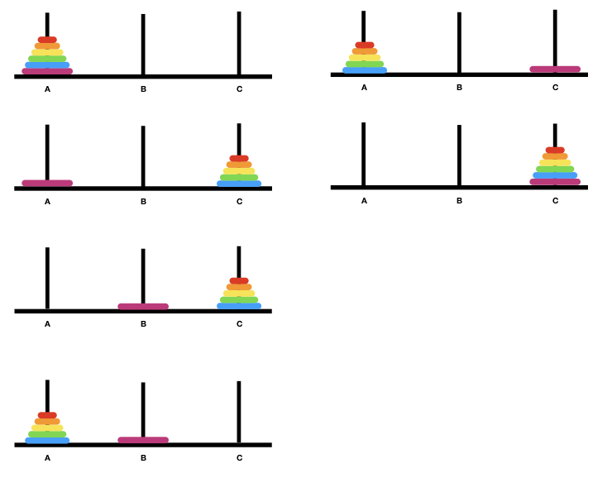
Problem Set 25.1
Notes:
Movements must be between adjacent pegs

Slide 11
Problem Set 25.1
void solve(long k, long source, long dest, long placeholder) {
if (k == 1) {
move(k, source, placeholder);
move(k, placeholder, dest);
return;
}
solve(k - 1, source, dest, placeholder);
move(k, source, placeholder);
solve(k - 1, dest, source, placeholder);
move(k, placeholder, dest);
solve(k - 1, source, dest, placeholder);
}

Slide 12
Problem Set 25.1
void solve(long k, long source, long dest, long placeholder) {
if (k == 1) {
move(k, source, placeholder);
move(k, placeholder, dest);
return;
}
solve(k - 1, source, dest, placeholder);
move(k, source, placeholder);
solve(k - 1, dest, source, placeholder);
move(k, placeholder, dest);
solve(k - 1, source, dest, placeholder);
}
How many steps (use big O notation) are needed now?
From O(2^k) to O(3^k)
T(k) = 3T(k-1) + 2 = 9T(k-2) + 6 + 2 + ... = O(3^k)

Slide 13
Problem Set 25.1
void solve(long k, long source, long dest, long placeholder) {
if (k == 1) {
move(k, source, placeholder);
move(k, placeholder, dest);
return;
}
solve(k - 1, source, dest, placeholder);
move(k, source, placeholder);
solve(k - 1, dest, source, placeholder);
move(k, placeholder, dest);
solve(k - 1, source, dest, placeholder);
}
How many steps (use big O notation) are needed now?
From O(2^k) to O(3^k)
T(k) = 3T(k-1) + 2 = 9T(k-2) + 6 + 2 + ... = O(3^k)

Slide 14
Tower of Hanoi
Original Tower of Hanoi code: https://github.com/DigiPie/cs1010_tut_c09/blob/master/Tutorial_10/tower_of_hanoi.c
Problem Set 25.1 solution: https://github.com/DigiPie/cs1010_tut_c09/blob/master/Tutorial_10/problem25_1.c

Slide 15
Permutations
Unit 26

Slide 16
Permutations
Consider a string length 3, abc. We start with a as the first character, and generate all the permutations of the string bc. We get two permutations abc and acb. The next character is b. We generate all permutations of the string ac. We get bac and bca. Similarly, we get the permutations cab and cba by considering c as the first character and permutating ba.

Slide 17
Permutations
void permute(char a[], long len, long curr) {
// permute characters a[curr]..a[len-1] and print out a for each permutation.
if (curr == len-1) {
cs1010_println_string(a);
return;
}
permute(a, len, curr + 1);
for (long i = curr + 1; i < len; i += 1) {
swap(a, curr, i);
permute(a, len, curr + 1);
swap(a, i, curr);
}
}

Slide 18
Problem Set 26.1
Write a boolean function that we can call in Line A to check if we should continue to permute the rest of the string, and therefore avoid generating duplicate permutations when the input string contains duplicate characters.
For instance, if the input is aaa, the existing code would print aaa six times. Print one time only instead.

Slide 19
Problem Set 26.1
permutate recursively
a
b
c
b
e
b
a
c
b
e
c
b
a
b
e
b
b
c
a
e
Duplicate work!
e
b
c
b
a
Notes:
Both will generate duplicates such as ‘bacbe’

Slide 20
Problem Set 26.1
void permute(char a[], long len, long curr) {
if (curr == len-1) {
cs1010_println_string(a);
return;
}
permute(a, len, curr + 1);
for (long i = curr + 1; i < len; i += 1) {
if (...) { // Line A
swap(a, curr, i);
permute(a, len, curr + 1);
swap(a, i, curr);
}
}
}

Slide 21
Problem Set 26.1
void permute(char a[], long len, long curr) {
if (curr == len-1) {
cs1010_println_string(a);
return;
}
permute(a, len, curr + 1);
for (long i = curr + 1; i < len; i += 1) {
if (!appear_before(a, curr, i)) { // If appeared before, skip further permutation
swap(a, curr, i);
permute(a, len, curr + 1);
swap(a, i, curr);
}
}
}

Slide 22
Problem Set 26.1
permutate recursively
one of the permutations generated:
a
b
c
b
e
b
a
c
b
e
b
a
c
b
e
c
b
a
b
e
b
b
c
a
e
b
a
c
…
…
e
b
c
b
a

Slide 23
Problem Set 26.1
permutate recursively
one of the permutations generated:
a
b
c
b
e
b
a
c
b
e
b
a
c
b
e
c
b
a
b
e
b
b
c
a
e
b
a
c
…
…
e
b
c
b
a

Slide 24
Problem Set 26.1
a[k]
a[i]
a
b
c
b
e
bool appear_before(char a[], long k, long i) {
for (int j = k; j < i; j += 1) {
if (a[j] == a[i]) {
return true;
}
}
return false;
}

Slide 25
Permutations
Original Permutations code: https://github.com/DigiPie/cs1010_tut_c09/blob/master/Tutorial_10/permutations.c
Problem Set 26.1 solution: https://github.com/DigiPie/cs1010_tut_c09/blob/master/Tutorial_10/problem26_1.c

Slide 26
PRACTICAL EXAM 1
Q2 Newton. Q5 Square
Notes:
Fail to consider if x is already the root
Using the wrong type (long instead of double, float instead of double
Wrong terminating conditions (did not take `fabs`, use `>` instead of `<`, comparing with 0.001 instead of 0.000000001, terminating after 4 times, etc.)

Slide 27

THE END
Evan Tay | evantay@comp.nus.edu.sg
https://github.com/DigiPie/cs1010_tut_c09

