Slide 1
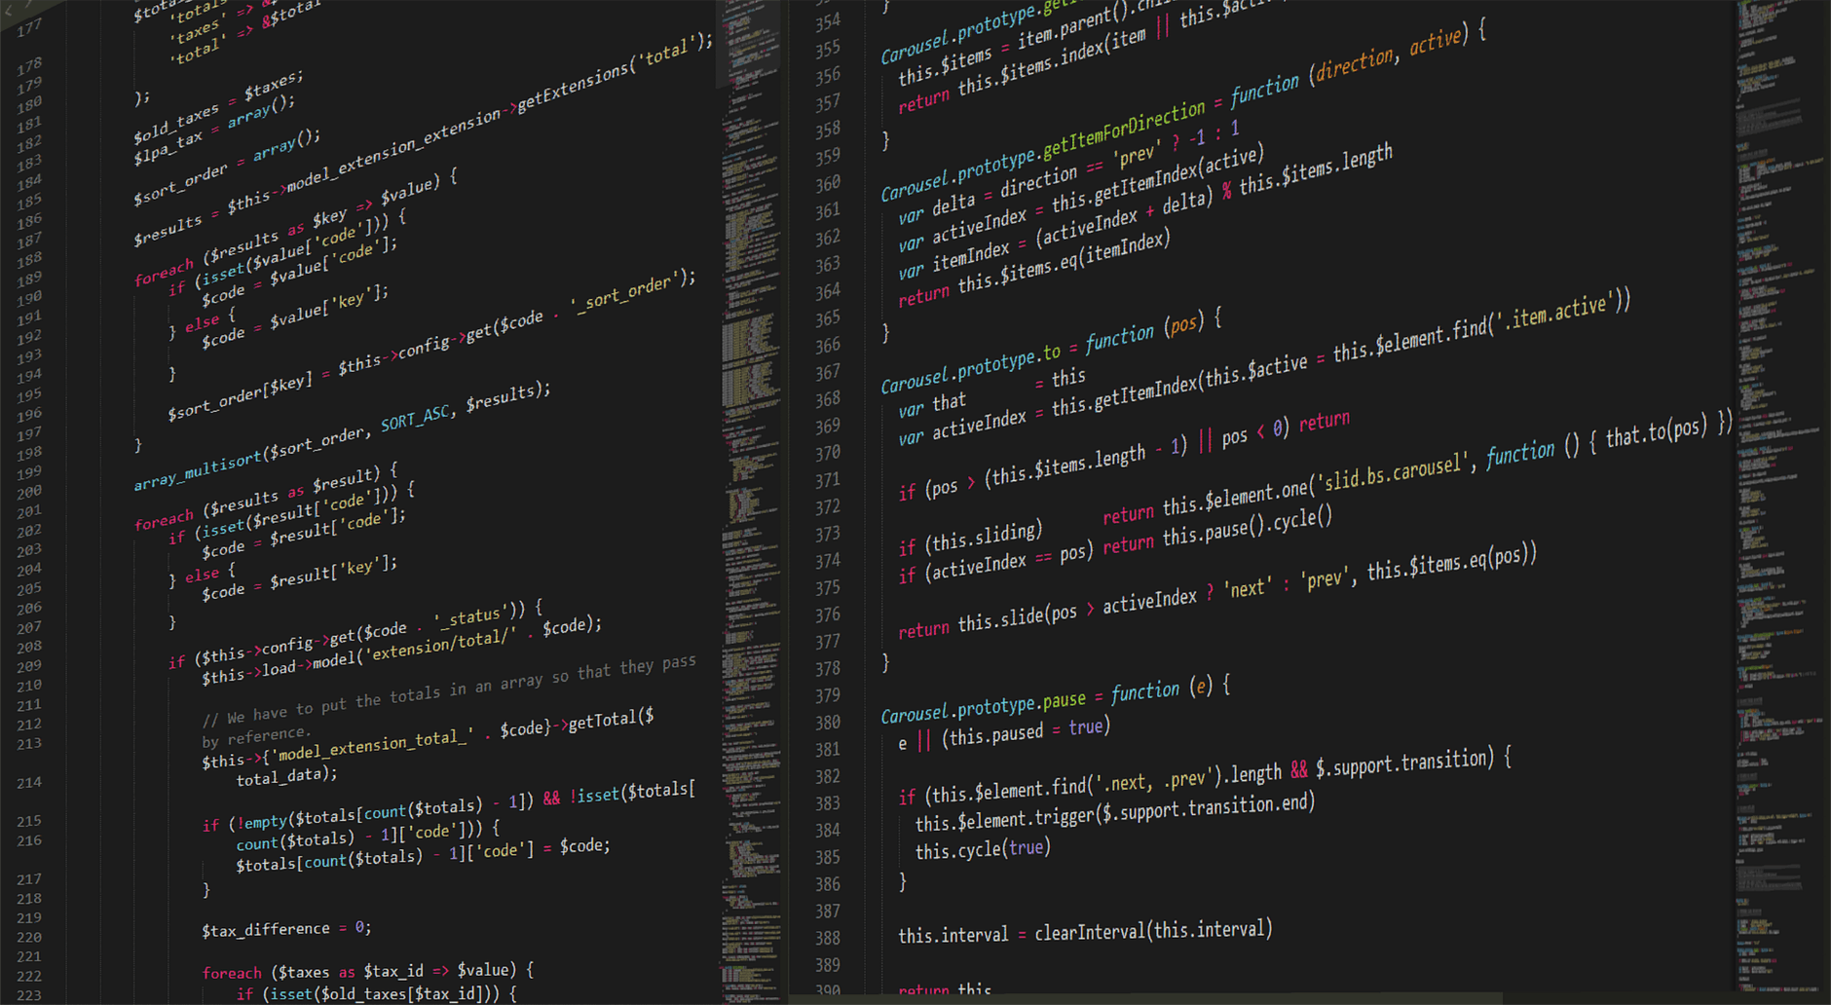
CS1010
https://github.com/DigiPie/cs1010_tut_c09

Slide 2
Today’s plan
Tutorial Segment
Kahoot Quiz!
Discussion of problem sets 8 to 9
Coding Style demonstration
Lab Segment
Exercises 1 & 2

Slide 3

KAHOOT!
Quick quiz
Notes:
https://play.kahoot.it/#/k/32e3a7c4-9fb5-42b1-9bc2-78b6139e1d07

Slide 4
Today’s plan
Tutorial Segment
Kahoot Quiz!
Discussion of problem sets 8 to 9
Coding Style demonstration
Lab Segment
Exercises 1 & 2

Slide 5
Problem sets
8.1, 8.2, 8.3, 9.1, 9.2, 9.3

Slide 6
Problem Set 8.1a)
Do the following two functions behave the same way?
long factorial(long n) { if (n == 0) { return 1; } return n * factorial(n - 1); }
long factorial(long n) { if (n == 0) { return 1; } else { return n * factorial(n - 1); } }
Notes:
Yes because in both cases:
If n == 0, return 1;
If n != 0, return n * factorial(n – 1);

Slide 7
Problem Set 8.1b)
Do the following two functions behave the same way?
long factorial(long n) { long results; if (n == 0) { results = 1; } results = n * factorial(n - 1); return results; }
long factorial(long n) { long results; if (n == 0) { results = 1; } else { results = n * factorial(n - 1); } return results; }
Notes:
No because in first case:
If n == 0, return n * factorial(n- 1);
If n != 0, return n * factorial(n – 1);
In second case:
If n == 0, return 1;
If n != 0, return n * factorial(n – 1);

Slide 8
Problem sets
8.1, 8.2, 8.3, 9.1, 9.2, 9.3

Slide 9
Problem Set 8.2
Draw the flow charts for the coding snippets below
if (x > y) { max = x; } if (x < y) { max = y; } if (x == y) { max = y; }
if (x > y) { max = x; } else { max = y; }

Slide 10
Problem Set 8.2
Draw the flow charts for the coding snippets below
if (x > y) { max = x; } if (x < y) { max = y; } if (x == y) { max = y; }
x > y
x < y
x == y
input
x, y
output max
NO
NO
YES
YES
YES
max = x
max = y
max = y

Slide 11
Problem Set 8.2
Draw the flow charts for the coding snippets below
if (x > y) { max = x; } else { max = y; }
x > y
max = y
input
x, y
output max
NO
YES
max = x

Slide 12
Problem sets
8.1, 8.2, 8.3, 9.1, 9.2, 9.3

Slide 13
Problem Set 8.3 Write the corresponding if-else statements to print out the letter grade based on the tables above.
Table 2
Table 3 (5 or higher)
Score | Letter Grade
5 or higher | See Table 3
Less than 5 | See Table 4
Score | Letter Grade
8 or higher | A
Less than 8 | B
Table 4 (less than 5)
Score | Letter Grade
3 or higher | C
Less than 3 | D

Slide 14
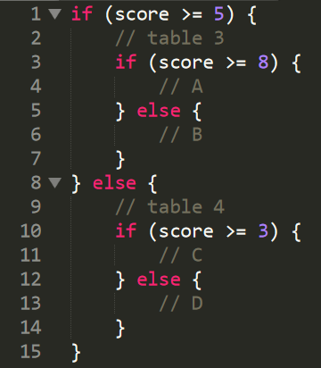
Problem Set 8.3
Code available on https://github.com/DigiPie/cs1010_tut_c09

Slide 15
Problem sets
8.1, 8.2, 8.3, 9.1, 9.2, 9.3

Slide 16
Problem Set 9.1 Fill in the table below.
a | b | a && b | a || b | !a
true | true
true | false
false | true
false | false

Slide 17
Problem Set 9.1 Fill in the table below.
a | b | a && b | a || b | !a
true | true | true | true | false
true | false | false | true | false
false | true | false | true | true
false | false | false | false | true

Slide 18
Problem sets
8.1, 8.2, 8.3, 9.1, 9.2, 9.3

Slide 19
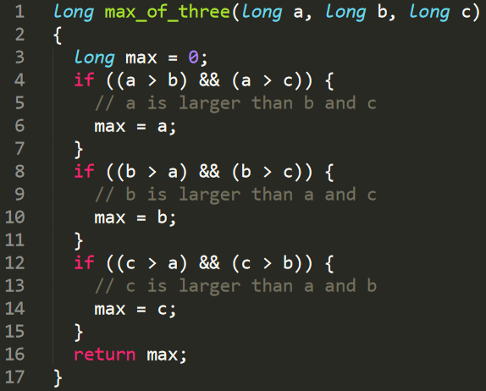
Problem Set 9.2
a) What is wrong with the code above?
b) Give a sample test value of a, b, and c that would expose the bug.

Slide 20
Problem Set 9.2
a) What is wrong with the code above?
No check for equality. What if a == b?
b) Give a sample test value of a, b, and c that would expose the bug.
a == b == c

Slide 21
Problem Set 9.2
b) continued…
What if there is a tie among two numbers to be the max? (e.g., 2 2 1)

Slide 22
Problem Set 9.2
b) continued…
What if there is a tie among two numbers to be the max? (e.g., 2 2 1)
Does not work as no assignment will happen.

Slide 23
Problem Set 9.2
b) continued…
What if the two numbers that is not the max are equal? (e.g., 2 1 1).

Slide 24
Problem Set 9.2
b) continued…
What if the two numbers that is not the max are equal? (e.g., 2 1 1).
Works as assignment still happens.

Slide 25
Problem Set 9.2
(c) Fix the code above to remove the bug.

Slide 26
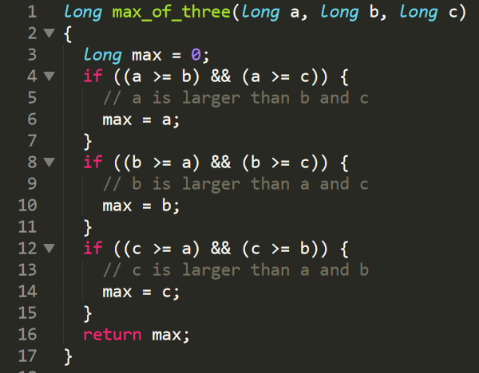
Problem Set 9.2
Code available on https://github.com/DigiPie/cs1010_tut_c09

Slide 27
Problem Set 9.2
(d) Replace the three if statements in the code above with if-else statements. Draw the corresponding flowchart.

Slide 28
Problem Set 9.2
(d) Replace the three if statements in the code above with if-else statements. Draw the corresponding flowchart.
a >= b?
input
a, b, c
NO
YES
a >= c?
NO
max = c
YES
max = a

Slide 29
Problem Set 9.2
(d) Replace the three if statements in the code above with if-else statements. Draw the corresponding flowchart.
a >= b?
is b >= c?
input
a, b, c
max = b
NO
YES
YES
NO
a >= c?
NO
max = c
YES
max = a

Slide 30
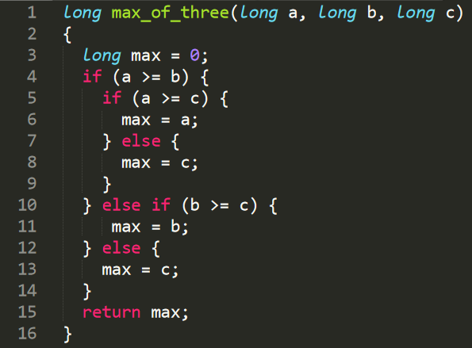
Problem Set 9.2
(d) Replace the three if statements in the code above with if-else statements. Draw the corresponding flowchart.
Code available on https://github.com/DigiPie/cs1010_tut_c09

Slide 31
Problem sets
8.1, 8.2, 8.3, 9.1, 9.2, 9.3

Slide 32
Problem Set 9.3
Code available on https://github.com/DigiPie/cs1010_tut_c09

Slide 33
Today’s plan
Tutorial Segment
Kahoot Quiz!
Discussion of problem sets 8 to 9
Coding Style demonstration
Lab Segment
Exercise 1 & 2

Slide 34
CODING STYLE DEM0
https://nus-cs1010.github.io/1819-s1/style/index.html

Slide 35
THE END
https://github.com/DigiPie/cs1010_tut_c09

