Slide 1
natural language processing challenge
PROJECT 2
NLP
Group 4_ Georg, Mariana, Ralitza, Sandra

Slide 2
executive summary
Naive Bayes (best model)
95 % (validation accuracy)
Config.2
alternatives considered & tested
Random Forest (91% with Config.2)
Logistic Regression (94% with Config.2)
XGBoost (84% with Config.1)
Simple Feedforward NN (94% with Config.2)
methodology & considerations
Config.1
Config.2
Config.3

Slide 3
models (preprocessing & embedding)
Configuration | Description
1. Clean + Lemmatize + TF-IDF | Custom cleaning and lemmatization, bigram TF-IDF
2. TF-IDF (raw text) | Unprocessed text with 1–3 grams
3. TF-IDF (stopwords removed) | Removes English stopwords
4. Sentence Embeddings | Encoded with all-MiniLM-L6-v2 (384-dim vectors)
Logistic Regression
Random Forest
Logistic Regression
Naive Bayes
XGBoost
SF NN

Slide 4
methods (preprocessing & embedding)

Slide 5
A note about embeddings
❌ Embeddings didn’t significantly improve the performance of our models (except for XGBoost).
 | TF-IDF | Embeddings
Interpretable? | ✅ Yes — we know which words matter | ❌ No — abstract dimensions
Captures meaning? | ❌ No | ✅ Yes
Best for | Simple, small, domain-specific data | Large, semantic, cross-domain data

Slide 6
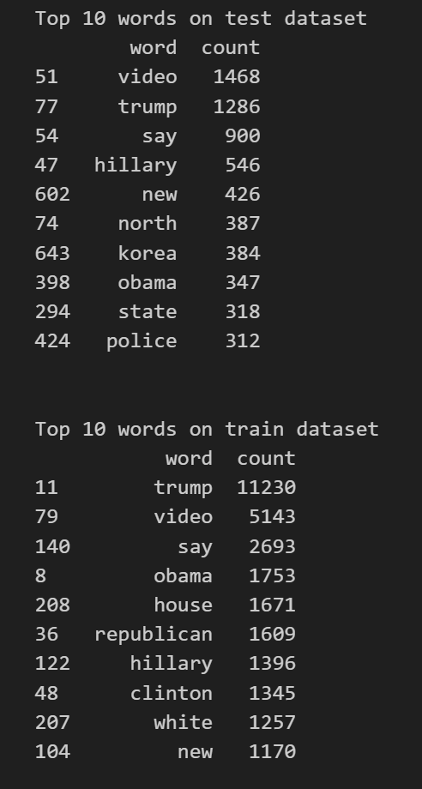
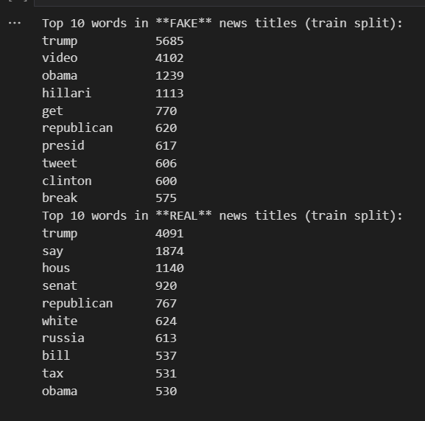
training vs validation accuracy
top 10 words_TEST dataset
top 10 words_TRAIN dataset

Slide 7
takeaways
Recap and Conclusions
Raw text+ TF-IDF+ Naive Bayes Model= 95% (best model)
Challenges and Key learnings
training and testing data consistency
The text was exactly the same in structure and format, so that overfitting that avoided overfitting
Saving time with TF-IDF built- in- cleaner
Lowercasing– Tokenization--Stop-word removal, N-gram creation
Over processing data
Manually cleaning and using the built- in- cleaner of TF-IDF resulted removing too much data and losing valuable features. This resulted in a much lower accuracy.

Slide 8
Our estimate for accuracy on TEST DATA
92% - 94%
thank you
Group 4_ Georg, Mariana, Ralitza, Sandra

