Slide 1



Automation plant watering
Git Hub Link;-
https://github.com/Digidigidinesh/VMD.S
Dataset Link:-
INTELLIGENT IRRIGATION SYSTEM
Govt.Arts And Science college,Hosur
Dhanush.S
Vinay Kumar.M
Mubarak Ulla khan.B

Slide 2
1.Brief Overview:
This project introduces a streamlined approach to plant care using modern technologies. It utilizes Python, Streamlit, and pickle for developing a web-based system that monitors soil moisture levels and automates irrigation. This reduces human effort and ensures plants receive optimal care.
Source :
www.freepik.com/

Slide 3
2: Problem Statement:
Challenge: Manual plant watering often results in inconsistencies such as over-watering or under-watering, hindering plant growth and wasting water.
Solution: A browser-based automation system using Python and Streamlit allows users to track soil moisture and automate irrigation efficiently. Key features include real-time monitoring and threshold-based watering decisions.

Slide 4
3: Dataset Description:
Simulated Data: Randomized soil moisture values mimic sensor input during testing. Data includes:
Moisture Level (%): A value between 0–100 indicating current soil dryness.
Settings: The app uses pickle to store user-defined moisture thresholds, ensuring persistent settings across sessions.

Slide 5
4: Approach and Methodology:
Software Features:
Browser Interface: Users can monitor and adjust soil moisture thresholds dynamically.
Threshold Persistence: Moisture thresholds are saved locally using pickle.
Automation Logic:
The app compares soil moisture levels with saved thresholds.
If moisture is below the threshold, it triggers "watering" using simulated images or real actuators (future work).
Source :
www.freepik.com/

Slide 6
5: Results:
Successful Outcomes:
Real-time monitoring of soil moisture levels in the browser.
Persistent threshold settings for user convenience.
Prototype proves feasibility of automation, laying groundwork for future hardware integration.

Slide 7

7: Conclusion
The automated plant watering system offers an innovative solution to streamline plant care. By combining Python, Streamlit, and the pickle module, the project showcases practical web-based automation.
Future Scope:
Integrate real soil moisture sensors.
Deploy predictive analytics for weather-based irrigation.
Scale for larger agricultural systems.
Source :
www.freepik.com/

Slide 8
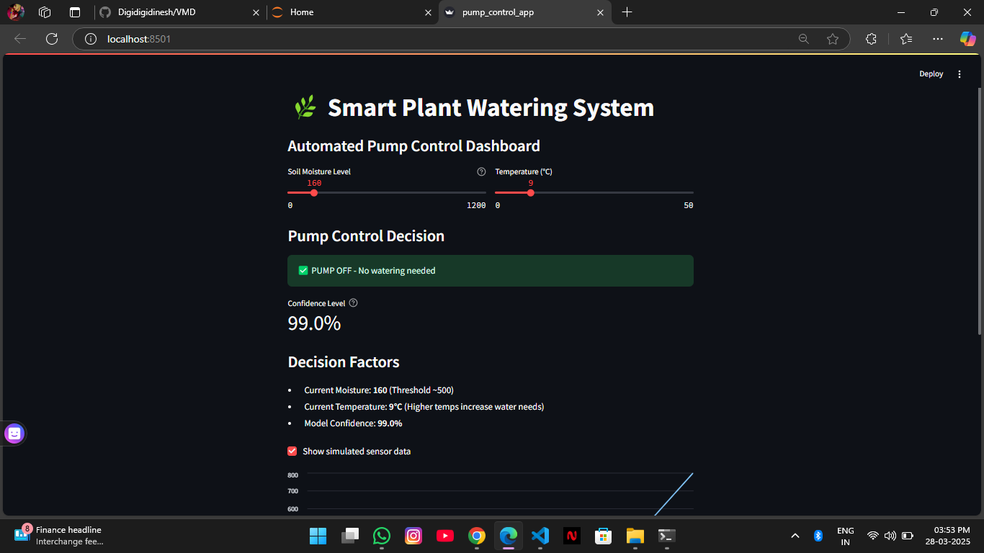
Sample Output

Slide 9
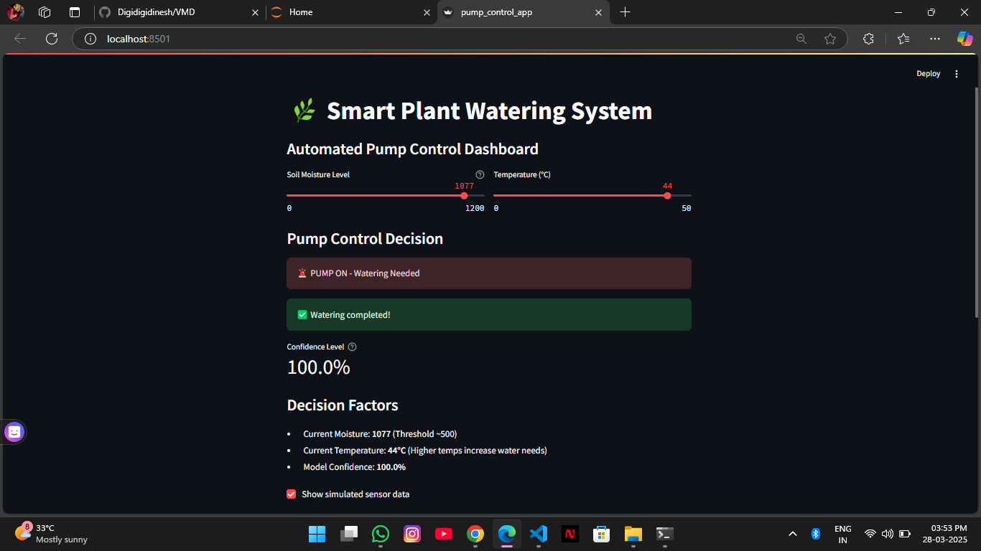
Sample Output

Slide 10
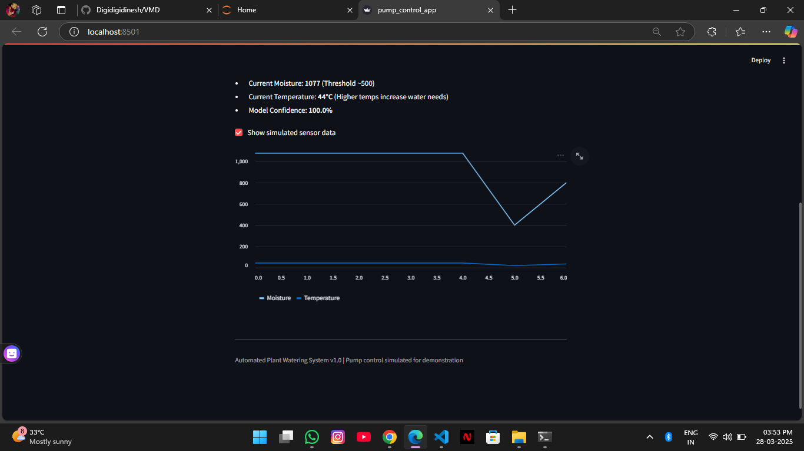

Slide 11
Thank You
Notes:
Thank You !!

