Slide 1

AI-Assisted IoT Development
Workshop – Building Sensor Networks for Natural Hazard Monitoring
DigiHaz Doctoral Training Programme · Module 7

Slide 2
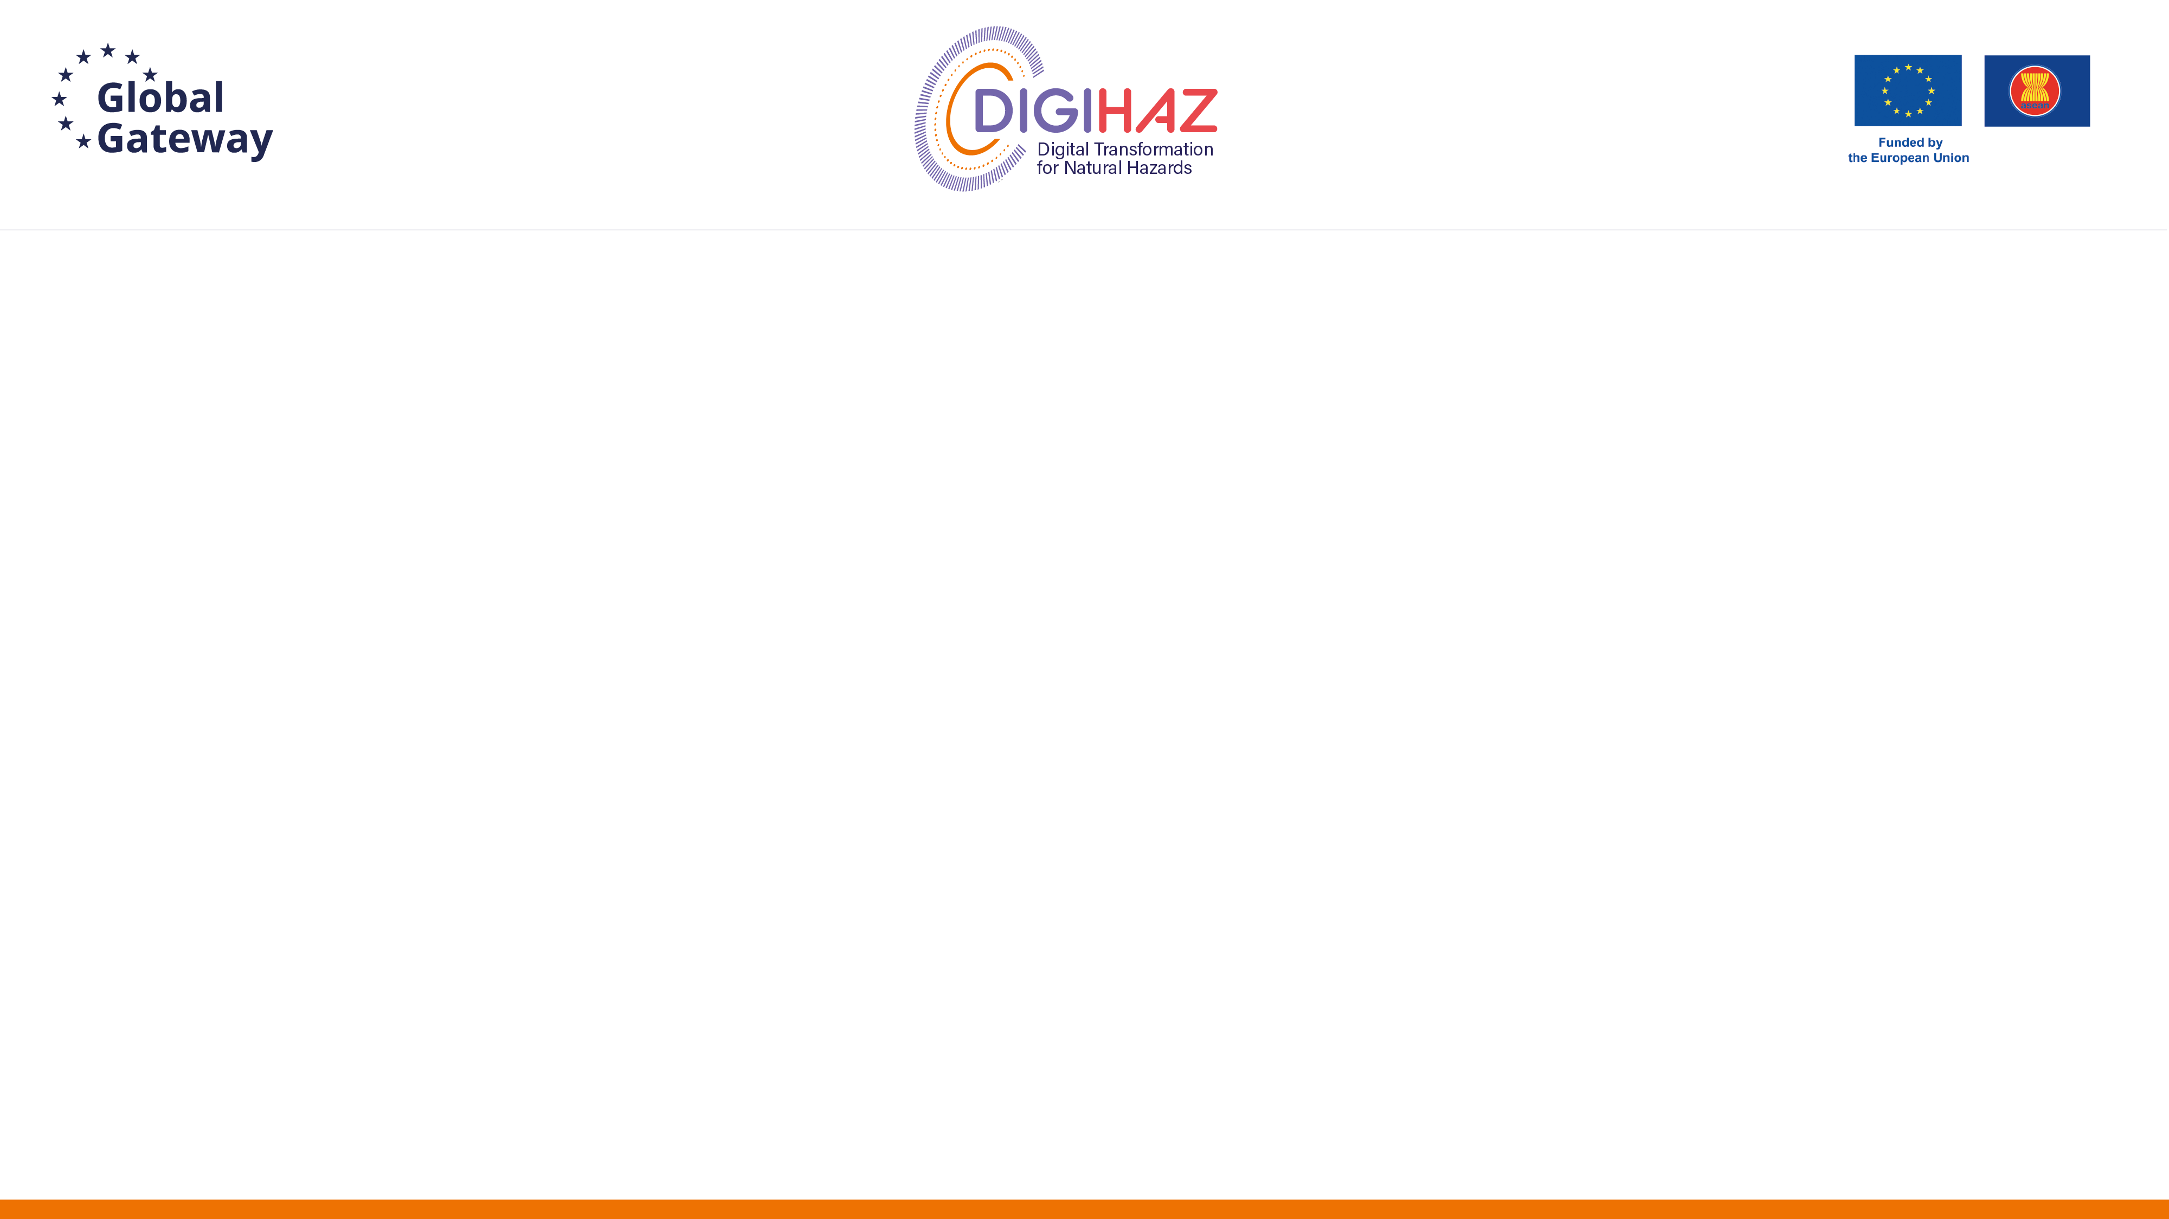
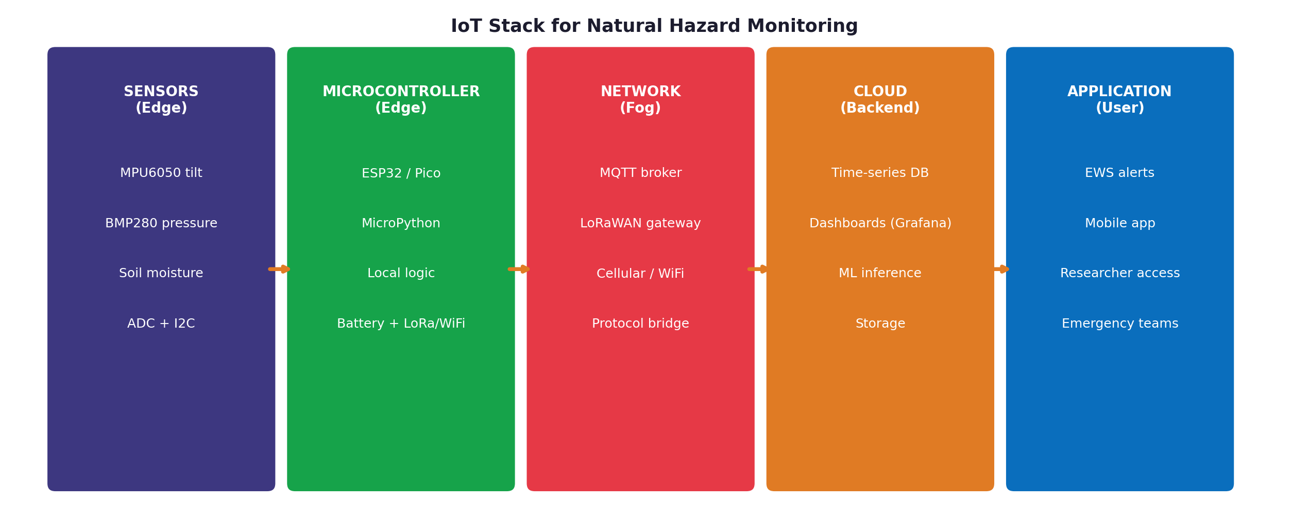
Learning Objectives
Understand the IoT stack: edge → fog → cloud → application
Identify three workshop sensors and their hazard applications
MPU6050 (tilt), BMP280 (pressure), soil moisture (water content)
Apply the 5-step AI-assisted coding workflow effectively
Recognise when to trust AI-generated code and when to verify
Write well-structured prompts that produce working code
Build a complete sensor → MQTT → dashboard pipeline
Configure alert rules and dissemination (Telegram + browser push)
Integrate IoT data streams with the EWS from Module 5

Slide 3

Part 1
Foundations of IoT for Hazard Monitoring
What is IoT? · Why hazard monitoring? · Hardware choices

Slide 4
The IoT Stack: From Sensor to EWS

Slide 5
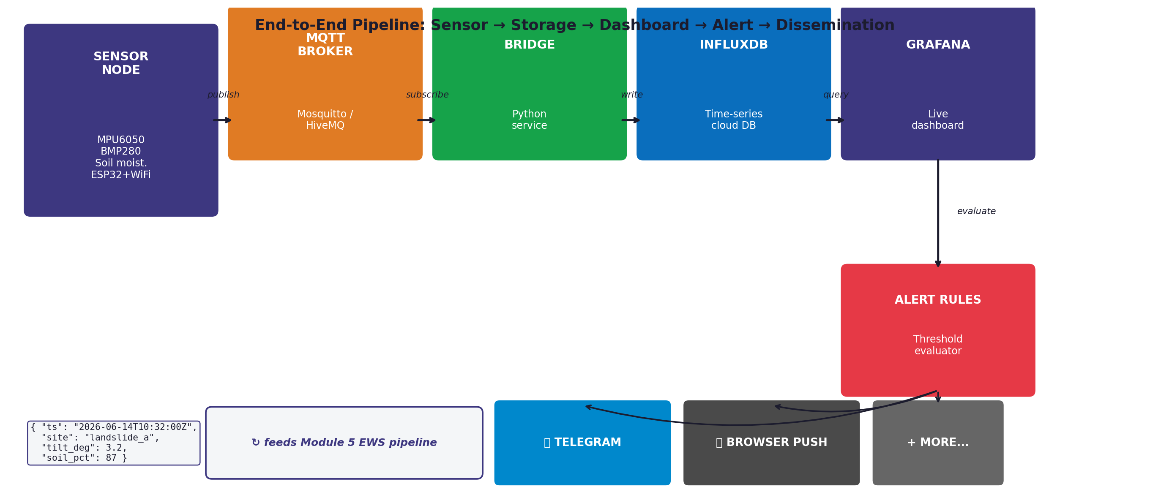
Why IoT for Natural Hazard Monitoring?
Traditional monitoring is expensive and sparse
Research-grade seismometers cost €10,000–€100,000+
Government networks cover only fraction of at-risk areas
IoT enables dense, low-cost, distributed sensing
€20–€50 sensor nodes vs. €10k+ traditional stations
Hundreds of nodes possible on the same budget
Real-time data via WiFi, LoRaWAN, cellular
Hazard applications:
Landslide tilt + soil moisture monitoring
Distributed seismic networks (citizen science)
River level + rainfall flood early warning
Building structural health monitoring

Slide 6
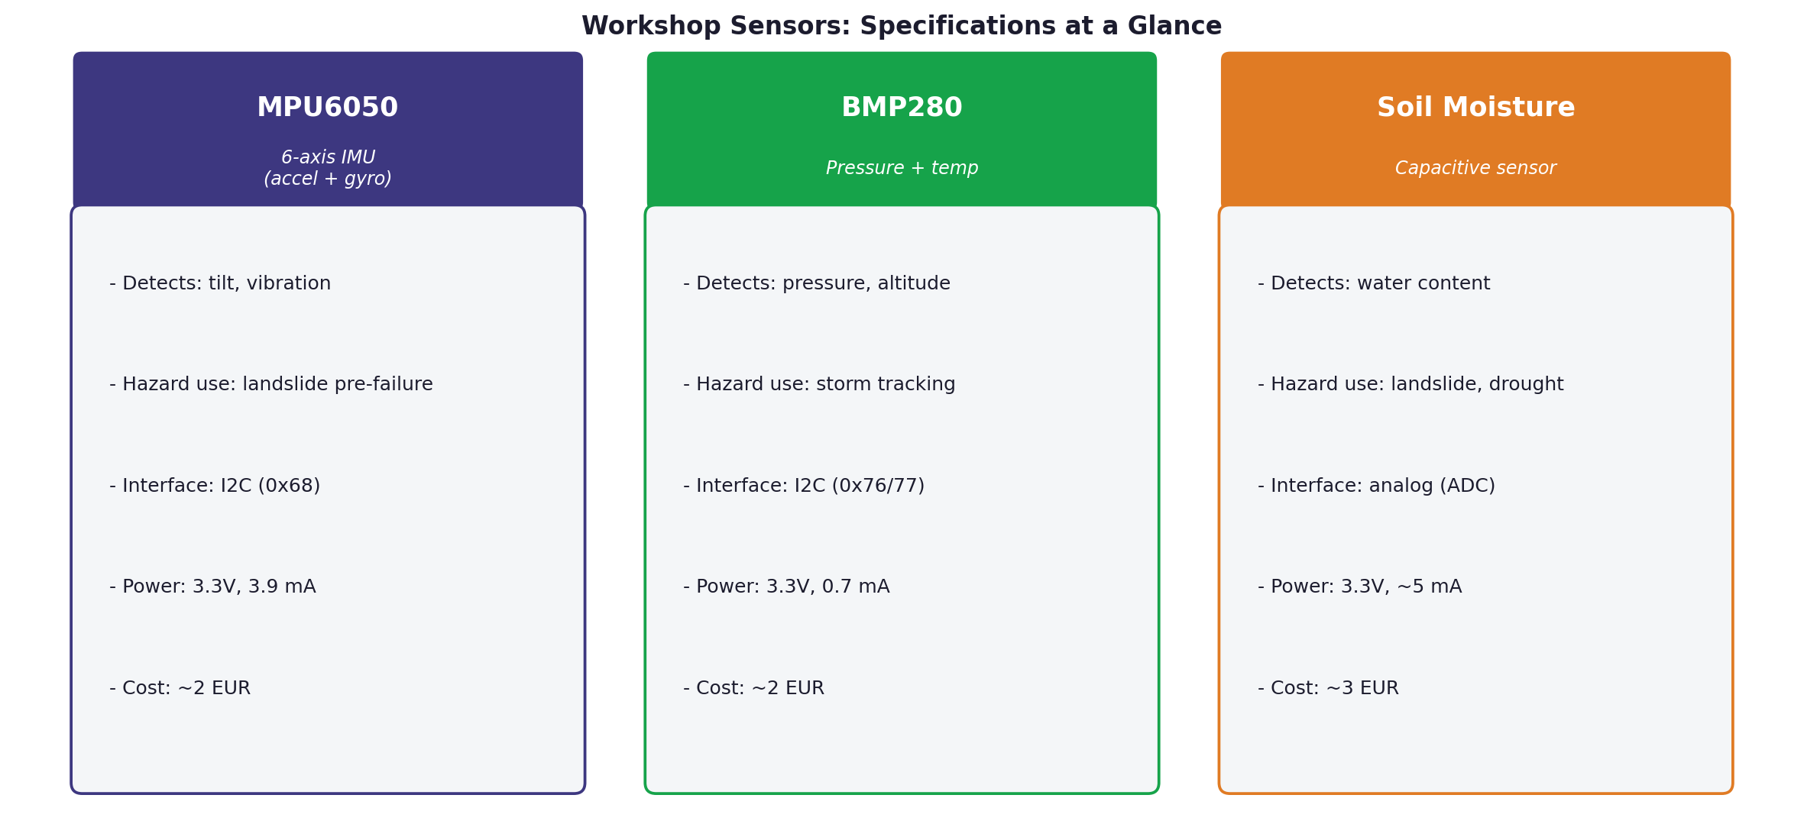
Workshop Sensors: MPU6050 · BMP280 · Soil Moisture

Slide 7
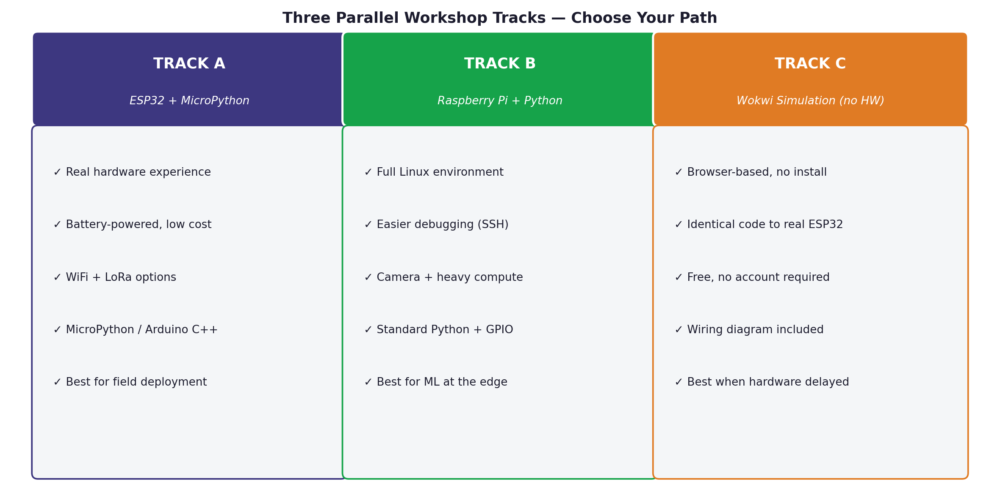
Three Parallel Tracks for the Hands-on Session

Slide 8
Part 2
AI-Assisted Coding ("Vibe Coding")
The 5-step loop · Prompt quality · When to verify

Slide 9
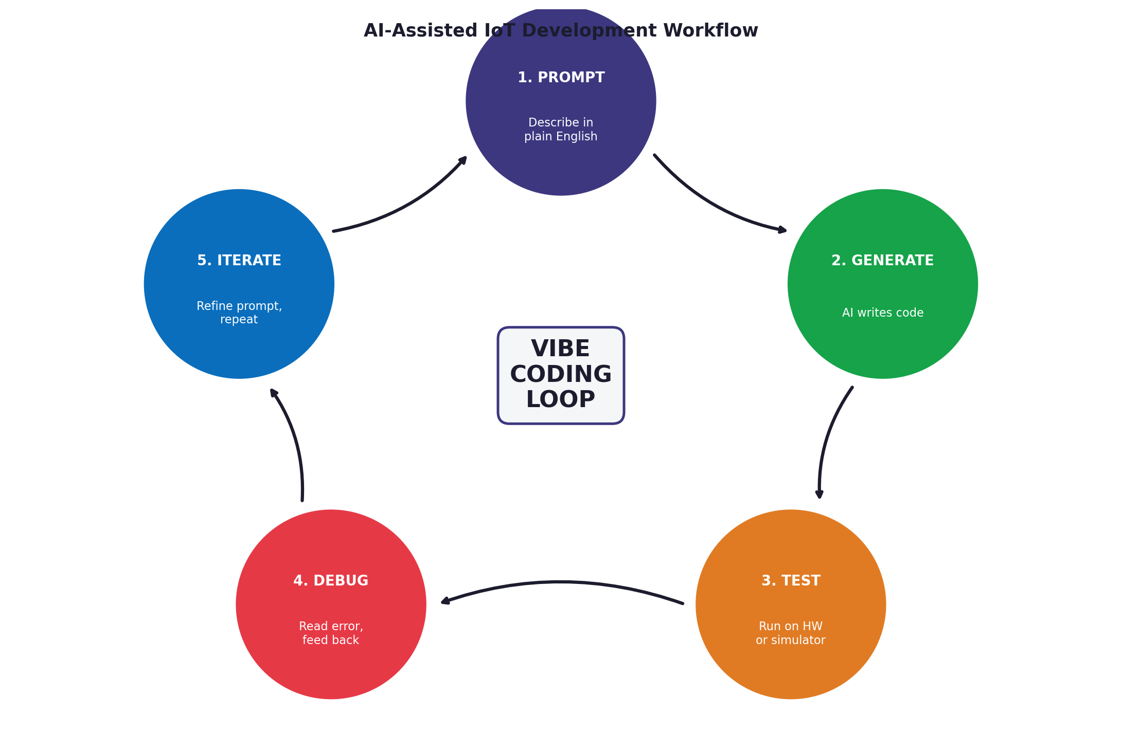
What is AI-Assisted IoT Development?
Definition:
Using LLMs (Claude, ChatGPT, Copilot, etc.) to generate code
by describing what you want in natural language
Why it matters for IoT:
Lowers the barrier to embedded programming
Faster prototyping of sensor logic
Generates boilerplate (MQTT, JSON, WiFi setup) instantly
Helps with unfamiliar libraries and APIs
But it is NOT magic:
Code can be subtly wrong in dangerous ways
You still need to understand the physics & hardware
Workshop teaches HOW to use it responsibly

Slide 10
The 5-Step AI-Assisted Coding Workflow

Slide 11
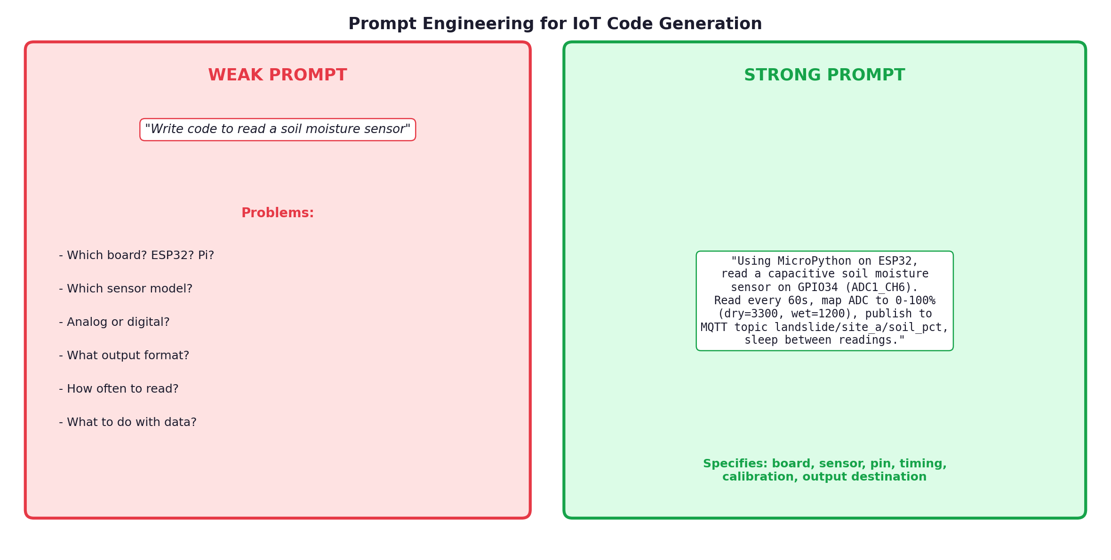
Prompt Engineering: Weak Prompts vs. Strong Prompts

Slide 12
Anatomy of a Good IoT Prompt
1. Specify the hardware
Board (ESP32, Pi Pico, Raspberry Pi 5)
Language (MicroPython, Python, Arduino C++)
2. Identify the sensor
Exact model (e.g. MPU6050, not just "IMU")
Interface (I2C address, ADC pin, SPI)
3. Define the data flow
Read frequency (every 60s)
Output format (JSON, CSV, raw)
Destination (MQTT topic, file, screen)
4. State constraints
Power budget, memory limits, calibration values

Slide 13
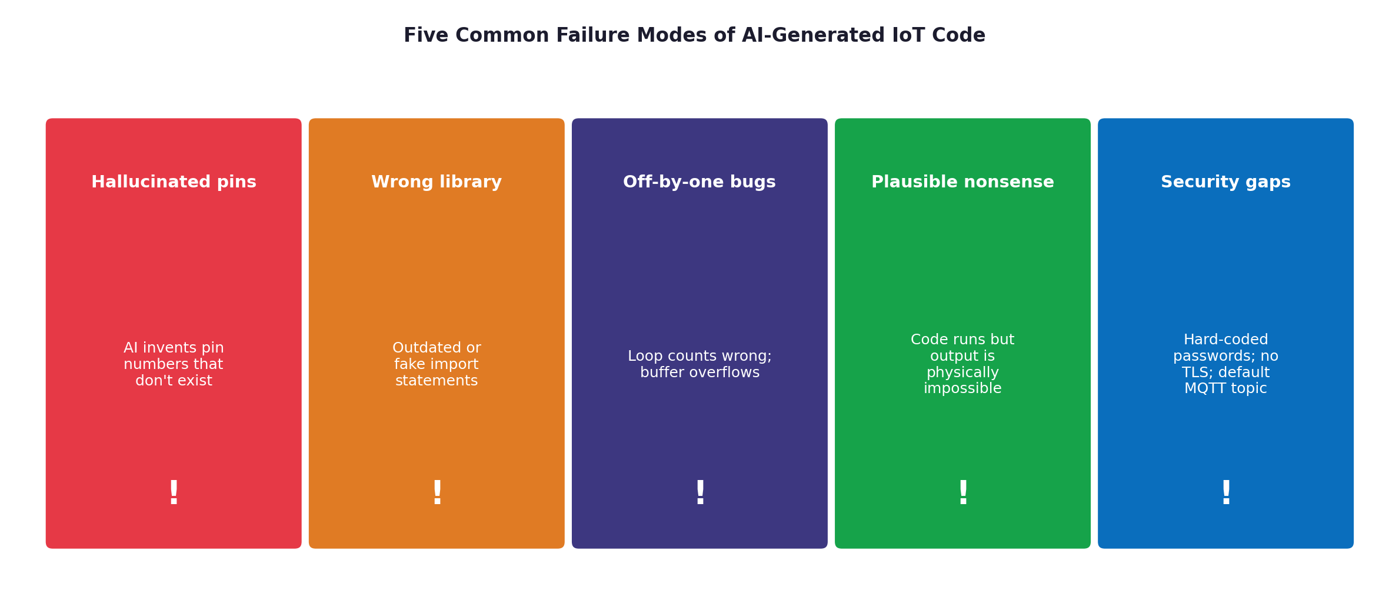
When AI Goes Wrong: Five Failure Modes

Slide 14
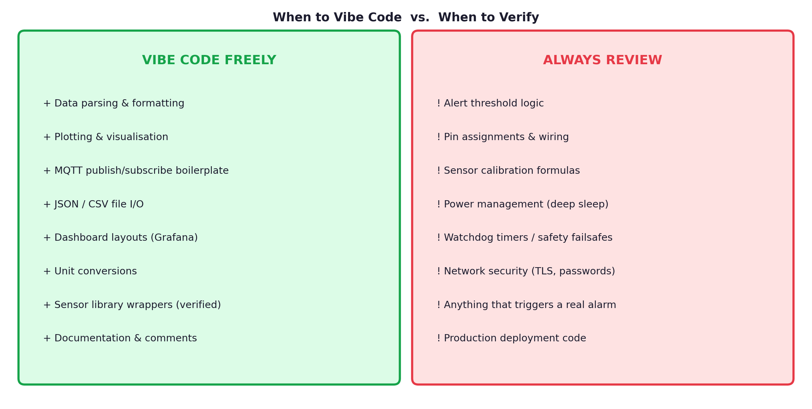
The Trust Boundary: When to Verify Carefully

Slide 15
Ethics & Safety in AI-Assisted IoT
AI-generated code can have real consequences:
Wrong threshold → missed landslide warning → casualties
Insecure code → sensor network compromised
Misread calibration → systematic data error in publication
Responsibilities of the researcher:
YOU are accountable for the code, not the AI
Always test on hardware before deployment
Document AI-assisted portions in your methodology
Have peers review safety-critical sections
Research integrity:
Disclose AI tool usage in publications (journal policies vary)
Verify any AI-generated calibration formulas against datasheets

Slide 16
Part 3
Hands-on Build
Sensor → MQTT → Dashboard → Alerts · Choose your track

Slide 17
Build Target: Full End-to-End EWS Pipeline

Slide 18
Today You Will Build...
A working IoT sensor node that:
Reads MPU6050 tilt, BMP280 pressure, soil moisture
Publishes JSON every 60s to MQTT
A persistent time-series database:
MQTT-to-InfluxDB bridge (already provided)
24h+ data retention with the free Grafana Cloud tier
A live shared dashboard:
Grafana — 7 panels, auto-refresh every 5s
Public URL you and your classmates can view
Alert rules + dissemination:
Threshold-based rules with FIRING / RESOLVED states
Real notifications via Telegram + browser push
Two assignments to submit:
Notebook 2 — Vibe Coding Lab (assessed)
Notebook 4 — Alert Rules & Dissemination (assessed)

Slide 19
Part 4
Integration & Reflection
Connecting to EWS · Alert dissemination · What you learned

Slide 20
Connecting Your Sensor Node to the EWS
From Module 5, recall the EWS pipeline:
Sensors → Processing → Decision → Dissemination → Response
Your IoT node fills the SENSORS layer
MQTT messages feed real-time data to the processor
Apply the threshold optimisation from Notebook 2
Grafana rules trigger when conditions exceed safe limits
Example landslide trigger conditions:
Tilt > 10° AND soil moisture > 90% → RED
Tilt > 5° AND soil moisture > 80% → YELLOW
Pressure dropping > 2 hPa/hour → STORM watch
This is real research infrastructure
Your code today is the basis for field deployments

Slide 21
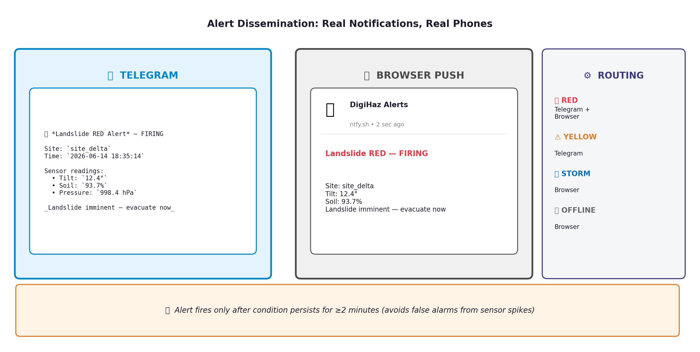
Alert Rules & Dissemination: Real Notifications, Real Phones

Slide 22
Key Takeaways
1
IoT enables dense, low-cost hazard monitoring — €20–50 vs. €10k+
2
AI-assisted coding is the new normal — use it, but understand it
3
Strong prompts specify board, sensor, interface, output, and constraints
4
Trust AI for boilerplate; ALWAYS review threshold logic and safety-critical code
5
Grafana + InfluxDB is the de facto standard for IoT dashboards (free tier works)
6
Alert state machines (FIRING / PENDING / RESOLVED) avoid noise from sensor spikes
7
IoT nodes are the data sources for the EWS — Module 7 feeds Module 5

Slide 23
Thank You!
github.com/Digihaz · AI-Assisted IoT Development Workshop
DigiHaz Doctoral Training Programme · iot@uniwa.gr

